Slide 1
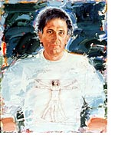
Paul Giovanopoulos
Born in Greece, November 11, 1939
Studied in New York
  New York University, 1958-1959
  School of Visual Arts, 1959-1961
Became US citizen 1961
Taught 1962-1980
Full time artist since

Slide 2
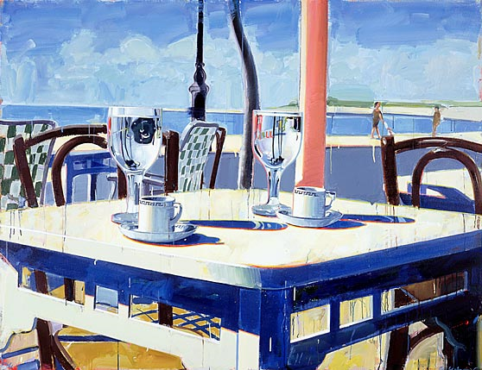
What do you notice here?

Slide 3
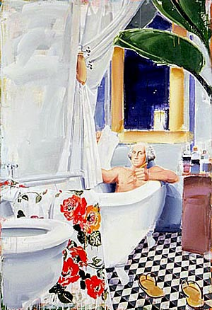
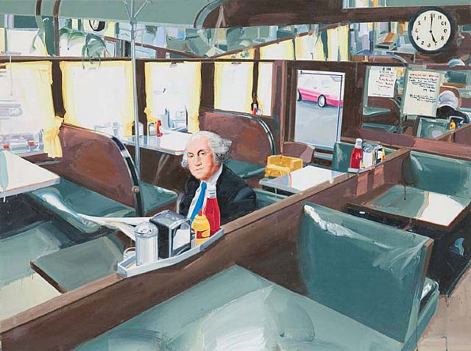
Familiar things in unusual settings

Slide 4
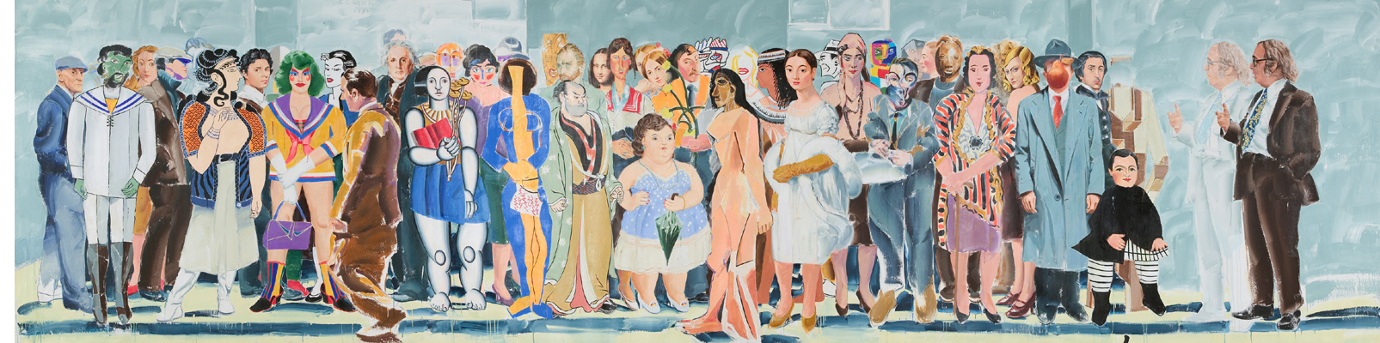
Playing with the style of different artists

Slide 5
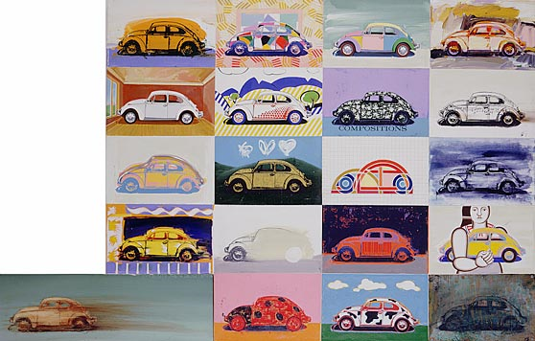
His favorite style: lots of ways of looking at the same thing

Slide 6
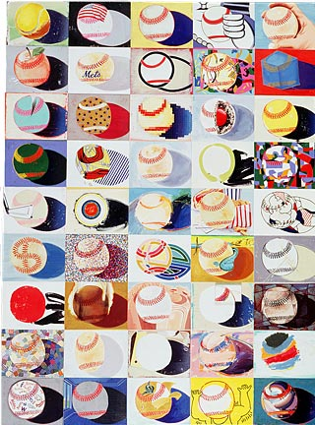
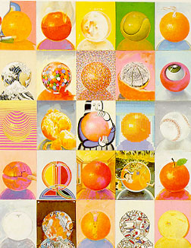
This is his favorite style…

Slide 7
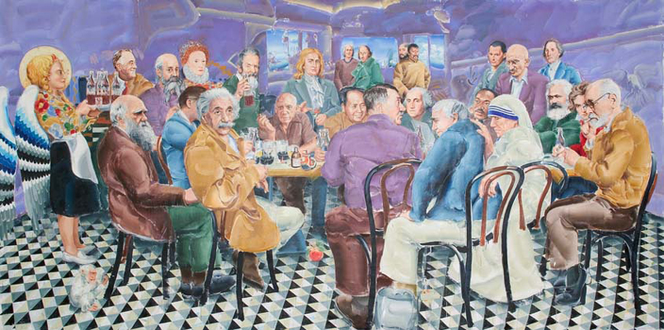
Recent work – still exploring different styles

