Slide 1
Fermilab Accelerator PhD Program
Eric Prebys
FNAL Accelerator Division

Slide 2
Outline
History
Basic accelerator physics concepts
The Fermilab accelerator complex
Other projects at Fermilab
PhD Program

Slide 3
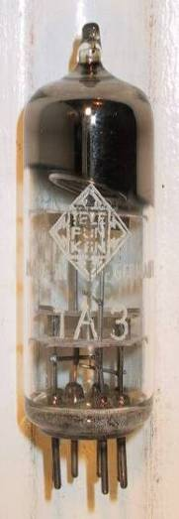



Particle Acceleration
The simplest accelerators accelerate charged particles through a static field. Example: vacuum tubes
Cathode
Anode
Limited by magnitude of static field:
  - TV Picture tube ~keV
  - X-ray tube ~10’s of keV
  - Van de Graaf ~MeV’s
Solutions:
  - Alternate fields to keep particles in accelerating fields -> RF acceleration
  - Bend particles so they see the same accelerating field over and over -> cyclotrons, synchrotrons

Slide 4
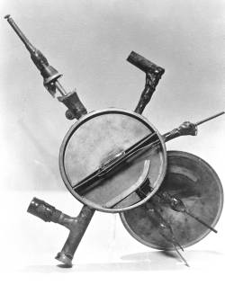
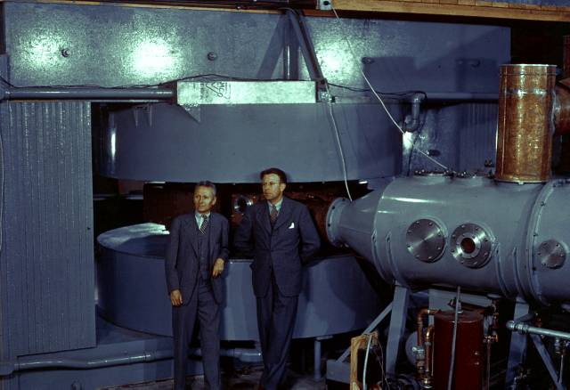
The first cyclotrons
1930 (Berkeley)
  Lawrence and Livingston
  K=80KeV
1935 - 60” Cyclotron
  Lawrence, et al. (LBL)
  ~19 MeV (D2)
  Prototype for many

Slide 5





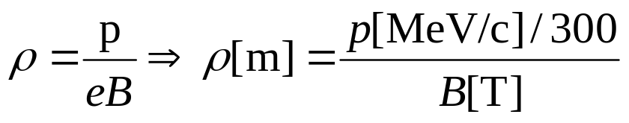

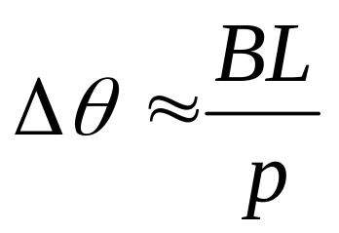
Basics: Bending Beams with Dipole Fields
side view
top view
“Thin lens” approximation
Typical Magnet Strength
  Conventional: ~1 T
  Latest superconducting: ~8T
  Next generation superconducting (Nb3Sn): ~12T

Slide 6

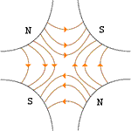



Focusing Beams with Quadrupole Magnets
Vertical Plane:
Horizontal Plane:
Luckily…
…pairs give net focusing in both planes! -> “FODO cell”

Slide 7


Longitudinal Motion: Phase Stability
Particles are typically accelerated by radiofrequency (“RF”) structures. Stability depends on particle arrival time relative to RF phase
If velocity dominates
If momentum (path length) dominates
Particles with lower E arrive earlier and see greater V.
Particles with lower E arrive later and see greater V.
Nominal Energy
Nominal Energy

Slide 8
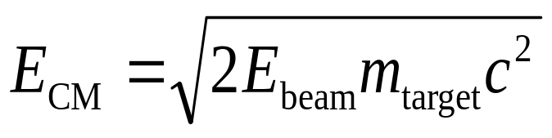

The Case for Colliding Beams
One very important parameter of an interaction is the center of mass energy. For a relativistic beam hitting a fixed target, the center of mass energy is:
For a 1TeV beam on H, E_{CM}=43.3 GeV!!
On the other hand, for colliding beams (of equal mass and energy):
Of course, energy isn’t the only important thing….

Slide 9
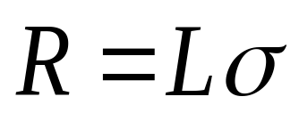
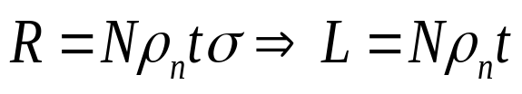

Luminosity
The relationship of the beam to the rate of observed physics processes is given by the “Luminosity”
Rate
Cross-section (“physics”)
“Luminosity”
Standard unit for Luminosity is cm⁻²s⁻¹
For fixed (thin) target:
Target thickness
For MiniBooNe primary target:
Incident rate
Target number density

Slide 10
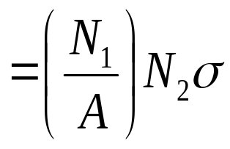
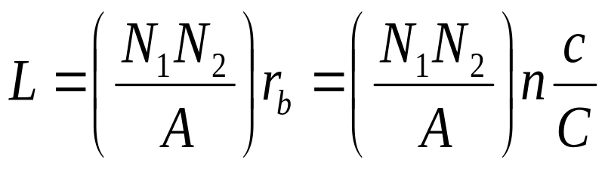
Colliding Beam Luminosity
Circulating beams typically “bunched”
(number of interactions)
Cross-sectional area of beam
Total Luminosity:
Circumference of machine
Number of bunches
Record Hadronic Luminosity (Tevatron): 2.85E32 cm⁻²s⁻¹
Record e+e- Luminosity (KEK-B): 1.71E34 cm⁻²s⁻¹

Slide 11
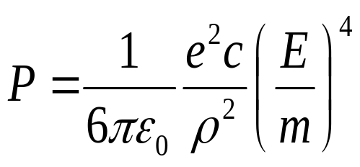
Electrons versus Protons: Synchrotron Radiation
As the trajectory of a charged particle is deflected, it emits “synchrotron radiation”
An electron will radiate about 10¹³ times more power than a proton of the same energy!!!!
Radius of curvature
Protons: Synchrotron radiation does not affect kinematics
Electrons: Beyond a few MeV, synchrotron radiation becomes very important
- Good Effects:
- Naturally “cools” beam in all dimensions
- Basis for light sources, FEL’s, etc.
- Bad Effects:
- Beam pipe heating
- Energy loss ultimately limits circular accelerators
- Exacerbates beam-beam effects

Slide 12






Producing Neutrinos
Target
Proton beam
Mostly pions
Pion sign determined whether it’s a neutrino or anti-neutrino
Mostly lower energy
Beam parameters not challenging, but need lots of protons
  Issues in beam intensity, beam loss, radiation, etc
  Same problem for spallation neutron sources, EA reactors, etc

Slide 13
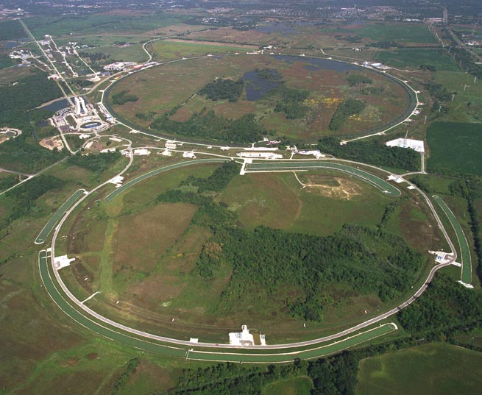
Fermilab
History
1968 – Construction begins.
1972 – First 200 GeV beam in the Main Ring.
1983 – First (512 GeV) beam in the Tevatron (“Energy Doubler”). Old Main Ring serves as “injector”.
1985 – First proton-antiproton collisions observed at CDF (1.6 TeV CoM).
1995 – Top quark discovery. End of Run I.
1999 – Main Injector complete.
2001 – Run II begins.
2005 – MINOS begins

Slide 14
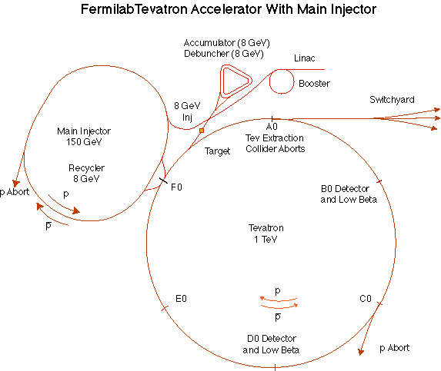
The Fermilab Accelerator Complex
MinBooNE
NUMI

Slide 15
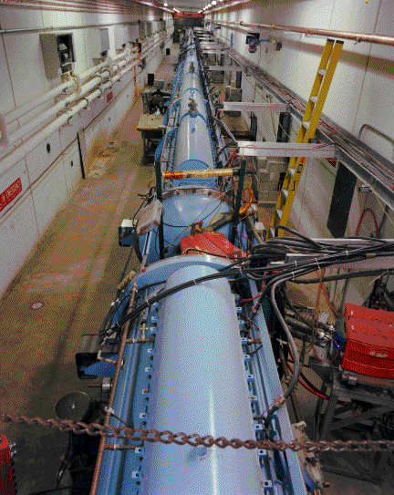
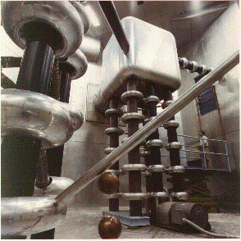
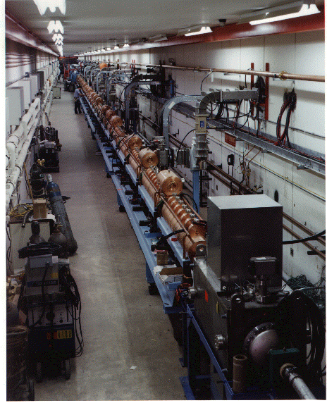
Preac(cellerator) and Linac
“New linac” (HEL)- Accelerate H- ions from 116 MeV to 400 MeV
“Preac” - Static Cockroft-Walton generator accelerates H- ions from 0 to 750 KeV.
“Old linac”(LEL)- accelerate H- ions from 750 keV to 116 MeV

Slide 16
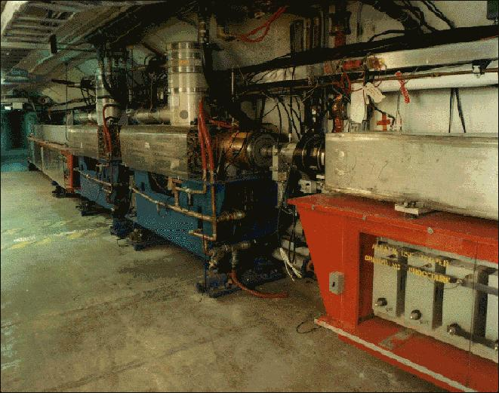
Booster
Accelerates the 400 MeV beam from the Linac to 8 GeV
From the Booster, beam can be directed to
  The Main Injector
  MiniBooNE (switch occurs in the MI-8 transfer line)
  A dump.
More or less original equipment

Slide 17
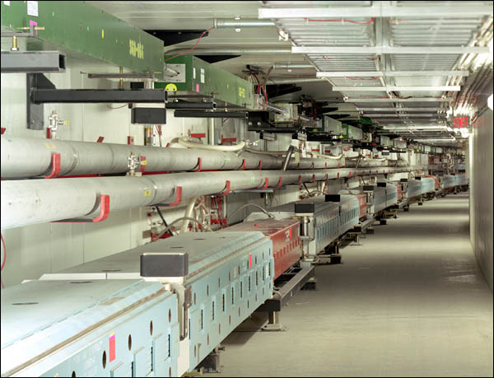
Main Injector
The Main Injector can accept 8 GeV protons OR antiprotons from
  Booster
  The anti-proton accumulator
  The Recycler (which shares the same tunnel and stores antiprotons)
It can accelerate protons to 120 GeV (in a minimum of 1.4 s) and deliver them to
  The antiproton production target.
  The fixed target area.
  The NUMI beamline.
It can accelerate protons OR antiprotons to 150 GeV and inject them into the Tevatron.

Slide 18
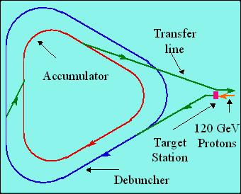
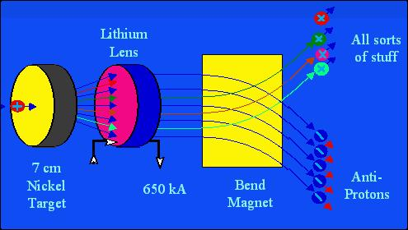
Antiproton Source
120 GeV protons strike a target, producing many things, including antiprotons.
a Lithium lens focuses these particles.
Debuncher
  Trades ΔE for Δt
Accumulator
  “Stacks” antiprotons
  ~ 1 day to make enough for a store

Slide 19
Recycler
The Recycler is an 8 GeV storage ring in the same tunnel as the Main Injector
Made out of permanent magnets
Originally designed to “recycle” antiprotons at end of store
Now used to store antiprotons from accumulator.
Uses electron cooling to reduce phase space
  Highest energy electron cooling in the world

Slide 20
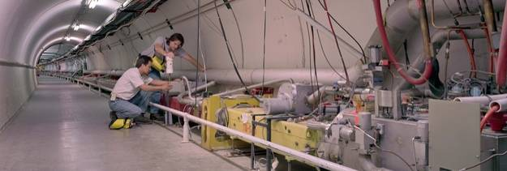
Tevatron
The Tevatron was the first superconducting accelerator/storage ring
  Built in early 80’s in original 1km radius “main ring” tunnel
Protons and antiprotons are injected at 150 GeV in same beam pipe in opposite directions.
Accelerated to 980 GeV
Collide in two experimental regions (CDF and D0) for about ~1 day, while more antiprotons are accumulated.

Slide 21
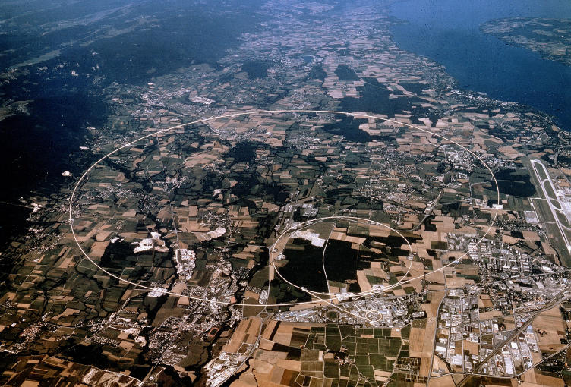
Large Hadron Collider: LHC
Being built at CERN
Using 27 km tunnel built for the LEP electron-positron collider
Will collide two proton beams of 7 GeV each
Ultimate Luminosity: 10E34
Scheduled to start commissioning later this year (maybe)
Fermilab is responsible for
  Focusing quads
  Collimation system
  High field (Nb3Sn) magnets for possible upgrade
  Some misc. beam physics and instrumentation
  Commissioning assistance.

Slide 22
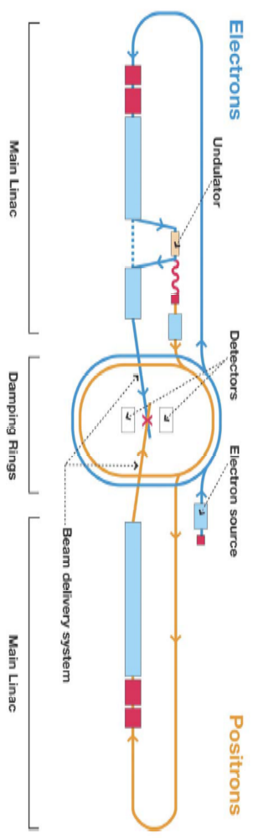
International Linear Collider (ILC)
Proposed “next big thing” in physics
30 km long, 250x250 GeV e+e-
Superconducting RF
Major push at Fermilab to host
Currently significant effort in
  Photoinjector
  Superconducting RF
  Low Level RF (LLRF)
  ect

Slide 23
(Some) Accelerator Physics Challenges at FNAL
Tevatron Luminosity Improvements
Stochastic and Electron Beam Cooling
Beam-Beam and Space Charge compensation
Accelerator Modeling and Simulation
Linear Electron Colliders
Large Hadron Collider Upgrades
Muon Colliders and Neutrino Sources
Advanced Accelerator R&D
Medical Accelerators and Beams
Conventional and Superconducting Magnet Technology
Conventional and Superconducting Radio Frequency Accelerating Structures
Beam Instrumentation and Diagnostics
Beam Transport and Magnetic Optics
Non-linear Beam Dynamics
Need students, but we’re not a university!

Slide 24
Fermilab Accelerator PhD Program
Started in 1985 by Leon Lederman in response to diminishing number of students going into the field.
A student works with an advisor at his or her home institution and a local advisor at Fermilab.
After completing the formal course requirements at the home institution, the student comes to the lab to work on thesis research.
Fermilab pays for tuition, stipend, and housing allowance.
Degree is granted by home institution.
Fermilab PhD Committee regularly reviews progress.

Slide 25
Graduates
B. Bordini (Pisa) 2006
X. Huang (Indiana) 2005
R. Zwaska (Texas) 2005
K. Bishofberger (UCLA) 2005
S. Seletskiy (Rochester) 2005
L. Nicolas (Glasgow) 2005
M. Alsharoa (IIT) 2005
L. Imbasciati (Vienna) 2003
V. Kashikhin (SRIEA, Russia) 2002
V. Wu (Cincinnati) 2001
J.-P. Carneiro (U. of Paris) 2001
M. Fitch (Rochester) 2000
O. Krivosheev (TPU, Russia) 1998
K. Langen (Wisconsin) 1997
E. Colby (UCLA) 1997
L. Spentzouris (Northwestern) 1996
D. Olivieri (Massachusetts) 1996
P. Chou (Northwestern) 1995
D. Siergiej (New Mexico) 1995
X. Lu (Colorado) 1994
W. Graves (Wisconsin) 1994
K. Harkay (Purdue) 1993
P. Zhou (Northwestern) 1993
T. Satogata (Northwestern) 1993
J. Palkovic (Wisconsin) 1991
P. Zhang (Houston) 1991
X. Wang (IIT) 1991
S. Stahl (Northwestern) 1991
L. Sagalofsky (Illinois) 1989
L. Merminga (Michigan) 1989
M. Syphers (Illinois - Chicago) 1987
  First graduate
  Co-wrote definitive textbook
  Now runs program

Slide 26
Current Students
P. Yoon (Rochester)
  Booster simulation
P. Snopok (Michigan State)
  Capture of large phase space beam
A. Poklonsky (Michigan State)
  Optimization and control of Tevatron phase space
T. Koeth (Rutgers)
  Superconducting cavity as diagnostic
Arthur Paytyan (Yerevan)
  Control system for superconductive cavities
Ryoichi Miyamoto (Texas)
  AC dipole for Tevatron tune measurement
Daniel McCarron (IIT)
  Booster beam dynamics
Uros Mavric (Ljubljana)
  ILC low level RF (LLRF)

Slide 27
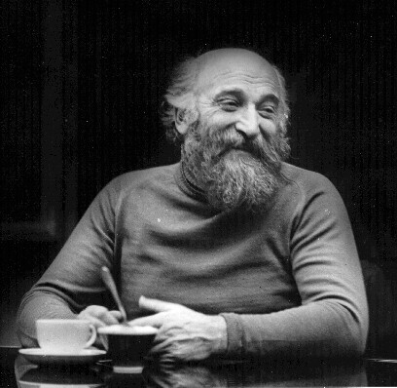
Budker Seminars
The PhD program hosts monthly “Budker Seminars” for students, advisors, and anyone else who’s interested.
About once a year, each student makes a short, informal presentation on his or her work, to let us know what they’re doing and to get feedback.
Pizza and beer provided.
Gersh Itskovich Budker
(1918-1977)
  Collective instabilities
  Colliding beams
  Electron cooling
  Exponential neutrino horns
  Nuclear fusion confinement
  Education
  A really cool beard!!
  Much, much more

Slide 28
Some Example Students
Xiaobiao Huang
  Co-advised with S.Y. Lee (Indiana)
  Worked on detailed measurement of Booster lattice functions and modes of transverse beam motion
  Hired directly into a staff position at SLAC, working on the SSRL
Bob Zwaska
  Co advised with Sacha Kopp (UT Austin)
  Worked on several things related to NuMI/MINOS
  Perfected “cogging” system, which synchronizes Booster acceleration cycle to Main Injector
  Awarded a Peoples Fellowship at FNAL to work on issues involved in increasing intensity in the Main Injector
Note: both of these students skipped their postdoctoral stage!
  Uncommon in accelerator physics
  Totally unheard of in high energy physics

Slide 29
A Few Pet Project Ideas
Notch creation in Linac
  Create “notch” in beam near the source, so less beam is lost later (and at higher energy) at extraction from the Booster.
  Would involve calculations, modeling, experiments and hardware
Harmonic resonance control in Booster
  We’re installing an enhanced correction system in the Booster to better control position and tune.
  It will also allow much better control of resonant instabilities.
  Need to develop a systematic approach to doing that.
  Would involve calculation modeling, experiments, and code development
Efficient resonant extraction
  For years, it’s been standard practice to slowly excite resonant instabilities in beams as a means to gradually extract beam.
  This process typically has an inefficiency of about 2%, which is unacceptable in high intensity environments.
  There are a number of ideas that could potentially reduce the inefficiency.

Slide 30
Accelerators as a Career: Pros
Accelerators are very complex, yet largely ideal, physical systems. Fun to play with.
Accelerators allow a close interaction with hardware (this is a plus or minus, depending on your taste).
Can make contributions to a broad range of physics programs, or even industry.
Many people end up doing a wide variety of things in their careers.
Still lots of small scale, short time, interesting things to be done.
Can be involved with HEP without joining a zillion member collaboration.

Slide 31
Accelerator Physics as a Career: Cons
Accelerator physics is not fundamental, in the sense that finding the Higgs or neutrino mass is.
  Although it’s a vital part of that research
Accelerator physics is a means to an end, not an end in itself.
Limited faculty opportunities
  That may be changing

Slide 32
For More Information
Talk to Prof. Sacha Kopp
  Sacha has had one student graduate from the program and is currently advising a second
Contact me
  prebys@fnal.gov
Visit the program web site:
  http://www-ap.fnal.gov/PhDProgram/

Slide 33
Backup Slides

Slide 34

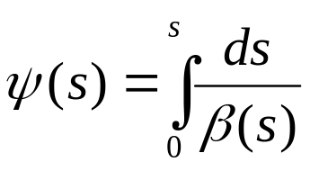

Betatron Motion
For a particular particle, the deviation from an idea orbit will undergo “pseudo-harmonic” oscillation as a function of the path along the orbit:
x
Lateral deviation in one plane
s
The “betatron function” β(s) is effectively the local wavenumber and also defines the beam envelope.
Phase advance
Closely spaced strong quads -> small β -> small aperture
Sparsely spaced weak quads -> large β -> large aperture
β(s) is has the fundamental cell periodicity of the lattice
length of one, e.g., FODO cell
However, in general the phase (and therefore particle motion) does not, and indeed must not, follow the periodicity of the ring…

Slide 35
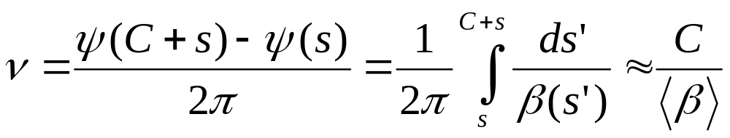
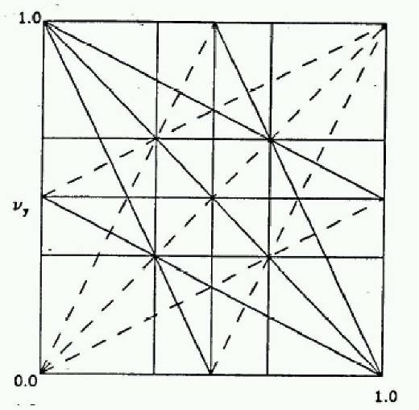
Tune and Tune Plane
We define the “tune” Q (or ν) as the number of complete betatron oscillations around the ring.
For example, the horizontal tune of the Booster is about:
6.7
Magnet Count/Aperture optimization
Beam Stability
In general…
“small” integers
Many deviations from the ideal lattice are characterized in terms of their resulting “tune-shift”. In general, the beam will become unstable if it shifts onto a resonance.
fract. part of Y tune
fract. part of X tune

Slide 36
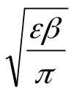

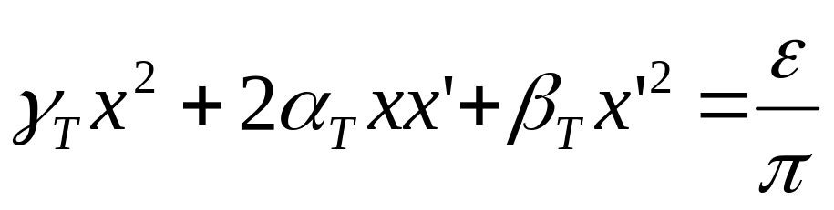


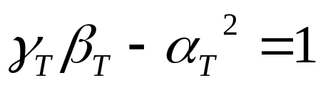
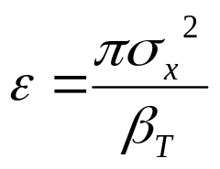
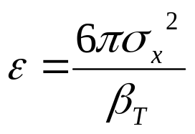
Emittance
As a particle returns to the same point on subsequent revolutions, it will map out an ellipse in phase space, defined by
Area = ε
Twiss Parameters
An ensemble of particles will have a “bounding” ε. This is referred to as the “emmitance” of the ensemble. Various definitions:
Electron machines:
Contains 39% of Gaussian particles
Usually leave π as a unit, e.g. E=12 π-mm-mrad
Proton machines:
(FNAL)
Contains 95% of Gaussian particles

Slide 37
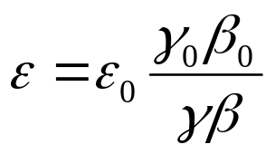

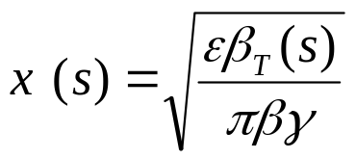
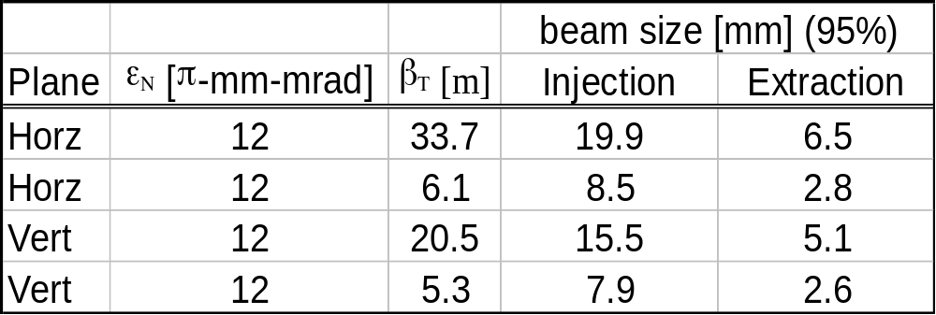
Normalized Emittance
As the beam accelerates “adiabatic damping” will reduce the emittance as:
The usual relativistic γ and β !!!!
so we define the “normalized emittance” as:
We can calculate the size of the beam at any time and position as:
Example: Booster

Slide 38
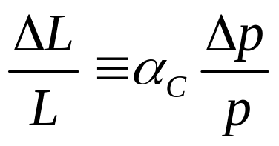
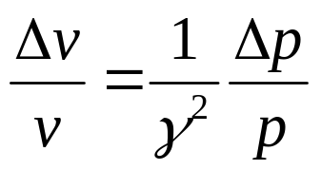
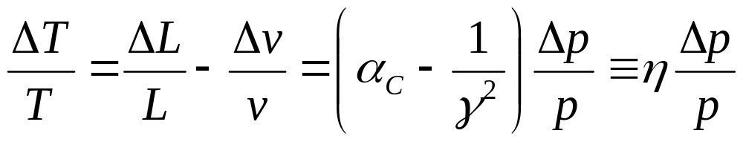
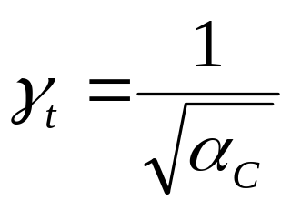
Slip Factor/Transition
A particle which deviates from the nominal momentum will travel a different path length given by….
“Momentum compaction factor”
It will also travel at a slightly different velocity, given by
… so the time it takes to make one revolution will change by an amount
“slip factor”
This changes sign at “transition”, defined by
Usually γ_{T} ≈ ν. In booster γ_{T} = 5.45

Slide 39



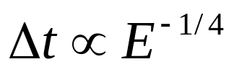
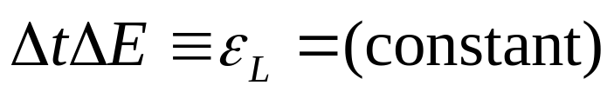
Longitudinal Emittance
As the particles accelerate
Typical values out of the booster are about .15 eV-s
Longitudinal Emittance. Usually expressed in eV-s

Slide 40





Neutrino Horn – “Focusing” Neutrinos
Can’t focus neutrinos themselves, but they will go more or less where the parent particles go.
Coaxial “horn” will focus particles of a particular sign in both planes
Target
Horn current selects π⁺ -> ν_{μ} or π⁻ -> ν_{μ}
p

Slide 41
So What’s So Hard?
Probability that a 150 GeV proton on the antiproton target will produce an accumulated pbar:
.000015 (1.5E-5)
Probability that a proton on the MiniBooNE target will result in a detected neutrino:
.000000000000004 (4E-15)
Probability that a proton on the NUMI target will result in a detected neutrino at the MINOS far detector:
.000000000000000025 (2.5E-17)
⇒ Need more protons in a year than Fermilab has produced in its lifetime!!

Slide 42
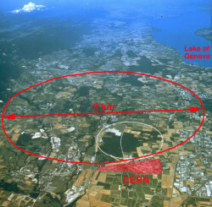
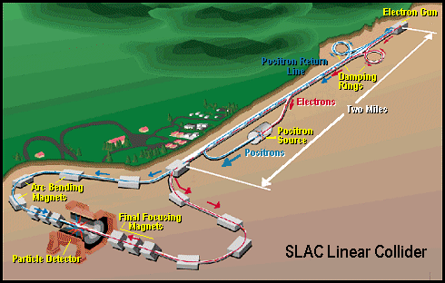
Some Other Important Accelerators (past):
LEP (at CERN):
  27 km in circumference
  - e+e-
  - Primarily at 2E=M_{Z} (90 GeV)
  - Pushed to E_{CM}=200GeV
  - L = 2E31
  - Highest energy circular e+e- collider that will ever be built.
  - Tunnel will house LHC
SLC (at SLAC):
  2 km long LINAC accelerated electrons AND positrons on opposite phases.
  - 2E=M_{Z} (90 GeV)
  - polarized
  - L = 3E30
  - Proof of principle for linear collider

Slide 43
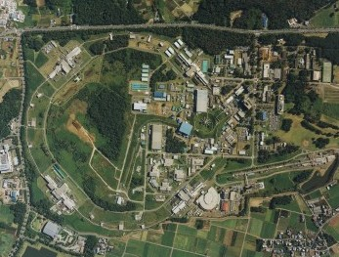
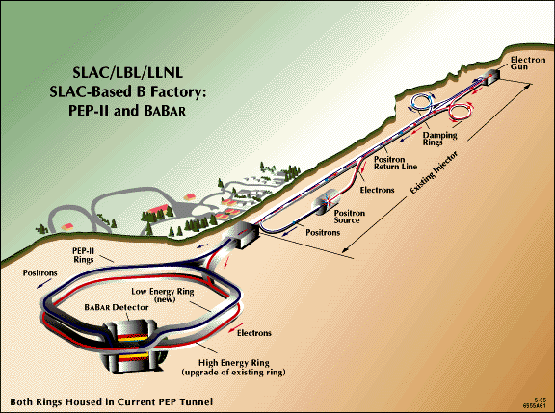
Major Accelerators: B-Factories
- B-Factories collide e+e- at E_{CM} = M(ϒ(4S)).
-Asymmetric beam energy (moving center of mass) allows for time-dependent measurement of B-decays to study CP violation.
KEKB (Belle Experiment):
- Located at KEK (Japan)
- 8GeV e- x 3.5 GeV e+
- Peak luminosity 1E34
PEP-II (BaBar Experiment)
- Located at SLAC (USA)
- 9GeV e- x 3.1 GeV e+
- Peak luminosity 0.6E34

Slide 44
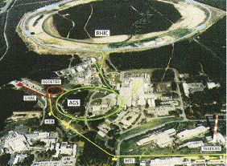
Major Accelerators: Relativistic Heavy Ion Collider
- Located at Brookhaven:
Can collide protons (at 28.1 GeV) and many types of ions up to Gold (at 11 GeV/amu).
Luminosity: 2E26 for Gold (??)
Goal: heavy ion physics, quark-gluon plasma, ??

Slide 45
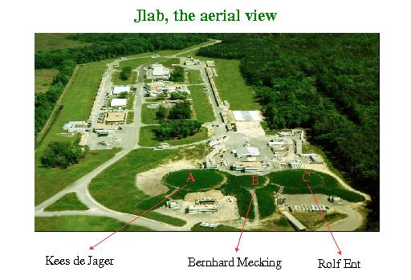
Continuous Electron Beam Accelerator Facility (CEBAF)
Locate at Jefferson Laboratory, Newport News, VA
6GeV e- at 200 uA continuous current
Nuclear physics, precision spectroscopy, etc

Slide 46
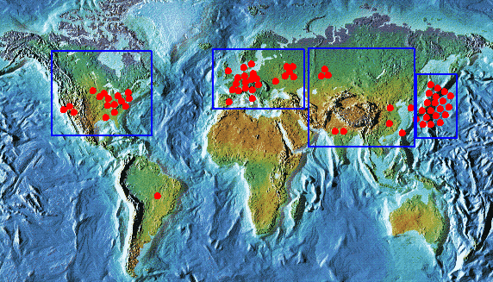
Light Sources: Too Many too Count
Put circulating electron beam through an “undulator” to create synchrotron radiation (typically X-ray)
Many applications in biophysics, materials science, industry.
New proposed machines will use very short bunches to create coherent light.

Slide 47
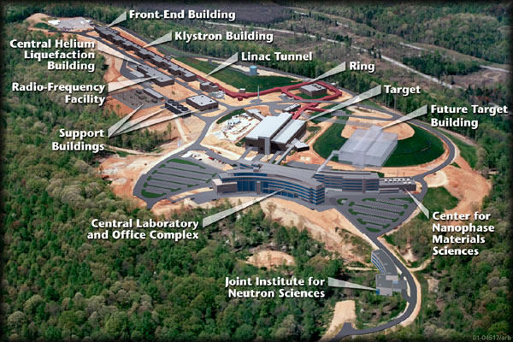
Future Machines: Spallation Neutron Source (SNS)
(Oak Ridge, TN)
A 1 GeV Linac will load 1.5E14 protons into a non-accelerating synchrtron ring.
These will be fast-extracted to a liquid mercury target.
This will happen at 60 Hz -> 1.4 MW
Neutrons will be used for biophysics, materials science, inductry, etc…
Turn-on in 2006

Slide 48
Challenges in the Field
Theoretical challenges:
  Beam stability issues
  Space charge
  Halo formation
Computational challenges:
  Accurate 3D space charge modeling
  Monitoring and control.
Instrumentation challenges:
  Correctly characterizing 6D phase space to compare to models.
Engineering challenges:
  Magnets
  RF
  Cryogenics
  Quality control/systems issues.

