Slide 1
MiniBooNE Beam Liasons
Eric Prebys
FNAL Beams Division

Slide 2
The Facts
Right now, the Booster is delivering about 1/5 of what MiniBooNE wants.
This is primarily limited by beam losses in the tunnel.
In 2005 (?), NuMI will come up wanting about half the protons of MiniBooNE – hopefully ramping up to about the same number.
-> To run the two together is a factor of 10 over what is now being delivered.
There is no clear plan to do this.
In addition to improving the peak running of the Booster, it’s very important to work to maintain extremely consistent operation to get the most protons we can.

Slide 3
How Can Experimenters Reasonably Help?
(this is a question)
Help tune the Booster?
  Must go to formal operator training.
  ~75% commitment for at least 6 months.
  Maybe better to pressure lab to hire dedicated operator.
Help with studies?
  Need to learn accelerator physics (just missed USPAS).
  Need to learn something about controls, but maybe not formal operator training.
  ~75% commitment for at least 6 months.
  Probably have enough people already.
Help “keep an eye” on things?
  Must get reasonably familiar with the controls system.
  Significant, but not total, commitment.
  Need to establish a well defined, and mutually acceptable, relationship with operations.

Slide 4
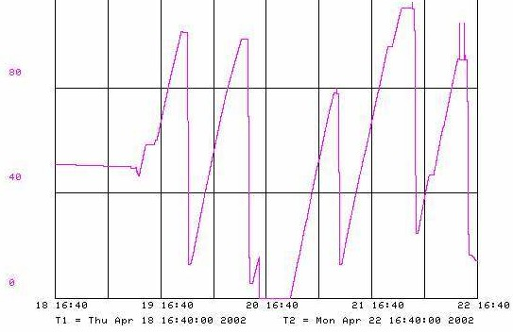
Modes of Operation
Run II Life Revolves around the antiproton stack. Stacking typically occurs about 2/3 of the time.
Stacking
Shot Setup
Something broken (usually NOT the proton source)

Slide 5
Modes of Operation vis-à-vis MiniBooNE
Stacking
  Requires: Proton Source, Main Injector, Debuncher-Accumulator.
  Requires “significant” protons.
  A train of MiniBooNE batches occur every 1.5-2.0 s, at 15 Hz following stack batch.
  Stable operation.
  Can tolerate “reasonable” number of trips.
Shot Setup
  Requires: Everything
  No significant proton requirement
  Configuration changes rapidly, and MiniBooNE timeline will have to accommodate.
  Probably less tolerance for trips.
Studies
  Requires: Whatever’s up
  Generally no significant proton requirement
  Configuration can change even more rapidly.

Slide 6
The Road to MiniBooNE
Switch Magnet
MiniBooNE Horn
Old 200 MHz Linac
750 keV→ 116 MeV
H⁻
ORBUMP Injection
Main Injector
I⁻
New 800 MHz Linac
116 MeV→ 400 MeV
Preac
25 keV→ 750 keV
Debuncher
Booster (20000 turns) 400 MeV→ 8 GeV

Slide 7
Stumbling Blocks in the Road (injection)
Ion Source – current fluctuation can screw up linac beam load compensation → off momentum beam.
Old linac – Old power amplifier tubes very temperamental → off momentum beam, slewing momentum, oscillating momentum.
New linac – New klystrons more robust than old PA’s, but still sometimes phase drifts (or intentional changes) → off momentum beam, slewing momentum.
400 MeV transfer line – not well understood, not regularly tuned → beta mismatch at injection.
Debuncher – too much “black magic”. Often incorrectly used to compensate for off-momentum linac beam.
All of these can lead to capture problems, early losses, and/or beta mismatch (which could lead to losses throughout cycle).

Slide 8
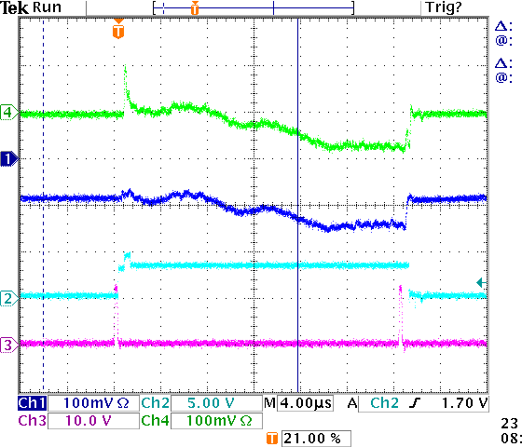
Monitoring Injected Beam
We now (after 30 years!!) measure the relative phase of the beam at two point to get the velocity (energy), and also the phase relative to the debuncher.
Presently available on the “chopper scope”, but soon (now??) becoming an official device.
Most of the problems mentioned will show up on this monitor, but crew is only now becoming conditioned to use it.
This is highly correlated with a variety of “weird behavior” which was formerly dealt with by adjusting the capture parameters of the booster!

Slide 9
Stumbling Blocks in the Road (Booster)
(These are listed as symptom: possible causes)
Capture losses: injections problems discussed, RF paraphasing, RF feedback sample timing problems.
Steady losses: orbit misalignment, scraping, RF feedback problems. Quadrupole and sextupole ramp adjustments.
Transition losses: tune/chromaticity problems. Adjust quadrupole and sextupole ramps.
Post transition losses: coupled bunch instabilities. Check state of longitudinal dampers.
Extraction losses: notch position, orbit control at extraction septa.
Mysterious losses (buzz 1, buzz2): talk to Ray Tomlin

Slide 10

Typical Booster Cycle
Various Injected Intensities
Transition
Intensity (E12)
Energy Lost (KJ)
Time (s)

Slide 11
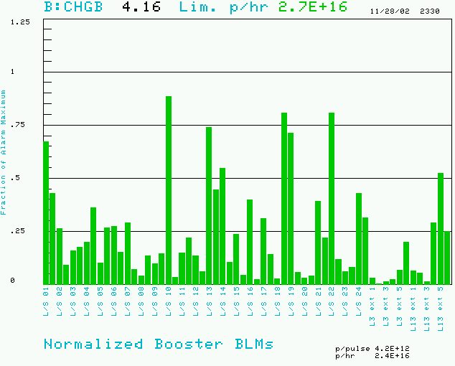
Booster Losses (Normalized to Trip Point)
BRF11: 200 mR/hr @ 1ft
BRF15: 300 mR/hr @ 1ft

