Slide 1
Mu2e beam needs
Eliminate prompt beam backgrounds by using a primary beam with short proton pulses with separation on the order of a muon life time
~100 ns
~1-2 μs
Prompt backgrounds
live window
Need extinction of at least 10⁻⁹

Slide 2
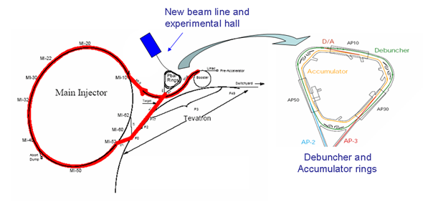
Delivering Protons: “Boomerang” Scheme
MI-8 -> Recycler done for NOvA
Recycler
(Main Injector Tunnel)
New switch magnet extraction to P150 (no need for kicker)
Deliver beam to Accumulator/Debuncher enclosure with minimal beam line modifications and no civil construction.

Slide 3
Momentum Stacking
Inject a newly accelerated Booster batch every 67 mS onto the low momentum orbit of the Accumulator
The freshly injected batch is accelerated towards the core orbit where it is merged and debunched into the core orbit
Momentum stack 3-6 Booster batches
Energy
T=0
1st batch is injected onto the injection orbit
T<66ms
1st batch is accelerated to the core orbit
T=67ms
2nd Batch is injected
T<133ms
2nd Batch is accelerated
T=134ms
3rd Batch is injected

Slide 4
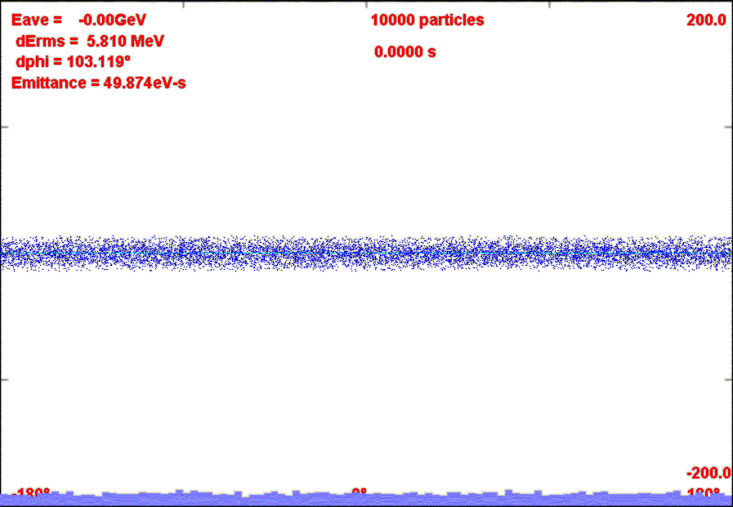
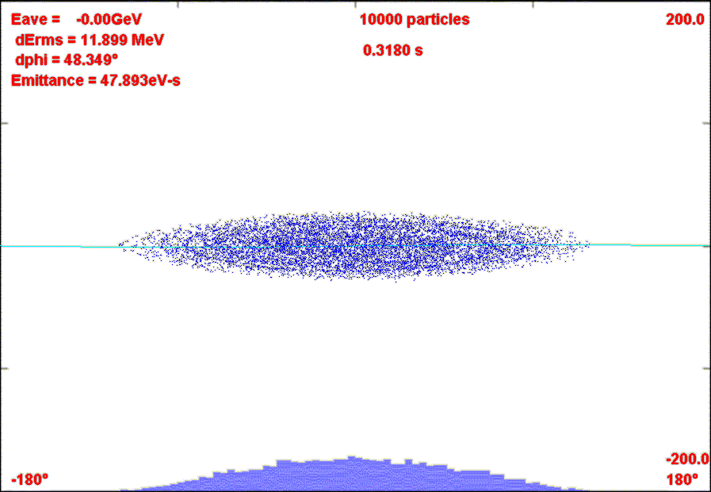
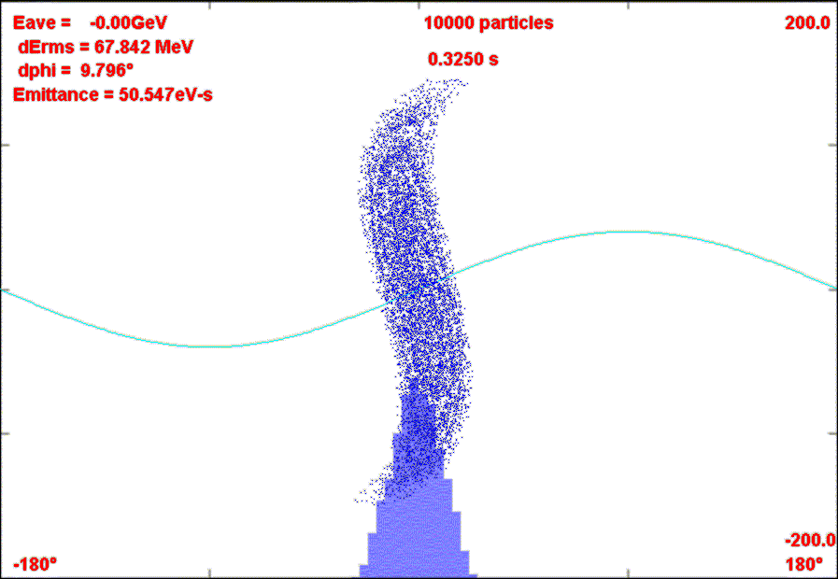
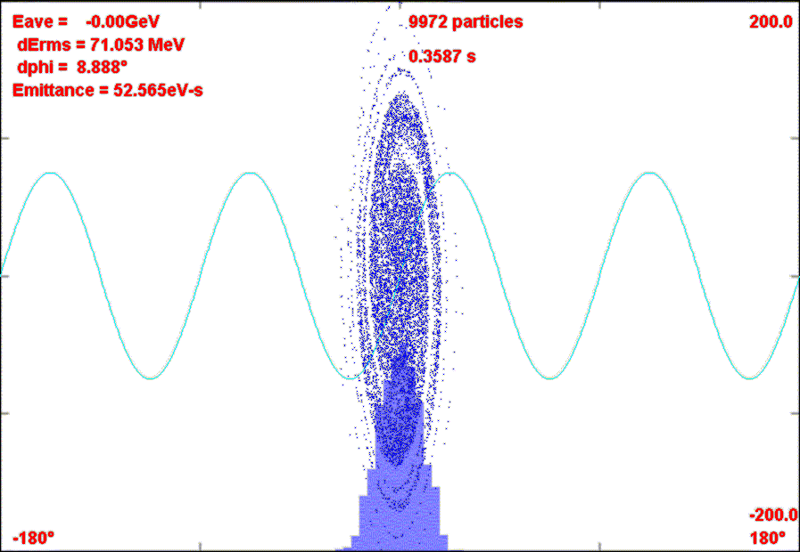
Rebunching in Accumulator/Debuncher
Momentum stack 6 Booster batches directly in Accumulator (i.e. reverse direction)
Capture in 4 kV h=1 RF System.
Transfer to Debuncher
Phase Rotate with 40 kV h=1 RF in Debuncher
Recapture with 200 kV h=4 RF system
σ_{t}~40 ns

Slide 5
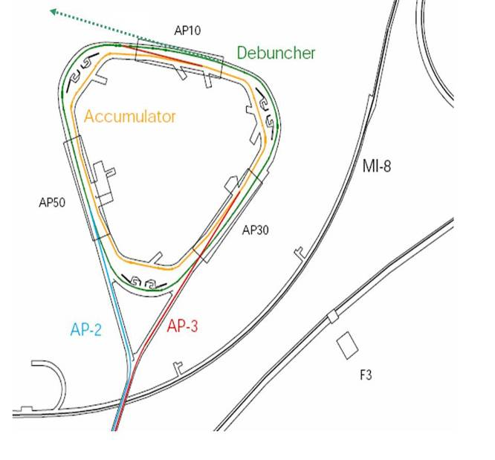
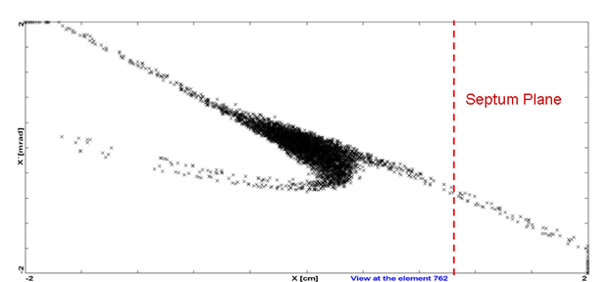
Resonant Extraction
Exploit 29/3 resonance
Extraction hardware similar to Main Injector
  Septum: 80 kV/1cm x 3m
  Lambertson+C magnet ~.8T x 3m

Slide 6
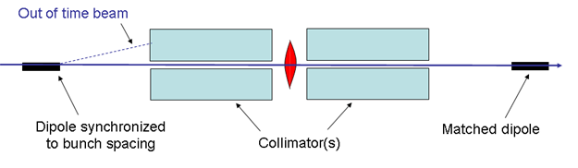
Beam line extinction concept
180° phase advance
quad
Considerations
  High frequency: 1/(2*1.7 μsec) ~ 300 kHz
  Minimize power supply cost and complexity
    Optimize stored energy
    Maximize Q

Slide 7
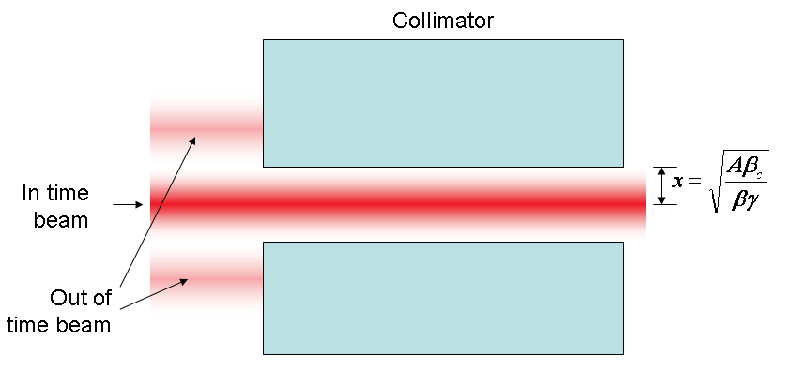
Amplitude requirement
At collimator:

Slide 8
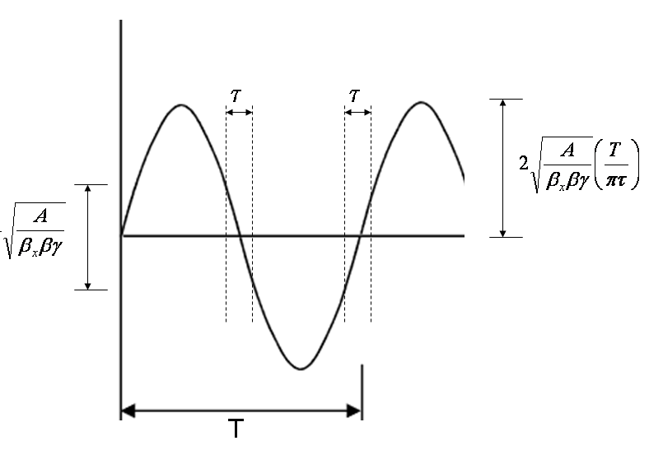
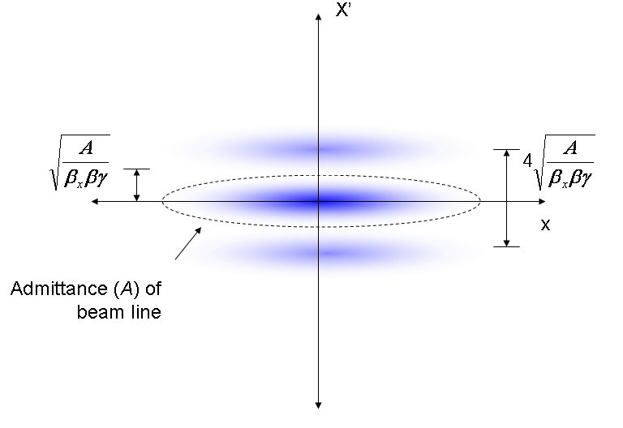
At magnet
Phase space (live window τ):
Full amplitude:

Slide 9
Beam line needs
Need to design a beam line with a collimator or system of collimators between the two AC dipoles, such that any particles striking the first collimator have an extremely low (preferably 10⁻⁹) chance of propagating to the target.
Must consider possibility that secondary, tertiary, etc. particles scatter into the detector.

