Slide 1
Setting BLM Limits in the Booster
The Booster is now delivering all the protons needed by the collider program, and about 40% of the protons needed by MiniBooNE.
We are physically capable of delivering all the protons requested, but we are limited by the loss limits we have set in the tunnel:
  Rad damage issues
  Worker safety issues.
Generally, we’re doing very well at controlling losses in the Booster
  We’re putting roughly 10 times as much beam through the Booster as before MiniBooNE came on.
  Average activation has only risen by a little over a factor of 2.
However, we’ve been seeing some disturbing levels of activation, particularly at RF cavities.
This is getting noticed, and if we don’t address the problem, someone else will address if for us.
Many of our problems come from loss limits which are set too high.
We should be able to reduce several of these without decreasing the total intensity.

Slide 2
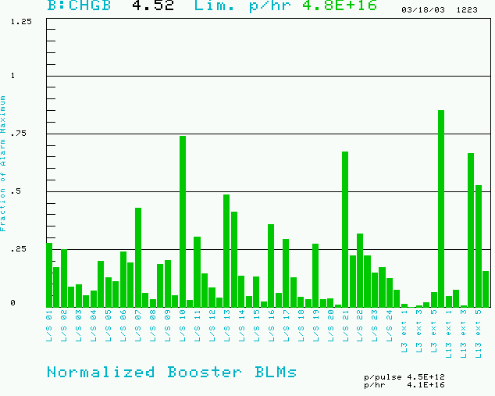
What Limits the Booster
Maximum based on trip point
Irreducible loss created by the notch
Also limit total booster average power loss (B:BPL5MA) to 400W.
Present rate

Slide 3
How Limits Were Set
Individual Loss Monitors:
  Limits were set to twice measured values during typical “good” stacking, before MiniBooNE.
  When MiniBooNE came on line, these were all increased by 50%
  Individual limits have been adjusted by hand
    Raised if it was felt they were too sensitive
    Lowered when high activation was seen (example: L24)
Power meter:
  The limit was NOT based on the SNS 1 W/m number.
  250W was found to be a decent limit during pre-MB stacking.
  We began to increase it when MiniBooNE came on line, with the plan of eventually hitting 500W.
  In December 2002, we were at 450W, and found that the activation in the tunnel was very high, so we lowered it to 400W, where it will stay until…
  After the summer shutdown, when the new collimator system renders it useless.
Another reason we must improve the individual loss monitors!!

Slide 4
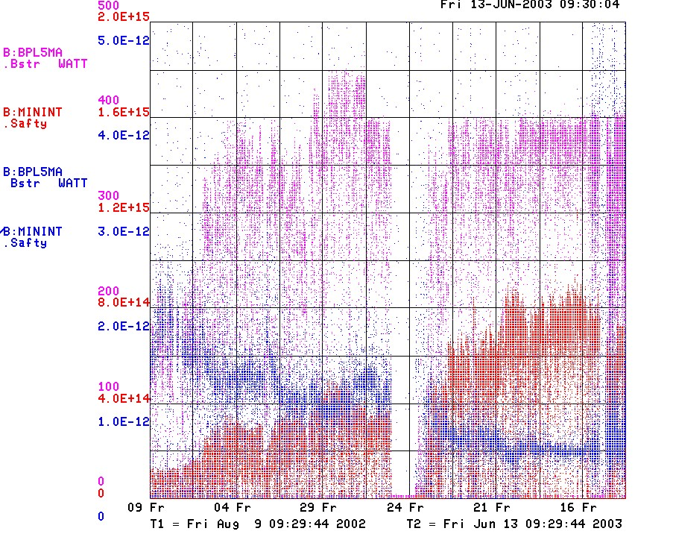
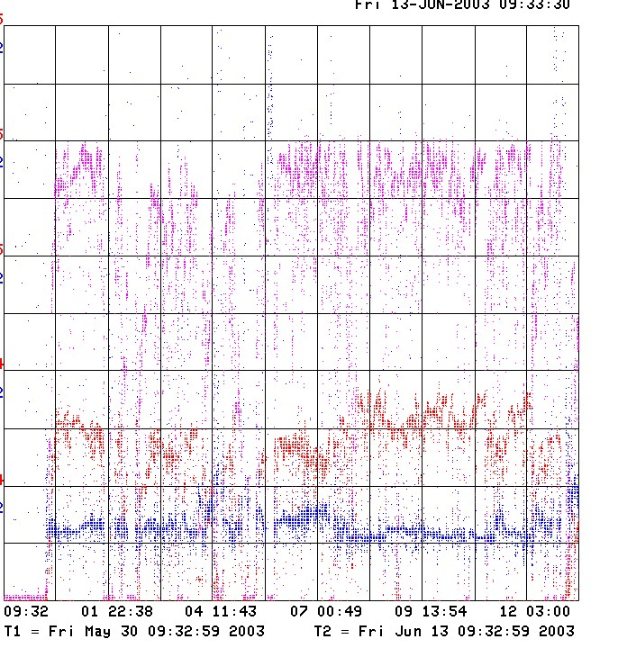
How are we doing? (Really well, actually)
Since MiniBooNE
Last 2 Weeks
Power loss (W)
rate (p/min)
Unstable Running
Energy lost per proton, good, BUT
Must get better at recovering from shutdowns!!!

Slide 5
Examining High Radiation Areas
I picked four surveys:
  8/28/02: Before MiniBooNE started running seriously
  4/10/03 and 4/29/03: During some of our best running to date
  6/17/03: recent access
All of these had similar cooldown times, so I didn’t apply any cooldown correction
I corrected data to mR/hr as follows:
  1ft measurement: no correction
  Contact measurements EXCEPT short straights: divide by 5
  Short strait measurements: divide by 2 (this is because the contact point is on the stand, not the beampipe)

Slide 6
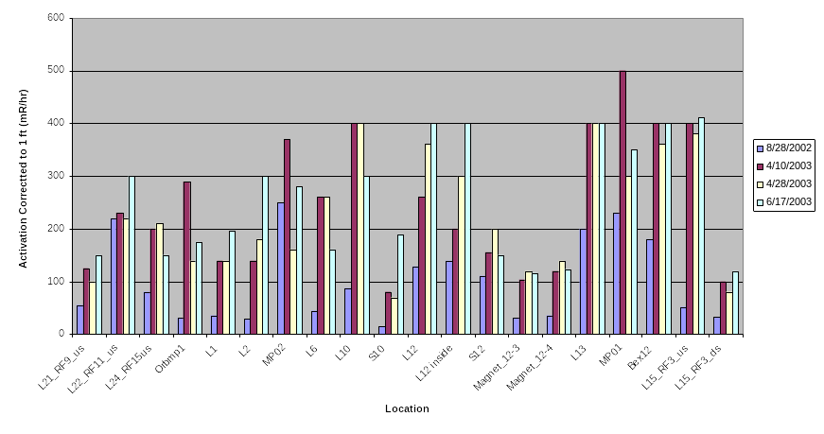
High Radiation Areas (> 100 mR/hr@1ft)
alignment
and tuning
injection tuning
limits too low
notch
extraction
tuning
collimator?
extraction

Slide 7
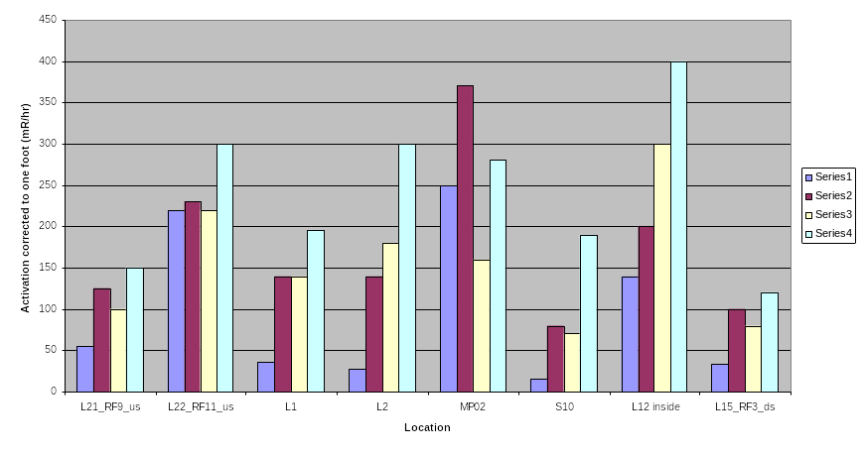
Tuning Sensitive Areas (>100 mR/hr and 25% worse on last access)

Slide 8
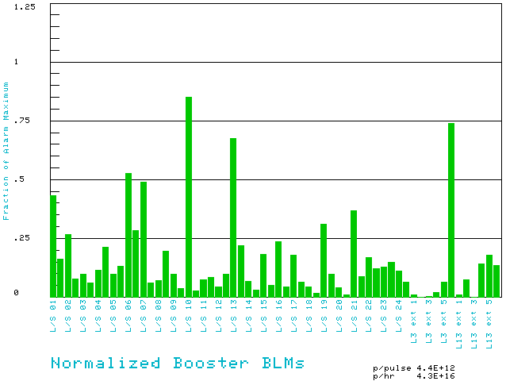
Typical “best” Running
Notch loss – irreducible, should be our limiting loss
L3
L13
Anything averaging below 20% of trip point probably has too high of a limit

Slide 9
Short Term Recommendations
Decrease limits around injection by ~25%
  S21: 900->675
  L22: 300->225
  S22: 900->675
  L23: 150->115
  S23: 300->225
  L24: 225->170
  S24: 300->225
  L1: 16->12
  S1: 900->675
  L2: 23->18
  S2: 900->675
Cut some other high limits roughly in half:
  S10: 900->450
  L12: 75->40
  S12: 600->300
  L15: 250->150 (Done)
Bypassing limits:
  No limit may be bypassed during normal operation.
  At the request of Booster experts, at most 3 (??) individual loss limits may be bypassed for at most 1 hour. Both the bypass and the restoring of the limits should be duly noted in the Elog.
  The power loss limit should never be bypassed.

Slide 10
On the Horizon
During the shutdown:
  We will stretch out the L3 dogleg region. This should improve the lattice and decrease losses.
  We’re (finally) installing a collimation system. This should further reduce uncontrolled losses, HOWEVER
Once the collimation system is installed, the power loss meter will not be a good measure, so we will have to rely more on the individual loss monitors.

