Slide 1
Booster/Beam Status
Eric Prebys
FNAL Beams Division

Slide 2
Beamline Issues
All instrumentation working well.
We are continuing to try to understand high losses at 870
  Theory that a permanent quad was improperly installed were wrong.
  All checks of alignment look OK.
  Activation is low, even with the high losses – not a huge worry.
Improved stripline air pressure monitor installed
Insulation to MI12A air monitor to prevent trips caused by condesation.

Slide 3
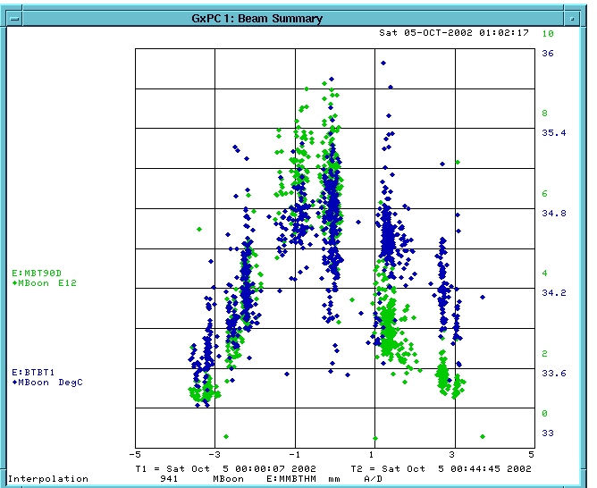
Imaging the Fin
90 degree monitor
Temp.

Slide 4
Operational Issues
Ran with beam missing the target for 12 hours!!!!!!
  Improved beam line/shift documentation!!
  Operators now on the lookout for this.
Operations has gotten much better at optimizing MiniBooNE rate without being told.

Slide 5
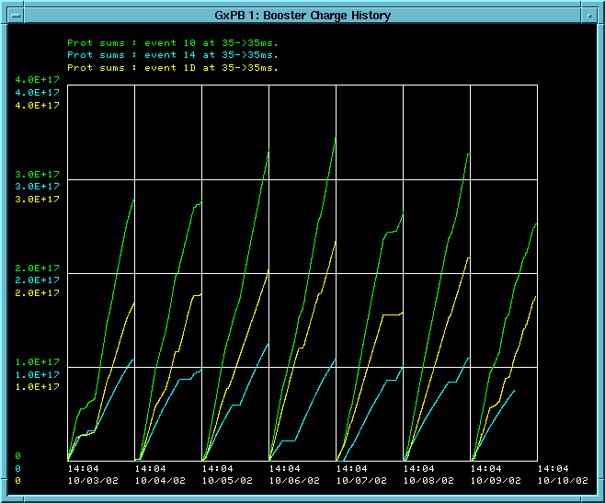
Protons to MiniBooNE this Week
Total
MiniBooNE
Stacking

Slide 6
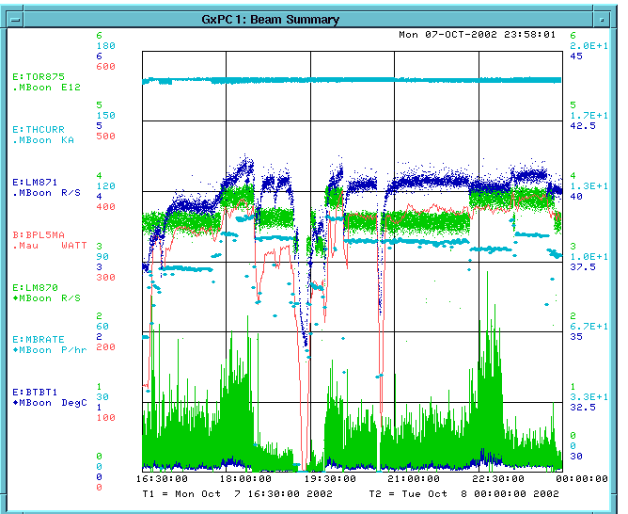
Typical Performance
Booster Power Loss
Per pulse intensity (E12)
MiniBooNE rate (p/hr)

Slide 7
In Short…
MiniBooNE is running.
We typically take 1.5-2.0 times as many protons as stacking.
This number needs to go up by about a factor of 8.

Slide 8
What it Limiting MiniBooNE
(Longitudinal?) instabilities in the Booster are limiting the per pulse intensity to ~3.7E12 ppp.
Normalized tunnel losses limit the total protons to about 2E16 pph when the Booster is running well.
Beam power loss limit (currently 400 W) is similar.
Heating in the extraction septum (MP02) currently limits MiniBooNE rate to ~.9 Hz during stacking.

Slide 9
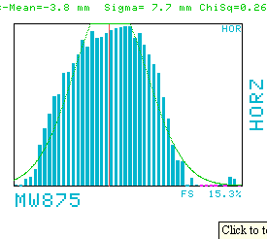
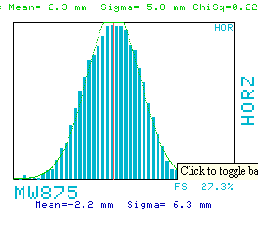
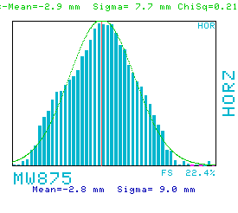
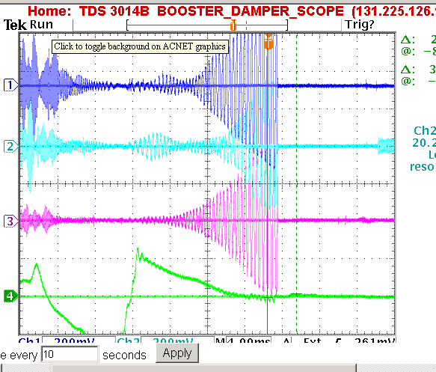
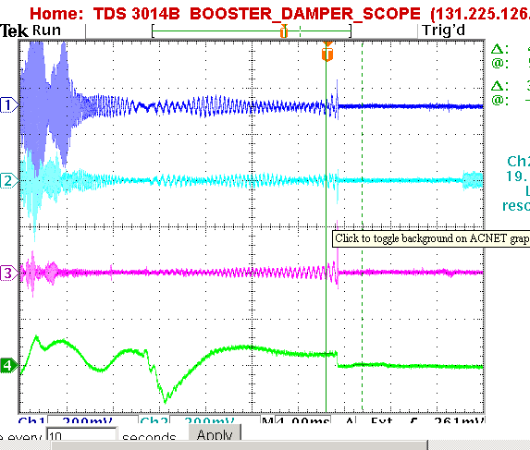
Effect of Longitudinal Damping
High Dispersion Region
Dampers Working
Occasional Bad Pulse at High Intensity (trips loss monitors)
No Dampers

Slide 10
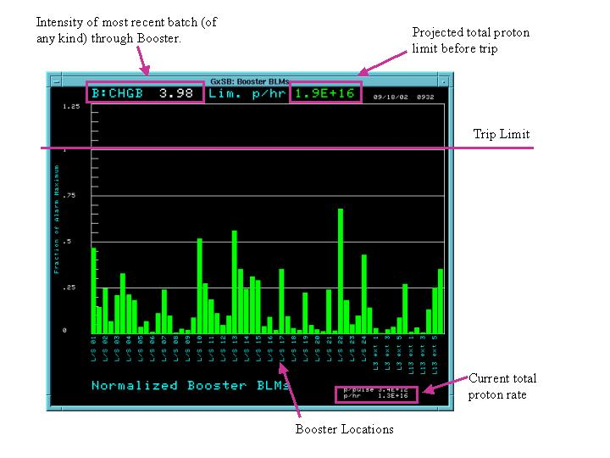
Tunnel Losses

Slide 11
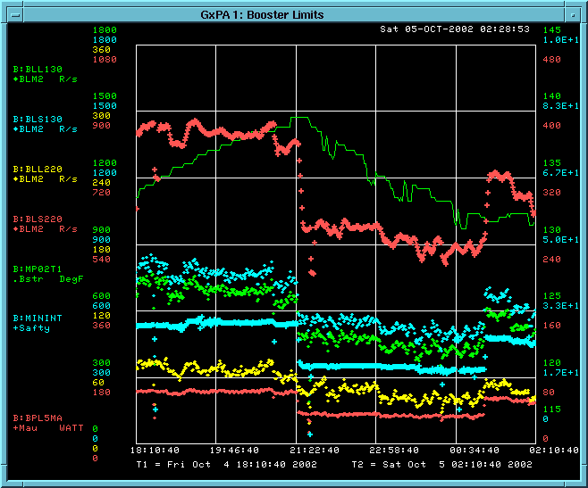
Booster Limitations
Trip point
Beam power loss
MP02 Temp.
“Troublesome” losses (shown as diamonds)
Total protons/min. out of Booster (blue crosses)

Slide 12
Plan
New Power Supply is Ready for MP02. Negotiating time to connect, but probably won’t happen until early November, because of the impact on Run II.
At the same time, we will do a magnet move which should improve some of the worst losses (L13, L22, L24).
We had a review of the collimator shielding. It is unlikely that the shielding will be installed until the January shutdown. WE MUST PUSH FOR THE JANUARY SHUTDOWN.
Finally making progress in beam orbit correction. Tuning to reduce loss at high intensity.
New extraction septum nearly ready to be pumped down and tested. Will be installed during January shutdown.

