Slide 1
Booster Update
In light of the “dogleg problem”, recent activities have focus on reducing dogleg current and optimizing tune.
Recently raised Long3 (dump) septum by 2mm so we can reduce that dogleg more.
Seems to help. Have exceeded 5E16 pph to MiniBooNE.
Can possibly raise it another mm.
Working on long term solutions
  New pulsed dogleg (year or two)
  Anything possible by the summer?
Final (??) timeline issues resolved. Should be fully automatic now and reduce ORBUMP overpulsing problems. (Perhaps not yet implemented)

Slide 2
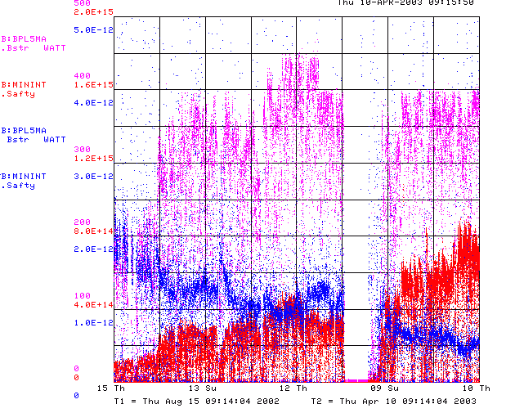
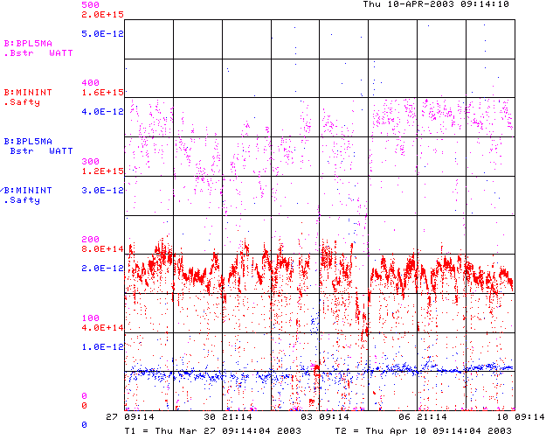
Booster Performance
Since Beginning
Last 2 weeks

Slide 3
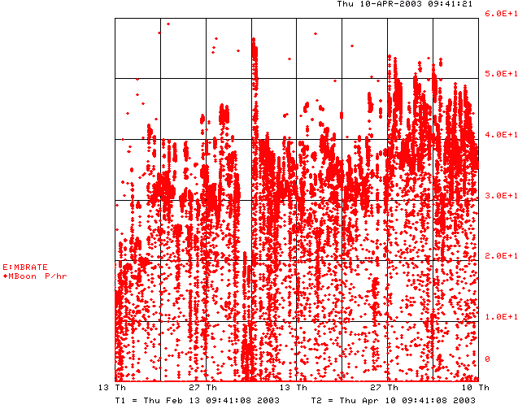
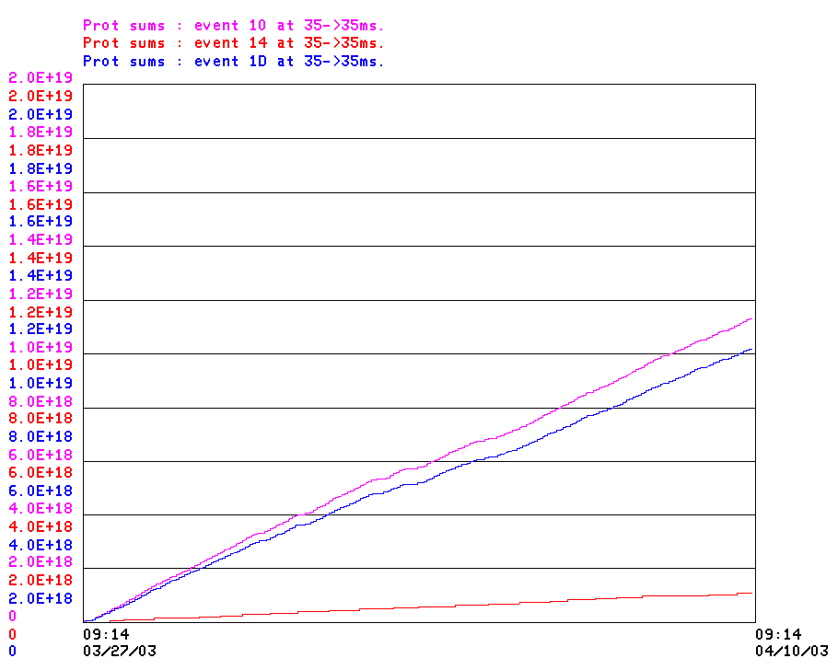
Proton Flux
10% low
Last 8 weeks
1.1E19 in 2 weeks = 2.2E16 in a year
-> 44% of baseline!!

Slide 4
RF Project
After some initial confusion, all parts have been assigned to universities
All necessary PO’s out or in the pipeline.
Production underway at universities.
Many parts complete
Still looks good for summer installation.

Slide 5
Breaking News
ORBUMP water hoses broke again today.
Down for the day.
In the process of fixing, will reduce PFN from 6 to 4 cells.
Should be able to go beyond 7.5 Hz on ORBUMP after that.

