Slide 1
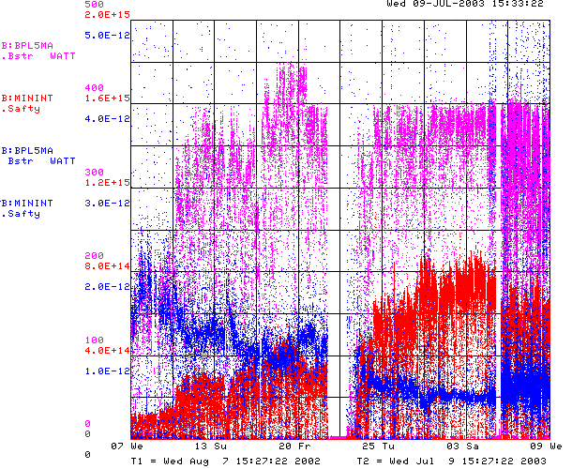
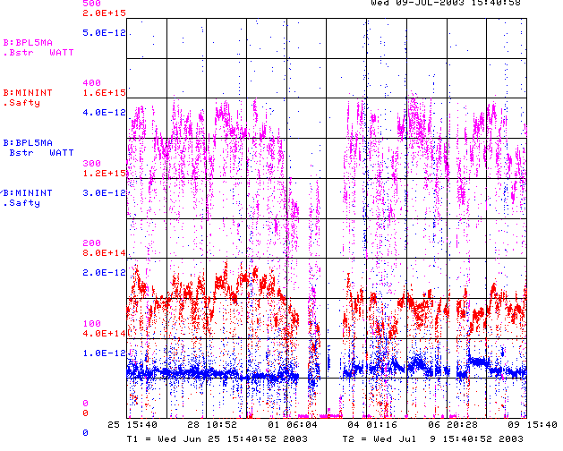

How are we doing?
Since MiniBooNE
Booster Power Loss
Last 2 weeks
Total protons/minute
Unstable Running after
power problems and Summer
Energy lost per proton
So why do things suck now?!?!?

Slide 2
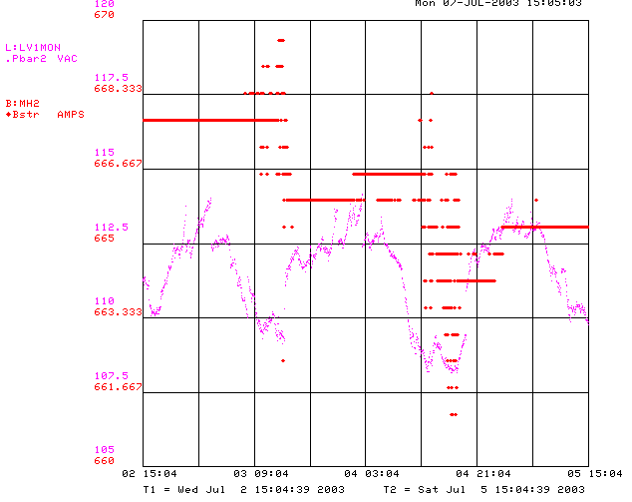
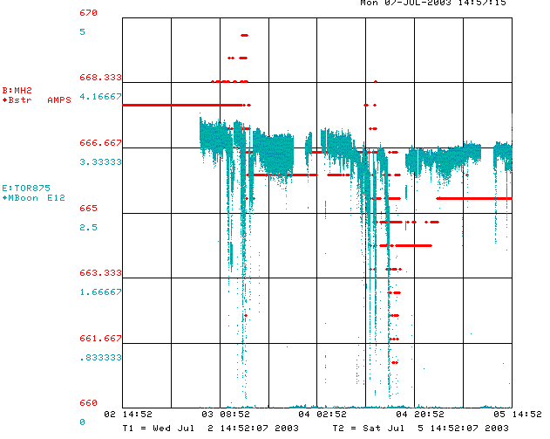
MH2 Regulation Problems
MH2 is the final horizontal bend in the 400 MeV line
It is rated for 60V, 1kA, but has run at ~62V for years.
Regulation problems occur at ~63V – VERY sensitive to line voltage.
MiniBooNE events cause line voltage to sag, which results in MH2 regulation problems.
Power supply seems to be deteriorating.
Have been lowering current setting and retuning line to compensate, but reaching the limit.
New supply (75V) ready for installation.
Need about a shift.
Effect on MiniBooNE intensity

Slide 3
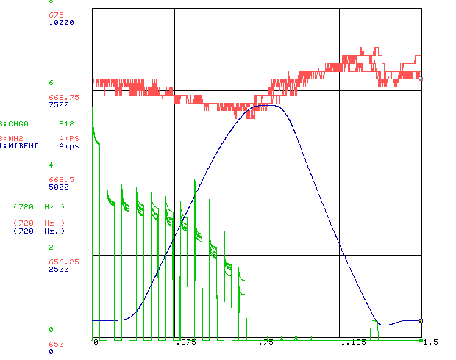
MH2 Continued
Booster batches
Solution: MH2 Supply being replaced as we speak
Booster batches
MI Current

Slide 4
Other Stability Problems/Solutions
Linac Energy Drift (also related to line current)
  Elliott McCrory has written a feedback control loop to regulate linac velocity
  Will purchase power line stabilizers for all 200 MHz RF stations.
Water in Linac annex
  Rerouting parking lot drainage – DONE.
General 400 MeV line reproducibility
  Dave McGinnis is modifying beam line tuner code to automatically set trims to reproduce reference trajectory (kind of like “autotune”). Finished in ~1 week.
General booster characterization:
  Sharon Lackey and Bill Marsh will modify BPM program to allow capture of turn by turn orbit data for all 96 BPM’s on a cycle.
  Peter Kasper has introduced reference loss patterns into the BLM display to help reproduce periods of good performance (Jim Lackey suggestion)
  Booster ramp monitor program now being commissioned (Guglielmo, Kasper, Coney, Jacobs)

Slide 5
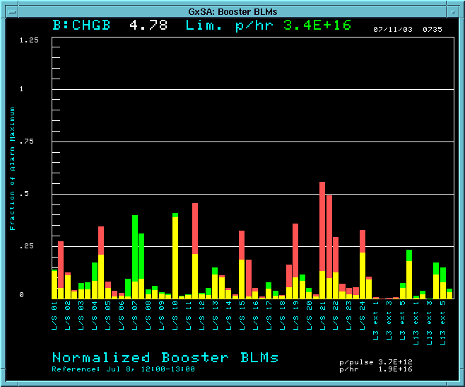
New BLM Trip Monitor (B88)
Higher than reference set
Lower than reference set

Slide 6
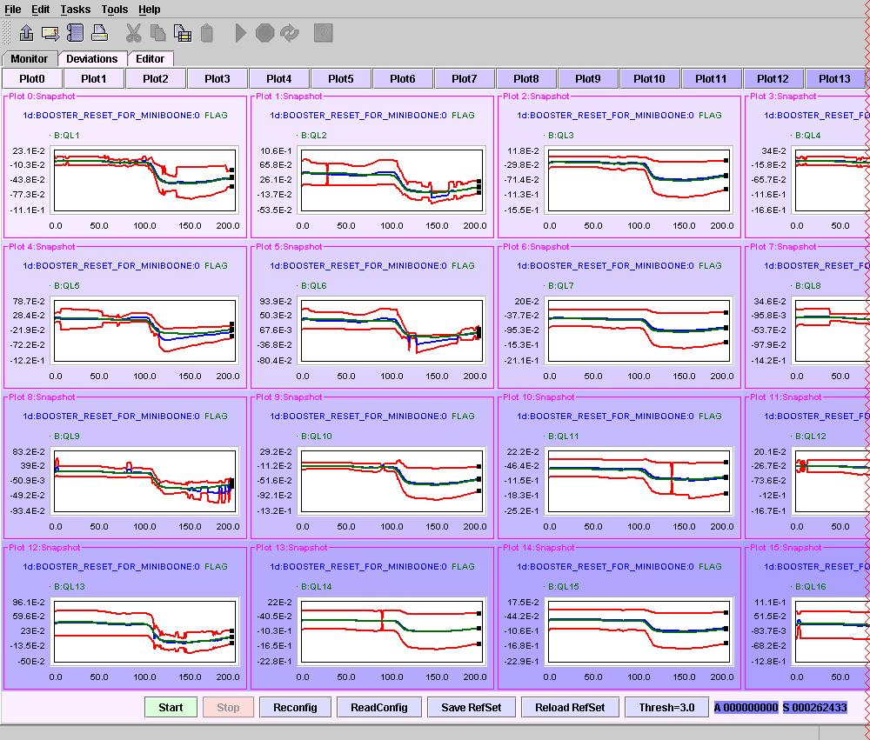
Rampmon – Now appearing in logbook

Slide 7
Summer Shutdown
The good news: ALL of the major Booster and Linac projects are back on the table for the summer shutdown. (Thanks Columbia, Indiana, Roger…)
The bad news: ALL of the major Booster and Linac projects are back on the table for the summer shutdown.

Slide 8
Summary of Major Projects for the Summer Shutdown
Stretch out Long 3 extraction region (ameliorates dogleg problem).
Install collimator system.
Replace 2 (of 18) RF cavities with wide aperture prototypes.
New dedicated damping cavity for additional longitudinal modes.
Do complete vertical alignments !! (as-founds are ongoing)
Install new Linac Lamberston (will improve 400 MeV optics and reduce losses)
Install four new wide aperture (EDWA) magnets in 8 GeV line.
Install new MP01 power supply and cable to new cable header (preparation for new MP01 septum.
Install new vacuum gauges as part of vacuum system upgrade.
Cautiously optimistic we can reach the MiniBooNE baseline goal after this shutdown!!

Slide 9
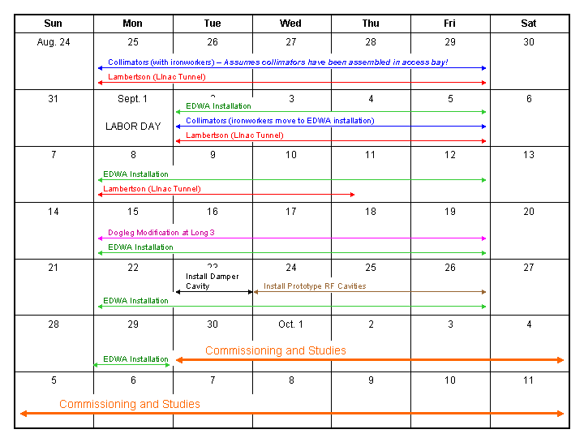
Approximate Schedule

