Slide 1
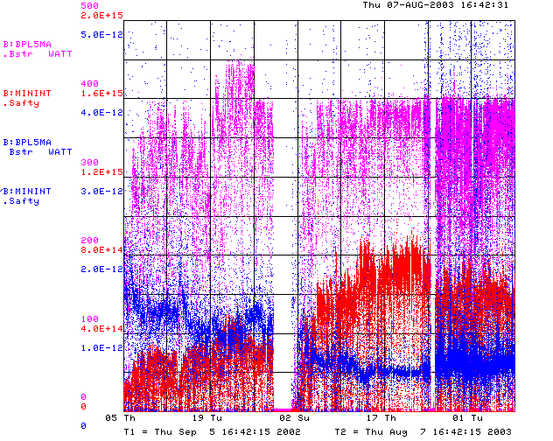
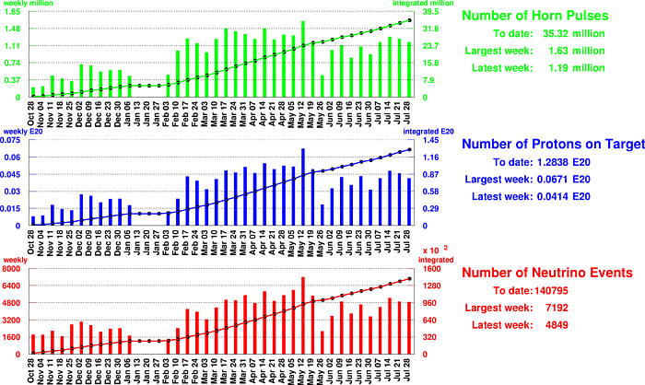
How are we doing?
Total Output
Beam to MiniBooNE
MH2 and Q10 supplies replaced
Mid-March to Mid May: great running!!!
What the hell has happened

Slide 2
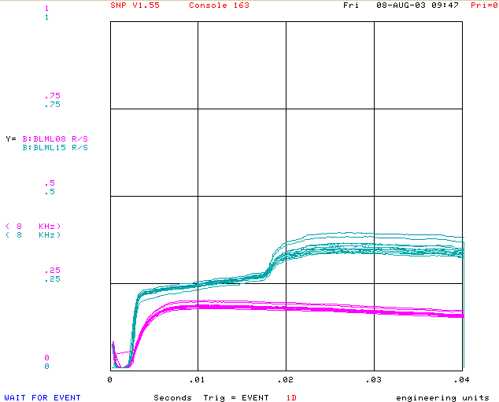
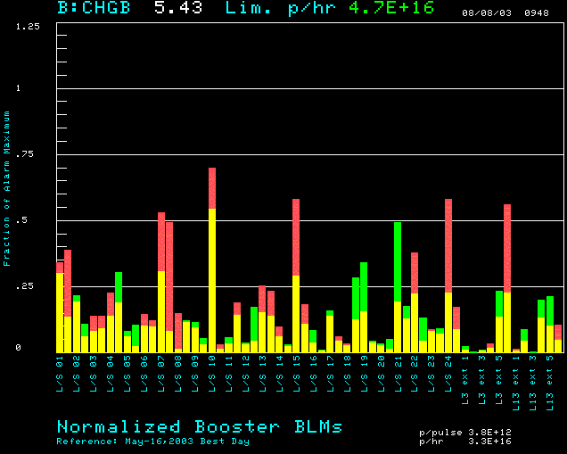
What’s Different
Losses Compared to May 13
L3 and L15
L8
Sometimes these are
much more unstable
L15

Slide 3
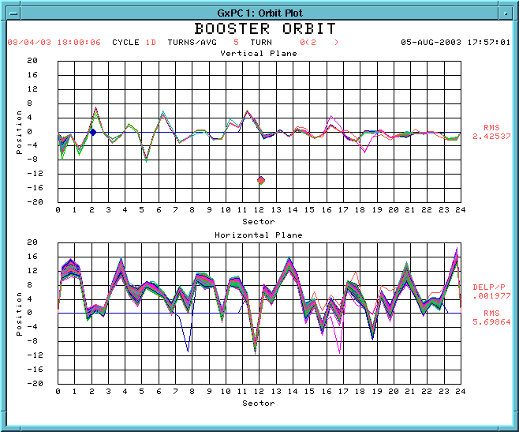
Injection Orbit Jitter?
Consistent with
Dp/p ~ .1%
Implementing a plan of study

Slide 4
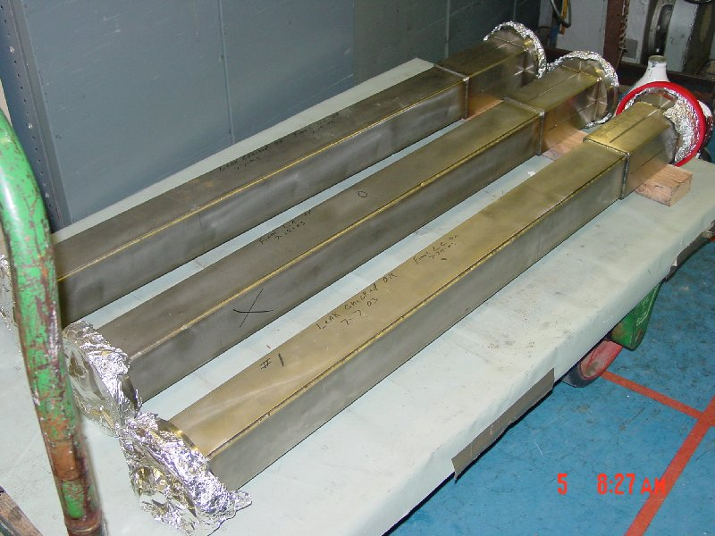
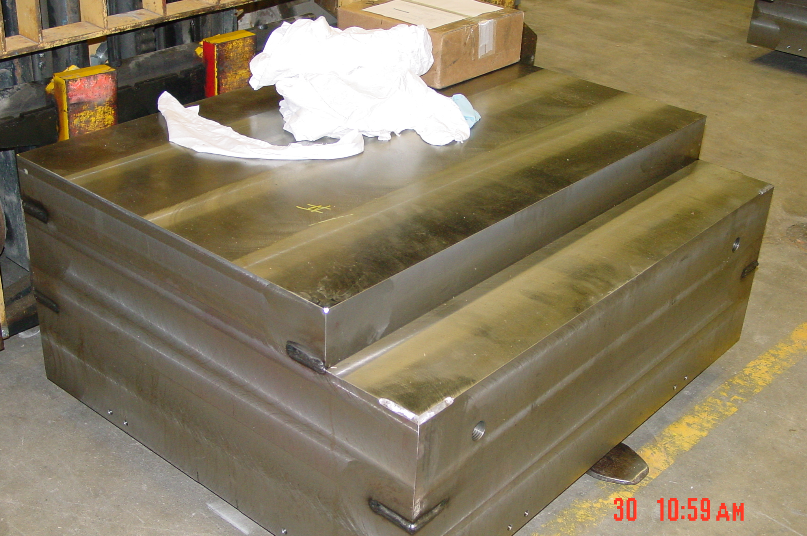
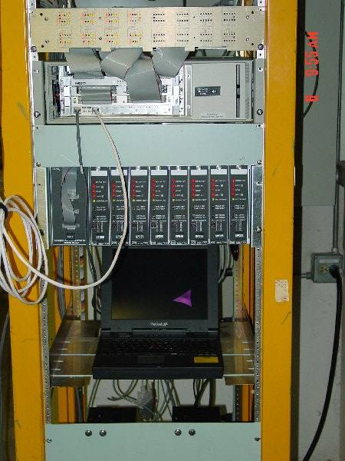
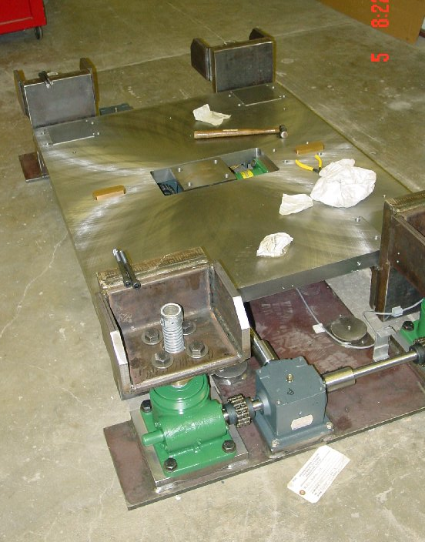
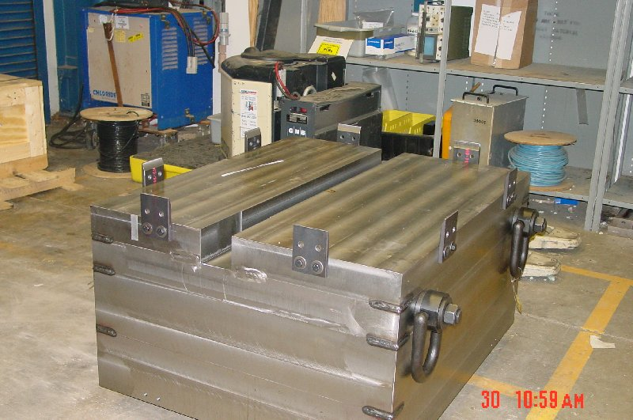
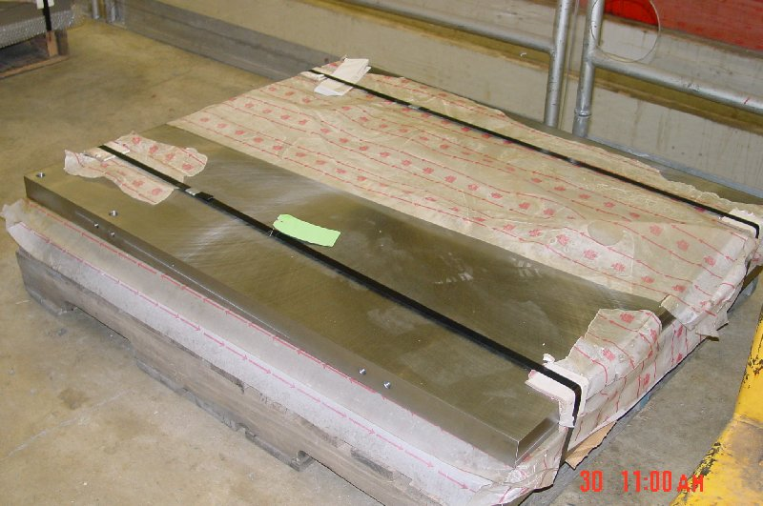
Collimator Project
All parts delivered
Three collimators being assembled in parallel
Controller being exercised
On schedule for shutdown

Slide 5
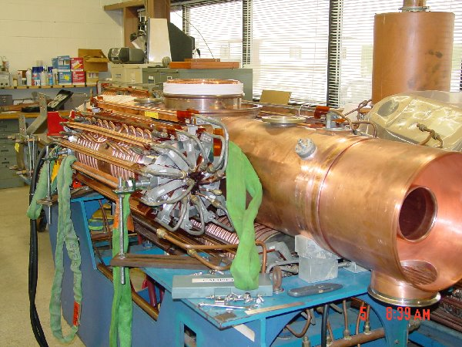
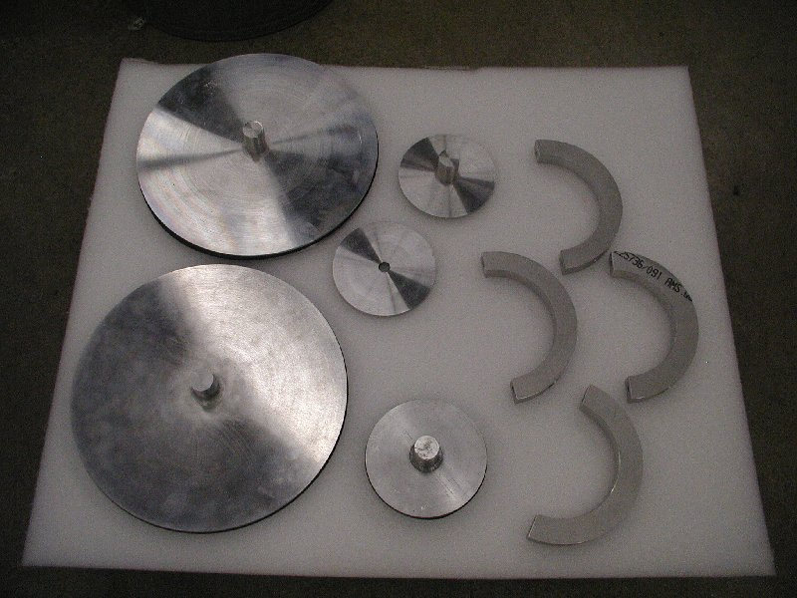
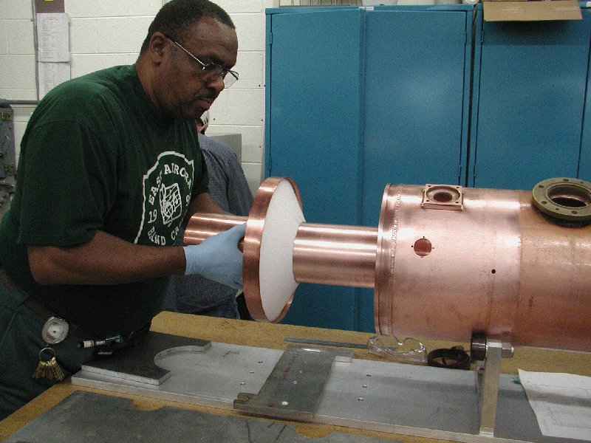
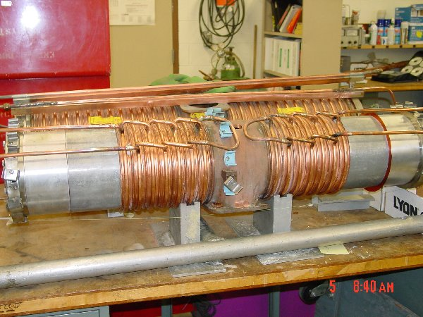
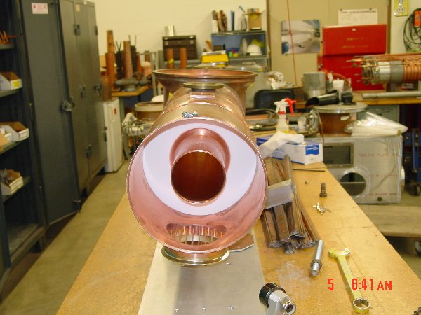
RF Prototype Project
Two cavities assembled in parallel.
More or less complete.
Made 37-53 MHz tuning range!!!
Begin power tests next week.
Will be ready for shutdown.

Slide 6
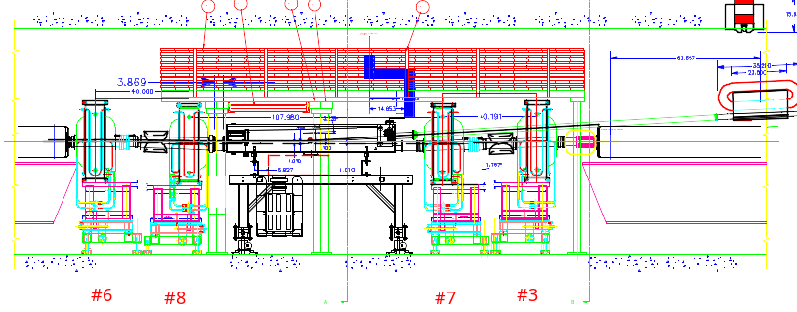
Long 3 Modifications
Spare dog magnets on new stands
Design complete
Stands being fabricated at Hi-tech (Argonne is paying)
Magnet cooling manifolds being modified at IB-2
Stands should be delivered Sept. 15

Slide 7
Other Shutdown Projects
Linac Lambertson – built a long time ago. Ready to go.
4 new EDWA magnets in MI-8 – build a long time ago. Ready to go.
New Power supply for MP01 – in place, ready to be cabled up.
New RF damper cavity – ready to go in.
New ORBUMP SCR network and capacitors – hopefully done in shutdown.
Wireless cabling for robot. At least the tunnel part done in shutdown.
Vertical alignment – complete network first week of shutdown. Take a week to move magnets later in the shutdown.

Slide 8
Shutdown Schedule
Sun | Mon | Tue | Wed | Thu | Fri | Sat
Sept. 7 | 8 | 9 | 10 | 11 | 12 | 13
14 | 15 | 16 | 17 | 18 | 19 | 20
21 | 22 | 23 | 24 | 25 | 26 | 27
28 | 29 | 30 | Oct. 1 | 2 | 3 | 4
5 | 6 | 7 | 8 | 9 | 10 | 11
12 | 13 | 14 | 15 | 16 | 17 | 18
BOOSTER OFF- Cool down and miscellaneous prep work
Collimators (with ironworkers) – Assumes collimators have been assembled in access bay!
Lambertson (LInac Tunnel)
EDWA Installation
Collimators (ironworkers move to EDWA installation)
Lambertson (LInac Tunnel)
EDWA Installation
Lambertson (LInac Tunnel)
Dogleg Modification at Long 3
EDWA Installation
Install Damper Cavity
EDWA Installation

Slide 9
Shutdown Schedule (cont’d)
Sun | Mon | Tue | Wed | Thu | Fri | Sat
Oct. 19 | 20 | 21 | 22 | 23 | 24 | 25
26 | 27 | 28 | 29 | 30 | 31 | Nov 1
2 | 3 | 4 | 5 | 6 | 7 | 8
9 | 10 | 11 | 12 | 13 | 14 | 15
16 | 17 | 18 | 19 | 20 | 21 | 22
Commissioning and Studies. Test MI-8 extraction.
Shutdown to Install Prototype RF Cavities
Commissioning and Studies. Possible off-hours beam to MiniBooNE
Return to normal operation

