Slide 1
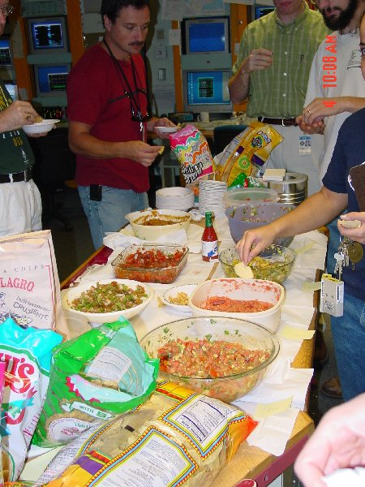
Frantic Shutdown Preparations Continue…

Slide 2
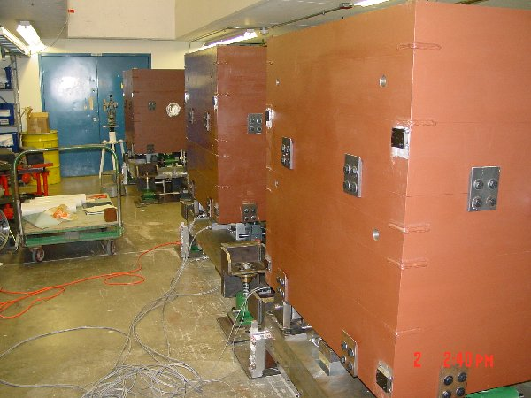
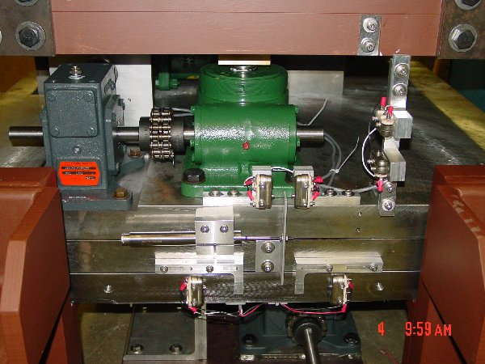
Collimator Status
Collimators complete and fiducialized.
Finalizing our grouting/leveling procedure.
Must wait until beam pipe is out to complete ALARA plan.

Slide 3
Other Projects
L3 Work
  New dogleg stands arrived today at IB-2
  Magnets should be ready to in about end of next week.
  New C-magnet and hanger stand design complete and being fabricated.
  Scheduled for 4th week of shutdown.
Prototype RF Cavities
  Power tests and characterizations under way.
  Still scheduled for installation in 8th week of shutdown.
Lambertson and EDWA installation.
  Very good shape except for radiation concerns.
All other projects.
  No real worries.

Slide 4
Proton Source Shutdown Schedule
Sun | Mon | Tue | Wed | Thu | Fri | Sat
Sept. 7 | 8 | 9 | 10 | 11 | 12 | 13
14 | 15 | 16 | 17 | 18 | 19 | 20
21 | 22 | 23 | 24 | 25 | 26 | 27
28 | 29 | 30 | Oct. 1 | 2 | 3 | 4
5 | 6 | 7 | 8 | 9 | 10 | 11
12 | 13 | 14 | 15 | 16 | 17 | 18
Prep L6 and L3 for collimator placement
BOOSTER OFF- Cool down and miscellaneous prep work
Collimators (with ironworkers) – Assumes collimators have been assembled in access bay!
Lambertson (LInac Tunnel)
EDWA Installation
Collimators (ironworkers move to EDWA installation)
Lambertson (LInac Tunnel)
EDWA Installation
Lambertson (LInac Tunnel)
Dogleg Modification at Long 3
EDWA Installation
Install Damper Cavity
EDWA Installation

Slide 5
Shutdown Schedule (cont’d)
Sun | Mon | Tue | Wed | Thu | Fri | Sat
Oct. 19 | 20 | 21 | 22 | 23 | 24 | 25
26 | 27 | 28 | 29 | 30 | 31 | Nov 1
2 | 3 | 4 | 5 | 6 | 7 | 8
9 | 10 | 11 | 12 | 13 | 14 | 15
16 | 17 | 18 | 19 | 20 | 21 | 22
Commissioning and Studies. Test MI-8 extraction on weekend.
Install Prototype RF Cavities
Vertically align Booster
Commissioning and Studies. Possible weekend extraction tests.
Return to normal operation

Slide 6
ORBUMP Issues
New SCR-network and charging supply controller will not be ready until probably December.
Recent flow restrictor replacements have greatly reduced the operating temperature.
(Original) capacitors are beginning to leak oil.
  Still seem to work.
  Full set of replacements coming over the shutdown.
  Must investigate a longer term solution.
Over the shutdown, we will add some plastic baffles to reduce the effect of water line breaks.
-> We feel we can push the supply to the 6.5 Hz needed by full MiniBooNE operation when called upon to do so.

Slide 7
What to expect after the shutdown
We think there’s a good chance that after the 10-week shutdown, we will be able to deliver “more” beam to MiniBooNE than we do now. This statement is based on our experience in the Feb. “dead dog” test, and our experience with the prototype collimator system.
Optimizing the system will take some time
  Tuning new lattice
  Commissioning collimator system
  Establishing new safety protocols without power meter (B:BPL5MA).
Estimate 2-3 months to approach full performance.
We’re “cautiously optimistic” that this full performance will be the MiniBooNE baseline request.

