Slide 1
Proton Source Shutdown Work, Fall 2003

Slide 2
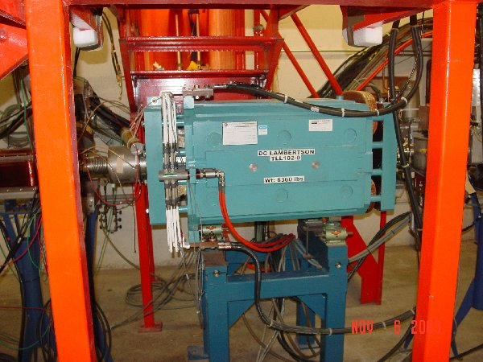
New Lambertson
New Lambertson magnet to steer beam to Booster
  Imroved field quality
  Should reduce losses in the 400 MeV line.

Slide 3
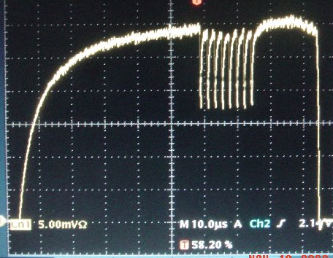
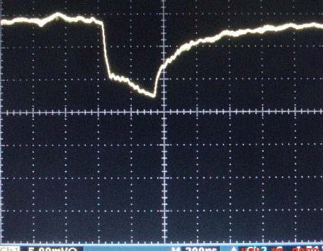
Other Linac Projects
Major LCW upgrade.
  Should improve reliability of the system
Install “notchable” ion source
  Use to test idea create extraction notch at the beginning of the linac, thus reducing tunnel losses.

Slide 4
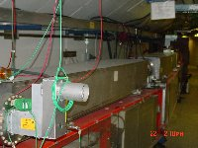
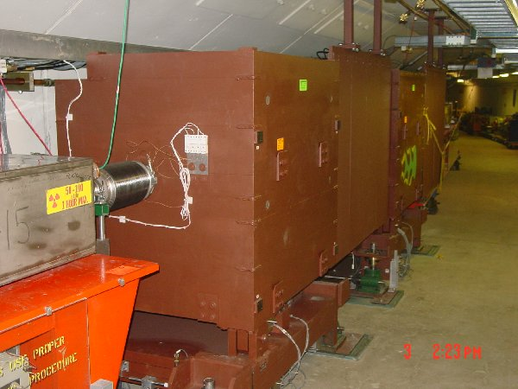
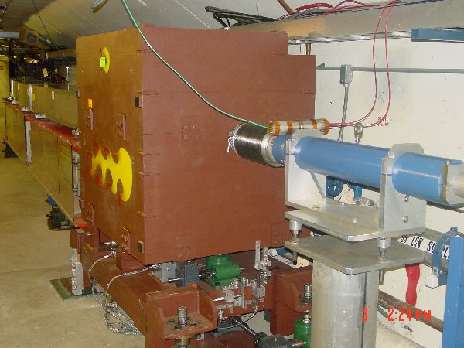
New Collimator System
Basic Idea…
A scraping foil deflects the orbit of halo particles…
…and they are absorbed by thick collimators in the next periods.
Should dramatically reduce uncontrolled losses

Slide 5
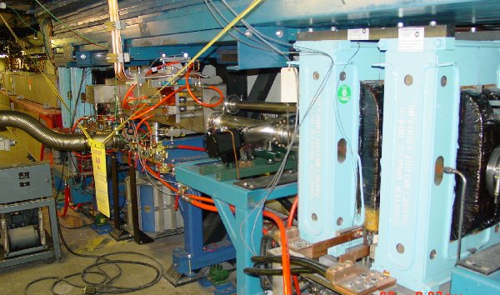
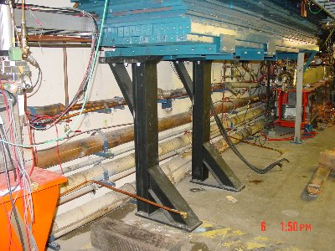
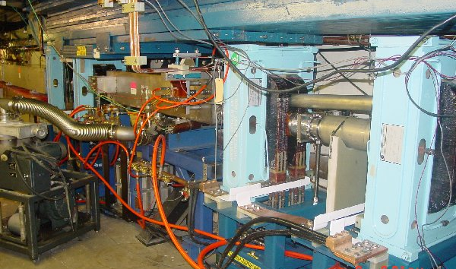
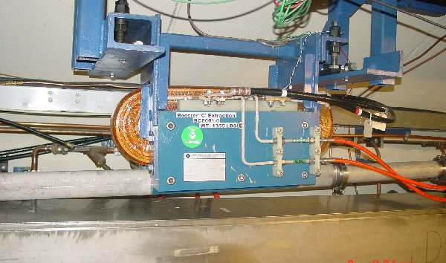
Long 3 Dogleg Work
New magnet to match extraction line
Increase spacing between dogleg pairs from 18” to 40” to reduce lattice distortions at injection.

Slide 6
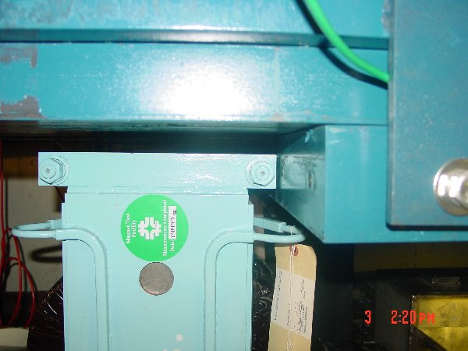
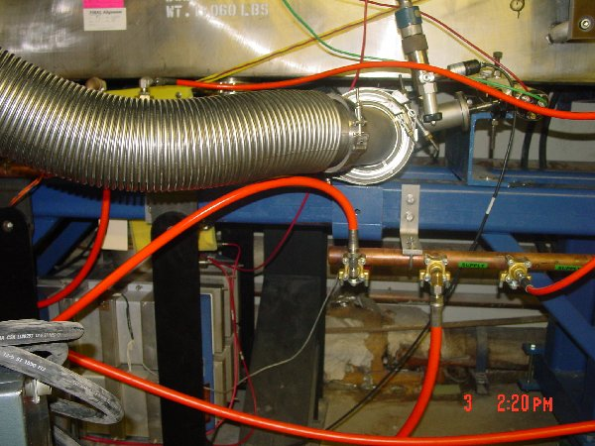
Long 3 Work (cont’d)
Precision fit…
MP02 ion pump
Shielding Steel
New dogleg magnet position
Steel support stand
This will be much less of an issue at long 13 (no steel, more room)

Slide 7
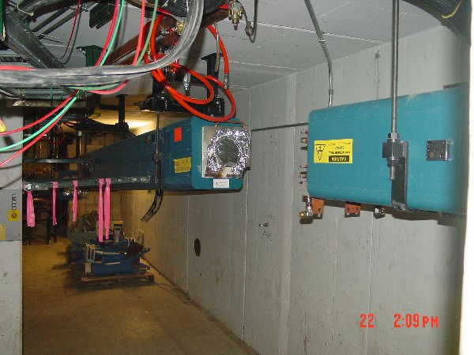
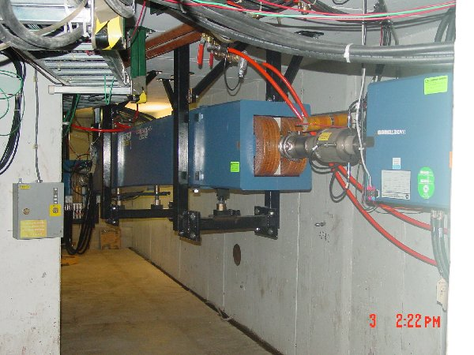
Four New Large Aperture MI-8 Magnets
Rectangular magnets
Large-aperture sector
magnets
Should reduce losses and possibly improve extraction optics

Slide 8
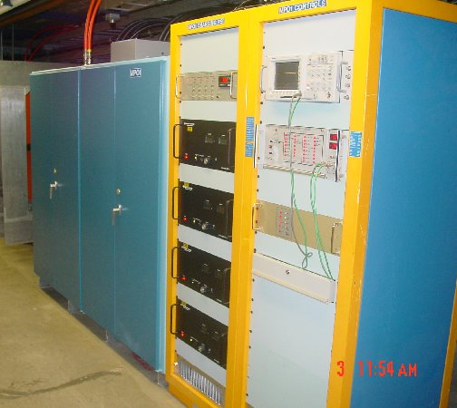
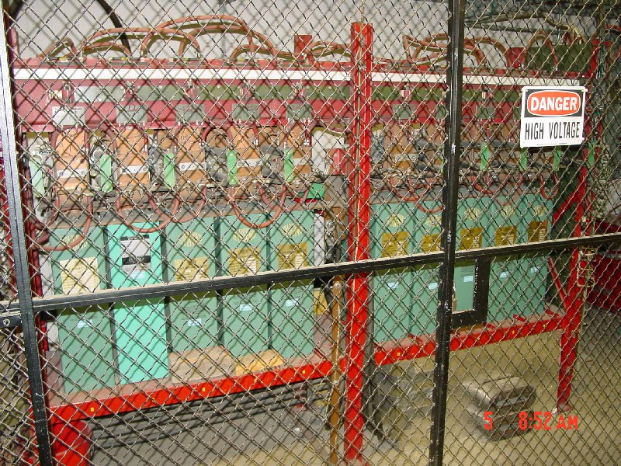
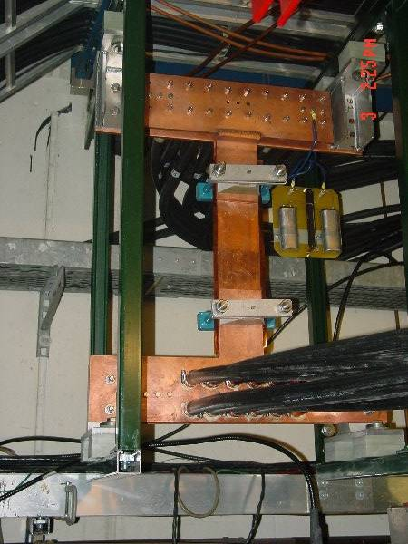
Replace (original) MP01 Power Supply
100% Spare compatibility with MP02
Preparation for L13 septum and dogleg work next year.
Polarity reverser in tunnel

Slide 9
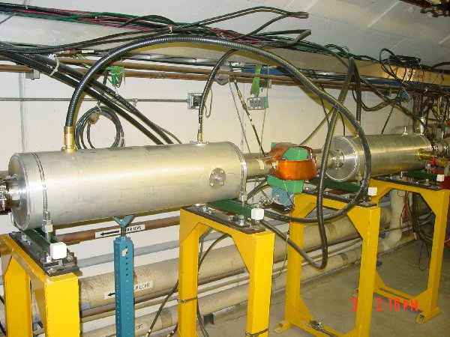
New Mode 16 Damper
Old damper
New damper
Damp more coupled bunch modes

Slide 10
Vacuum Upgrade
Old, badly documented vacuum readout system replaced with modern PLC-based system.
Should improve vacuum reliability and diagnostic capability, as well as reducing the need for expert intervention.
This is a major project that has been under way for a very long time, and is now coming up with remarkably few problems.

Slide 11
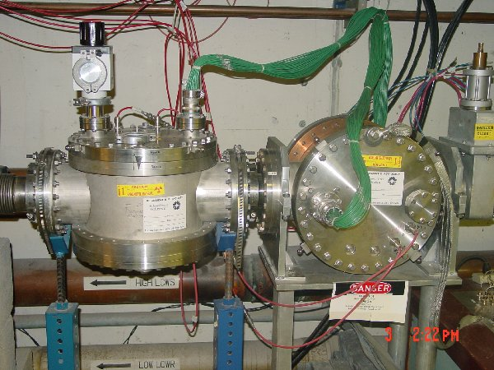
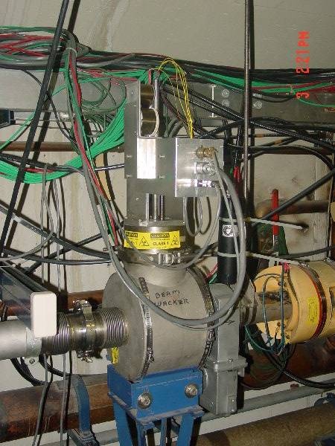
Small Projects
Swap planes of Ionization Profile Monitor to put best plane vertical, where we trust our space charge models.
Rotating wire “beam whacker” to measure beam halo.

Slide 12
Other Projects
We completed a vertical survey network of the Booster, which will be used to determine vertical moves to better align the Booster. This could potentially have a dramatic effect.
(Unplanned): It was discovered that the 4x96 plastic hoses which distribute water to the magnets were badly radiation damaged. These were all replaced with more rad-hard hoses.
Significant preventive maintenance in the RF system.

Slide 13
Deferred Projects
Two large aperture RF cavities
  Not ready in time
  When ready, will be installed when schedule permits
Vertical magnet moves
  Vertical survey data not processed
  Magnet moves might be confusing in light of our other tuning needs.
  Will move magnets as schedules permit.

Slide 14
Acknowledgements
In addition to the hard work from within the department, we had substantial support from
  Mechanical Support
  Technical Division
  The RF Department
  The LCW Group
  The Alignment Group
  EE Support
  Operations
  The MiniBooNE Experiment
  Taft Engineering
  Bartoszek Engineering
  ES&H

Slide 15
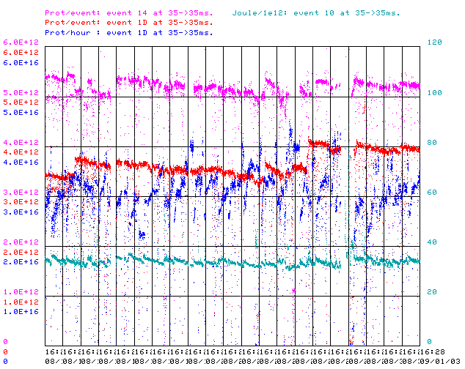
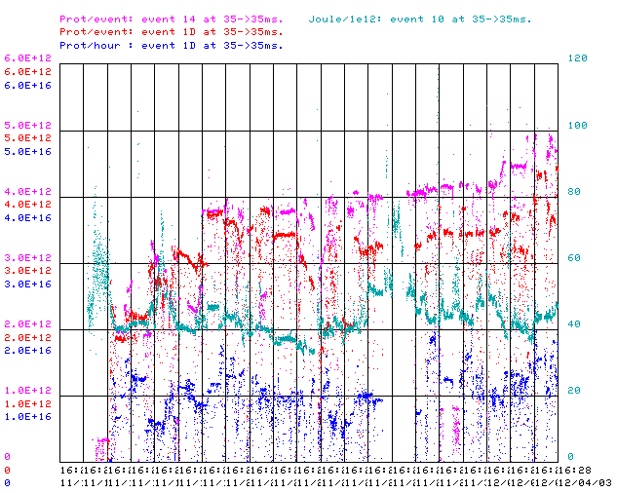
How are we doing?
Protons/pulse to stacking
Protons/pulse to MB
p/hr to MB
J/E12 Energy lost
We’re getting there, but so much for my promise to “come back better than before”.

Slide 16
Plans
Tune-up has been slower than anticipated, but so far no sign of serious problems.
Continue more or less as we are:
  Focus on 400 MeV line optics (Fernanda coordinating)
  Now that we can hit 5E12 per pulse, focus on losses in Booster to increase intensity to MiniBooNE.
  Continue to deliver high per pulse intensity (4E12) to MiniBooNE even if it means less overall intensity (this is a MiniBooNE request).
Won’t exercise collimators until our performance is at least as good as before shutdown.

Slide 17
This Year’s Big Projects
Modify Long 13 to match Long 3
  Finish building new septa (need 2 at long 13 + spare)
  Build new dogleg magnets (have 5 cores; need to wind)
  Build new dogleg stands.
  Install in the Fall ’04 shutdown
New ORBUMP supply
  Patch the existing one “soon”
    New capacitors
    New SCR switch network
  Work on new supply
    Meeting with EE support to set specs
(possible) New ORBUMP magnets
  Cooled versions of existing magnets, BUT go to slightly higher field
    Clean up injection
    Allow possible novel injection scheme (a la M. Popovic)
  Possible new ferrites will simplify the design.
  If built, hope to install in the FY04 shutdown (VERY tight).

Slide 18
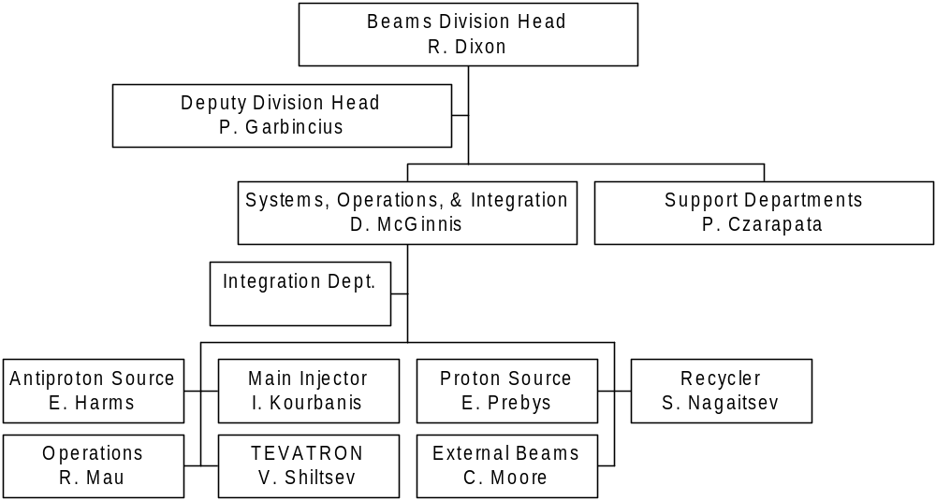
Understanding the New Accelerator Division Structure
Replaces Run Coordinator

Slide 19
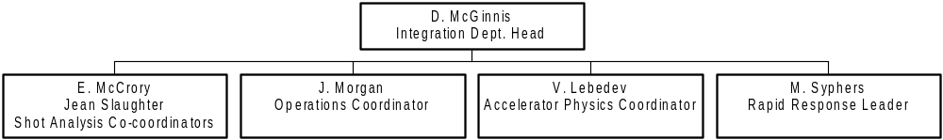
Integration Department Organization
New department absorbs part of Beam Physics Dept.; the rest go to the systems departments.
Responsible for all operational and procedural policies, but…
Where is
  MiniBooNE?
  NuMI?
  SY120?
Now is the time to make sure they don’t fall through the cracks.

Slide 20
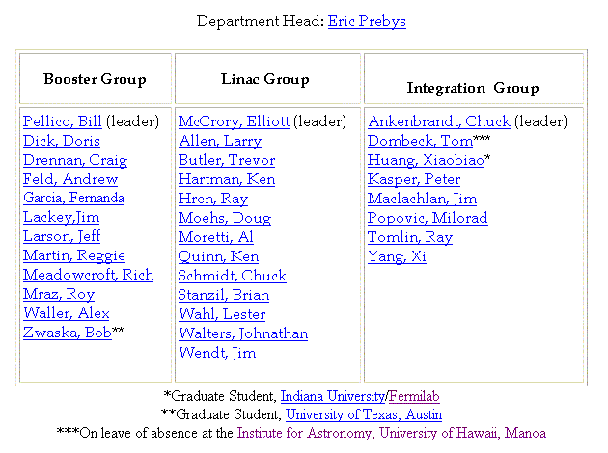
Jumping on the Restructuring Bandwagon…
Proton Source Department
New
New group. Responsibilies:
Coordinate modeling and studies
Address global issues

Slide 21
What is this “Pbar tax”?
Need to balance present collider needs with high luminosity goals; specifically, with the integration of the Recycler.
Arrangement can only work if it’s quantified.
-> in FY04, the recycler will get 25% “of the antiprotons”. They can take these in three ways:
  Antiproton transfers from the stack
    major use, can use 25% very quickly.
    no effect on MiniBooNE.
  A fraction of the stacking timeline
    Small impact on stacking, since MI doesn’t have to ramp
    no effect on MiniBooNE
  Accesses
    Shuts MiniBooNE off.
    Vacuum looks good, so probably not much need.
    Sergei Nagaitsev says “probably not many”.
    Nevertheless, must keep an eye on this.

