Slide 1
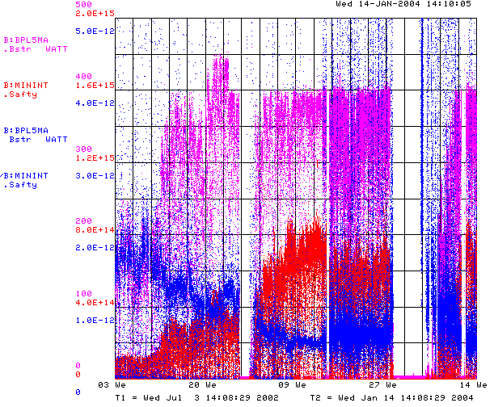
How are we doing?
Power loss (W)
Protons (p/min)
Energy Lost (W-min/p)
Mysterious bad running
Best running again ?
Best running

Slide 2

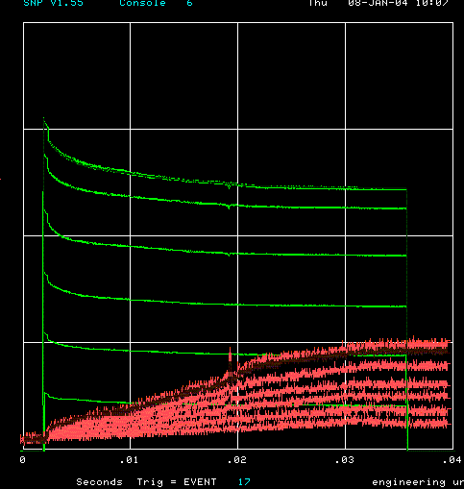
How far have we come?
Before MiniBooNE
Now (same scale!!)
Charge
5E12
Time (s)
Energy Lost
Note less pronounced injection and transition losses

Slide 3
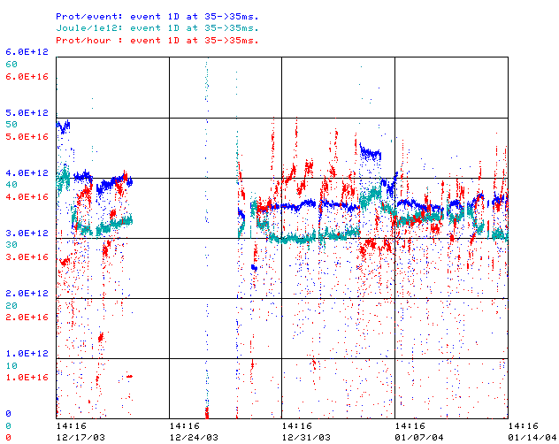
Last 4 Weeks - Detail
Protons to MB [p/hr]
Protons per pulse
Energy lost per proton
Mysterious dip

Slide 4
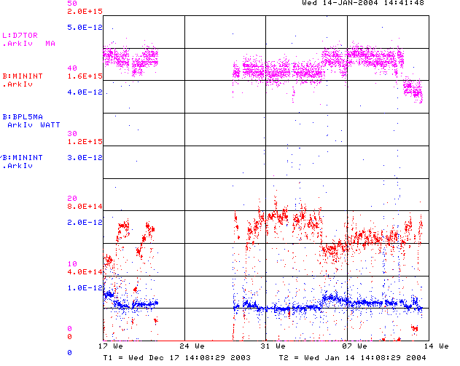
Related to Linac current?
Linac Current
Total Protons
Energy Loss/proton

Slide 5
Christmas Klystron Woes
As of Dec. 1, we believed 800 MHz klystrons were not a worry.
  Only two had failed
  We had six spares
A few days before Christmas, the klystron in station one failed.
  Three spares turned out to be bad
  Tracked down to vacuum problem (and a flaw in our measurement technique).
Plan
  Ralph Pasquinelli put in charge of investigating and acting
  We think we understand the problem and will work with L3 to address it.
Current stock
  One “good” spare (i.e. verified vacuum).
  One good tube at lab G, which is being moved.
  One gassy tube, which can probably be conditioned
  One tube being rebuilt at L3. Delivered ??
  One tube being sent back to be rebuilt (4-6 months).

Slide 6
Alignment in the Booster
Always been recognized as a problem
A little over a year ago, we started a vertical network of the entire Booster
  Level run
  4 survey points on each magnet (some a bit complicated)
  (Mostly) completed during the shutdown. Data now in hand.
  Some big problems!
Historical difficulties
  Lack of priority!
  Lack of a coherent plan, both on our part and alignment.
  Inefficient use of downtime (response time issues).
Solution? What else – a task force.

Slide 7
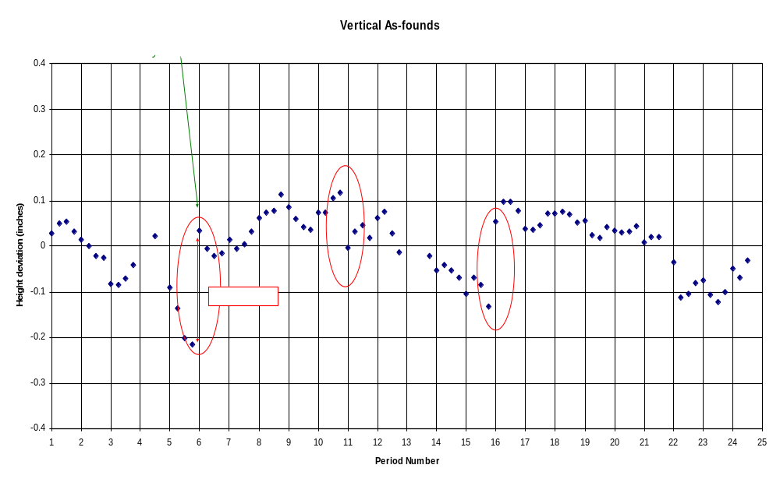
Big Alignment Problems!

Slide 8
Alignment Plan
Peter Kasper put in charge of coordinating alignment on our end.
O’sheg made task manager on the AMG end.
Andrew Feld will be trained as a liaison.
Near term goals (ASAP as opportunities arise)
  Complete vertical network (5-10% to be done or redone)
  Develop a plan for vertical moves, including both “opportunities” and longer term requests.
  Align RF cavities and other key elements to optical center of straights.
Longer term (aim to complete by next big shutdown)
  Produce a “beam sheet” based on Sasha’s MAD file
  Add non-magnetic elements
  Complete network, including horizontal.

Slide 9
Collimators
Chose to wait until we were running “better than when we shutdown”.
This happened two weeks ago, so we were going to start last week.
Last week
  Efficiency dropped.
  Dave has asked us to wait to finish the 400 MeV line studies.
I’d like to start this week.
  I’m working up a study plan.
  Will do extinction studies as opportunity arises.
  Working on beam motion control to allow cycle-dependent studies (Dave McGinnis’ suggestion).

Slide 10
Machine Summary (from McGinnis)
Proton Source
  Linac Current Optimization
    Goal: More protons to MiniBoone
    Slightly lower Linac current points to better efficiency in Booster
    Counter-intuitive with past “thinking”
  400 MeV Optimization
    Goal: More protons to MiniBoone
    Smaller beta functions for less beam loss in line
    Phase space matching for more efficient transfer into Booster
    Three lattice iterations were done over the weekend
      Numerous problems identified.
      Solution to problems relatively straight-forward in a 2-4 week time-scale

Slide 11
Machine Summary (McGinnis, cont’d)
Proton Source
  Booster Collimator
    Goal: More protons to MiniBoone
    Key to the success of the Booster Collimator is orbit control at the collimator
      At startup, initial attempts at controlling the horizontal orbit (rpos) resulted in poor Booster performance at high intensities.
    Our first order of business in commissioning the collimators, is to develop and understand orbit control at the collimators.
      A plan needs to be developed by the Proton Source. This plan must account for:
        Radial position control, Cogging, Booster Alignment, etc.
      We will launch these studies, once we have prepared the plan
    Depending on the success of our orbit control, we might have to modify the present operational scenario of the collimators. In parallel to the orbit control project we should start considering what these alternatives are.
    We also must be able to measure the success of the collimators.
      i.e. how much beam is loss in the Booster compared to the collimators
      At present, we don’t have a viable plan to do this.
      We could use the help of the experiment in developing this measurement system.

