Slide 1
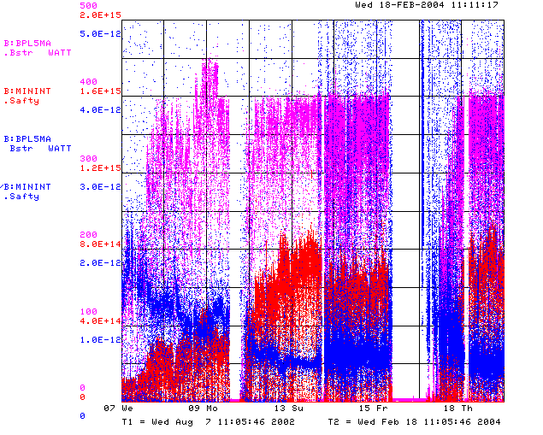
How are We Doing?
Power loss (W)
Protons (p/min)
Energy Lost (W-min/p)
BooNE turn-on (Sept. 2002)
“Mysterious”
Performance Problems
Big Shutdown

Slide 2
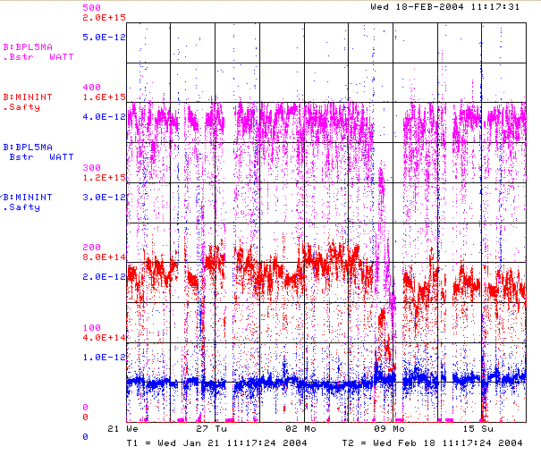
Recent Running (Last 4 Weeks)
Power loss (W)
Protons (p/min)
Energy Lost (W-min/p)
Record Performance
3 RF Failures
Several Unrelated Problems

Slide 3
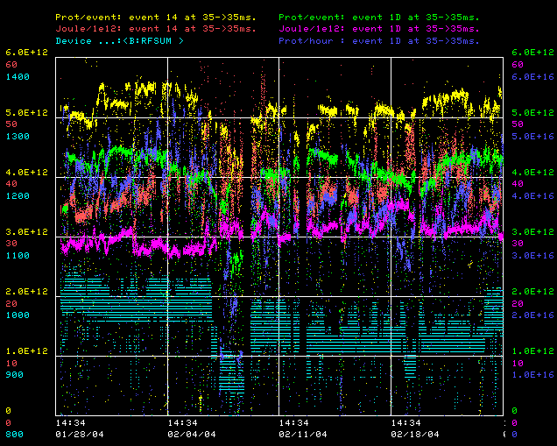
RFSUM and Performance
pBar p/batch
MB p/hr
MB p/batch
pBar Eloss/p
MB Eloss/p
RFSUM

Slide 4
Near Term Priorities (Booster)
Optimizing Booster for improved lattice:
  Tuning and characterizing 400 MeV line (Linac to Booster).
  Tuning Booster orbit to minimize losses.
  Demonstrated performance “good enough” for now
    > 5.2E12 to stacking
    < 30 J/E12 energy loss on MiniBooNE cycles.
Commission Collimators:
Multibatch timing: Beam cogging
  Need for slipstacked pBar production and NuMI
Aperture Improvments:
  Alignment
  Orbit control
    Abandoning our original global plan in favor of local control at problem spots for the time being.
  Prototype RF Cavities
    Possibly install one during upcoming shutdown.

Slide 5
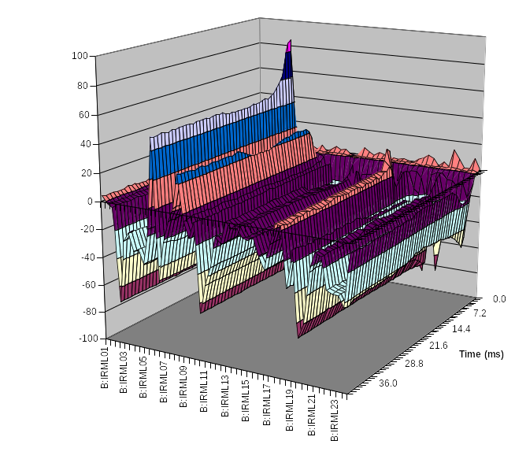
Collimator Studies
Collimator location
Shown is the effect of putting in one of the secondary collimators as a percentage change in losses as a function of time around the ring.
Studies are continuing.
  “Rapid response team” will be put on problem.
At present, primary collimators are not optimized to energy loss profile
  Will replace in upcoming shutdown.
location

Slide 6
Shutdown
Currently scheduled for 5 days, week of March 15.
Our plans
  Significant magnet moves to improve aperture and correct high field orbit.
  Prototype RF cavity? (possibly)
  Replace primary collimator foils (.1 mm Tungsten?)
  Beam study time:
    6 GeV operation
      Effectively increases RF power.
      Demonstrates potential of 30 Hz harmonic.
    Destructive collimator studies (if not already done)

Slide 7
Priorities over the Next Year
Linac Characterization and Reliability
  Increase instrumentation of old linac to study instabilities.
  Develop set of performance parameters.
Booster improvements.
  Prepare for modification of second extraction region
    New septum
    Modified dogleg magnets
    On track for next year’s shutdown.
  Injection bump (ORBUMP) improvements:
    Injection Bump (ORBUMP) Power Supply
      Existing supply a reliability worry.
      Limited to 7.5 Hz
      Building new supply, capable of 15 Hz.
      Aiming for summer shutdown (aggressive, but doable)
    New ORBUMP Magnets
      Existing magnets limited by heating to 7.5 Hz
      Working on a design for cooled versions.
      These, with a new power supply, will make the Booster capable of sustained 15 Hz operation.
      Aiming for summer shutdown (aggressive, but doable).
Add RF cavities:
  Based on our revelations about our RF limitiations, we’re considering using the prototype cavities plus some spare parts as to additional cavities.
  Working on a plan with John Reid and Jim Lackey.

