Slide 1
Booster Status
Eric Prebys – FNAL/AD

Slide 2
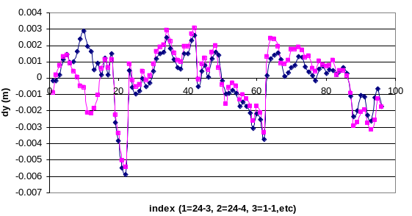
Shutdown Activities
Magnet moves
  Moved 9 (out of 48) girders and one magnet on a girder
Fix high field orbit
Fix L3 misalignment
Changed primary collimators from 300 um C to 500 um Cu (optimised for ~few GeV)
Moved loss monitors, so their locations are more useful and consistent.

Slide 3
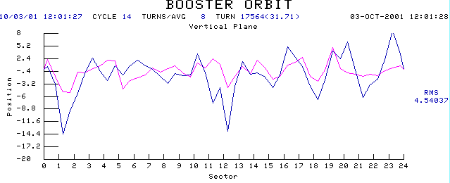
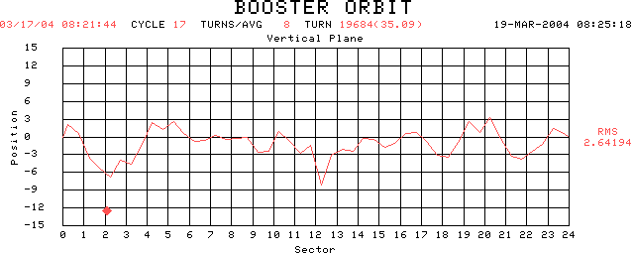
Effects of Moves on High Field Orbit
Before (blue curve)
RF Cavities
After (matches prediction)
Extraction

Slide 4
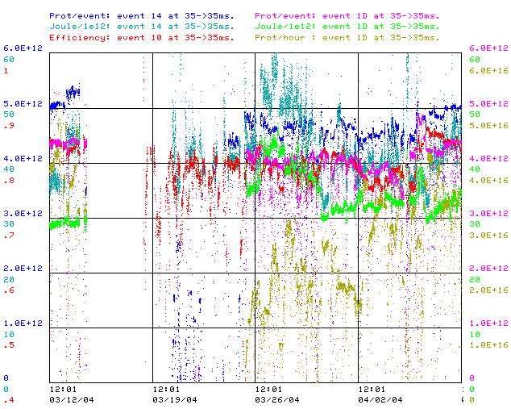
Recent Running
pBar p/batch
pBar J/E12
Average Eff.
MB p/batch
MB J/E12
MB p/hr
“about as good” as before the shutdown

Slide 5
Tuning Problems
Opening Aperture not all good
  L6 restriction caused fortuitous collimation
  High individual loss monitors confused tuning
    Some loss monitors were moved, making them more sensitive
  New philosophy
    Bypass individual loss monitors
    Tune for high intensity/efficiency
    Then focus on problematic losses
Now we’re at the point where collimator studies are beginning in earnest.

Slide 6
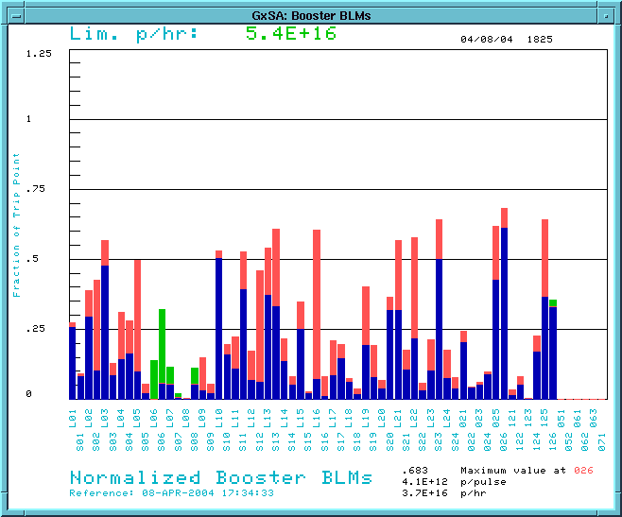
Collimator Studies
Lots of work going on, both in studies and in control software
  Special thanks to Dean Still, who is the expert on the Tevatron collimators
Preliminary results
Without Collimators
With Collimators
Effect still seems to be mostly from secondary collimators

Slide 7
Collimator Plans
Continue to study collimators
  Attempt to establish two-stage collimation
  Find optimized configuration
Will begin to leave in operationally very soon, possibly over the weekend.
Worry: collimators can mask actual problems.

Slide 8
Other Issues
7835’s
  3 good spares
  Oldest one in service is at .9 of the median lifetime
  Next tube in April
  Burle yield back near 100% (up from 20%)
Klystrons
  L3 has identified the problem
    Corrosion through stainless steel flange plate at water-vacuum interface (NOT the braise joint)
    Exacerbated by standing water in storage
  Fix identified
    Eliminate all water/vacuum flanges
    New flow path eliminates standing water
    Major redesign
    First tubes back in September at the earliest
  Existing stock
    Two good spares
    Marginal spare is showing signs of life (vacuum finally coming down)
  Worried but not panicked.

Slide 9
The future (this year)
L13 “dogleg” fix: on track for summer shutdown
ORBUMP magnets
  Design more or less complete
  Passed mini-review
  Proceeding with ferrite procurement
  Will probably NOT be ready for summer shutdown (est. 1/05)
ORBUMP power supply
  Design proceeding
  Working on timeline
Extra RF cavities
  New idea, much simpler
  Plan to put in at least one, maybe two in summer shutdown.

