Slide 1
Booster Status Report
Eric Prebys
FNAL Accelerator Division

Slide 2
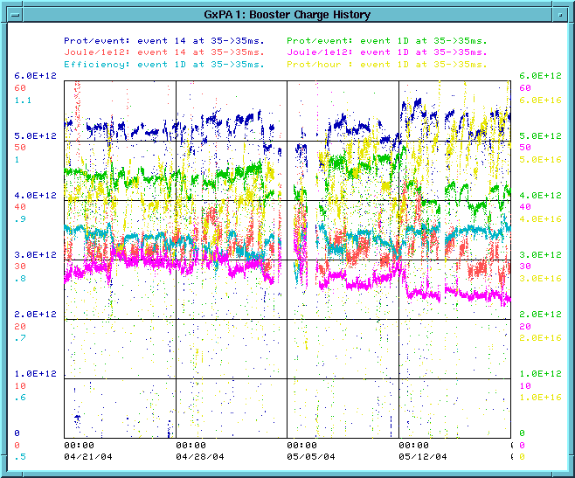
Recent Performance
Several Records Broken
  Weekly protons: >7E18
  Hourly: >6E16 (2/3 Goal)
Continue to Improve
  Combination of Collimators and Tuning
Energy loss per proton (prime figure of merit)
Last 4 Weeks

Slide 3
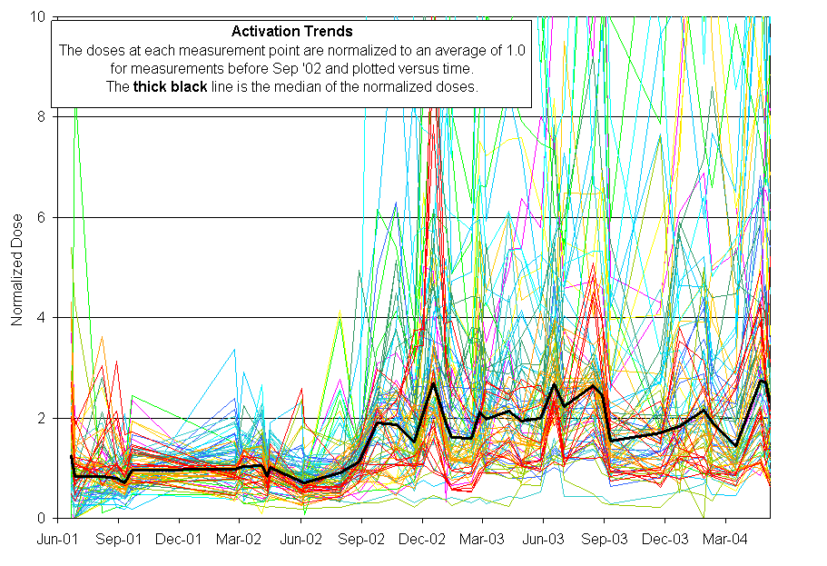
Activation History
MiniBooNE
Protons increased x10
Activation increased by ~3

Slide 4
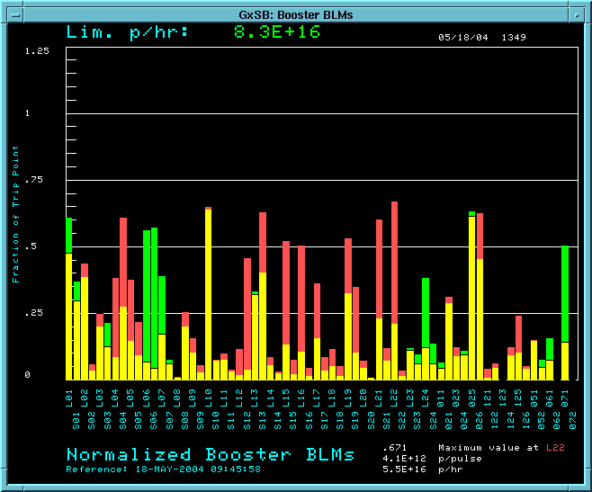
Collimator Commissioning
We have begun to use the collimators in normal operation:
Not (yet) as good as expected, but encouraging.
RF Region
Losses w/o collimators
Losses with collimators

Slide 5
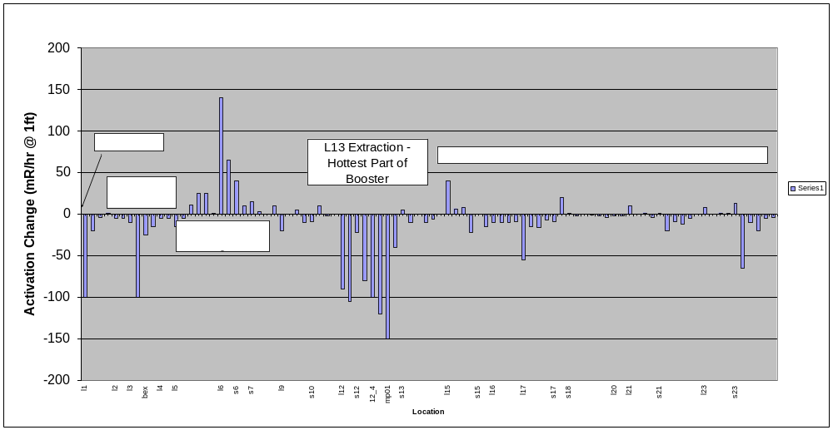
Effect of Collimators on Activation
One week of continuous collimator operation….
  Difference from previous week measurement (mr/hr @ 1ft)

Slide 6
Increasing intensity with collimators
Our level of activation in the Booster has been more or less constant for more than a year.
It is “OK”:
  Employee exposure within limits
  We believe we have reached equilibrium in terms of radiation damage repairs.
We do not wish to increase it!!
Currently, our most accurate measure of Booster activation is the power loss, which is calculated from lost protons.
This will cease to be a good measure once the collimators are implemented.
Our plan is to measure activation at a set of chosen locations on a weekly basis
  Impact ~2 hrs/wk
As activation is observed to decrease, we will increase intensity to keep it roughly constant.

Slide 7
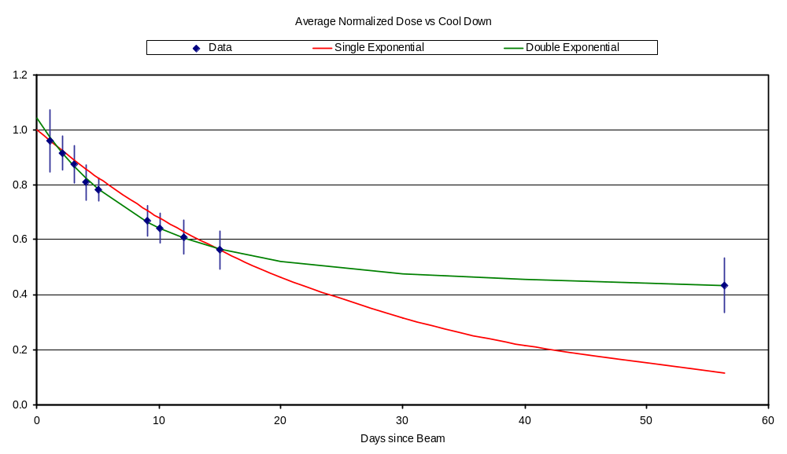
Predicting Rate Based on Cooldown
Best fit with two roughly equal components:
  Half-life 5.6 days
  Half-life 282 days (⁵⁷Co)
Predict effect of increase method based on this model.

Slide 8
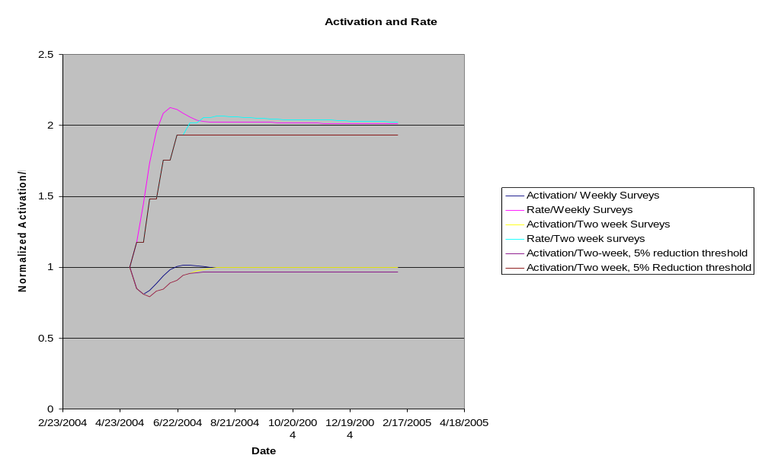
Rate Increase
Assuming 50% loss reduction

Slide 9
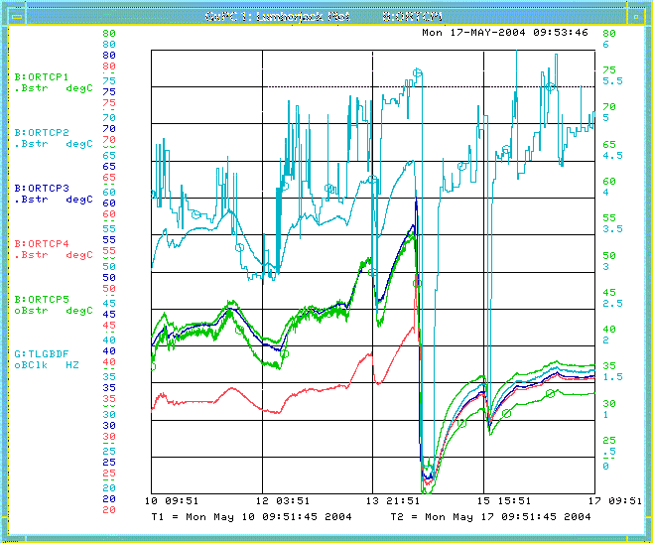
Increased Repetition Rate
Going >5Hz Stresses
  ORBUMP Power Supply
  ORBUMP Magnets
  RF System
Recent ORBUMP cap failure was predicted
  Cap ~30 years old
  Temperature had been rising
  Replaced all 5 capacitors with new ones
Temperatures
Bad cap
Failure
All new

Slide 10
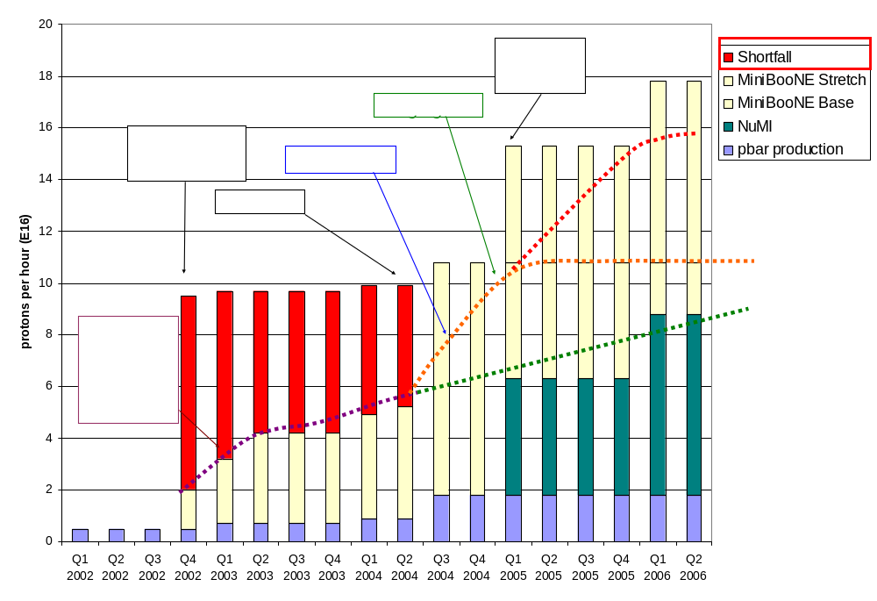
Making Projections
Stretch
Optimistic
Conservative
This week!!!

Slide 11
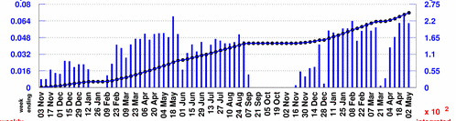
Projecting to MiniBooNE
Rather than use the instantaneous rate, will scale from typical weekly MiniBooNE totals:
Baseline Scenario:
  Improvements compensate for increased protons to pBar -> Continue to average 5.5E18/wk
  MBooNE shuts OFF 1/05
Optimistic Scenario:
  MBooNE rate increases more or less linearly to 10E18/wk at 1/05
  5.5E18/wk after NuMI turns on.
Stretch Scenario:
  MBooNE rate increases linearly to 10E18/wk at 1/05
  5.5E18/wk after NuMI turns on.
  Linearly to 10E18/wk on 1/06
Typically 5.5E18/wk

Slide 12
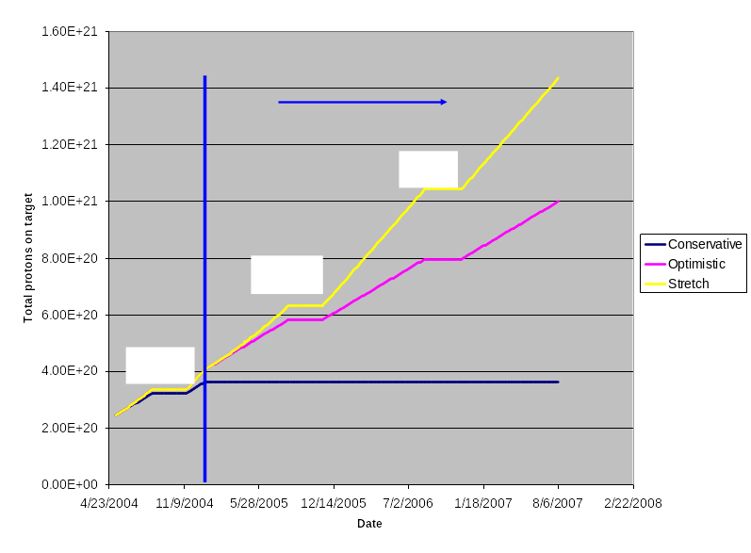
Protons to MiniBooNE

Slide 13
Projecting in Your Head
5E12@5Hz = 9E16 protons/hr = 5E20 protons/yr
MiniBooNE has ~2.5E20 protons now
If we hit 9E16 tomorrow, we would just make 5E20 (initial MiniBooNE request) by 1/05.
After NuMI turn:
  If 1E17 pph remains limit: Another 2 yrs to get to 1E21.
  If limit goes to 1.6E16 pph: Can do it in another year.

