Slide 1
Booster Status
Eric Prebys
FNAL Accelerator Division

Slide 2
Recent Booster Activities
Collimators are now used in regular operation
We have seen a reduction in Booster activation
We are raising the rate (Watt limit) to try to keep activation more or less constant.
  Currently at 475W
  Need to go to ~575W to run full MiniBooNE during shot setup
  Need to go to 650W to run full MiniBooNE at all times.
We’ve hit a max of 8E16 pph to MiniBooNE
We have now raised the administrative limit to the point where it’s no longer a concern.
We regularly run at the 6.5Hz booster rate needed to go to full MiniBooNE intensity
  Need only go to 5E12 protons per batch to hit full intensity.
Wrestling with collimator problems for the last week
  Good news: NOT stuck (problem in the controller)
  We think it’s fixed
Note: Bill Pellico won an Employee Recognition Award (I’m sure the collaboration’s letter helped)

Slide 3
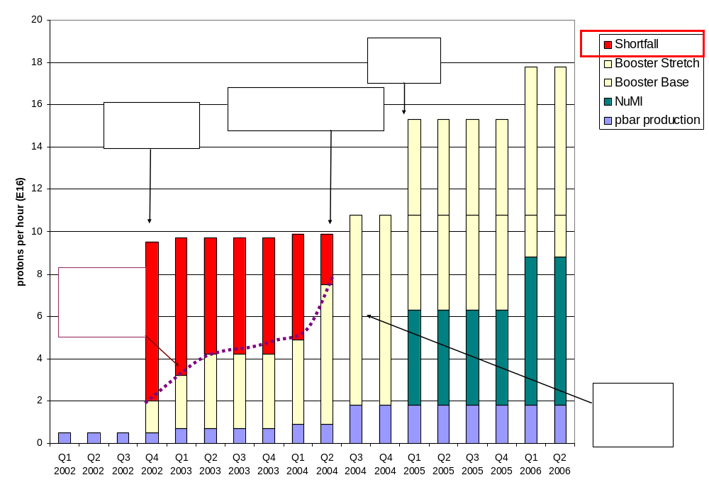
Proton Demand – History (Shown to PAC)
7.5 Hz
Have now exceeded initial NuMI needs!!!!

Slide 4
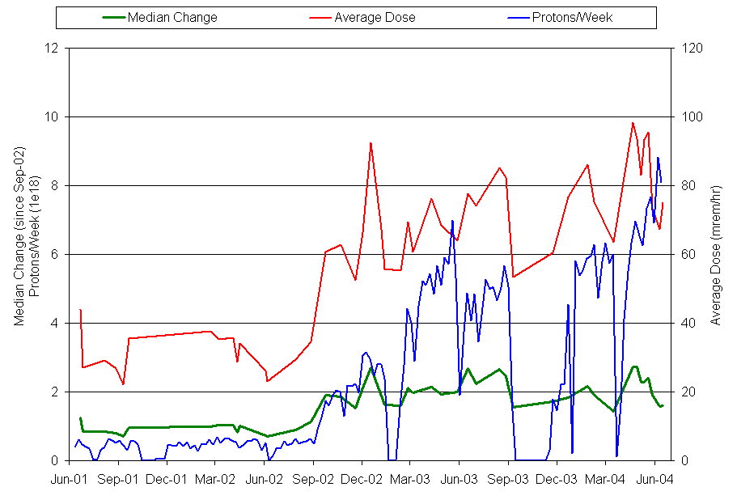
Activation History In Booster (Shown to PAC)
MiniBooNE
x2~3 activation
16x proton increase
Collimators

Slide 5
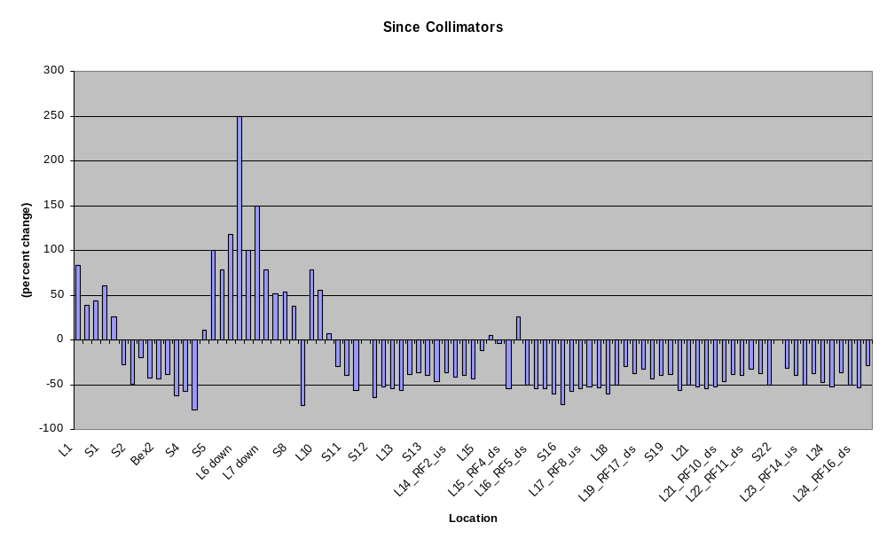
Change In Activation Since Collimators – Shown to PAC
Collimator
region
L3
Extraction
L13
Extraction
RF Region

Slide 6
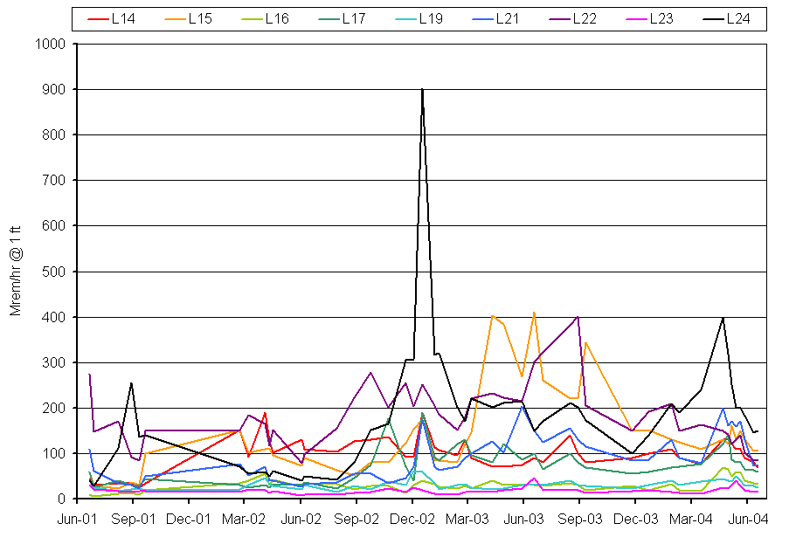
Activation in RF Cavities
MiniBooNE
Collimators
Pre-MiniBooNE levels!!

Slide 7

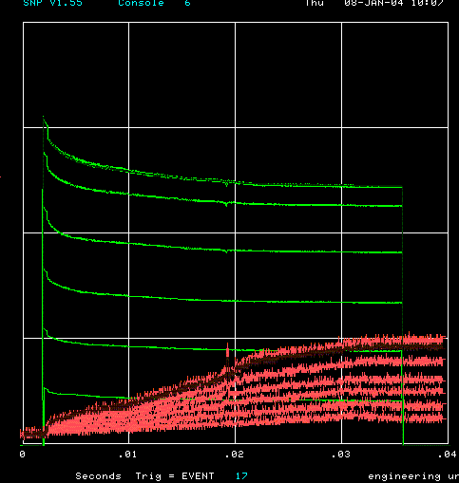
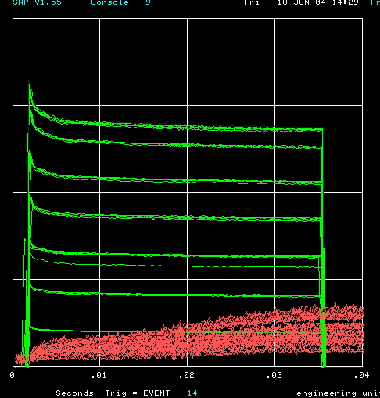
How far have we come?
Oct. 2002 (MB turn-on)
Jan. 2004
Now
Charge through Booster cycle
Energy Lost
Time (s)
Typical:
  5.5E12 protons/batch to stacking (Run II handbook = 5E12)
  >6.5E16 pph to MiniBooNE (MiniBooNE goal 9E16)
  9E18 p/wk (MiniBooNE nominal 12.5E18)
Records:
  >6E12 protons/batch to stacking
  8E16 pph to MiniBooNE
  10E18 protons/week

Slide 8
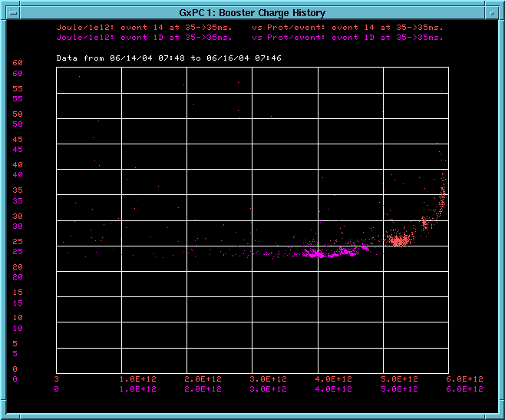
Effect of increased intensity (recent running)
4E12
5E12
~5% more losses (activation) at 5E12
Energy Lost per proton
Protons per pulse
Can really deliver 5E12 efficiently for the first time!!!!!

Slide 9
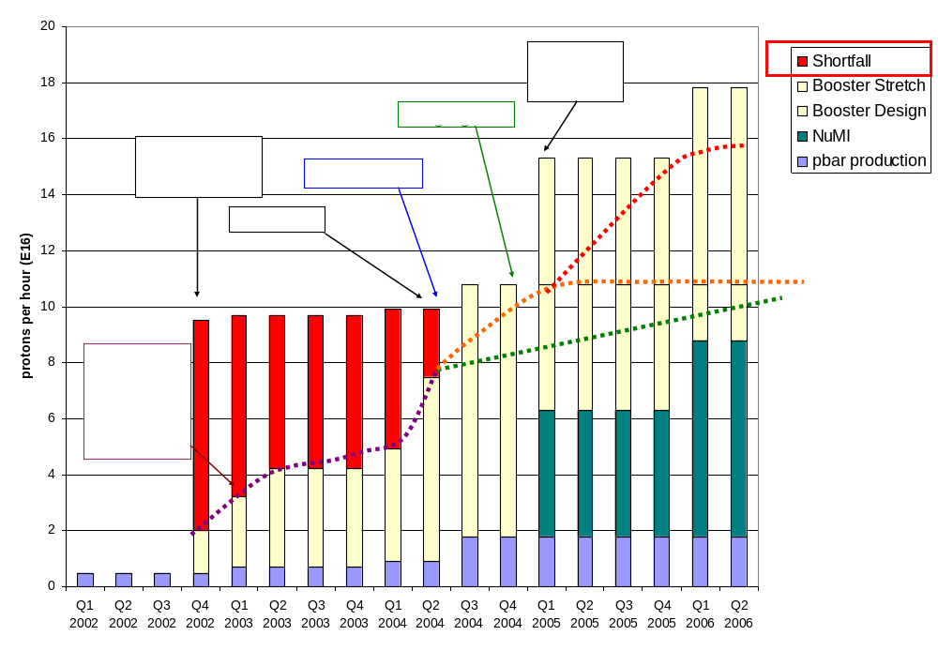
Making Projections (shown to PAC)
Stretch
7.5 Hz
“design”
Conservative

Slide 10
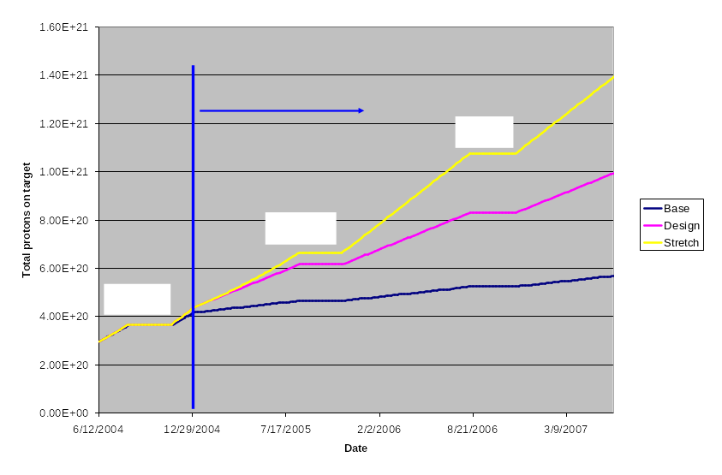
Protons to MiniBooNE (shown to PAC)

Slide 11
Comments on Pack Meeting
Things I said (for the first time):
  We have demonstrated NuMI intensities.
  I believe we will demonstrate full MiniBooNE instensity soon.
  I believe we can run the 8 GeV line at some level when NuMI comes on.
General impression:
  Committee was impressed and supportive
  Want to see “design goal” expanded to include estimate of effects of shutdown work
  “Stretch goal” should disappear

Slide 12
Near Future
Will discuss Watt limit tomorrow
  Probably raise to 525W
Trying to find and optimum collimator configuration that achieves adequate loss reduction around the ring with the minumum increase near the collimators.
In the near future, will at least demonstrate full MiniBooNE intensity.
Still hope to hit full intensity soon.

Slide 13
Shutdown Prep
Long 13 dogleg work
  On track
  Will begin after 4 weeks of cooldown
  Expect big improvement
RF work
  On track for a 19th cavity and prep for a 20th
Kicker work
  Move period 9 girder to period 5 and rotate horizontal kicker to vertical
    Notch losses in less sensitive area
    New vertical kicker helps both extraction regions
  On track
Alignment
  Align RF cavities (requires new moving hardware)
  Complete 3D laser-tracker as found (on track?)
  Maybe to horizontal moves after a period of running
400 MeV line:
  Don’t rock the boat!

Slide 14
Gates Status
Shutdown ~13 weeks
Major Booster tunnel work
  Long 13
    4 weeks cooldown
    2 weeks for project
  RF work
    Tunnel: should be done in 6 weeks
    Upstairs: full preventive maintenance. Time: ?
Possibility of gates to let MiniBooNE get some beam before end of shutdown??
Problems:
  Recycler work planned in gated area through most of shutdown
  Already 30 technicians short. If resources can be found to install gates, they should be used to shorten shutdown.
  Booster RF schedule and turn-on needs still unclear. Can’t make beam promises.
AD Conclusion: no gates.
And now, on to Dave…

