Slide 1
Booster Status
Eric Prebys
FNAL Accelerator Division

Slide 2
Major Shutdown Projects
Linac
  Replace Quad 19 in tank 5
    Hot job
    Requires lots of planning and some fixtures
  Add window to tank 1 for laser chopping R&D
    Discovered ancient collimator; may be useful
  Upgrade of HEL LLRF
  Lots of water work.

Slide 3
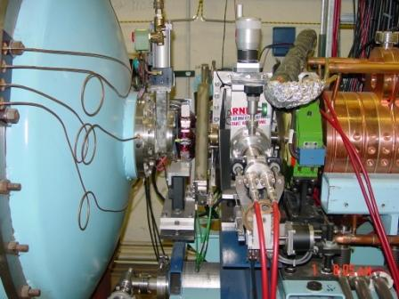
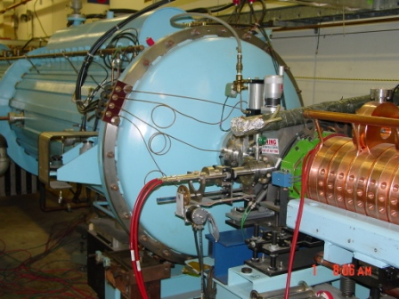
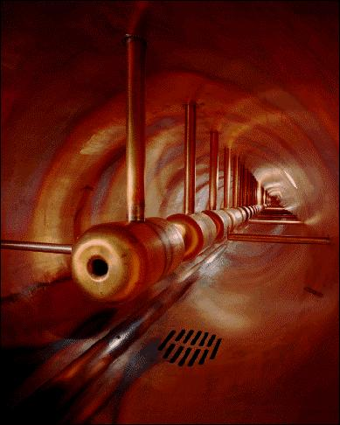
Tank 5 Work
Remove this stuff
Remove this endcap
Go in and replace quad

Slide 4
Booster
Period 13 rearrangement
  Improve dogleg problem
  Newer septa
19th cavity installation
  Use university-build prototype
  Higher batch size with good efficiency
  More reliability
Kicker girder move
  Notcher will now fire into collimator
  Extra 5th kicker for both extraction regions (when we get the power supply built)
3D laser-tracker alignment network and as-found.
  Use to plan vertical moves in the next year.
Vacuum controls upgrade
  Reliability

Slide 5
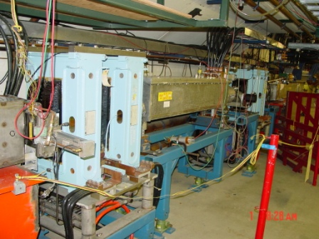
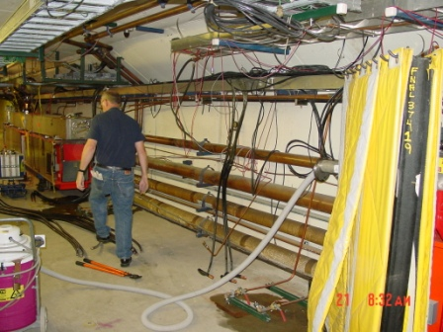
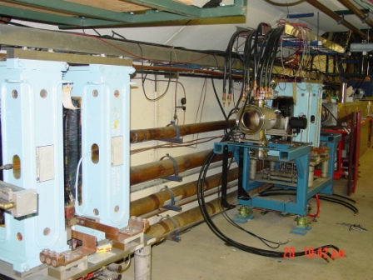
L13 Work
Step 1: Wait 4 weeks
Step 2: Remove Everything
Next: Put new stuff back…a little differently

Slide 6
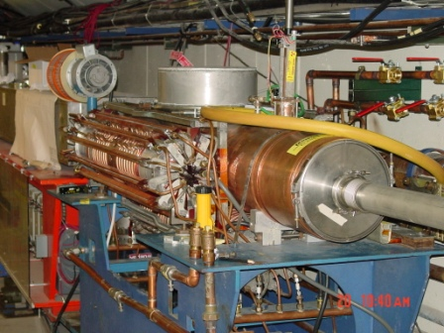
19th Cavity
Cavity and stripline are in place
Upstairs work is proceeding

Slide 7
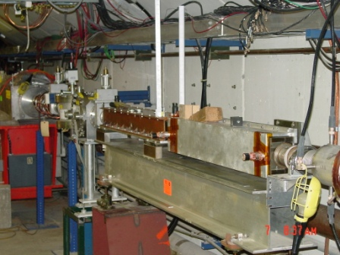
Kicker Move
Move this girder from period 9 to period 5
Rotate this kicker from horizontal to vertical (done)

Slide 8
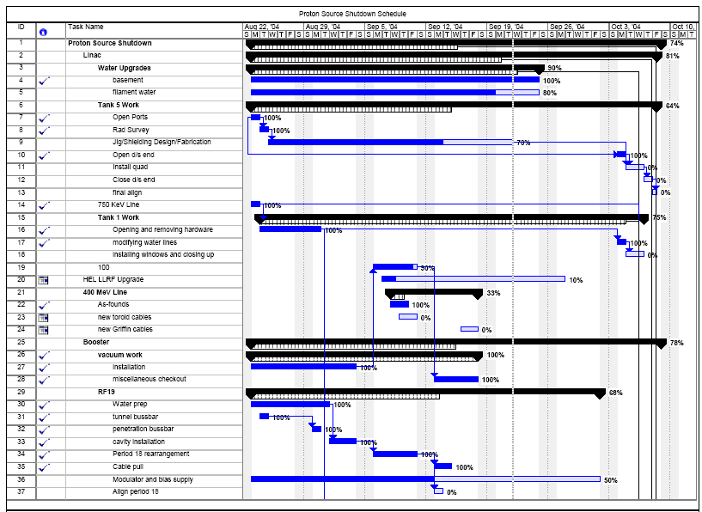
Schedule (1/2)

Slide 9
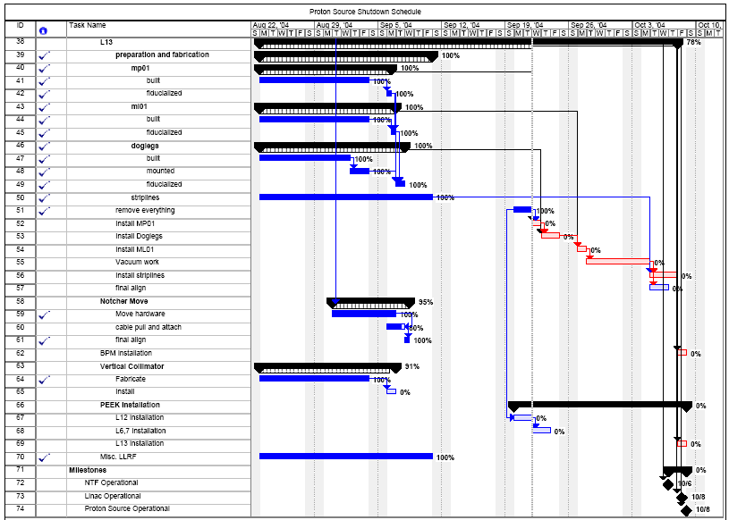
Schedule (2/2)

Slide 10
ORBUMP Project
Design finalized.
Ferrite arriving
  looks good so far.
Beginning to assemble first magnet
  Should be done in November
Power supply proceeding
  SCR switch complete
  Will use same charging supply as MP01/MP02
  Waiting for magnet measurement to order caps.
Hope for mid-2005

Slide 11
Proton Planning
NuMI
  Presenting a timeline for NuMI beam delivery, including
    Multibatch operation
    Mixed slipstacked-pBar/NuMI operation
    Full slipstacked operation
  Hardware Implications
    Aperture – new quads
    RF: dual PA upgrade (big $$$ soon)
MiniBooNE
  Plan to continue to run the 8 GeV line based on demonstrated performance
  Will run within loss limits in the Booster
  Timeline for rep. rate related upgrades
    Up to at least 10 Hz
    Branch-point issues for 15 Hz
  A series of aperture and beam quality improvements to reduce losses
  A study plan to determine the potential benefits of these improvements.

