Slide 1
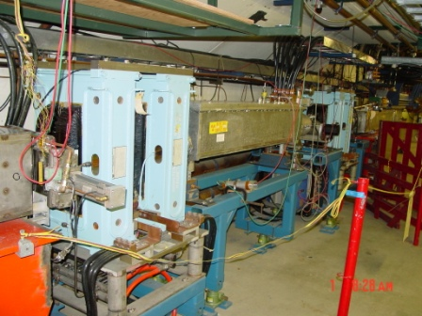
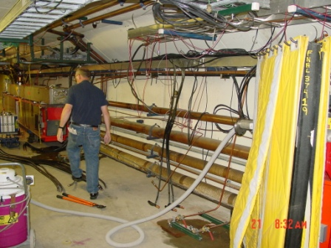
Long 13

Slide 2
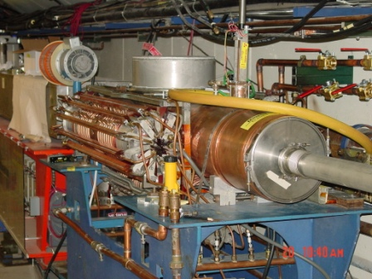
RF 19

Slide 3
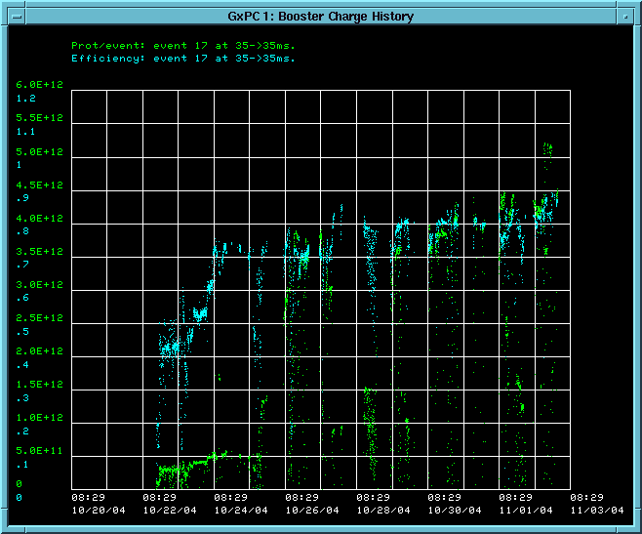
Timeline
Startup Milestones:
  October 13: Beam through linac
  October 22: Beam to Booster dump
  November 2: 5E12@80% efficiency
This was our trigger to begin studies

Slide 4
Studies – 11/8-11/14
Mon Tue Wed Thu Fri Sat Sun
Owl
Day
Eve
DC Studies
6 GeV Running

Slide 5
Studies – 11/15-11/21
Mon Tue Wed Thu Fri Sat Sun
Owl
Day
Eve
Tuning + Collimators
RF 19 Commissioning
Misc. studies
Beam officially up Nov. 27th

