Slide 1
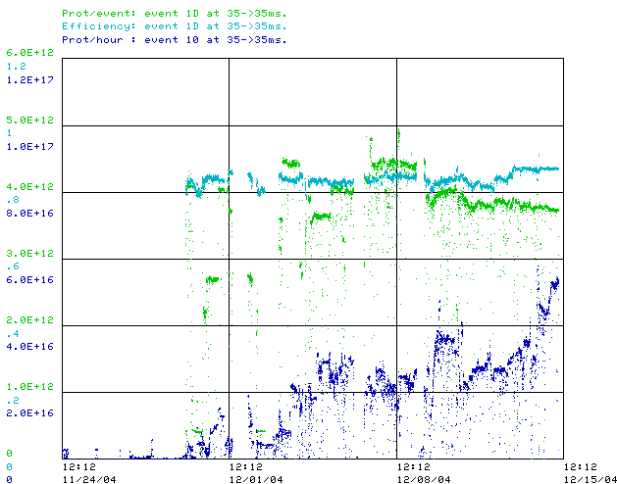
How are we doing (last 3 weeks)?
MB Efficiency
MB protons/batch
MB Rate (peak 5.4E16 pph)
MB Line tuning
BEX
issues
Tuning + collimators

Slide 2
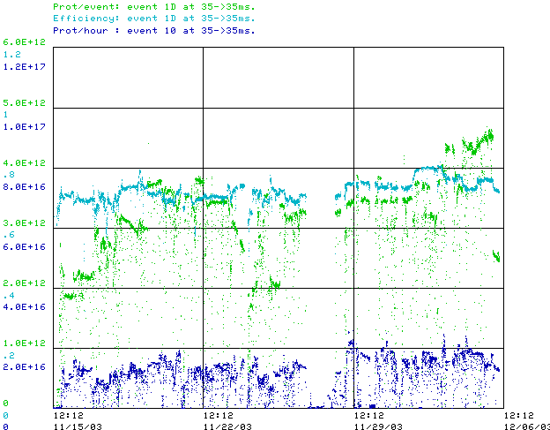
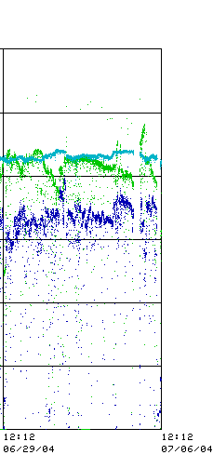
Some Comparisons
Last week
First 3 weeks after 2003 Shutdown
Best Performance (July 2004)

Slide 3
Issues
High field orbit issues
  BEX bump sagging
    Add prepulses
    Working to replace power supplies
    Magnet reconfiguration
  Magnet moves?
    Waiting on alignment data
Multi-batch extraction jitter
  Debugging cogging
  Fixed notcher problems
  Wider notch being considered
Period L5 alignment problems
  Communication problem during shutdown
  Realigned yesterday

Slide 4
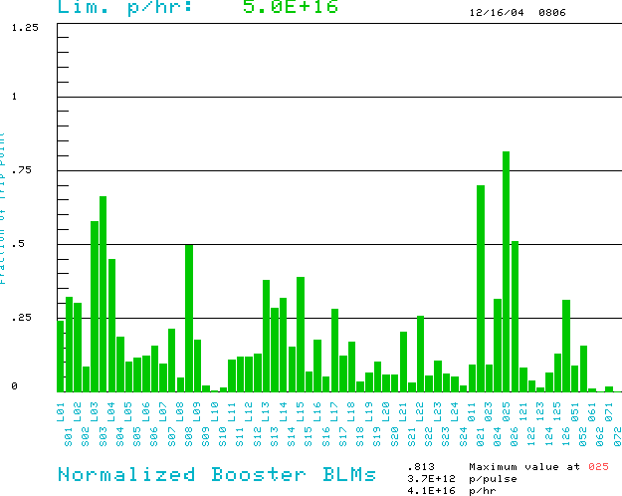
What’s Limiting Us?
Period 3 Extraction
Transition loss
Working to control orbit and transition losses

