Slide 1
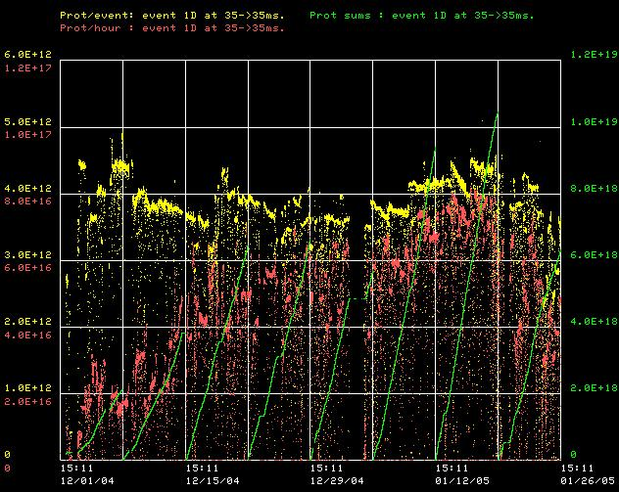
How are we doing?
Great!
Protons/batch
Protons/hr
Weekly totals
Lousy

Slide 2
Successes
Routine cogged operation to pBar production.
  Culmination of major effort
  Still a few bugs to work out.
Hit > 8E16 pph to MiniBooNE (limited by batch intensity)
  Proton plan says ~7E16 at this point
Routinely had > 7E16 pph during stacking
Booster operated >7Hz for extended periods with no problems.

Slide 3
Why has the last week been so bad
Things were looking good, but not perfect
  Problems hitting high intensity batches
    Excess beam motion in both planes
  Problems related to beam cogging
    Excess motion in horizontal plane
Things which have been done in the last week
  Remove one time break from ramped correctors (GOOD)
  Started from scratch for horizontal plane correctors (very painful)
  Changed extraction bump configuration (in progress)

Slide 4
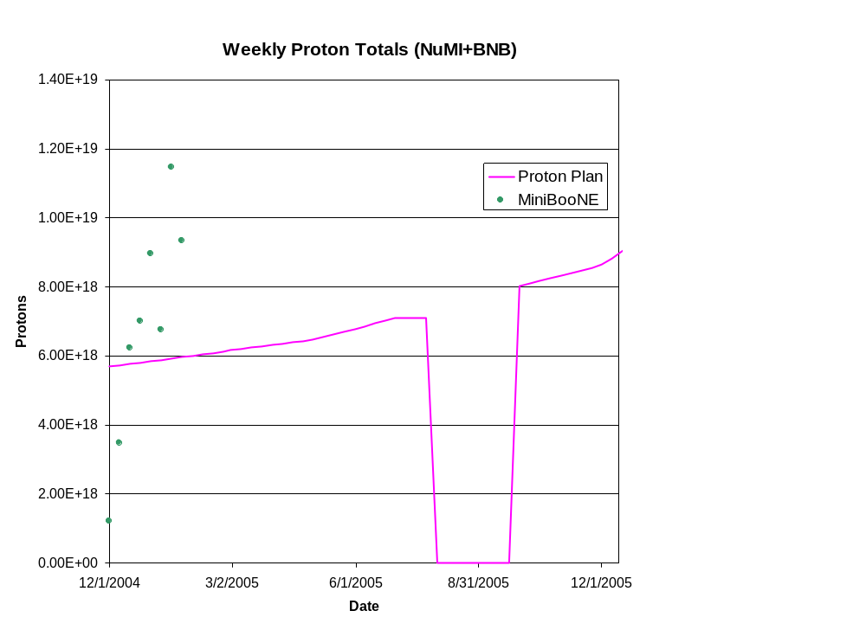
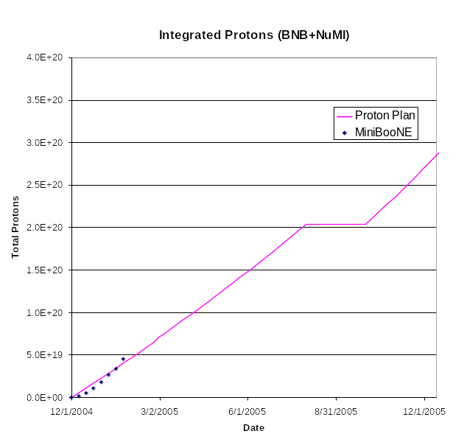
Projecting PoT
From Proton Plan…

