Slide 1
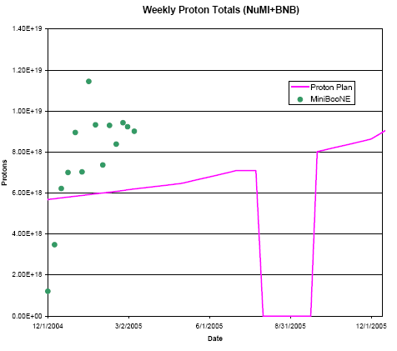
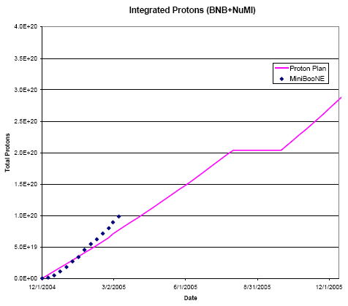
Beam Delivery
From Proton Plan…

Slide 2
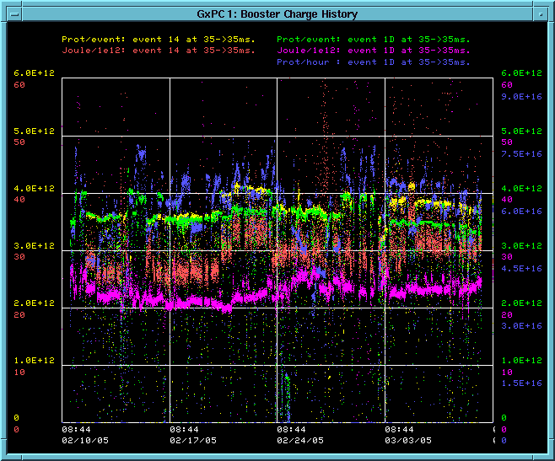
How are we doing?
Protons/hr (MBooNE)
Protons/batch (pbar)
Protons/batch (MB)
Joules/E12 (pBAR)
Worrisome!!!
Joules/E12 (MB)

Slide 3
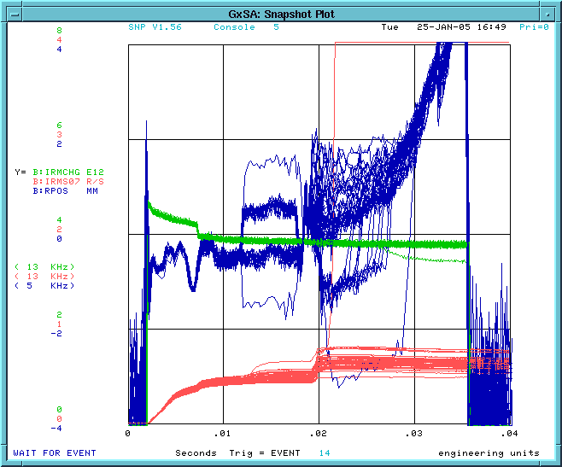
Cogging Losses
Cogging
Radial position
Booster Charge
Beam Loss

Slide 4
Worries
We’re doing OK in terms of total protons, BUT
We’re losing significantly more energy on cogged cycles.
This will become an issue when NuMI starts taking serious beam!
Working on problem
  Understanding loss patterns
  Better beam control
Proper beam cogging vital to continued MiniBooNE operation

Slide 5
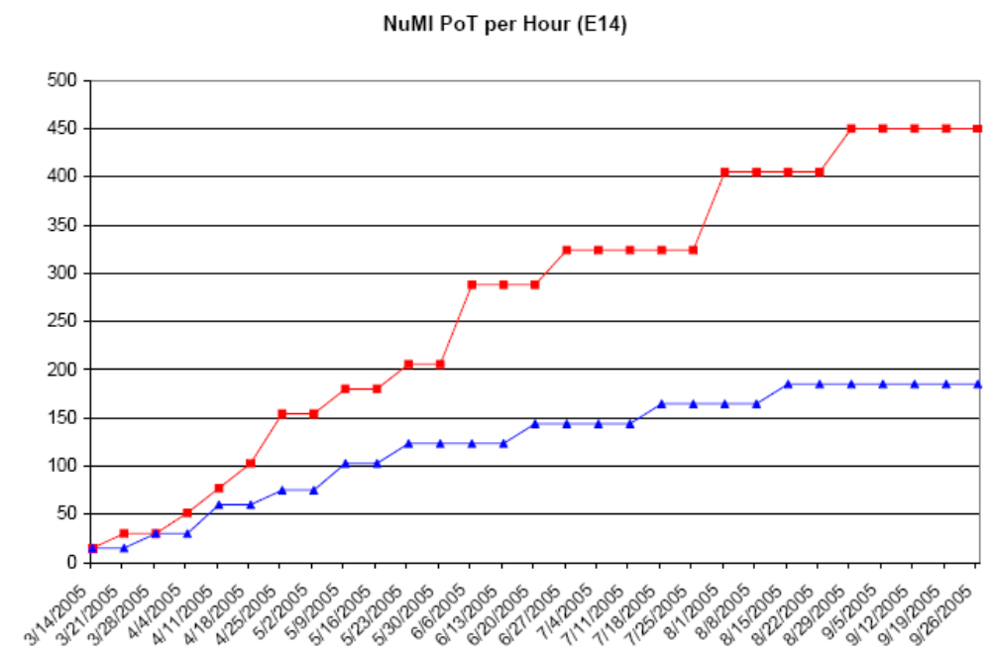
NuMI Turn-on Plan
EXTREMELY PRELIMINARY!!!!!
~half MiniBooNE

