Slide 1
Status of the Proton Source
Haud ignota loquor*
Eric Prebys
*I say things that are known

Slide 2
Fortitudine Vincimus¹
Booster performance has been steady and consistent with the Proton Plan since the shutdown.
We were anticipating significant beam lost to NuMI by this time, but Diis aliter visum² , and Malum quidem nullum esse sine aliquo bono³
As of April 3, habemus VeXX⁴
Ergo bibamus⁵
¹By endurance we conquer
²The gods decided otherwise
³There is, to be sure, no evil without some good
⁴We have 5e20
⁵Therefore, let us drink.

Slide 3
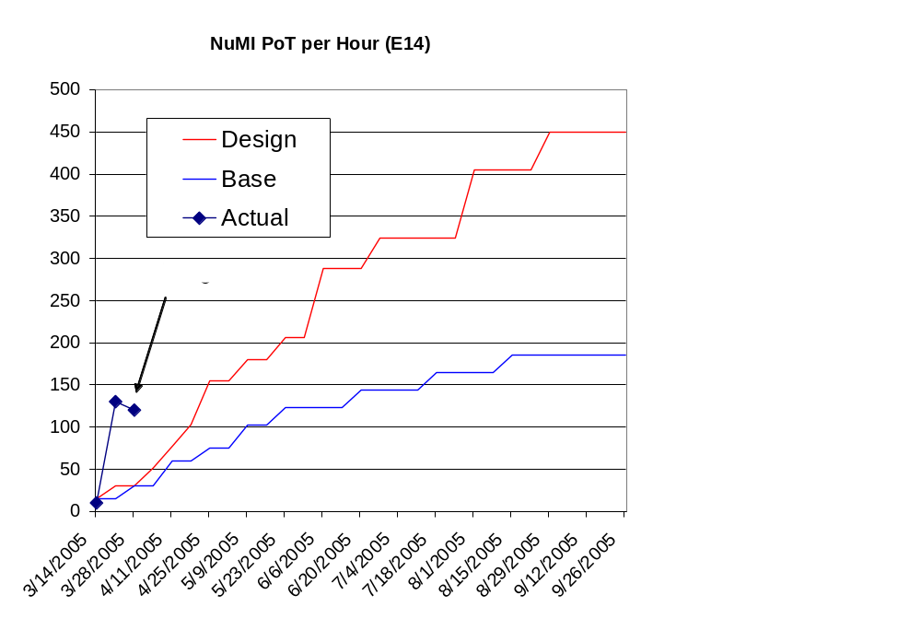
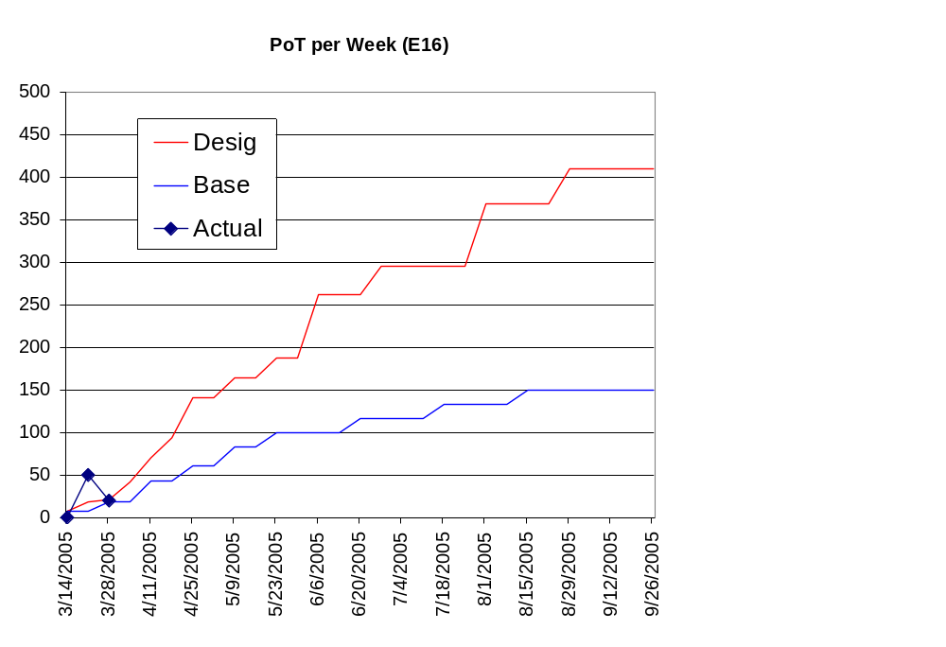
Initial NuMI Progress

Slide 4
NuMI Target Status
After two weeks of running, water was found in the oil of the vacuum pump which pumps out the target pipe.
A scan confirmed that the volume was full of water.
The target was removed and the water pumped out, but they have been unable to reproduce the leak.
They have returned the target with a “water letter outer” added.
Will attempt to run with a Helium overpressure in the target volume.
Probably begin to take beam early next week.

Slide 5
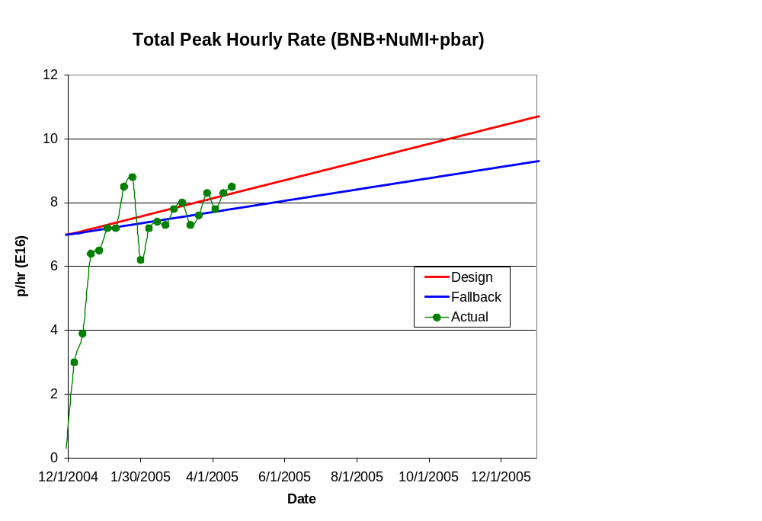
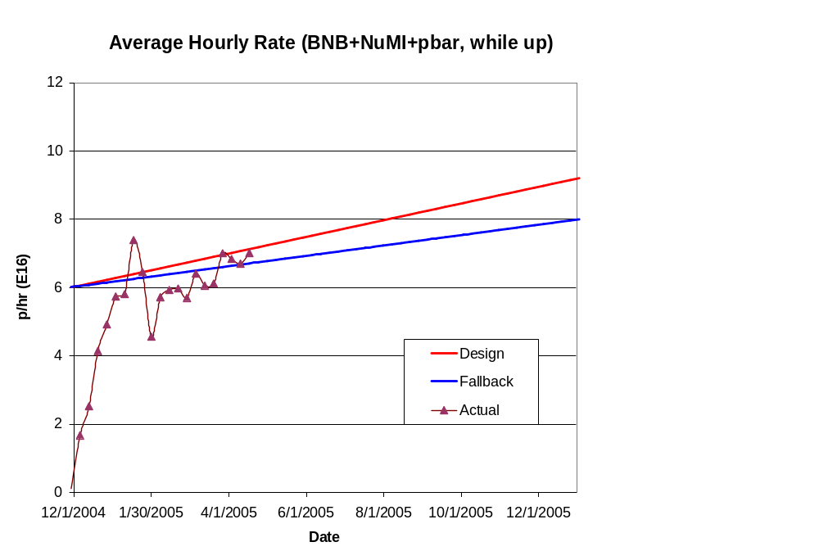
Hourly Proton Rate
Improved cogging stability

Slide 6
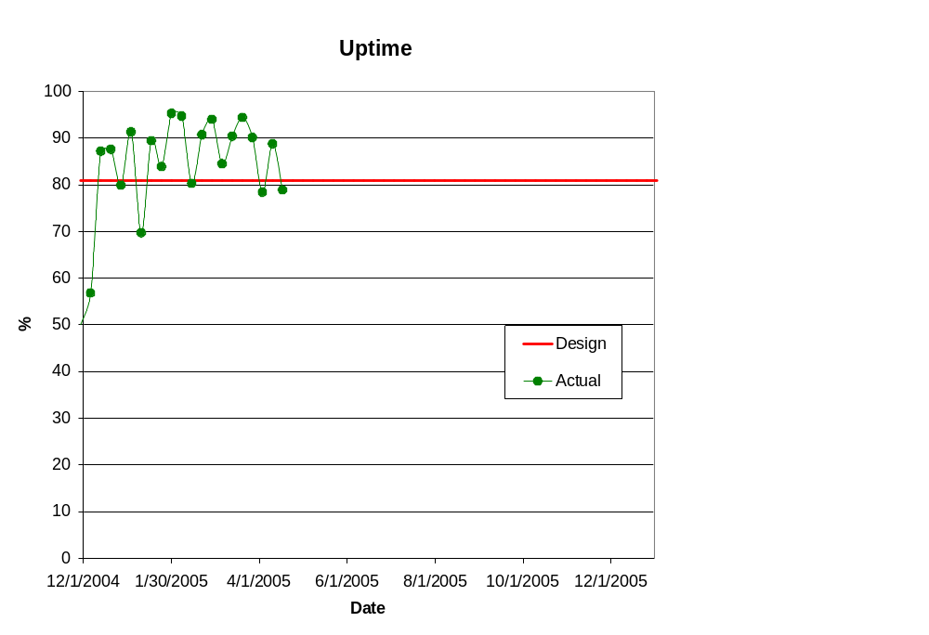
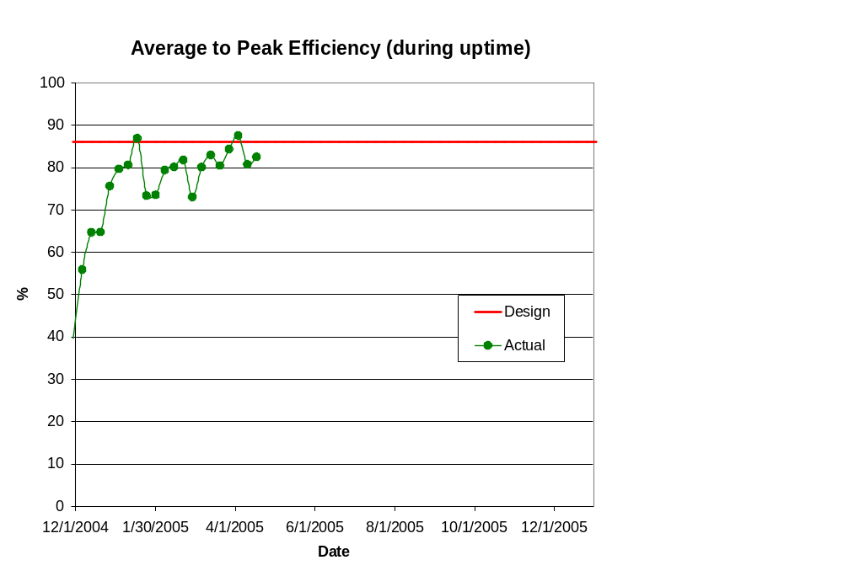
Efficiencies

Slide 7
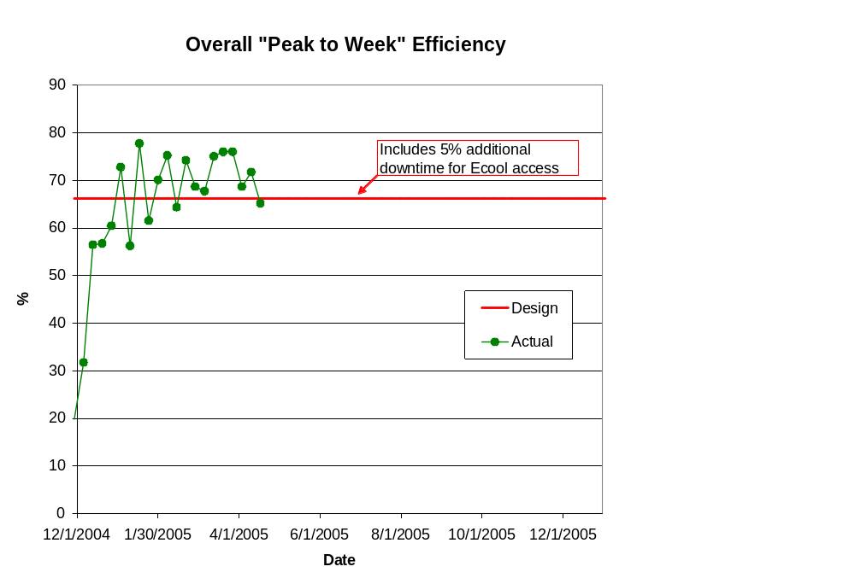
Overall “Peak to Week” Efficiency

Slide 8
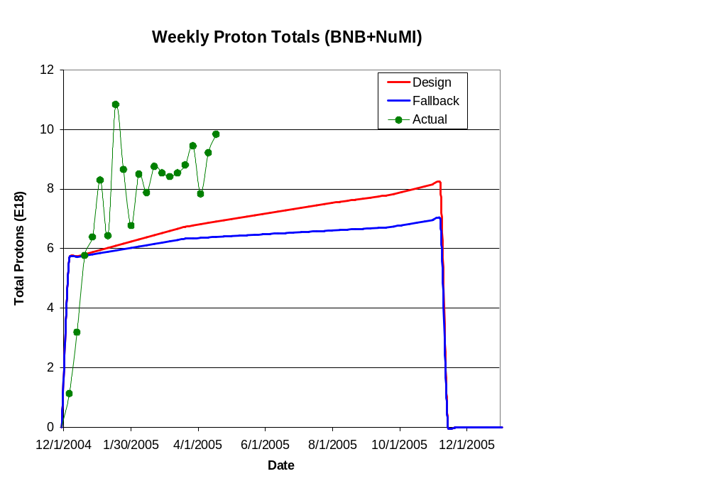
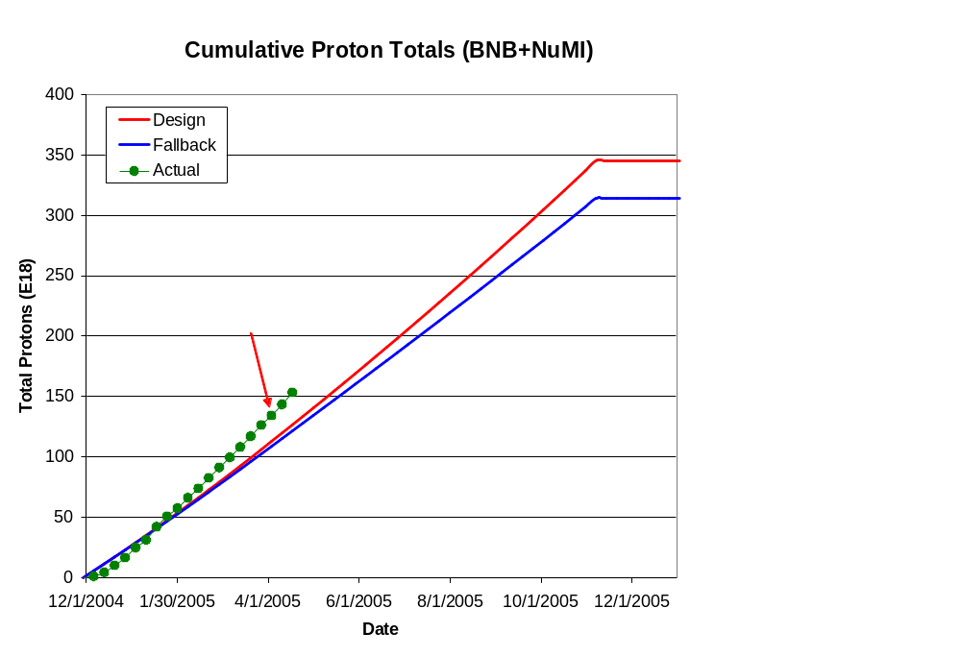
Integrated Delivery (BNB)

Slide 9
Issues
In terms of beam loss, we are doing very well
  Loss limit frequenty > 1E17 pph!
However, we have not been able to hit high batch intensities
  Typically 4-4.5E12
  MB intensity limited by 5Hz rate
This will become a bigger issue when NuMI comes back online
Now that cogging is working, reaching high batch intensities is a priority.
  Almost certainly related to our present slip stacking problems.

Slide 10
Major Ongoing Projects
ORBUMP system
  Major redesign of injection scheme
    3 magnets versus 4
    Eliminates problematic injection element (DCSEP)
  Magnet and power supply will be ready for the 2005 shutdown (likely to start Nov 1)
Dump reloction
  Booster dump will be relocated from Long 13 to the MI-8 line.
  This will eliminate one of the two extraction regions and should reduce loss significantly.

