Slide 1
Status of the Proton Source
Eric Prebys
*I say things that are known

Slide 2
General Status
NuMI target problems patched up.
  Now beginning to take significant beam
Wrestling with beam quality issues to NuMI and slip stacking
  Peak hourly rate fallen off a bit.
Higher rep. rates have resulted in significant RF reliability problems
  Investigating…
Sometimes instantaneous rep. rate problems with complex timelines
  Should improve when we lock to 2 second rep. rate.
Nevertheless, continue to deliver significant beam to MiniBooNE:
  Good news: cogging to NuMI not nearly as bad as we initially worried that it might be.

Slide 3
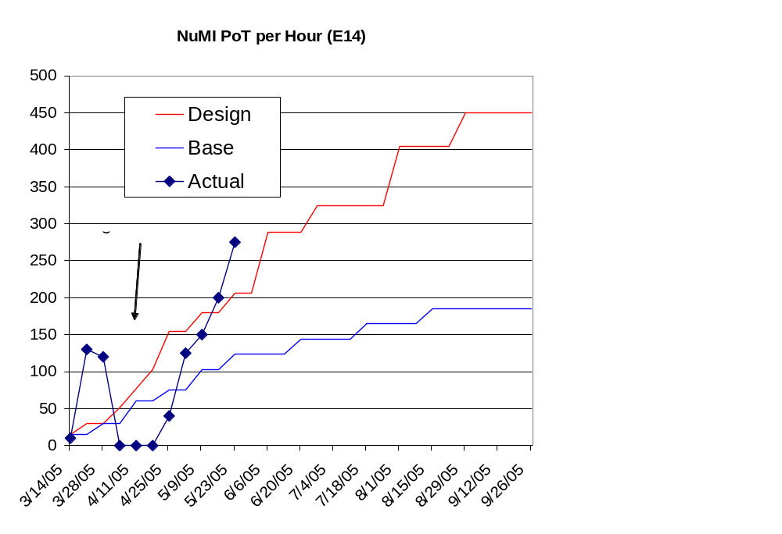
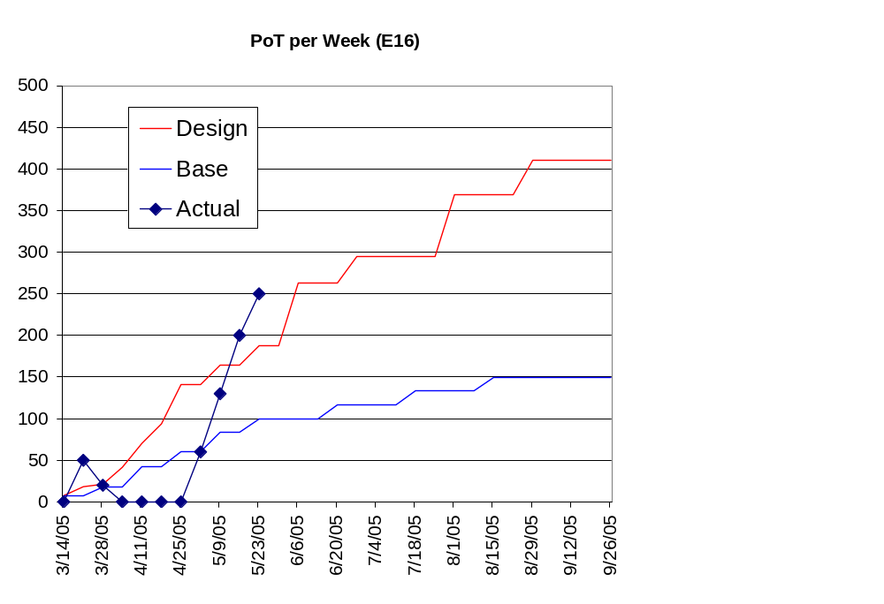
NuMI Progress

Slide 4
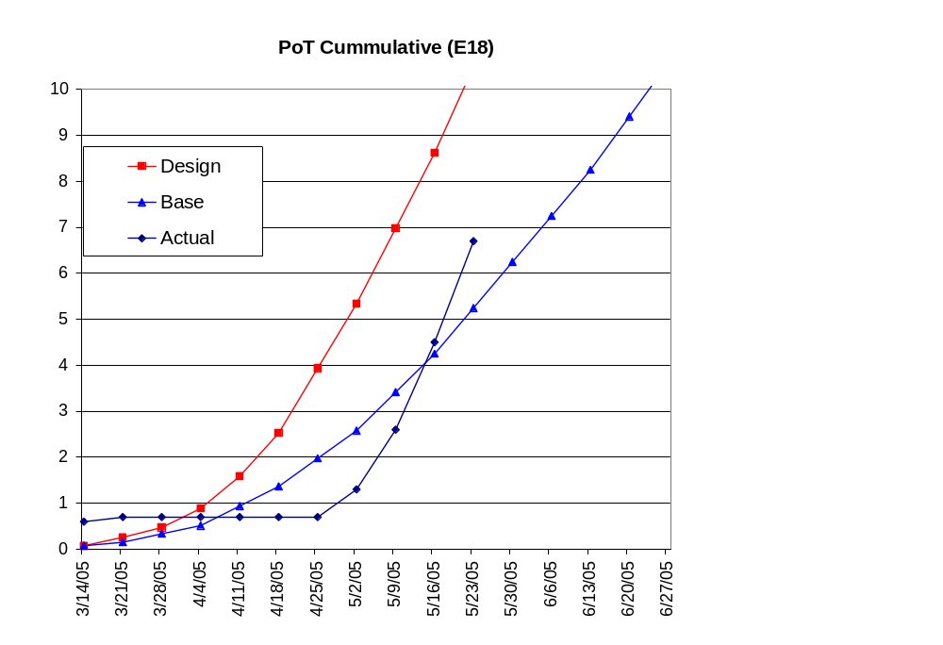
NuMI Catching Up

Slide 5
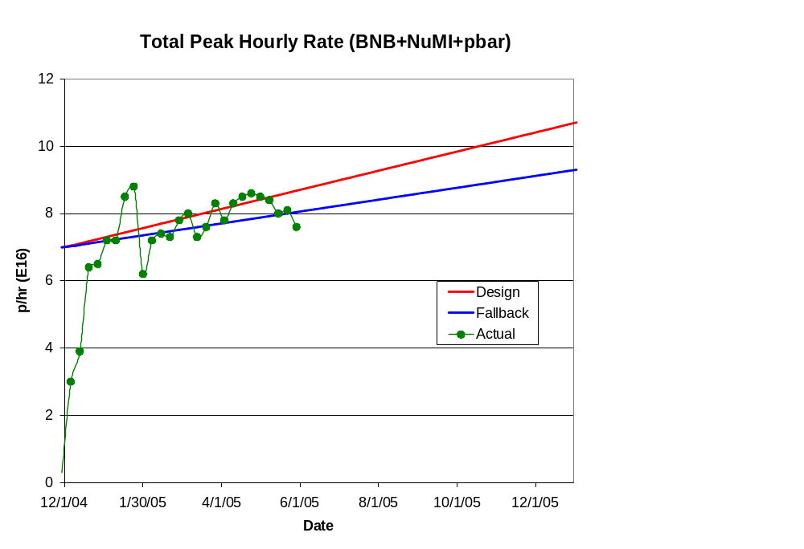
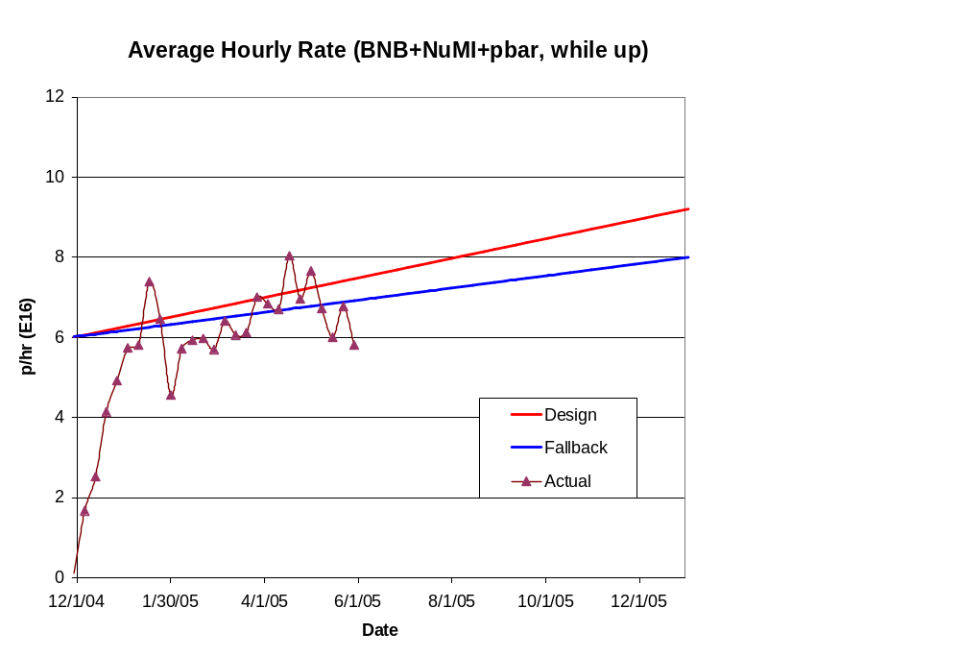
Total Hourly Proton Rate

Slide 6
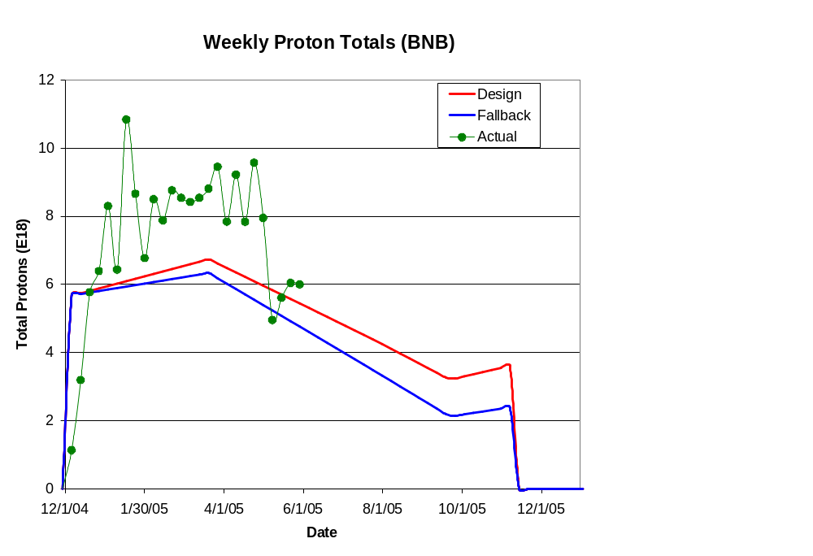
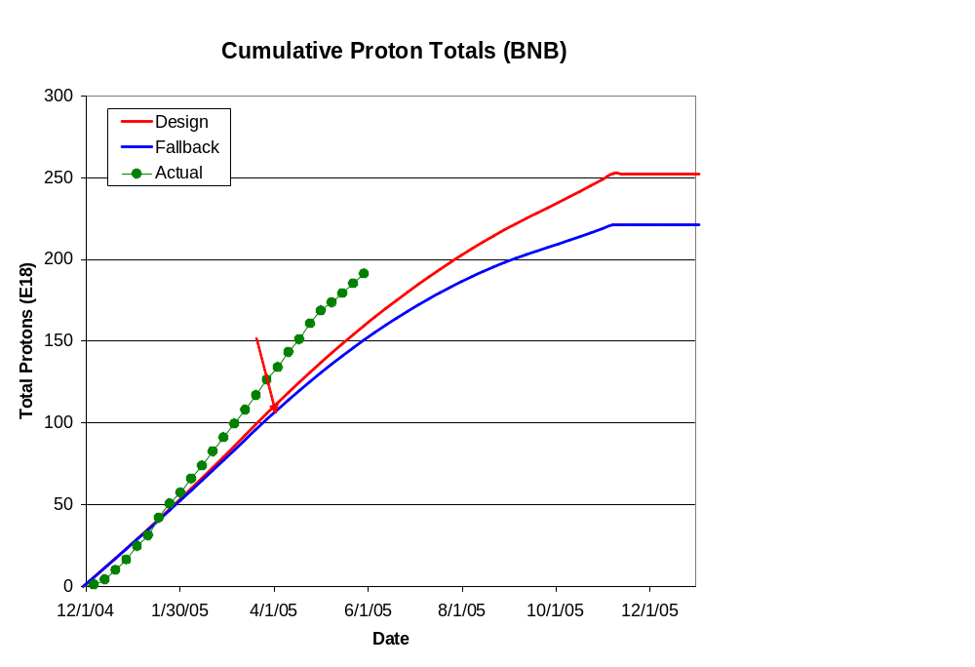
Integrated Delivery (BNB)

Slide 7
Major Ongoing Projects
ORBUMP system
  3 magnets complete
    Only need three, but first currently a spare
  Working on shimming scheme to improve field uniformity
    Probably OK as is, but will improve it if it’s not too hard.
  Girder and stripline design proceeding:
    New injection scheme only uses half the current-> stripline no longer needs to be water cooled!
  Power supply design complete and mostly fabricated
  Currently in final review.
Dump relocation
  Moving period 13 extraction to MI-8 line
  Progress on all fronts
Both projects in good shape for fall shutdown.

