Slide 1
Status of the Proton Source
Eric Prebys

Slide 2
General Status
NuMI moving along
  Ahead of schedule on per cycle intensity (~2E13)
  Have not yet locked complex to 2 second cycle
    Problems with pbar cooling
    Problems with MI losses on slip stacked cycle
    Average cycle time ~3 seconds
    Working on criteria for locking cycle
  ~more or less on schedule for total NuMI beam
Booster has calmed down a bit
  Rash of hot weather failures seems so have peaked
  Slip stacking “response team” work less disruptive
  More focus on reducing total losses and increasing total intensity.
Reduced cycle rate means less protons to pBar
  NuMI and MiniBooNE can be more or less on schedule even though total protons are a bit behind.

Slide 3
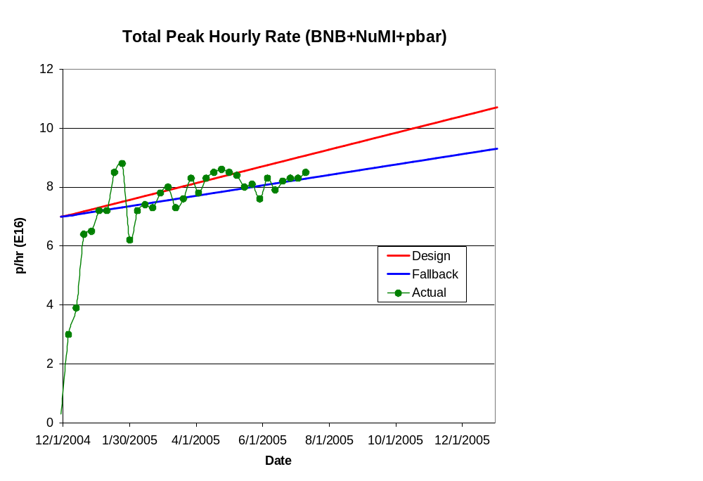
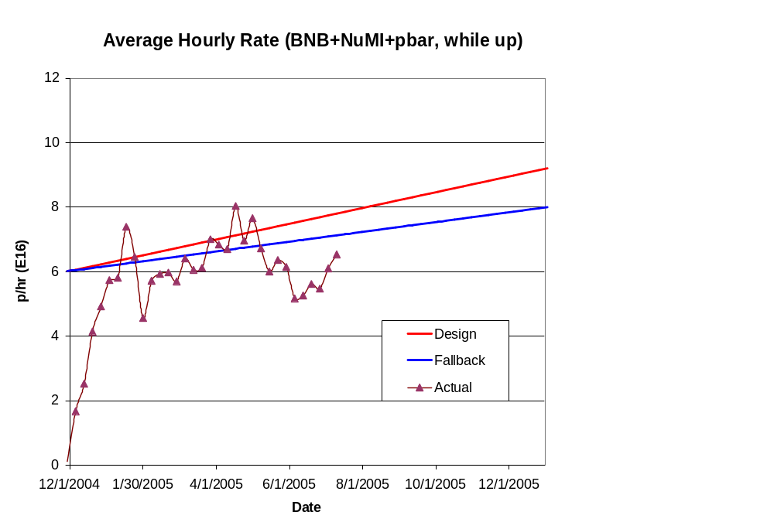
Total Hourly Proton Rate
“Summertime Blues” + focus on stacking issues

Slide 4
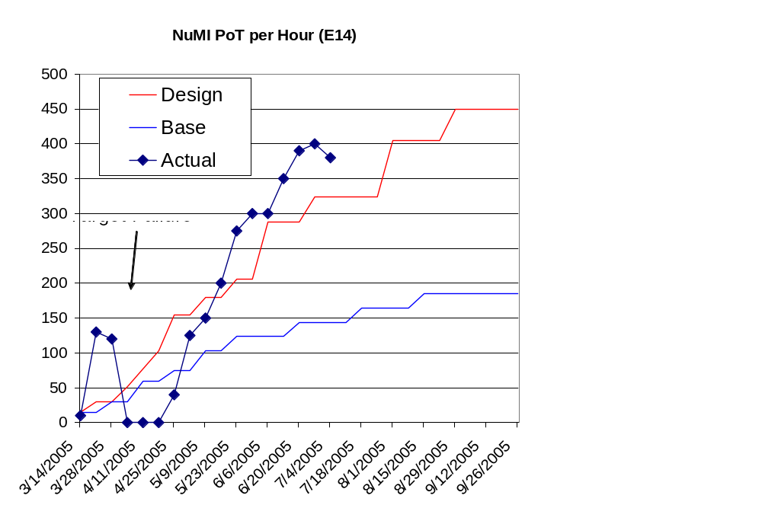
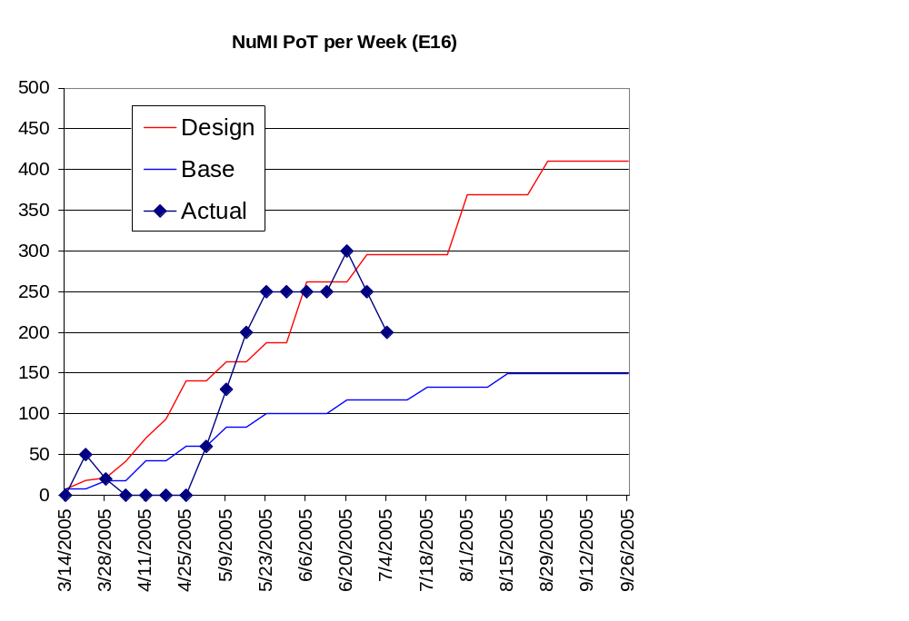
NuMI Progress

Slide 5
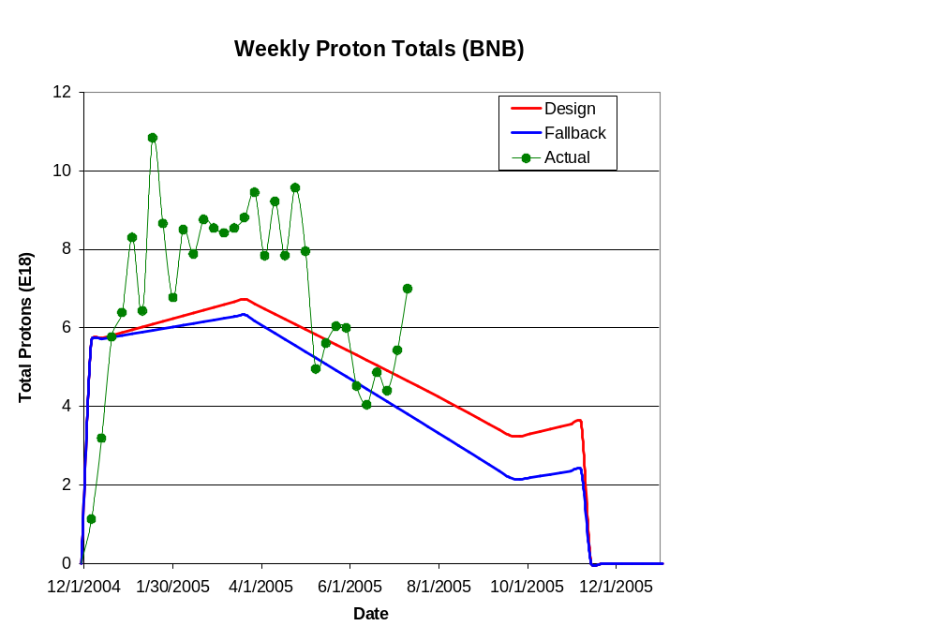
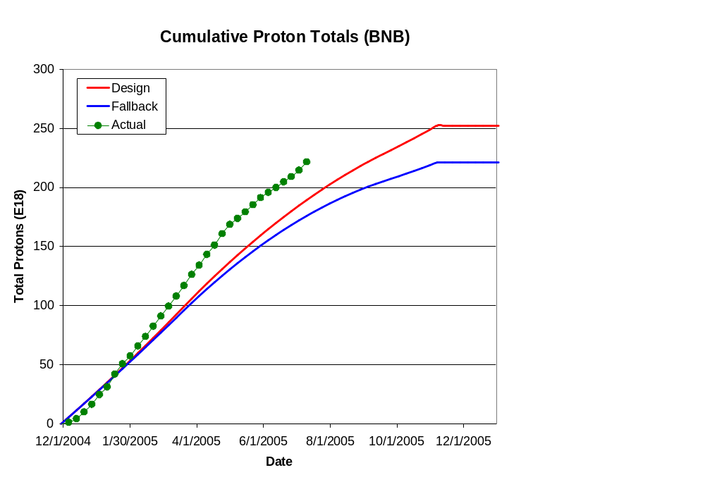
Integrated Delivery (MiniBooNE)

Slide 6
2005 Shutdown
Major Projects:
  ORBUMP + 400 MeV Line (F. Garcia):
    Preparation schedule in OK shape
    Need 28 work days + ~5 days cool down
  Dump relocation (B. Pellico):
    Preparation in good shape
    ~25 work days (no cooldown needed)
Shutdown schedule
  Tevatron Scheduled to turn off 10/31
    Driven by D0 Silicon Layer 0 upgrade
    13 weeks scheduled
  Options for Injector complex (Linac+Booster+MI):
    Remain up for ~4 weeks to do stacking and eCool studies:
      NuMI and MiniBooNE could run
      Pushes Booster work into Christmas (figure 2 additional weeks)
      Would push to turn off MB and NuMI 1wk before
    Shut down promptly on 10/31:
      Defer studies until end
      Complete work just before Christmas
      Consider shutting down or reducing NuMI and MB ~1 week beforehand
  Still possible we might bag the whole thing until the spring
  Hopefully, things will firm up at the next Run II PMG (7/20)
Favored by division

Slide 7
Longer Term (Proton Plan Status)
Internal review next week
  New design handbook
  New cost and schedule
Major changes
  Full circle on Main Injector RF
    Existing system can go to ~5.9E13 protons
      ~Enough for slip stacked pBar and NuMI (2+9) operation
    Don’t need complete dual RF upgrade
    Good news for MiniBooNE: This frees up money and manpower for Proton Source projects:
      Full blown Booster corrector upgrade
      Linac LLRF upgrade
      Major Booster RF modulator refurbishment
    Bad news for MiniBooNE:
      Will likely start slip stacking to NuMI some time on 2006, rather than 2007

