Slide 1
Booster Performance
Eric Prebys

Slide 2
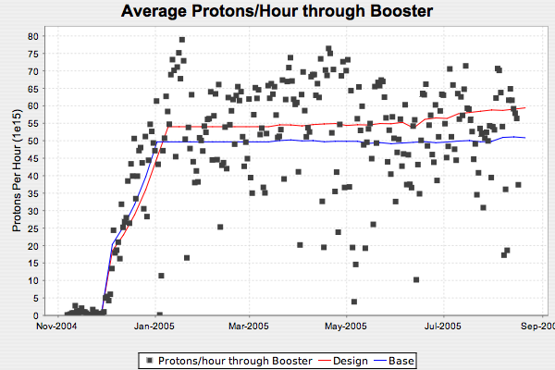
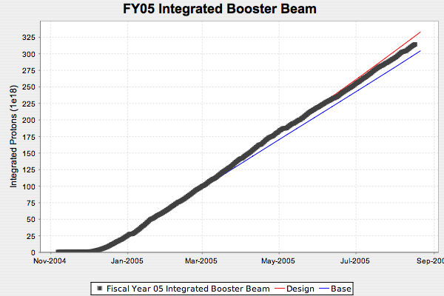
This Year: Total Proton Rate*
*Thanks to Paul Derwent for “Run II-style” automated proton delivery plots

Slide 3
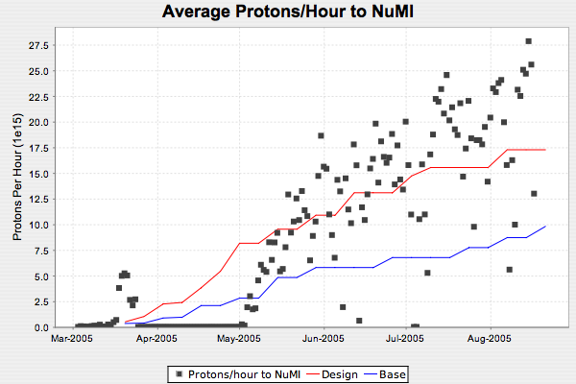
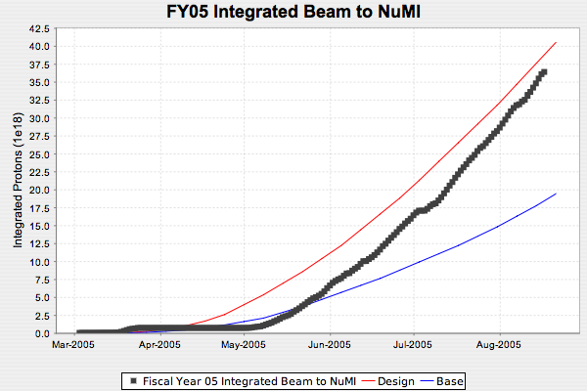
Protons to NuMI
Almost caught up
NuMI Target Failure

Slide 4
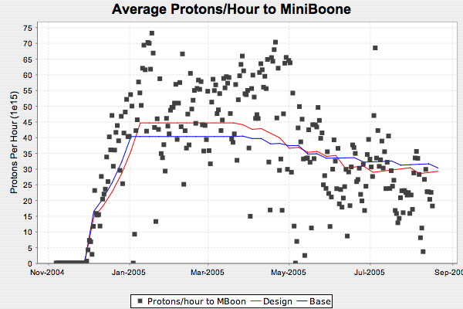
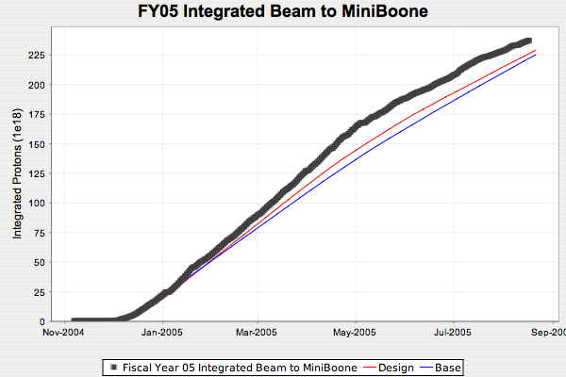
MiniBooNE
Benefited from NuMI’s problems

Slide 5
Near Term Plan for MiniBooNE Beam
Plan A:
  Accuse NuMI of being "a launching pad for Communist infiltration and Muslim extremism” at Fermilab
  Ask Pat Robertson to ask the President to have them all killed.
Plan B (If you don’t have the guts for Plan A):
  Spend less time in reviews
  Work to increase batch intensity to MiniBooNE, even if it costs intensity in the short term
  Encourage operations to stay closer to beam limits
    MiniBooNE MUCH more sensitive to margin now that NuMI is running
    Sent letter to operations to this effect
  Monitor beam power loss (B:BPL5MA), and consider raising it if it becomes consistently the limiting factor

Slide 6
Shutdown Planning
ORBUMP/400 MeV line Project
  Magnets nearly complete
  Girder out for bid (critical path)
  Installation plan in good shape
Booster dump relocation
  Plans in good shape
  Waiting to let contracts until shutdown date set
  West Tower settlers are reluctant to leave and may have to be removed by force.
Both projects still on track for Oct. 31st shutdown
  Final decision to be made ~9/3

Slide 7
Longer Term Planning
Just survived “Proton Plan” review
  Closeout this afternoon
  Expect it to go OK
One way or another, expect to go head with shutdown projects
  Expect significant loss reduction
Next major benefit for 8 GeV line is Booster corrector upgrade
  Scheduled for 2007 shutdown…
  …if nothing goes wrong

Slide 8
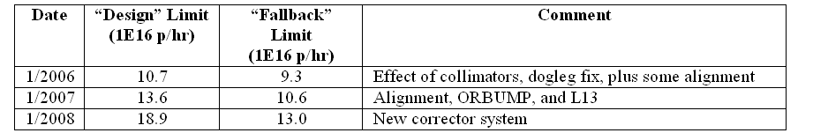
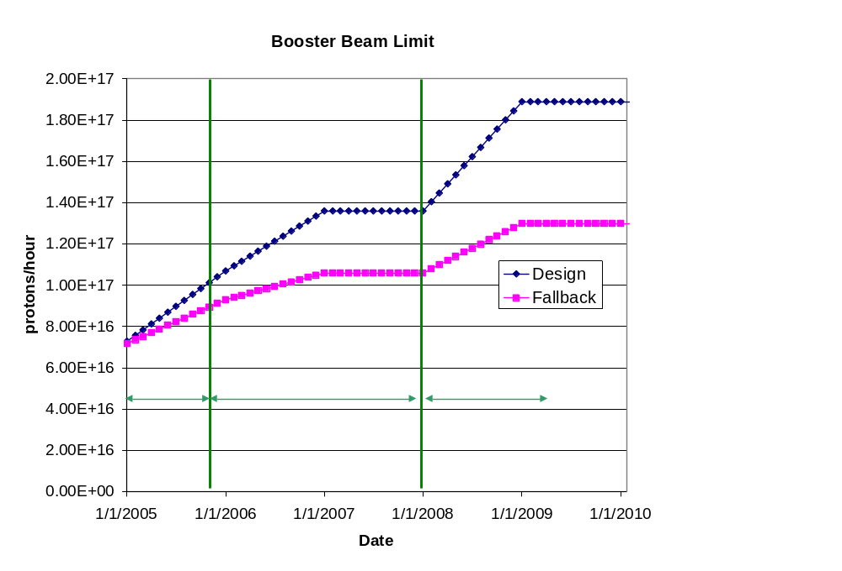
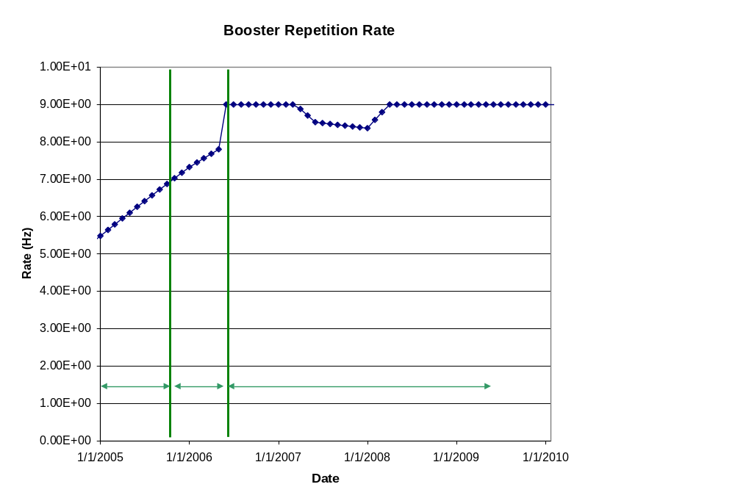
Peak Booster Intensities (increased from Plan V1)
“Peak” values
Low intensity slip stacking to NuMI

Slide 9
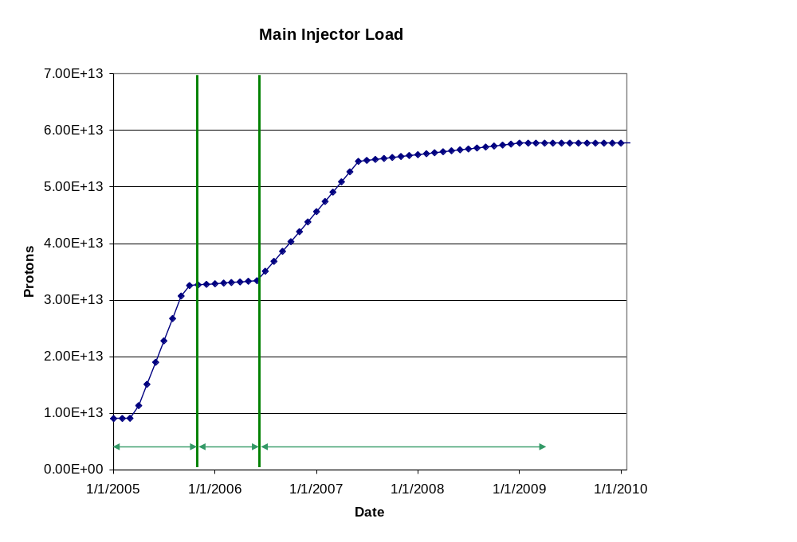
Machine Loading

Slide 10
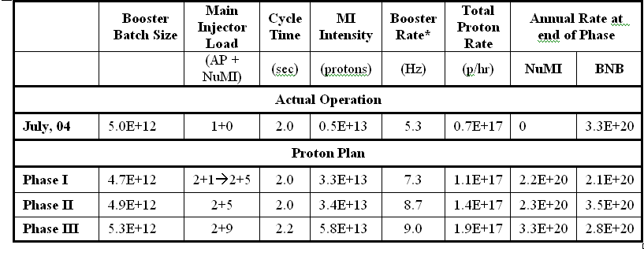
“Design” PoT
Peak values
Averages

Slide 11
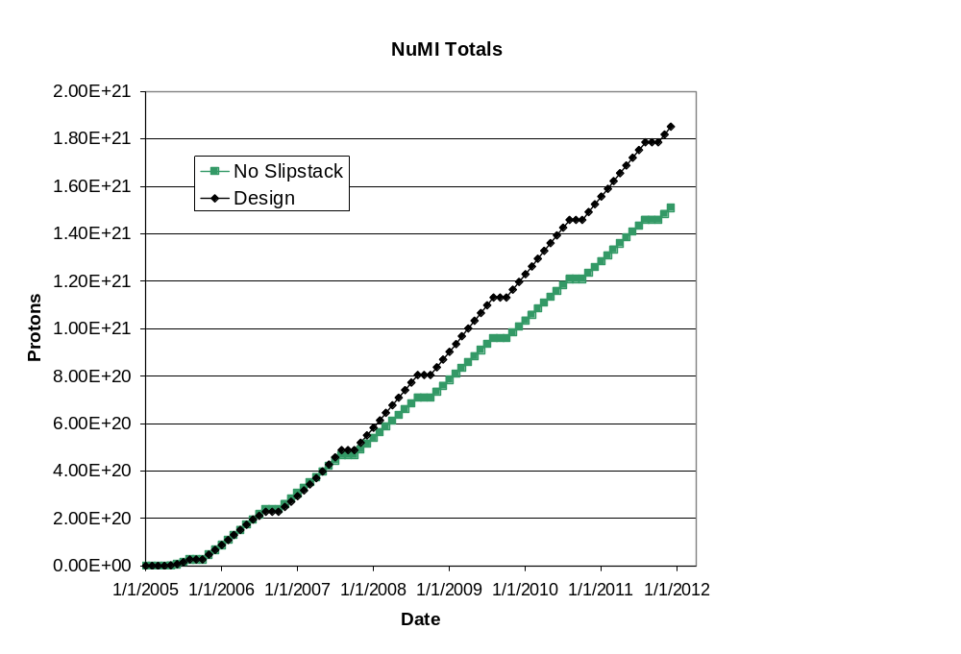
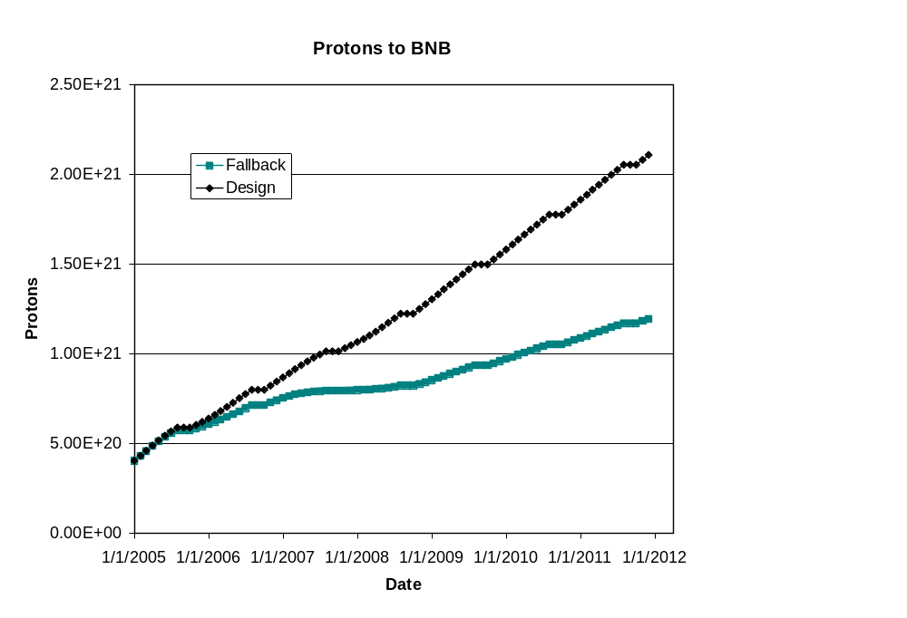
Cumulative Totals
Post Collider
Post Collider
Note: these projections do not take into account the collider turning off in 2009
  NuMI rates would go up at least 20%
  Possibly much higher with Stage II improvements

