Slide 1
Booster Status
Eric Prebys

Slide 2
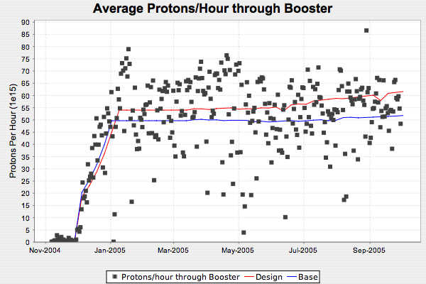
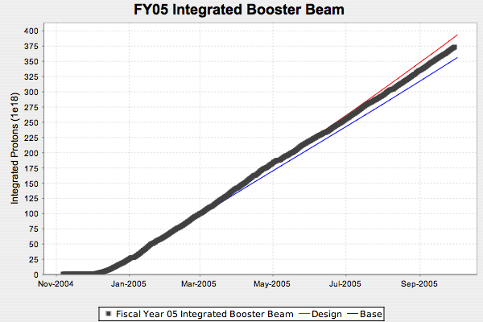
This Year: Total Proton Rate*
*Prior to NuMI problems

Slide 3
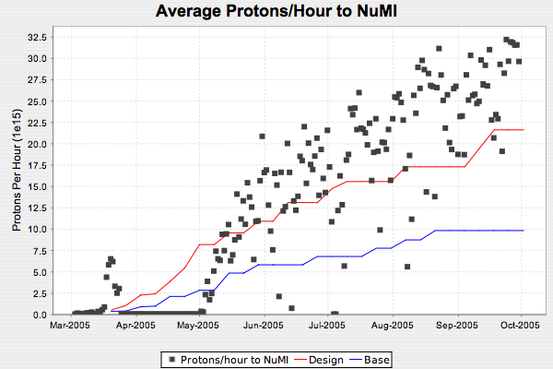
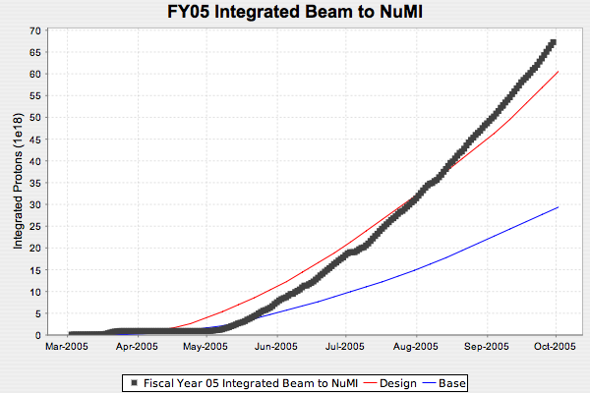
Protons to NuMI
NuMI ~at max until slip stacking (won’t happen before shutdown)

Slide 4
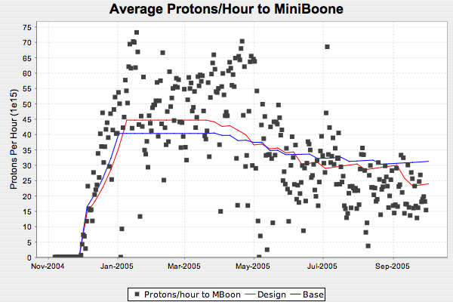
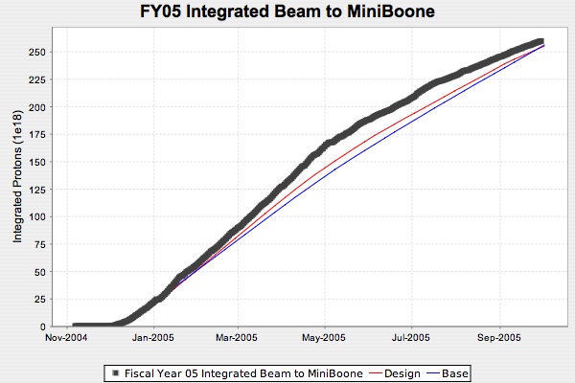
MiniBooNE

Slide 5
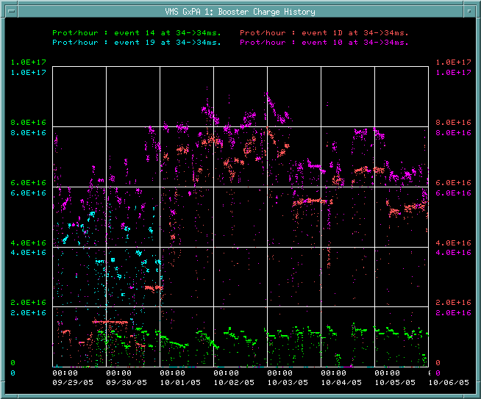
Since NuMI Horn Problems
NuMI horn fault
MiniBooNE
NuMI

Slide 6
NuMI Horn Problems
Ground fault in second horn
Probably in strip line that goes through shield block, caused by Nickel plating that is flaking off.
Horn II has been moved to hot cell.
Will disconnect stripline to isolate problem
  If stripline, then replace with spare, BUT
    Horn 1 showing same flaking, might also need spare
  If horn, either float, or run with only one horn
Timescale: “weeks”
MiniBooNE rate 2 to 3 times higher w/o NuMI

Slide 7
Longer Term
Tevatron shutdown nominally scheduled for 14 weeks, starting Feb. 6.
Injector complex either
  Same 14 weeks
  Remain up for 4 weeks at the beginning for pBar stacking studies (could also run MB and NuMI)
Scenario determined mostly by manpower, but
  If long shutdown, can probably run MB and NuMI flat out until start
  If shorter shutdown, will probably shut down NuMI and MB one week before injector complex (i.e. the difference would be 3 weeks to the experiments.
Working on FY06 “blue” and “red” curves, assuming 14 week shutdown.
  ~1.5E20 to MB

