Slide 1
Goals
Compare different methods of measuring POT to see if there are any systematic discrepancies
Use:
  Booster IRM sums (“B87”)
    Although not particularly well calibrated, the IRM’s are integrated locally, so the are inherently robust against ACNET DAQ problems.
  Minute by minute BooNE database (cal860)
  Cal860 as returned by DAQ
  Raw toroid information (available for last 2 months)
For the moment, no cuts
  Will investigate systematic trends of any cuts next

Slide 2
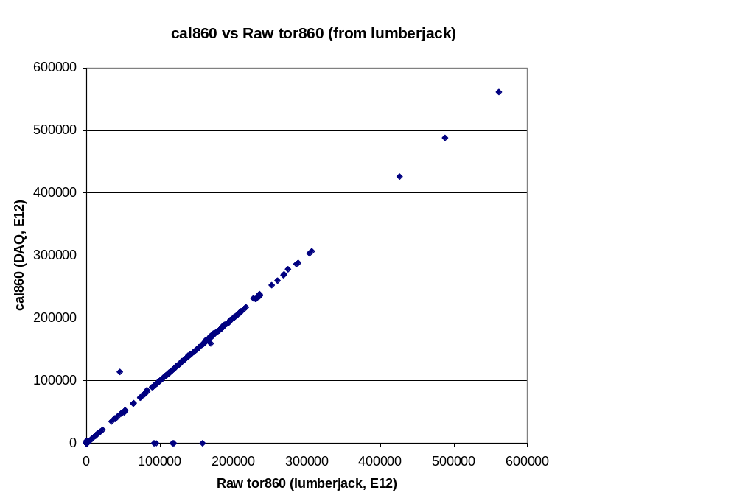
Cal860 vs raw toroid data

Slide 3
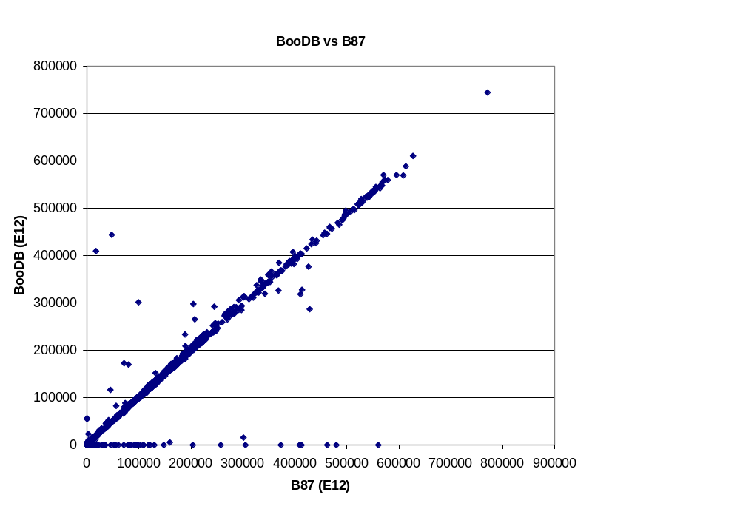
Minute by minute vs B87
No DB Info

Slide 4
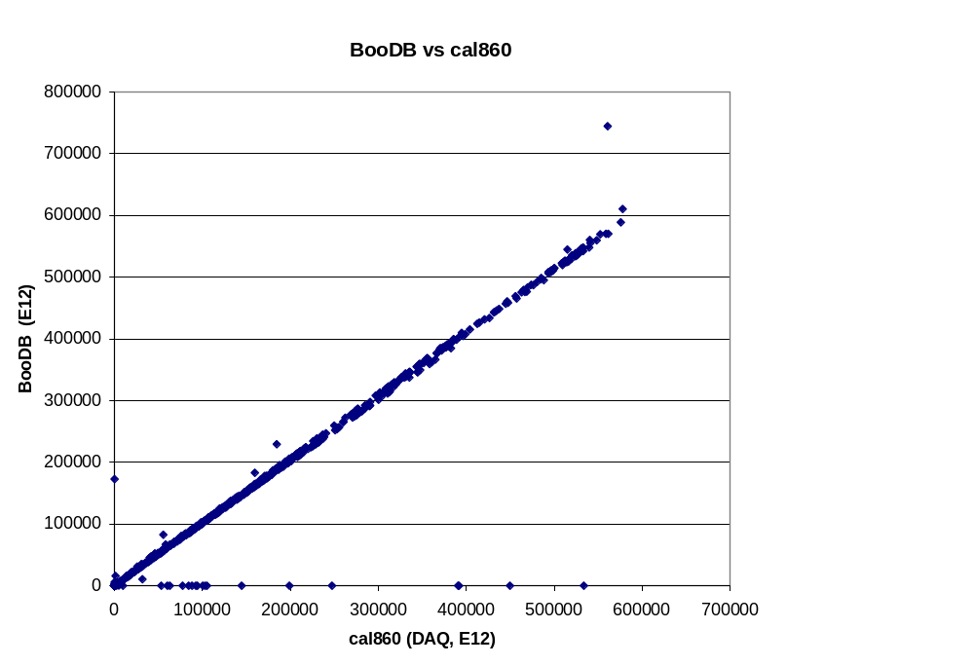
BooDB vs cal860 (DAQ)
No DB Info

Slide 5
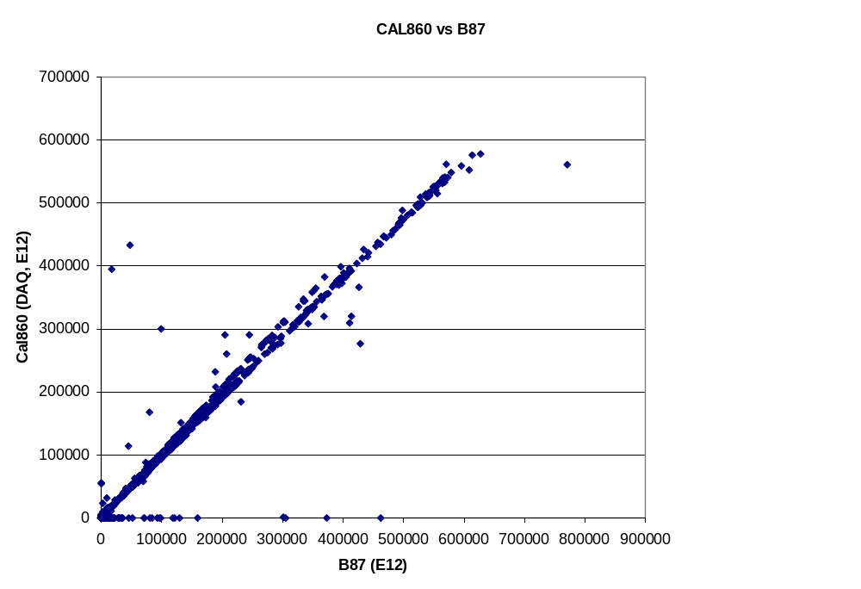
Cal860 vs B87
Less missing data, but still some

Slide 6
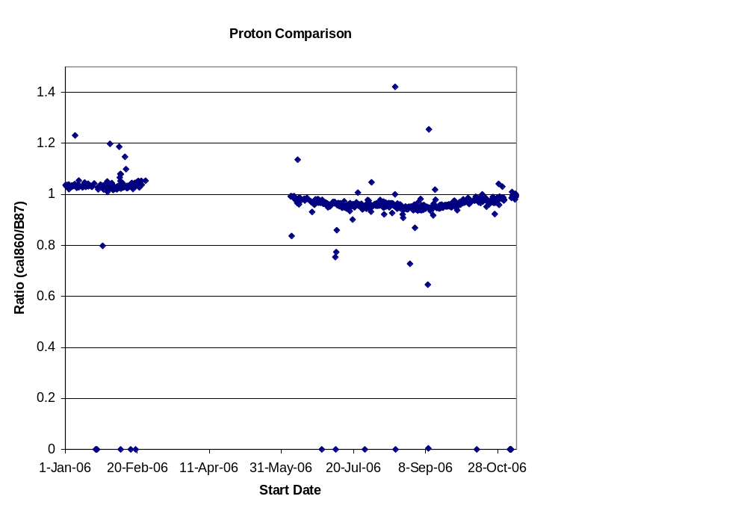
Compare cal860 to B87
Calibration change?

Slide 7
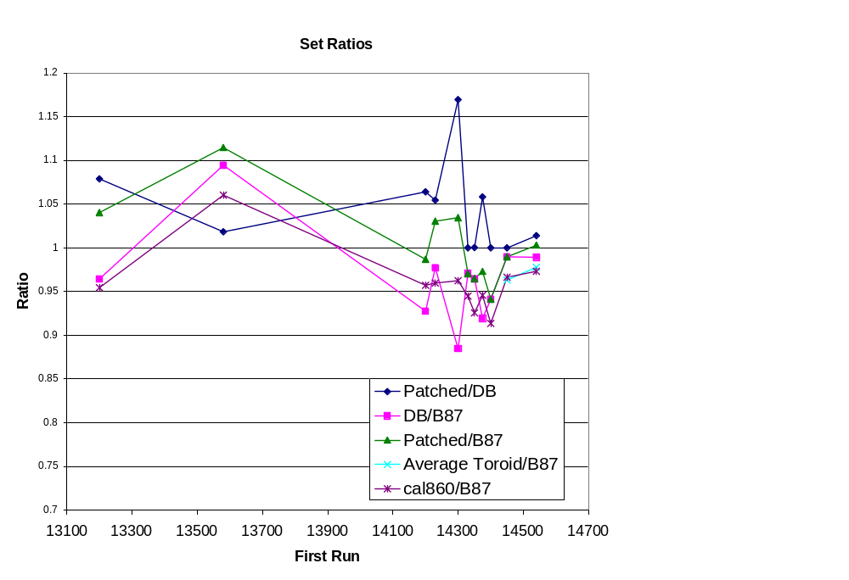
Compare for “Heather’s” Run sets
“Patched” = substitute B87 data for missing DB entries
Even though individual runs agree well, outliers cause pretty big differences for sums
Good agreement for recent running periods

Slide 8
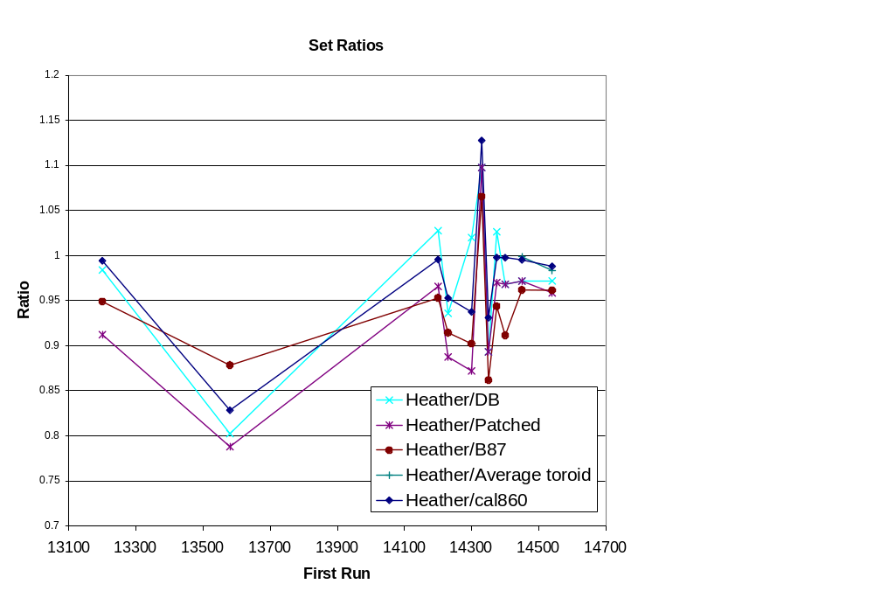
None seem to agree with numbers in her table
Something weird here!

Slide 9
Present Conclusions
Several very different methods give fairly consistent POT on a run by run basis, HOWEVER
Anomalous runs can cause fairly large discrepancies (~5-10%) when summing many runs
  In particular, quite a bit of missing data in minute by minute database
Still strange discrepancies between unfiltered POT sums, and filtered sums used by Heather
  Next thing to investigate

