Slide 1
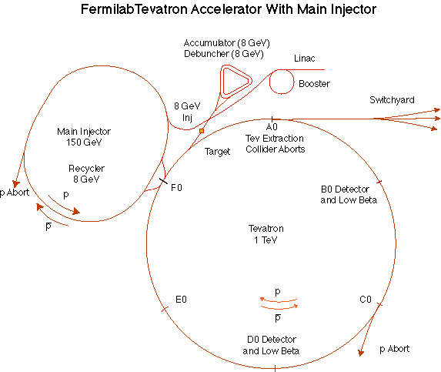
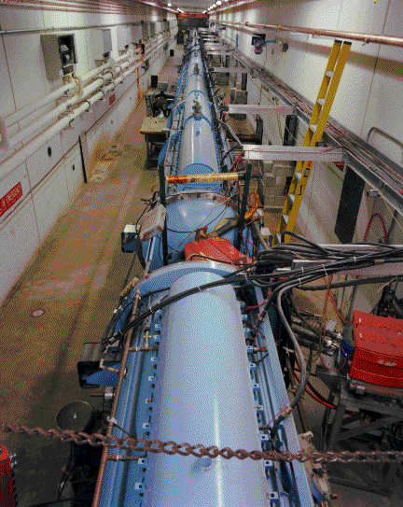
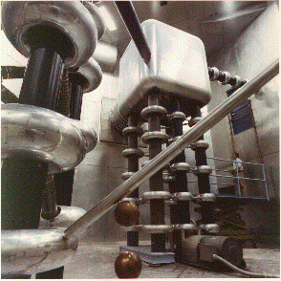
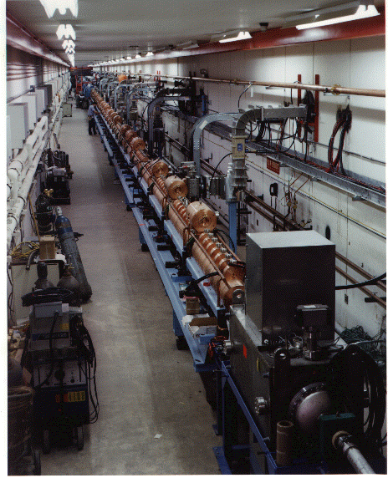
“New linac” (HEL)- Accelerate H- ions from 116 MeV to 400 MeV
“Preac” - Static Cockroft-Walton generator accelerates H- ions from 0 to 750 KeV.
“Old linac”(LEL)- accelerate H- ions from 750 keV to 116 MeV
g-2 meeting, September 3, 2008 - E. Prebys

Slide 2
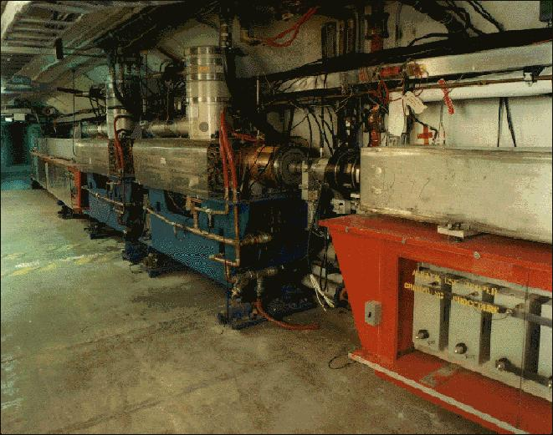
Accelerates the 400 MeV beam from the Linac to 8 GeV
  Operates in a 15 Hz offset resonant circuit
  Sets fundamental clock of accelerator complex
From the Booster, beam can be directed to
  The Main Injector
  MiniBooNE (switch occurs in the MI-8 transfer line)
  A dump.
More or less original equipment
g-2 meeting, September 3, 2008 - E. Prebys

Slide 3
Booster 15 Hz “batch” rate establishes a fundamental clock
Currently load 11 batches in Main Injector
  Period = (11(load) + 22(ramp))/15 = 2.2 s
    2 for pBar, 9 for NuMI
  Of the remaining 22/2.2 batches, send “as many as we can” to 8 GeV (see next slide)
NoVA era
  Preload 12 proton batches in Recycler to eliminate load time
  Shorten MI cycle to 20 tickes = 1.33 seconds
  Potentially 8 booster batches/1.33 seconds available
    = 6 Hz
    = 2.4e13 p/sec (assuming 4E12 batches)
    = 4.8e20 p/yr
g-2 meeting, September 3, 2008 - E. Prebys

Slide 4
Total proton rate from Proton Source (Linac+Booster):
  Booster batch size
    ~4-5E12 protons/batch, depending on beam quality required (assume 4E12 for high rate operation)
  Booster repetition rate
    15 Hz instantaneous
    Currently ~9Hz, limited by RF system.
  Beam loss
    Damage and/or activation of Booster components
    Above ground radiation
Historically our biggest worry
g-2 meeting, September 3, 2008 - E. Prebys

Slide 5
Beam loss
  Total proton rate limited by a set of beam loss monitors, which form a 100s running average
  Based on this, we could currently deliver about 1.6x10¹⁷ protons/hour, compared to 2.2x10¹⁷ needed by 15 Hz x 4x10¹² operation.
  Expect this improvement to come from new corrector system, which will be installed in 2009, under the Proton Plan.
Repetition rate
  Currently 9Hz
  Going to 15 Hz
    End cone cooling for RF tuners
    Refurbish half of the RF bias supplies with new transformers
    New transformers for anode power supplies
g-2 meeting, September 3, 2008 - E. Prebys

Slide 6
Proton Plan (collider+NuMI+pBar)
  Increased rate to 9Hz (from 1.5!)
  If an upgrade was required, new solution robust to 15 Hz
  Included
    Extraction septa
    Injection bump
    Miscellaneous improvements
NoVA (only!)
  Preload protons in Recycler to lower MI cycle time
  Requires 10.5 Hz
  9 Hz ~ 10.5 Hz, so might work
  If not, follow same philosophy (ie, improvements robust to 15 Hz)
15 Hz
  RF groups argues that improvements should be done anyway to improve reliability.
g-2 meeting, September 3, 2008 - E. Prebys

