Slide 1
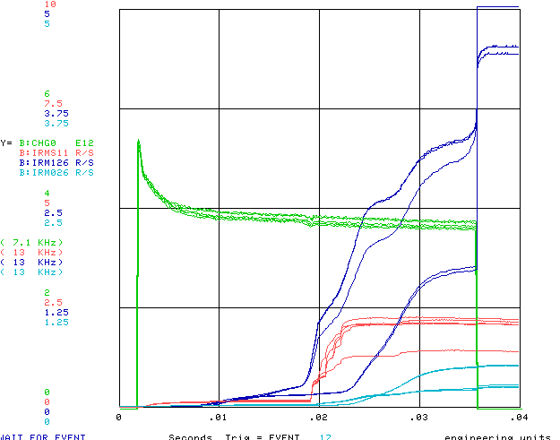
Ramped Corrector Status (10 turns)
No Ramps
Ramps

Slide 2
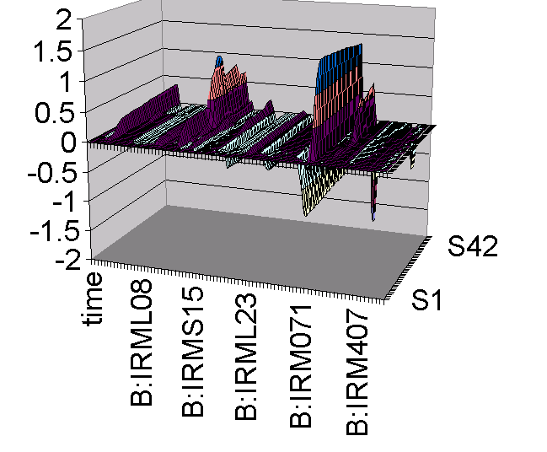
Differential Losses with Ramps (10 turns)
Still work to do, but can probably start using for MiniBooNE operation

Slide 3
Some of Specific Studies
Understanding fundamental machine characteristics:
  tunes
  chromaticity
Injection:
  Dependence on injected bunch width
  Dependence on injected bunch overlap
  Dependence on RF capture parameters
  Space charge: coherent tune shift, incoherent tune spread, etc.
Transition:
  Detailed study of loss mechanisms through transition and after.
  Gamma-t jump??

