Slide 1
Getting the Booster to 2010
Eric Prebys
December 20, 2002
Outine
  Longevity Issues
    Non-radiation related
    Radiation related
    Personnel
  Performance Issues
    Limiting Factors
    Plan

Slide 2
Longevity Issues (non-radiation)
GMPS (upgraded, OK)
Transformers (serviced, OK)
Vacuum system (being update, finished 2003)
Kicker PS charging cables
  Run three times over spec
  Fail at the rate of about 1/month – AFTER A CERTAIN NUMBER OF PULSES.
  Seven spare coils
  Evaluating improved design (better cable, LCW-filled heliac, etc)
Low voltage power supplies, in particular Power 10 Series:
  Unreliable, some no longer serviced.
  Starting search for new supplier and evaluate system to minimize number of different types.
  Probably a few $100K to upgrade system.

Slide 3
Longevity Issues (non-radiation, cont’d)
RF Hardware
  (original) Copper tuner cooling lines are beginning to spring leaks. Difficult to repair because they’re hot.
High Level RF
  More or less original.
  Our highest maintenance item.
  Will probably last, BUT expensive to maintain.
  John Reid and Ralph Pasquinelli feel a new solid state system would pay for itself ($5.5M) in about four years.
Low Level RF
  Many old modules, some without spares, some without drawings.
  An upgrade plan in place.
  Not expensive, but NEED people.

Slide 4
Longevity Issues (radiation related)
We’ve seen failures in ion pump HV lines -> planning to replace.
Hoses on beam valves will be replaced with copper of stainless.
Looking at other miscellaneous cabling and hoses.
Magnet insulation:
  Biggest worry
  We have no idea how close we are
  During January shutdown
    Will remove some existing dosimetry and evaluate
    Will put in widely distributed new dosimetry.
    Take these numbers to the people who know.

Slide 5
Longevity Issues: Personnel
Several key people will likely retire before 2010.
We need at least one new hire at the Engineer or Engineering Physicist level to insure continuity.

Slide 6
Some Cold Hard Facts about the Proton Future
Running as we are now, the Booster can deliver a little over 1E20 protons per year – this is about a factor of four over typical stacking operations, and gives MiniBooNE about 20% of their baseline.
NuMI will come on line in 2005, initially wanting about half of MiniBooNE’s rate, but hoping to increase their capacity – through Main Injector Improvements – until it is equal to MiniBooNE.
Whatever the lab’s official policy, there will be great pressure (and good physics arguments) for running MiniBooNE and NuMI at the same time.
-> By 2006 or so, the Proton Source will be called upon to deliver 10 times what it is delivering now.
At the moment, there is NO PLAN for achieving this, short of a complete replacement!

Slide 7
Limitations to Total Booster Flux
Total protons per batch: 4E12 with decent beam loss, 5E12 max.
Average rep rate of the machine:
  Injection bump magnets (7.5Hz)
  RF cavities (7.5Hz, maybe 15 w/cooling)
  Kickers (15 Hz)
  Extraction septa (now 4Hz, 7.5 after Jan. shutdown)
Beam loss
  Above ground:
    Shielding
    Occupancy class of Booster towers
  Tunnel losses
    Component damage
    Activiation of high maintenance items (particularly RF cavities)
Of particular interest to NUMI
Our biggest concern

Slide 8
Proton Timelines
Everything measured in 15 Hz “clicks”
Minimum Main Injector Ramp = 22 clicks = 1.4 s
MiniBoone batches “sneak in” while the MI is ramping.
Cycle times of interest
  Min. Stack cycle: 1 inj + 22 MI ramp = 23 clicks = 1.5 s
  Min. NuMI cycle: 6 inj + 22 MI ramp = 28 clicks = 1.9 s
  Full “Slipstack” cycle (total 11 batches):
    6 inject
    + 2 capture (6 -> 3)
    + 2 inject
    + 2 capture (2 -> 1)
    + 2 inject
    + 2 capture (2 -> 1)
    + 1 inject
    + 22 M.I. Ramp
    ----------------------
    39 clicks = 2.6 s

Slide 9
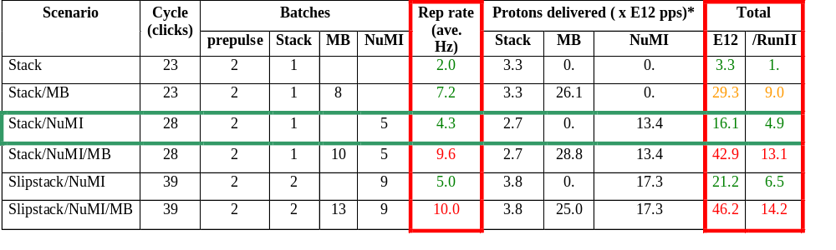
Summary of Proton Ecomomics
MiniBooNE baseline ≈ 5E20 p/year
Booster Hardware Issues
Radiation Issues
NUMI “baseline” = 13.4E12 pps x 2E7 s/year ≈ 2.7E20 p/year
Right now we’re at roughly 1/5 of the MiniBooNE baseline
*assuming 5E12 protons per batch

Slide 10

Typical Booster Cycle
Various Injected Intensities
Transition
Intensity (E12)
Energy Lost (KJ)
Time (s)

Slide 11
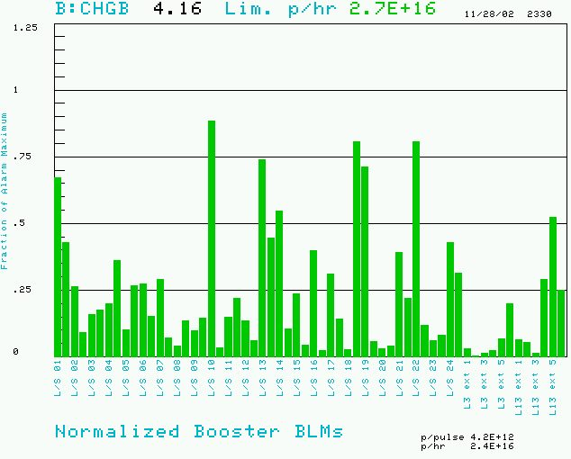
Booster Losses (Normalized to Trip Point)
BRF11: 200 mR/hr @ 1ft
BRF15: 300 mR/hr @ 1ft

Slide 12
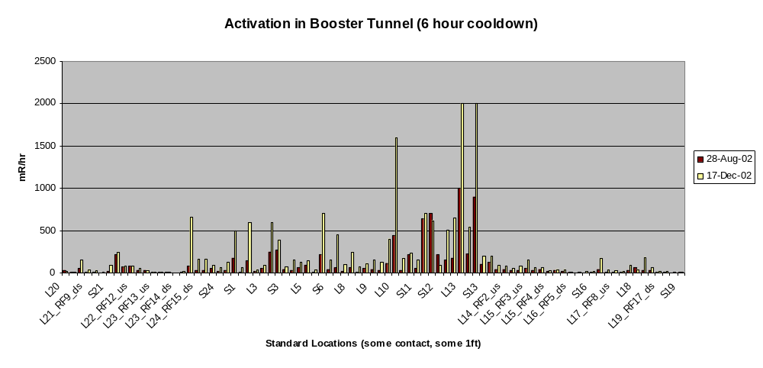
Booster Tunnel Radiation Levels
On the last access
  The people doing the radiation survey got about 20 mR.
  Two technicians received 30 mR doing a minor HV cable repair.
  We’re at (or past??) the absolute limit on our overall activation

Slide 13
Hardware Improvements to Booster
Shielding and reclassification of Booster towers: complete 2001
New extraction septum (MP02) power supply: complete 11/02
New extraction septum: magnet complete. To be installed 1/03
Collimation system: complete, but cannot be used until…
Collimation system shielding: 75 tons of steel to be stacked 1/03
Time line improvements (very important for MiniBooNE operation): more or less complete.
More cables for extraction septum (will allow 15 Hz operation): ??
New injection bump magnets: ??
New RF cavities: ??

Slide 14
Plan
All near term hardware improvements will be complete by early to mid 2003. At the point the Booster will physically be able to run a 7.5 Hz.
Proceed with tuning improvements (C. Ankenbrandt coor.):
  IPM calibration (Tomlin, Spentzouris, Lackey).
  Orbit correctors: complete, working out operational issues (Prebys, Coney).
  Precision lattice measurement: (Lackey, Coney, new grad. Student).
  Transition studies (gamma-t jump??): (Jackson et al.)
  Damping improvements: Pellico + ??

Slide 15
New RF System
The existing RF cavities form the primary aperture restriction (2 ¼” vs. 3 ¼”).
They are high maintenance, so their activation is a worry.
There is a plan for a new RF system with 5” cavities:
  Powered prototype built
  Vacuum prototype ready for summer installation
  Second prototype to be built by university machine shops?
Total cost: $5.5M cavities + $5.5M power supplies (maybe use old ones)
Is it worth it? On of the questions for the study group is how much improvement we might expect.

Slide 16
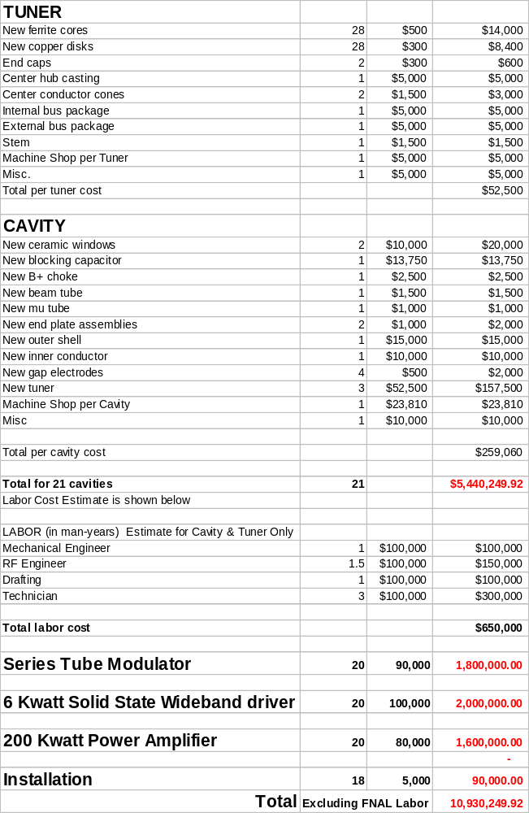
Upgrade Cost Estimate
Summary:
~$260K per cavity, of which $160K goes for the three tuners.
A roughly equal amount for the power supply chain.
About 20 cavities.
-> $11M total

Slide 17
RF Upgrade: Questions to Answer
Accuracy of the Cost Estimate?
Status:
  First prototype
  Vacuum prototype
  Design
Reasonable timeline.
Ways to save money:
  Use old tuners?
  Use existing power supplies?
Ways in which universities can help:
  Political pressure
  Money
  Fabrication

Slide 18
ORBUMP Project
The current ORBUMP magnets can ramp at 7.5 Hz, with a substantial temperature rise.
Need to go to 12 to support MiniBooNE and NuMI.
New design underway, but needs much more attention.
Can new design incorporate injection improvements??

Slide 19
Simulation/Studies
Any major improvement in the Booster will very likely involve at least some hardware improvements (in 30 years, every knob has been tuned).
Any proposed hardware improvement will have to be supported by simulations and measurements.
In a perfect world, we would be able to model the entire acceleration cycle of the Booster, and reproduce losses.
We are probably years away from that.
We need to focus our efforts:
  Obtain the best lattice we can – including measurements!!
  Do limited modeling studies to try to identify what are likely important factors in instabilities:
    Alignment??
    Nonlinearities??
    Aperiodicities??
    Etc.
There should be a much closer relationship between simulations and measurements.

Slide 20
Some General Comments
The Proton Source CANNOT achieve its goals parasitically.
The pressure from the collider program is not going to go away, so we have to come up with a plan to live together.
We need, at the very least:
  A commitment to a certain amount of dedicated study time (few hours a week).
  A commitment to priority on a console (preferably #2).

Slide 21
Conclusions
We are at or near the present limit of the Booster output.
This is a factor of up to ten away from what is needed.
Current plans might realistically increase things by a factor of two or three, tops.
Getting further will be hard!!!

