Slide 1
The Proton Source (mostly Booster) in the “Collider Era”
Eric Prebys
February 3, 2003

Slide 2
The “Run II Era”
The proton source is very close the the specifications in the Run II Handbook.
Although it’s the highest priority, support of collider operations is a relatively minor facet of life in the proton source.
Proton source activities are dominated by the current and projected needs of the neutrino program (MiniBooNE+NuMI+??)
Whatever a WBS chart may say, there’s not a separate proton source for RunII, MiniBooNE, NuMI, etc.

Slide 3
8 GeV Proton Goals and Performance
Parameter | Typical Current Performance | Run II Handbook Goal | Comments
Pbar Stacking Pulse Intensity | 4.7E12/batch* = 5.9E10/bunch | >5E12/batch | Limited by Booster efficiency and residual radiation concerns
Hourly Intensity | 0.8E16 Run II | 1.2E16 | Limited by Pbar cooling cycle time
Transverse Emittance | 15-17 π mm-mr | <15 π mm-mr
Collider filling Intensity | 7 bunches @ 5.5 - 5.9E10 / bunch | 5-7 bunches @ 6E10 / bunch
Longitudinal Emittance | 0.1 - 0.15 eV-sec / bunch | <0.1 eV-sec / bunch | Better understanding of transition crossing and improved longitudinal dampers
* One batch ~80 bunches (harmonic 84 with 4 bunch gap)

Slide 4
Some Cold Hard Facts about the Proton Source
Running as we are now, the Booster can deliver a little over 1E20 protons per year – this is about a factor of four over typical stacking operations, and gives MiniBooNE about 20% of their baseline.
NuMI will come on line in 2005, initially wanting about half of MiniBooNE’s rate, but hoping to increase their capacity – through Main Injector Improvements – until it is equal to MiniBooNE.
Whatever the lab’s official policy, there will be great pressure (and good physics arguments) for running MiniBooNE and NuMI at the same time.
-> By 2006 or so, the Proton Source will be called upon to deliver 10 times what it is delivering now.
At the moment, there is NO PLAN for achieving this, short of a complete replacement!

Slide 5
Limitations to Total Booster Flux
Total protons per batch: 4E12 with decent beam loss, 5E12 max.
Average rep rate of the machine:
  Injection bump magnets (7.5Hz)
  RF cavities (7.5Hz, maybe 15 w/cooling)
  Kickers (15 Hz)
  Extraction septa (15Hz after Jan. shutdown)
Beam loss
  Above ground:
    Shielding
    Occupancy class of Booster towers
  Tunnel losses
    Component damage
    Activiation of high maintenance items (particularly RF cavities)
Of particular interest to NUMI
Our biggest concern

Slide 6
Proton Timelines
Everything measured in 15 Hz “clicks”
Minimum Main Injector Ramp = 22 clicks = 1.4 s
MiniBoone batches “sneak in” while the MI is ramping.
Cycle times of interest
  Min. Stack cycle: 1 inj + 22 MI ramp = 23 clicks = 1.5 s
  Min. NuMI cycle: 6 inj + 22 MI ramp = 28 clicks = 1.9 s
  Full “Slipstack” cycle (total 11 batches):
    6 inject
    + 2 capture (6 -> 3)
    + 2 inject
    + 2 capture (2 -> 1)
    + 2 inject
    + 2 capture (2 -> 1)
    + 1 inject
    + 22 M.I. Ramp
    ----------------------
    39 clicks = 2.6 s

Slide 7
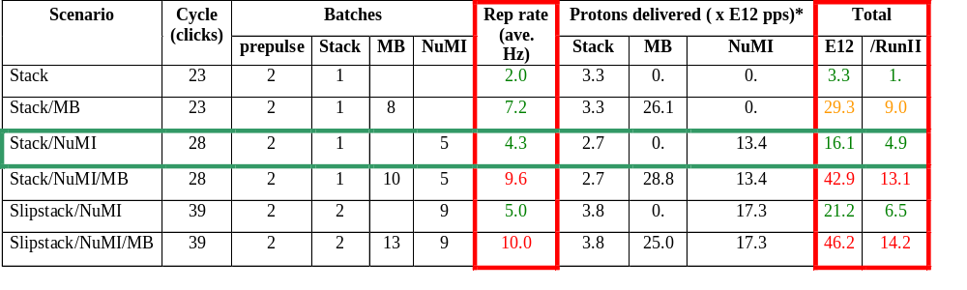
Summary of Proton Ecomomics
MiniBooNE baseline ≈ 5E20 p/year
Booster Hardware Issues
Radiation Issues
NUMI “baseline” = 13.4E12 pps x 2E7 s/year ≈ 2.7E20 p/year
Right now we’re at roughly 1/5 of the MiniBooNE baseline
*assuming 5E12 protons per batch

Slide 8

Typical Booster Cycle
Various Injected Intensities
Transition
Intensity (E12)
Energy Lost (KJ)
Time (s)

Slide 9
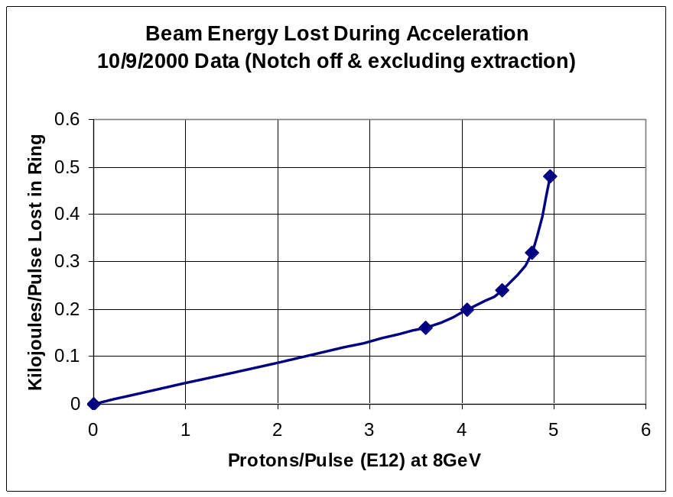
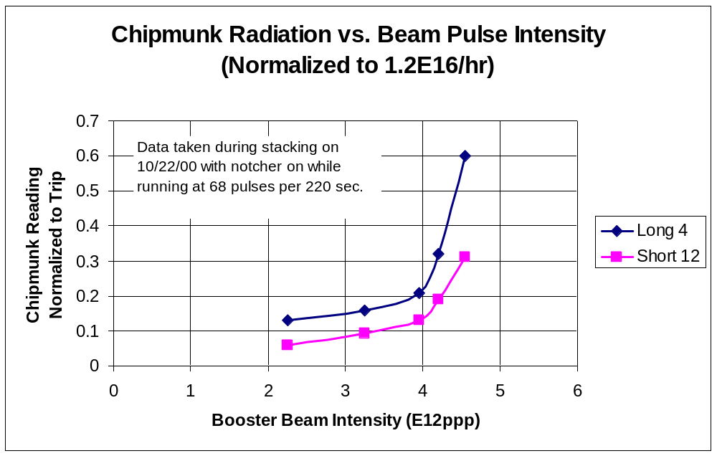
Beam Loss Intensity Sensitivity

Slide 10
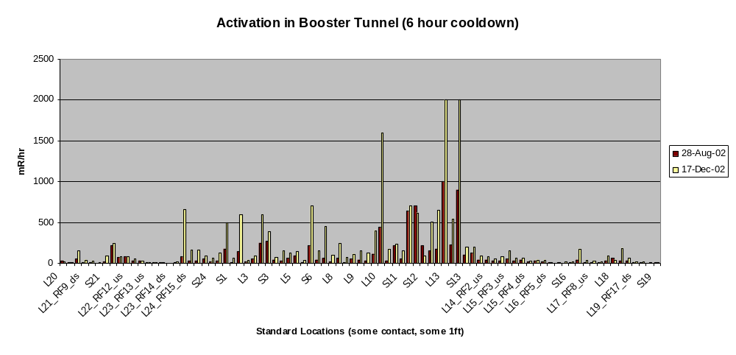
Booster Tunnel Radiation Levels
On a recent access
  The people doing the radiation survey got about 20 mR.
  Two technicians received 30 mR doing a minor HV cable repair.
  We’re at (or past??) the absolute limit on our overall activation

Slide 11
Longevity Issues (non-radiation)
GMPS (upgraded, OK)
Transformers (serviced, OK)
Vacuum system (being update, finished 2003)
Kicker PS charging cables
  Run three times over spec
  Fail at the rate of about 1/month – AFTER A CERTAIN NUMBER OF PULSES.
  Seven spare coils
  Evaluating improved design (better cable, LCW-filled heliac, etc)
Low voltage power supplies, in particular Power 10 Series:
  Unreliable, some no longer serviced.
  Starting search for new supplier and evaluate system to minimize number of different types.
  Probably a few $100K to upgrade system.

Slide 12
Longevity Issues (non-radiation, cont’d)
RF Hardware
  (original) Copper tuner cooling lines are beginning to spring leaks. Difficult to repair because they’re hot.
High Level RF
  More or less original.
  Our highest maintenance item.
  Will probably last, BUT expensive to maintain.
  John Reid and Ralph Pasquinelli feel a new solid state system would pay for itself ($5.5M) in about four years.
Low Level RF
  Many old modules, some without spares, some without drawings.
  An upgrade plan in place.
  Not expensive, but NEED people.

Slide 13
Longevity Issues (radiation related)
We’ve seen failures in ion pump HV lines -> planning to replace.
Hoses on beam valves will be replaced with copper of stainless.
Looking at other miscellaneous cabling and hoses.
Magnet insulation:
  Biggest worry
  We have no idea how close we are
  During January shutdown
    Will remove some existing dosimetry and evaluate
    Will put in widely distributed new dosimetry.
    Take these numbers to the people who know.

Slide 14
Longevity Issues: Personnel
Several key people will likely retire before 2010.
We need at least one new hire at the Engineer or Engineering Physicist level to insure continuity.

Slide 15
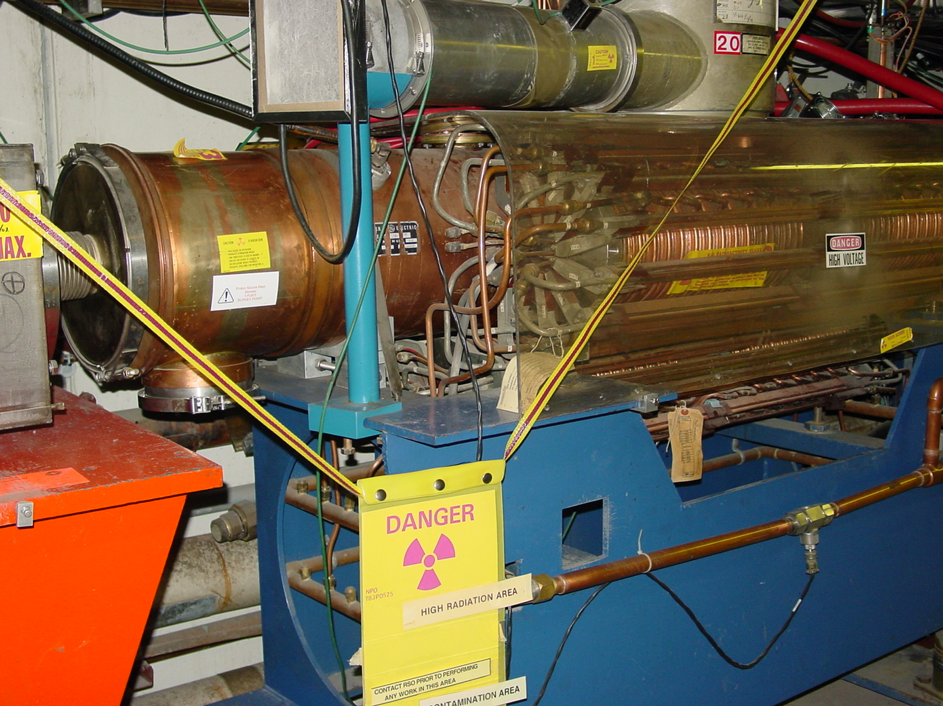
Activation (cont’d)

Slide 16
Radiation Damage Worries
Cables: frequent replacement of HV cables and connectors for ion pumps.
Hoses: valve actuator hoses have failed and are now being replaced with stainless steel.
Kicker magnets: A kicker which recently failed showed signs of radiation damage to the potting rubber.
Main magnet insulation: No main magnets have failed in 30 years, but…
Installed radiation “dose tabs” around the ring in January shutdown to get a real estimate of dosage.

Slide 17
Specific Improvements to Booster
Shielding and reclassification of Booster towers: complete 2001
New extraction septum (MP02) power supply: complete 11/02
New extraction septum: complete 1/03
Collimation system: REMOVED for redesign.
New collimation system: 3 months (???)
Studies/simulation: ongoing.
Beam notch cogging for multibatch operation: ongoing
New injection bump magnets: ??
New extraction kickers??
New RF cavities: ??

Slide 18
Booster Collimator System
Basic Idea…
A scraping foil deflects the orbit of halo particles…
…and they are absorbed by thick collimators in the next periods.
Unshielded copper secondary collimators were installed in summer 2002, with a plan to shield them later.
Due the the unexpected extent of the shielding and the difficulty of working in the area, the design was ultimately abandoned as unacceptable.
Collimators were removed during the January shutdown.
A new collimator system is being designed with steel secondary jaws fixed within a movable shielding body.
Hope to have then ready in ~3 months.

Slide 19
New RF System?
The existing RF cavities form the primary aperture restriction (2 ¼” vs. 3 ¼”).
They are high maintenance, so their activation is a worry.

Slide 20
New RF System (cont’d)
There is a plan for a new RF system with 5” cavities:
  Powered prototype built
  Build two vacuum prototypes by the summer shutdown with substantial machining done at universities.
  Evaluate these and procede (hopefully?) with full system.
Total cost: $5.5M cavities + $5.5M power supplies (power supplies would pay for themselves in a few years)
Is it worth it? On of the questions for the study group is how much improvement we might expect.

Slide 21
Injection Dogleg (ORBUMP)
The current injection bump dogleg (ORBUMP) magnets can ramp at 7.5 Hz, with a substantial temperature rise.
Need to go to 12 to support MiniBooNE and NuMI.
2 spares for the 4 (identical) magnets. Most likely failure mode probably repairable.
New design underway, but needs much more attention.
Can new design incorporate injection improvements??
Some power supply issues as well:
  One full set of replacement SCR’s for the switch network.
  New switchbox being designed, but needs attention (or order more spare SCR’s).
  No spare for charge recovery choke.

Slide 22
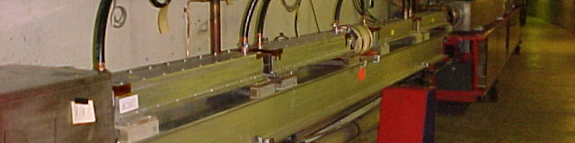
Extraction Kickers
Each extraction region requires four extraction kickers in the long straight section prior to extraction.
After these RF cavities, these are the next aperture restriction (2.5” ID).
Recently, a kicker failed with signs of radiation damage, and we were forced to swap in our only spare (really our tune measurement pinger).
Plan:
  Use spare and recovered ferrites to build two spares on a very short timescale.
  Order ferrites to build at least two additional spares.
  Investigate a new, larger aperture design.

Slide 23
Multibatch Timing
In order to Reduce radiation, a “notch” is made in the beam early in the booster cycle.
Currently, the extraction time is based on the counted number of revolutions (RF buckets) of the Booster. This ensures that the notch is in the right place.
The actual time can vary by > 5 usec!
This is not a problem if booster sets the timing, but it’s incompatible with multi-bunch running.
We must be able to fix this total time so we can synchronize to the M.I. orbit.
This is called “beam cogging”.

Slide 24
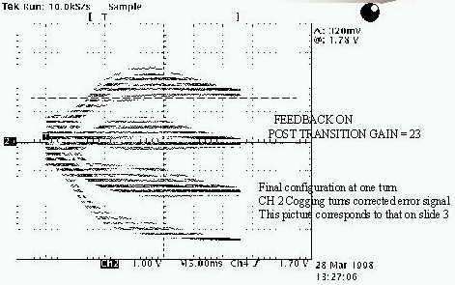
Active cogging
Detect slippage of notch relative to nominal and adjust radius of beam to compensate.
Allow to slip by integer turns, maintaining the same total time.
Does not currently work at high intensities.
Still do not really understand the problem.
Needs to be solved by the time NuMI runs.

Slide 25
Simulation/Studies
Historically, the booster has lacked a fundamental understanding of beam loss mechanisms.
If (!!!) it is possible at all to go the the required beam flux, it will require some mitigation of beam loss.
Recently, there has been an great increase in the involvement of the Beam Physics department in the Booster:
  Space charge group (W. Chou, et al) has begun to focus on the Booster again.
  Chuck Ankenbrandt has moved into Booster group as “Beam Physics Liaison” to help coordinate studies.
  Starting to make quantitative comparisons between predictions and measurement.
This is an ongoing effort, which will require at least some dedicated beam study time.

Slide 26
Conclusions
We are at or near the present limit of the Booster output.
This is a factor of five to ten away from what is needed.
Current plans (collimators, orbit control, …) might realistically increase things by a factor of two or three, tops.
Getting further will be hard!!!

