Slide 1
Booster Status and Plan
Eric Prebys
DOE Review, Proton Source Breakout Session
July 22,2003

Slide 2
Some comments about the proton source
There is only one Linac and one Booster, and these must supply all the protons needed by the lab.
Although supplying protons to the collider program is the highest priority, that’s a fairly small part of the demand on the proton source.
Our lives are dominated by the current and future needs of the neutrino program.
It’s difficult to fit the Linac and Booster into the “Run II” plan, but
A good proton source is good for everyone.

Slide 3
8 GeV Proton Run II Goals and Performance
Parameter | Typical Current Performance | Run II Handbook Goal | Comments
Pbar Stacking Pulse Intensity | 4.8E12/batch* = 6.0E10/bunch | >5E12/batch | Limited by Booster efficiency and residual radiation concerns
Hourly Intensity | 0.8E16 Run II | 1.2E16 | Limited by Pbar cooling cycle time
Transverse Emittance | 15-17 π mm-mr | <15 π mm-mr
Collider filling Intensity | 7 bunches @ 5.5 – 6.0E10 / bunch | 5-7 bunches @ 6E10 / bunch
Longitudinal Emittance | 0.1 - 0.3 eV-sec / bunch | <0.1 eV-sec / bunch | Better understanding of transition crossing and improved longitudinal dampers
* One batch ~80 bunches (harmonic 84 with 3 bunch gap)

Slide 4
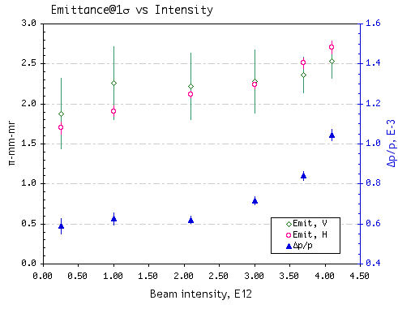
Dependence of Booster Output on Intensity
18
15
(95%)
12
9
6
3

Slide 5
Recommendations from the Last Review (5.3)
Increase significantly efforts on Booster machine physics and on hardware to meet anticipated demands on proton throughput and pulse intensity. A vigorous program to commission and understand the collimators should be launched.
  The original collimator design was cancelled, as will be discussed in the talk
Monitor the radiation dose received by the Booster ring components, including magnets.
  Roughly 100 dose tabs were installed around the ring
  These were removed after a few months
  The data are being analyzed.
Implement a program of beam studies to understand space-charge effects in the Booster and the beam dynamics during transition crossing, with the goal of minimizing losses and allowing for higher beam intensity. Beam Physics Department members should help.
  There has been a dramatic increase in the involvement of the Beam Physics Group (see Weiren Chou’s talk)
  Already paying of big with the (serendipitous) discovery of the “dogleg problem”, discussed shortly.

Slide 6
2002 Recommendations (cont’d)
Develop a plan to address upgrading of aging and un-maintainable equipment throughout the Proton Source, especially those items that can cause extended downtime like the Booster low level radio frequency system, injection bump power supplies, etc.
  We are adiabatically upgrading the injection bump power supply.
  We are continuing with R. Webber and B. Pellico’s plan to upgrade the lower level RF system.
Consider strengthening the Booster team to enable it to vigorously pursue the above tasks.
  Chuck Ankenbrandt – Beam physics liaison
  Xi Yang – Research Associate
  Xiaobiao Huang – Graduate student from Indiana in the accelerator PhD program
  Bob Zwaska – Minos graduate student from UT Austin (not officially affiliated with the lab)

Slide 7
Major Developments Since Last Review
New extraction septum and power supply in place
  Allows Booster to physically meet its current demands (limits now come entirely from losses)
Original collimator design scrapped:
  Realized that serviceability issues made the design too risky
  Totally new design, based on the same principal, has been designed and will be installed in the summer shutdown.
Discovered major problem related to the extraction “doglegs”:
  Significantly distorts injection lattice
  Reducing this effect has become a major (and very successful) focus of our tuning efforts.
  We have a plan to ameliorate the situation which will be partially implemented during the summer shutdown.
  The discovery of this problem was the direct result of increased involvement of the beam physics group!

Slide 8
General Running Strategy
Provide Collider with everything they want, sending the most protons we can stably send to pbar production (>5E12 when things are running well)
Run MiniBooNE at the maximum batch intensity where energy loss is linear with the number of protons (typically ~4E12).
Adjust MiniBooNE rep. rate as high as possible within the loss limits (individual loss monitors and total power loss).
Tune to minimize losses.
In practice this also delivers the best beam to the collider.

Slide 9
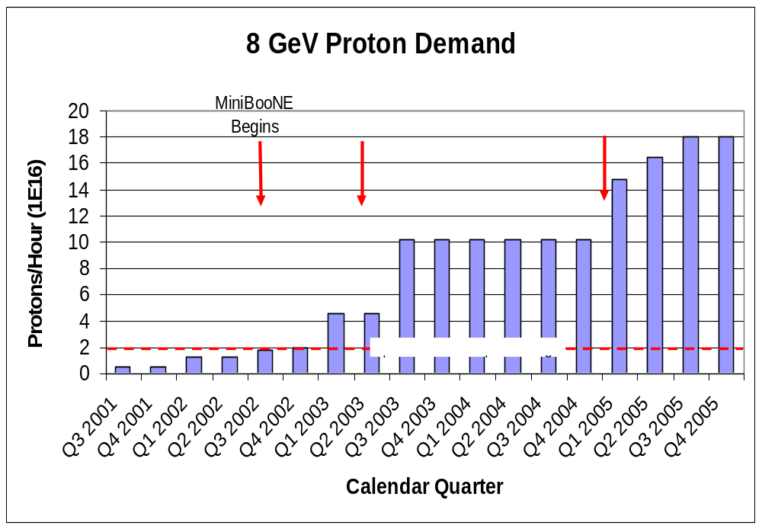
Demand for 8 GeV Protons
Fancy MI Loading schemes (or >5E12)
Present Operating Level
Shortfall

Slide 10
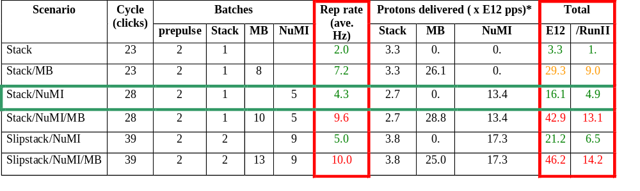
Summary of Proton Ecomomics
MiniBooNE baseline ≈ 5E20 p/year
Booster Hardware Issues
Radiation Issues
NUMI “baseline” = 13.4E12 pps x 2E7 s/year ≈ 2.7E20 p/year
Right now we’re at roughly 40% of the MiniBooNE baseline
*assuming 5E12 protons per batch

Slide 11
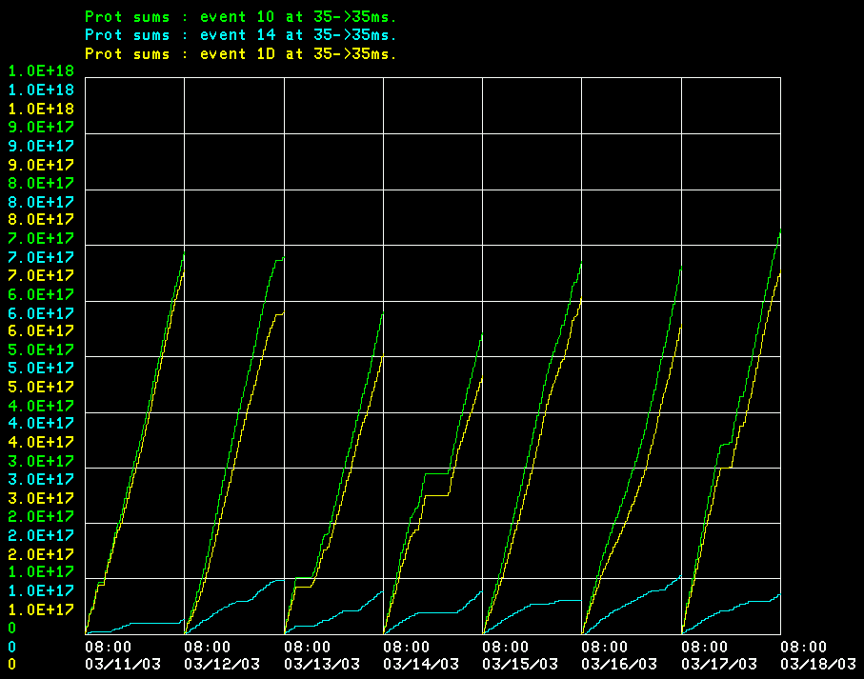
Where do Protons Go Now?
Total
MiniBooNE
Pbar production (limited by debuncher)

Slide 12
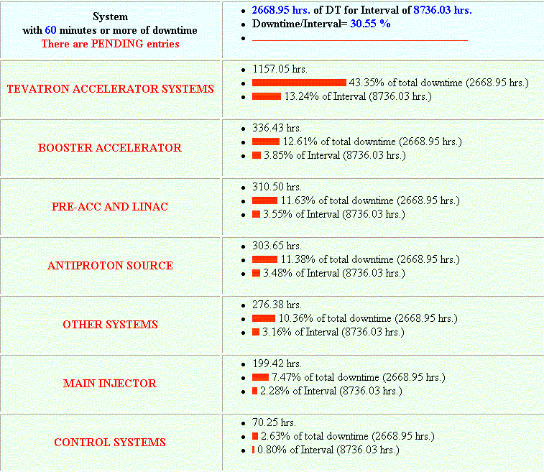
Linac and Booster Reliability (answer to question)

Slide 13
Limitations to Total Proton Flux
NOT the linac (except perhaps 400 MeV line losses)
Total protons per batch: 4.2E12 with decent beam loss, 5.5E12 max.
Average rep rate of the machine:
  Injection bump magnets (7.5Hz)
  RF cavities (7.5Hz, maybe 15 w/cooling)
  Kickers (15 Hz)
  Extraction septa (was 2.5Hz, now 15Hz)
Beam loss
  Above ground:
    Shielding
    Occupancy class of Booster towers
  Tunnel losses
    Component damage
    Activation of high maintenance items (particularly RF cavities)
Of particular interest to NUMI and stacking
Our biggest concern

Slide 14
A word about “hands on maintenance” (answer to question)
Goal to keep activation at “about twice pre-MiniBooNE levels”
Now delivering about 10 times the protons we were before MiniBooNE.
Average activation has gone up by a little more than two.
We’re committed to achieving any further improvements without increasing activation any further!
We’re optimistic that we can do that.

Slide 15
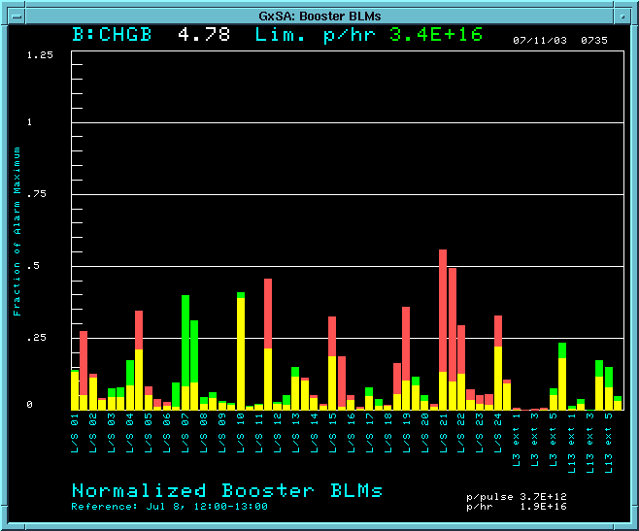
Monitoring Beam Loss
We keep a running 100 second sum of 60 individual loss monitors, and display these normalized to their trip points
We now also have the ability to display losses relative to a reference set, to help use match loss patterns in periods of good running. We expect this to be very important.
Also limit total beam power loss to 400 W
Higher than reference set
Lower than reference set

Slide 16
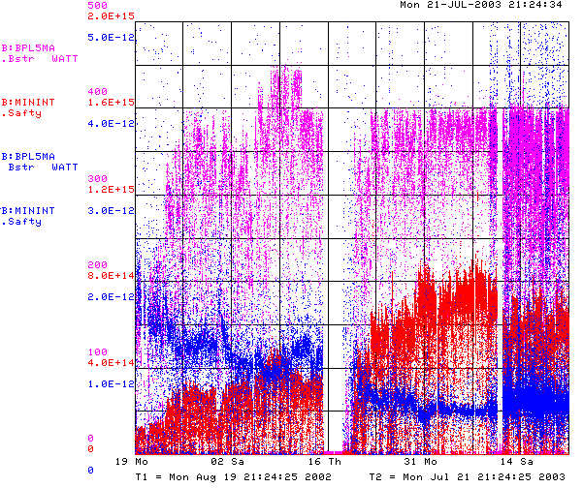
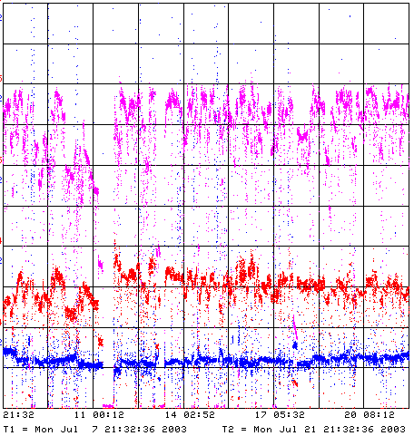
How are we doing?
Lowered Power loss limit because of activation concerns
Repaired 400 MeV line power supplies
Booster Power Loss
Total protons/minute
Since MiniBooNE
Last 2 weeks
Energy lost per proton
Unstable Running after
power problems and Summer

Slide 17
Bottom Line
(improvements since 11/02 indicated)
12
2E20
Running as we are now, the Booster can deliver a little over 1E20 protons per year – this is about a factor of six over typical stacking operations, and gives MiniBooNE about 20% of their baseline.
NuMI will come on line in 2005, initially wanting about half of MiniBooNE’s rate, but hoping to increase their capacity – through Main Injector Improvements – until it is equal to MiniBooNE.
Whatever the lab’s official policy, there will be great pressure (and good physics arguments) for running MiniBooNE and NuMI at the same time.
-> By 2006 or so, the Proton Source might be called upon to deliver
10 times what it is delivering now.
At the moment, there is no plan for assuring this, short of a complete replacement!
So what are we going to try?…
40%
5

Slide 18
Booster Collimator System
Basic Idea…
A scraping foil deflects the orbit of halo particles…
…and they are absorbed by thick collimators in the next periods.
Unshielded copper secondary collimators were installed in summer 2002, with a plan to shield them later.
Due the the unexpected extent of the shielding and the difficulty of working in the area, the design was ultimately abandoned as unacceptable.
Collimators were removed during the January shutdown.
A new collimator system has been designed with steel secondary jaws fixed within a movable shielding body.

Slide 19
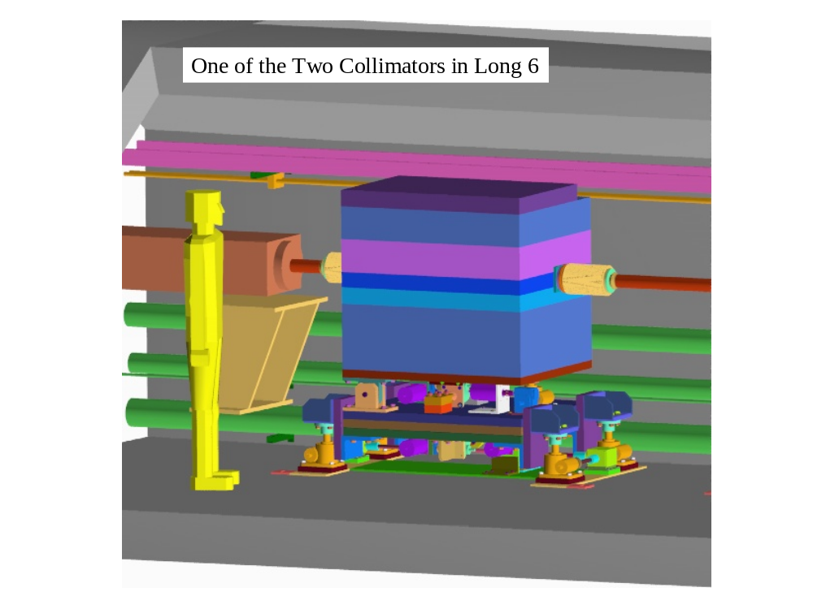
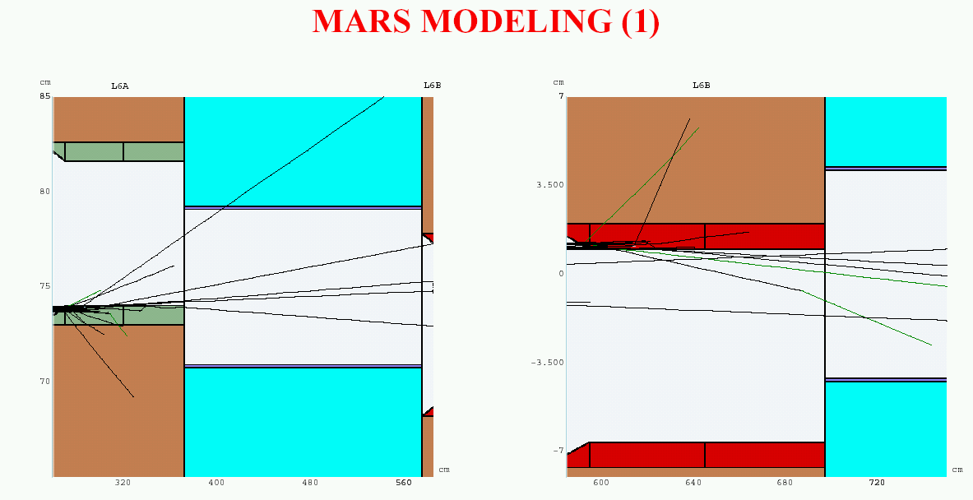
New Collimator System
System Designed to operate at full NuMI+MiniBooNE intensity and intercept:
  30% of beam at 400 MeV
  2% of beam at 8 GeV
Shielding determined by:
  Above ground radiation
  Sump water contamination
  Residual activation
No active cooling
All parts serviceable
Assembly begins next week
Installation during the shutdown

Slide 20
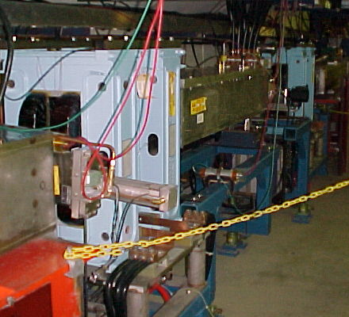
Dogleg Problem
Septum
Each of the two Booster extraction septa has a set of vertical dogleg magnets to steer the beam around it during acceleration.
More powerful doglegs were installed in 1998 to reduce losses early in the cycle.
These magnets have an edge focusing effect which distorts the horizontal injection lattice:
  50% increase in maximum β
  100% increase in maximum dispersion.
  Harmonic contributions.
Effect goes like I². Now tune to minimize.
Recently got an unusual opportunity to explore potential improvements from fixing the problem.
Working on schemes to reduce or remove problem.
Dogleg Magnets

Slide 21
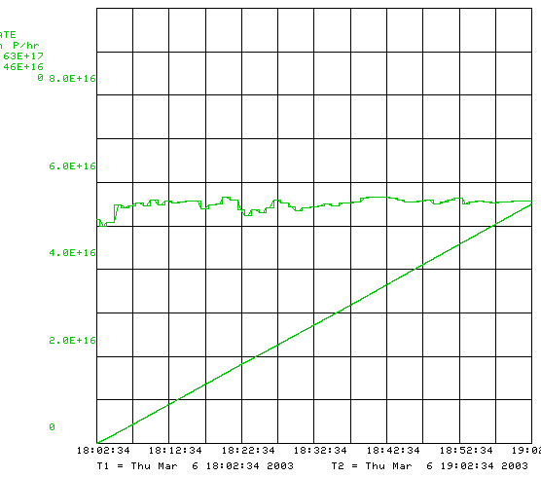
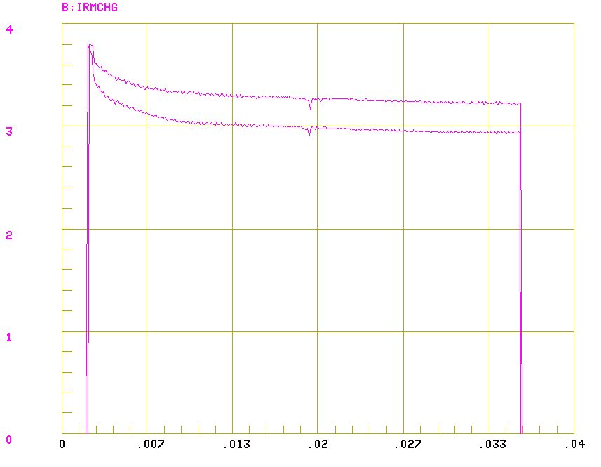
Dead Dog Studies
Took advantage of TeV Magnet failure to raise the Long 13 (dump) septum and turn off the associated dogleg.
Doglegs almost exactly add, so this should reduce the effect by almost half.
The mode of operation prevents short batching, booster study cycles and RDF operation.
Had about 36 hours of study in this mode.
Bottom Line: major improvement.
1 dog!!!
5.3E16 pph-> Record!
both dogs
transmission
intensity

Slide 22
Possible Solutions
Tune to minimize current?
  helped so far, but near limit.
  Maybe raise L13 septum a bit?
Motorize L13 septum to switch modes quickly?
  Operational nightmare
Eliminate L13?
  Find another way to short-batch
  Make a dump in MI-8 for Booster study cycles?
Correctors?:
  These don’t look like quads, so can’t totally fix
  Might ameliorate the situation
Spread out doglegs (effect goes down with square of separation): YES!!
  Long 3 this summer
  Long 13 later
Possibly redesign extraction septum later: EXPENSIVE!

Slide 23
Dogleg Stretch Out
Present Setup: Limited by strength of old extraction septum
Kicked beam
Circulating beam
Lattice D
septum
Lattice D
dogs
dogs
New Setup: New Long 3 septum allows it to be in middle of straight
Kicked beam
Circulating beam
septum
Lattice D
dogs
dogs
Lattice D
Increase dog pair separation from 18” -> 40”: More than a factor of four reduction in effect on beta and dispersion
Working hard to get done for L3 in summer shutdown (Argonne helping with stand fabrication)
New L13 septum built. Will modify when time allows.
When both are done, effect almost eliminated.
In the mean time, we will raise L13 (dump) septum slightly -> Overall factor of two reduction.
Expect dramatic improvements!!!!

Slide 24
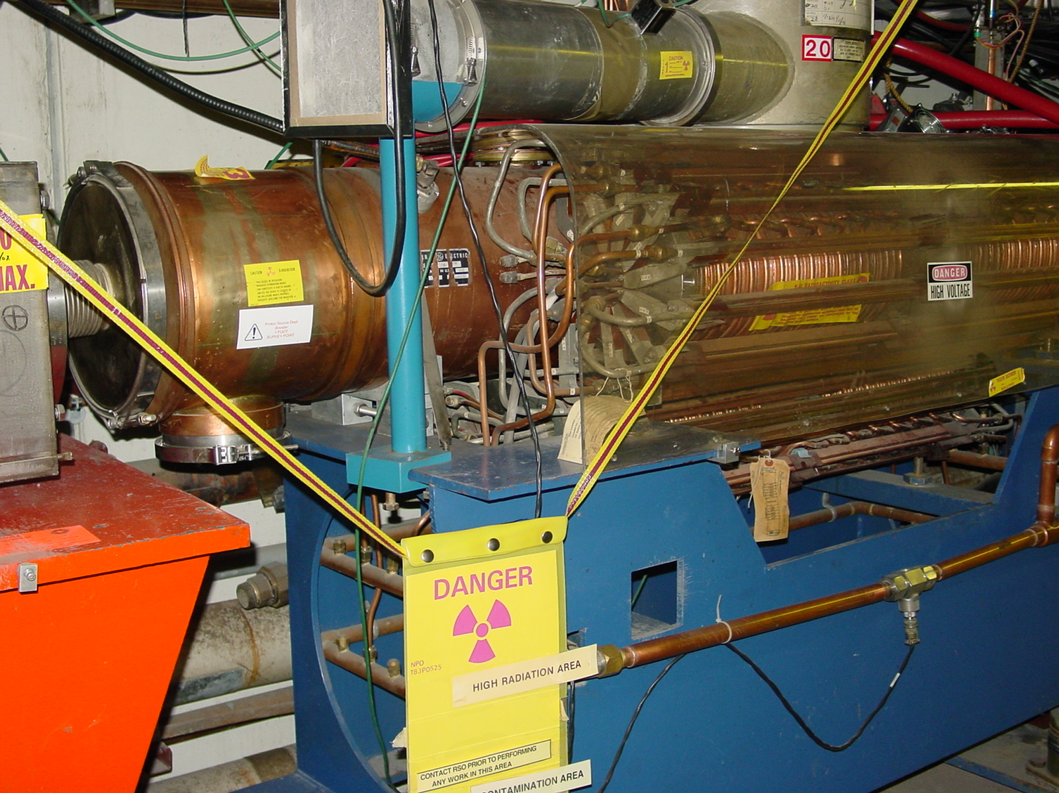
New RF System?
The existing RF cavities form the primary aperture restriction (2 ¼” vs. 3 ¼”).
They are high maintenance, so their activation is a worry.
They might have heat load problems beyond 7.5Hz
There is a plan for a new RF system with 5” cavities:
  Powered prototype built
  Building two vacuum prototypes for the summer shutdown with substantial machining done at universities.
  Evaluate these and decide whether to procede with a full system.

Slide 25
Summary of Major Projects for the Summer Shutdown
Stretch out Long 3 extraction region (ameliorates dogleg problem).
Install collimator system.
Replace 2 (of 18) RF cavities with wide aperture prototypes.
New dedicated damping cavity for additional longitudinal modes.
Do complete vertical alignments !! (as-founds are ongoing)
Install new Linac Lamberston (will improve 400 MeV optics and reduce losses)
Install four new wide aperture (EDWA) magnets in 8 GeV line.
Install new MP01 power supply and cable to new cable header (preparation for new MP01 septum.
Install new vacuum gauges as part of vacuum system upgrade.
Cautiously optimistic we can reach the MiniBooNE baseline goal after this shutdown!!

Slide 26
Injection Bump (ORBUMP)
4 pulsed “ORBUMP” magnets
Circulating Beam
DC “Septum”
400 MeV H⁻ beam from LINAC
Beam at injection
Stripping foil
Existing system (four identical magnets + two spares) has been demonstrated to go to 7.5 Hz – enough for pbar production+MiniBooNE
To run collider+MiniBooNE+NuMI, must go to at least 10 Hz.
Originally planned to replace all four magnets, but now plan to stretch out existing dogleg and replace injection septum.
Designing and costing out now.
Adiabatically upgrading power supply
  New SCR switch network – by summer shutdown
  New capacitors – by summer shutdown
  New charging supply control – investigating using version of MP02

Slide 27
Low Level RF (LLRF) System
Existing system has some original parts
  Limited spares
  Limited documentation
Upgrade plan in place (Webber, Pellico, Drennan)
  Adiabatically replace discrete components with quasi-generic DSP/FPGA boards
  Plan now modified to include phase shifter board based on MI-style FPGA board, which may ultimately absorb more functionality.
  Should be completed in FY04.
Damping system also being upgraded
  More scalability
  Higher signal to noise ratio
  More modes damped
  Also completed in FY04

Slide 28
Multibatch Timing
In order to Reduce radiation, a “notch” is made in the beam early in the booster cycle.
Currently, the extraction time is based on the counted number of revolutions (RF buckets) of the Booster. This ensures that the notch is in the right place.
The actual time can vary by > 5 usec!
This is not a problem if booster sets the timing, but it’s incompatible with multi-batch running (e.g. Slipstacking or NuMI)
We must be able to fix this total time so we can synchronize to the M.I. orbit.
This is called “beam cogging”.

Slide 29
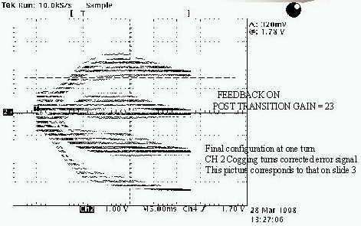
Active cogging
Detect slippage of notch relative to nominal and adjust radius of beam to compensate.
Allow to slip by integer turns, maintaining the same total time.
Does not currently work at high intensities.
Still do not really understand the problem.
Problem delayed by RF personnel problems -> easing up somewhat.
Significantly ramping up activity on this problem (and other LLRF)
Hope to demonstrate cogging in the next two months

Slide 30
>5E12 Batches (answer to question)
Our current strategy is to be satisfied with the Run II goal of 5E12 protons per batch (6E10 protons per bunch) with reasonable losses and beam parameters.
We have demonstrated we can do this, and are working on doing it more reliably.
Obviously, the collider program and NuMI would benefit from larger batches.
There are obstacles to be overcome to reach this
  Transition crossing
    Recommision existing system (have help from Argonne)
  Coupled bunch oscillations
    Improve damping system? Increase power?
This is not, at the moment, critical path.

