Slide 1
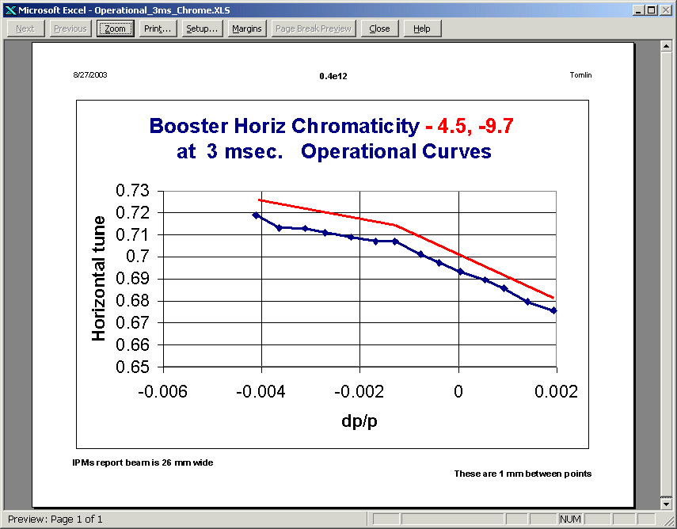
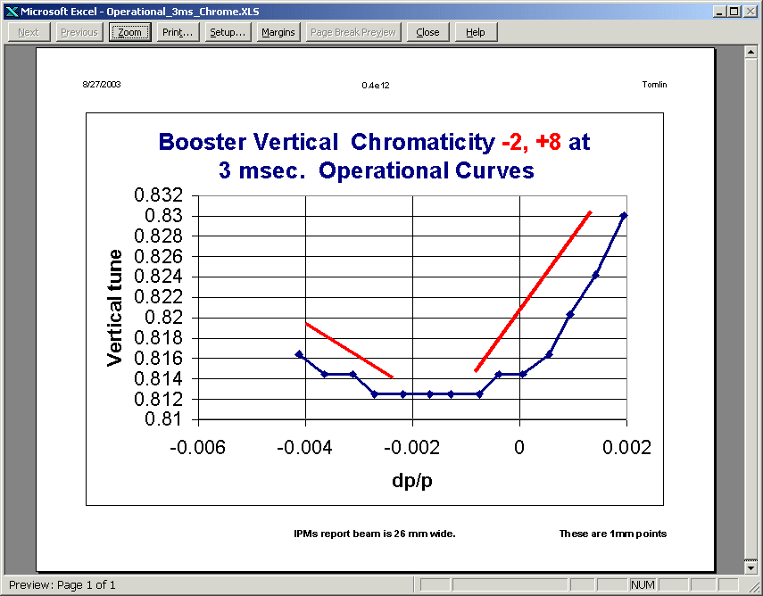
Operational Chromaticity Measurements (Tomlin)
Horizontal OK
Vertical looks weird

Slide 2
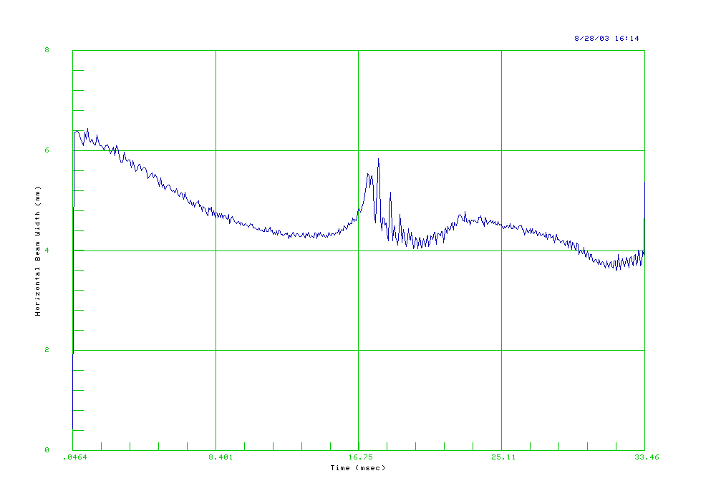
Cogging Studies (Zwaska, Pellico)
Priority has greatly increased.
Moved notch 3.4 ms into cycle
Successfully used radial feedback to manipulate to adjust notch position.
Discovered that horizontal emittance blows up with large (~8mm) radial feedback adjustments.

Slide 3
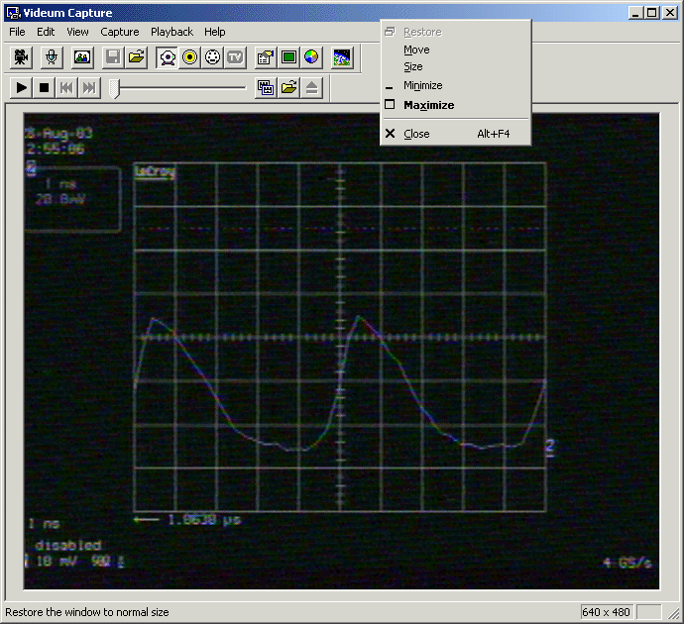
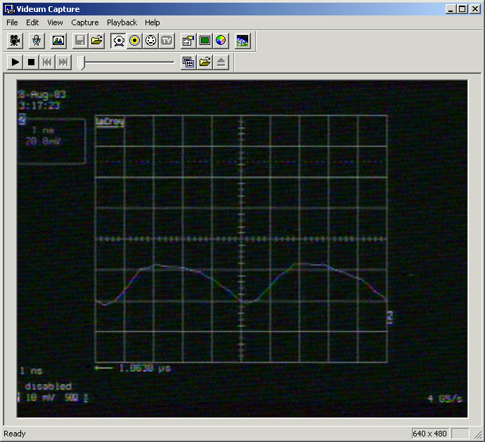
Debuncher Studies (Prebys, Tomlin)
Debuncher, historically tuned to maximize beam throughput.
Seems to “like” to run at a fairly large accelerating phase (70 degrees).
Suspected this was related to velocity-dependent instabilities.
Tried to optimize injection for zero debuncher phase.
Conclusion: we don’t understand what the debuncher is doing.
200 MHz bunches in Booster – Normal operation
Debuncher at zero phase -> much worse performance.

