Slide 1
Booster Corrector System
The existing Booster corrector system is marginal:
  Cannot control orbit adequately at high field
  Cannot control tune at high field
It appears that the few $M that would be needed to build a better corrector system could reasonably appear under the “proton plan”.
We want to make sure that we specify the system that we need.

Slide 2
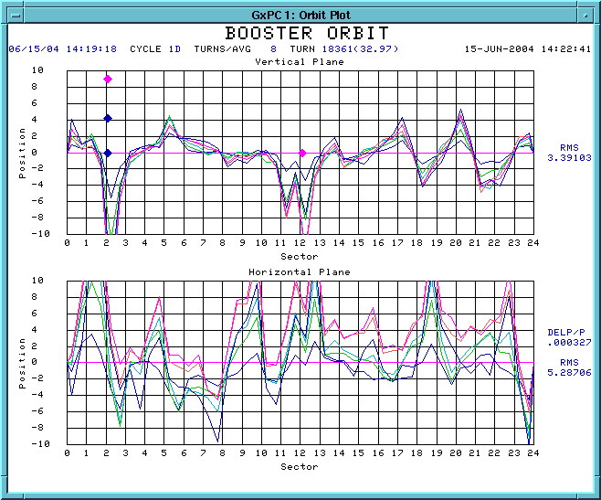
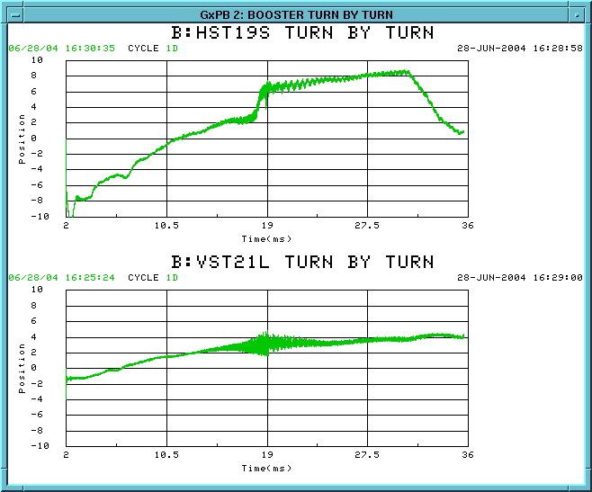
Background – Beam Motion
Preliminary specs:
  +- 1 cm beam motion in both planes at all energies
  1 mm/ms slew rate up to transition

Slide 3
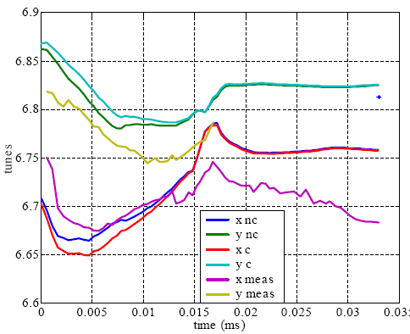
Beam Tune
Preliminary spec
  +- .1 unit at all energies
  .01 unit/ms at all energies
Is this enough??

Slide 4
Magnetic Specs
Type | Max. Field | Max. Slew Rate
Horizontal Trim | .009 T-m | .5 T-m/s
Vertical Trim | .015 T-m | .8 T-m/s
Quadrupole | .08 T-m/m | 8 (T-m/m)/s
Skew Quadrupole | ?? | ??
This is about 4 times as powerful as the existing system.
Questions:
  Are these specs reasonable?
  Did I do my calculations correctly?
  What do we want for skew quads?

