Slide 1
Bottom Line Numbers
The proton source is currently delivering about a fifth of what MiniBooNE would like.
Worrisome levels of activation in the Booster mean we will not push beyond this level without improvements in losses.
Some limits have been lowered, at least in preparation for the January shutdown.
Collimator shielding has been cancelled for the January shutdown.
We’ll proceed as best we can without it.

Slide 2
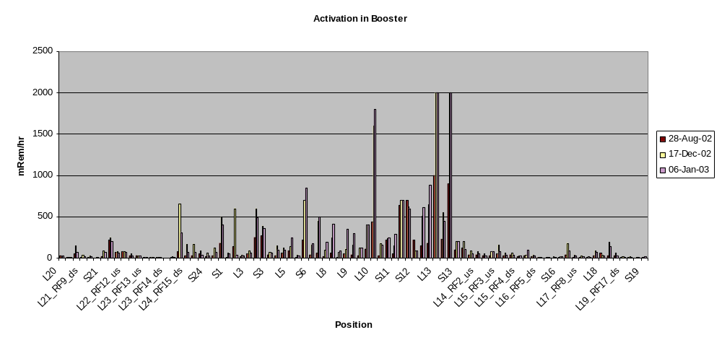
Activation in Booster

Slide 3
Bad News: Booster Collimator Shielding Cancelled for January
Radiation levels in the area of the collimators meant that it would require several crews to complete the shielding job.
The awkwardness of location made it likely that the beam pipe or bellows would be damaged – particularly if we had multiple crews trying to work quickly.
The existing design did not allow for servicing of the motors, LVDT’s, or vacuum flanges without unacceptable radiation exposure. Risk of significant downtime (weeks or more).
Important “details” (e.g. cooling) had not been worked out.
There was no provision for the eventual removal of the system.
Conclusion: Remove collimators during January shutdown and do it right.

Slide 4
Conceptual Design of Collimator
Integrate collimator and enough shielding for at least twice present Booster flux at 1% high field scraping into a movable system which can be assembled externally and installed quickly (~ 1 day)
Design must include a clear plan to scale up to the full shielding (MiniBooNE+NuMI @ 2% scraping).
After extended operation at full flux:
  There must be a reasonable method for servicing the motors and LVDT’s.
  There must be a reasonable plan to remove the central collimation system (“coffin”) in the event of a catastrophic failure (e.g. vacuum leak).
  There must be a reasonable plan to remove the entire system in the event Santa brings us a new Booster.

Slide 5
Collimator Plan
Peter Kasper will manage project.
Design will be hashed out with full participation of Gerardi and Mokhov.
Goal: converge on a plan of action by Jan 21st.

Slide 6
Good News on Personnel Front
Chuck Ankenbrandt has joined group as “Beam Physics Liaison”, charged with prioritizing studies.
Xi Yang (postdoc) will soon join group, primarily working on non-invasive profile measurement. Will also directly assist Chuck.
Xiaobiao Huang (graduate student) will come up from Indiana to work on precision lattice measurement and study mechanisms of beam loss from space charge.
Linda Coney (postdoc) has begun to contribute significant time. Primarily working on beam steering and (soon) lattice measurement.
We have (we hope) identified a person for the low level RF Engineering position.

Slide 7
Developments on Studies/Modeling Front
Completed calibration of IPM (ionization profile monitor).
Used DC beam time to measure emittance growth at injection – to be used to compare to models.
Space charge group has begun to focus on Booster again. Charges:
  Determine mechanism of space charge related beam loss.
  Identify likely important components of Booster model
    Alignment error.
    Multipole contributions.
    Aperiodicity (leads to extra harmonic instabilities)
    Estimate effect of large aperture RF cavities.

Slide 8
RF Upgrade Project
Vacuum prototype proceeding; still plan to have ready for the summer shutdown.
When design is complete, it is planned to have universities machine the components for a second prototype.
Example plans have gone out to get an idea which machine shops are capable of machining the necessary parts.

Slide 9
Plan
Collimator delay is a major blow; it was hoped that we would be entirely done with hardware projects for the near future.
The booster will be back up the last week of the shutdown. This will allow several days of dedicated studies:
  Optimize steering correction.
  Test Gamma-t jump.
  DC space charge studies
  ??
Proceed with collimator design and do the best we can do.

