Slide 1
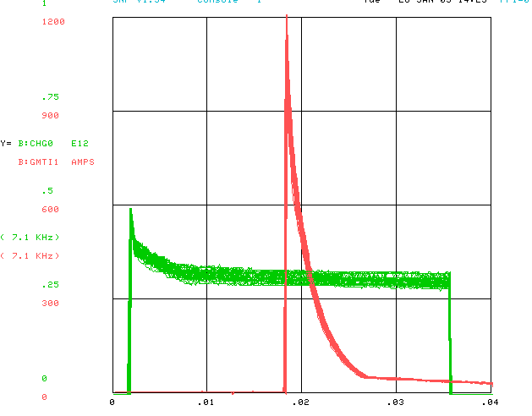
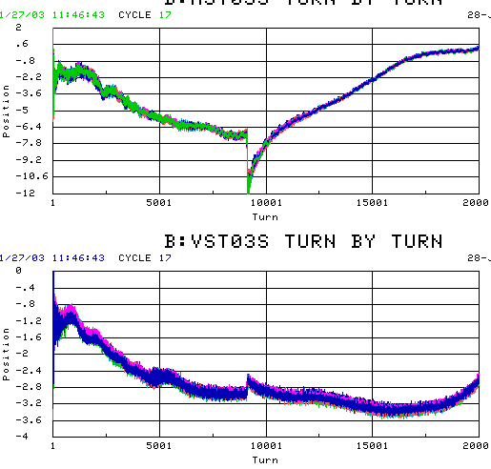
Gamma-t Jump
Commissioned in mid-80’s and used operationally.
Historically, quad misalignment caused beam steering, and low longitudinal emmittance exacerbated coupled bunch instabilities. Shut off in 90’s
After Jan. shutdown, we started it up again, with the goal of seeing if there’s any mode in which it can help us.

Slide 2
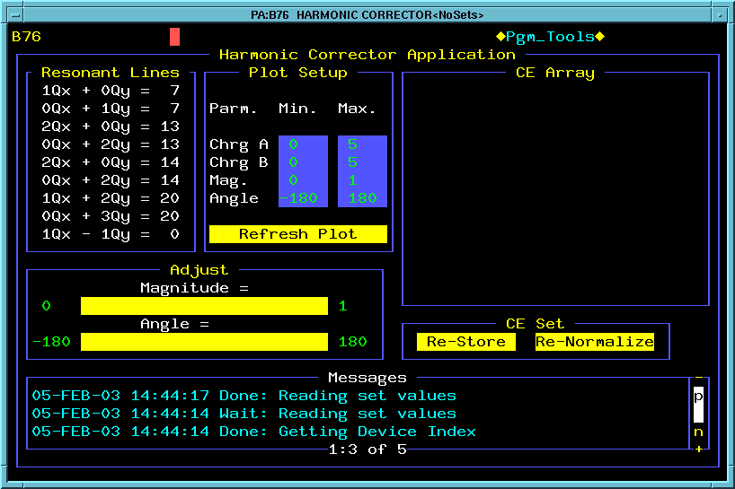
Stopband Corrections
Apply the following stopband corrections as fixed offsets, to which ramps are added.
Could possibly improve with ramped corrections.

