Slide 1
Proton MiniBooNE Projections
Eric Prebys
FNAL Accelerator Division

Slide 2
What Limits Total Proton Intensity?
Maximum number of Protons the Booster can stably accelerate: 5E12
Maximum average Booster rep. Rate: currently 7.5 Hz, may have to go to 10 Hz for NuMI+ (full) MiniBooNE
(NUMI only) Maximum number of booster batches the Main Injector can hold: currently 6 in principle, possibly go to 11 with fancy loading schemes in the future
(NUMI only) Minimum Main Injector ramp cycle time (NUMI only): 1.4s+loading time (at least 1/15s*nbatches)
Losses in the Booster:
  Above ground radiation
  Damage and/or activation of tunnel components
Our biggest worry at the moment!!!!

Slide 3
Operating Scenario
Run II gets what it needs:
  Only pBar production is a significant user of protons.
MiniBooNE get’s whatever it can on top of that, within the current local and total loss limits
  Presently, MiniBooNE gets about 9 times the protons of stacking
Lab policy:
  When NuMI turns on in 2005, it will get whatever protons it can after stacking.
  MiniBooNE will continue to run if there are more protons available.
  (more about this later…)

Slide 4
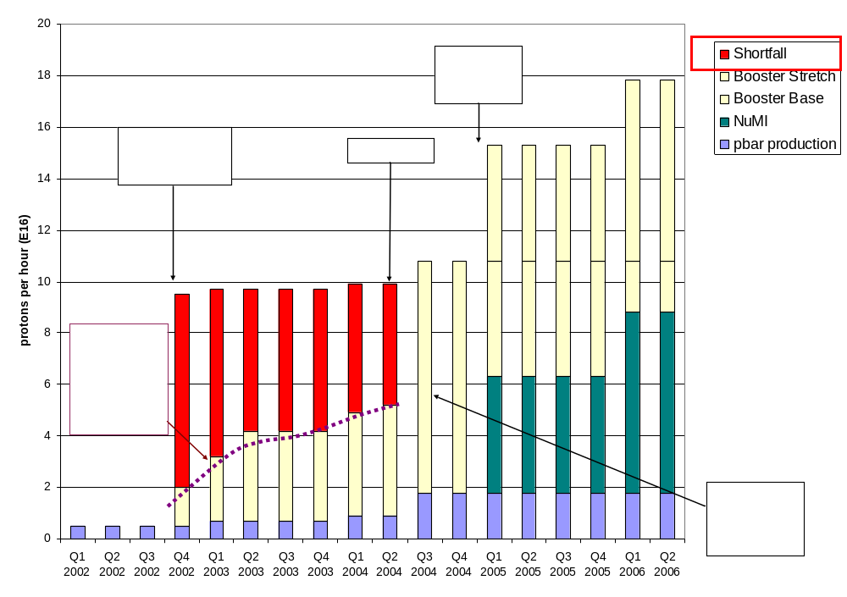
Proton Demand
We'll come back to this plot later

Slide 5
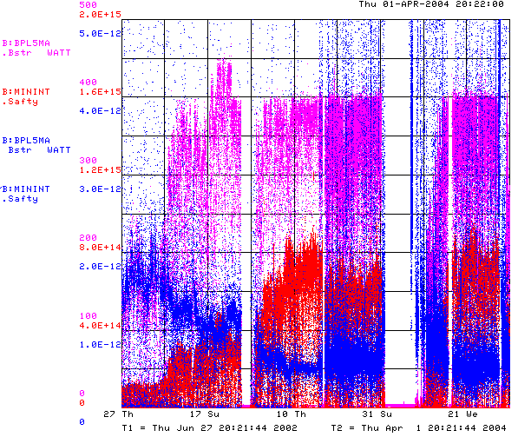
How are We Doing?
Power loss (W)
Protons (p/min)
Energy Lost (W-min/p)
Record Performance
BooNE turn-on (Sept. 2002)
“Mysterious”
Performance Problems
Big Shutdown

Slide 6

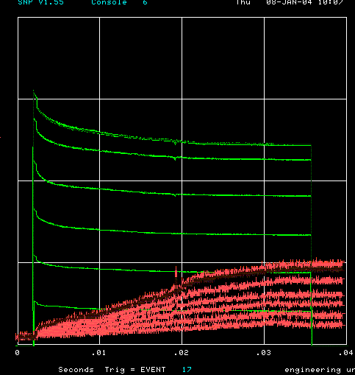
How far have we come?
Before MiniBooNE
Now (same scale!!)
Charge through Booster cycle
Time (s)
Energy Lost
Note less pronounced injection and transition losses

Slide 7
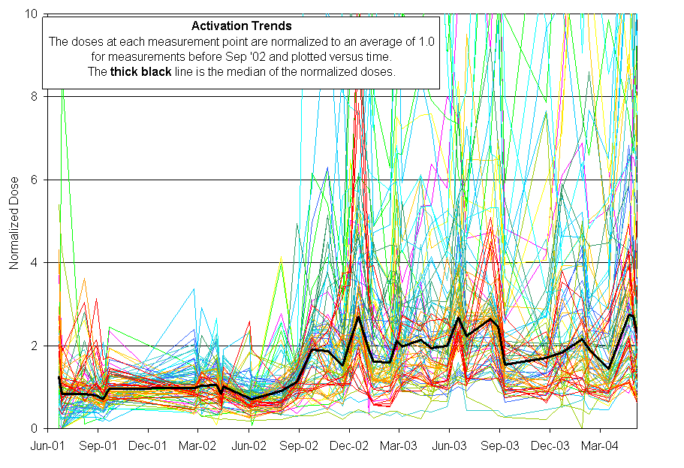
Activation History
MiniBooNE
Protons increased x10
Activation increased by ~3

Slide 8
Near Term Priorities (through early 2005)
Collimator Commissioning
Beam Cogging (synchronizing multiple batches to the Main Injector)
Alignment
L13 modifications
Add two RF cavities to the Booster, increasing the total number to 20.
Injection Bump (ORBUMP)
  Power supply
  Magnets

Slide 9
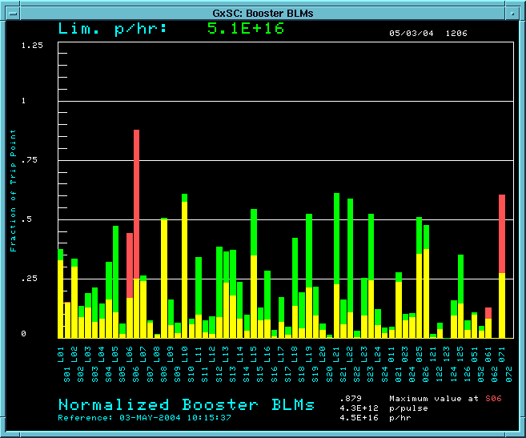
Collimator Commissioning
We have begun to use the collimators in normal operation:
Not (yet) as good as expected, but encouraging.
RF Region
Losses w/o collimators
Losses with collimators

Slide 10
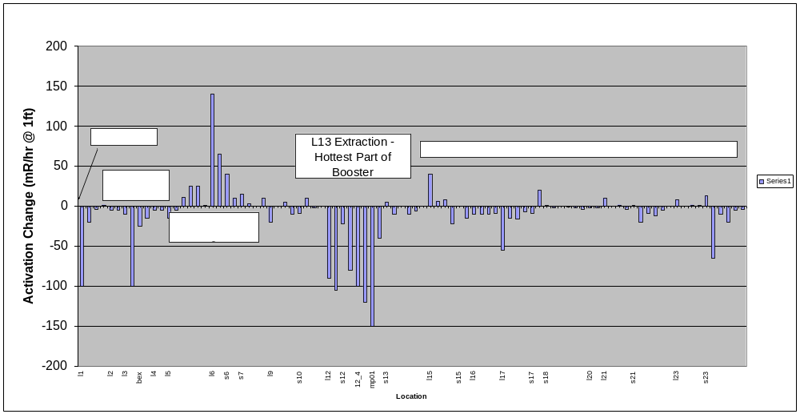
Effect of Collimators on Activation
One week of continuous collimator operation….
  Difference from previous week measurement (mr/hr @ 1ft)

Slide 11
Plan for collimator commissioning
Complete commissioning of feedback positioning system
  Move collimators in until losses observed on selected loss monitors
Find optimum position of primary and secondary collimators
Modify booster orbit to move losses from period 13 to collimators

Slide 12
Alignment
We will continue to improve vertical and cavity alignment as opportunities arise
Throughout the year, we will introduce a full laser-tracker network with the goal of having a complete 3D as-found, by the end of the Summer shutdown.
Will focus on a horizontal plan next year.

Slide 13
Increasing Number of RF cavities
Thanks to recent modeling and RF study progress, we now understand that our existing RF system is marginal for getting beam through transition
  Can get 6.5E12 to transition, but it falls out
  Performance significantly degraded when we lose one cavity (out of 18).
We have two large aperture prototype cavities which were built with significant help from universities.
We would like to use these to increase the total number of cavities
  At least one in by the end of Summer shutdown
  Second some time in 2005

Slide 14
Other Projects
L13 Modifications:
  Modify like L3 to reduce the overall “dogleg effect” by ~80% relative to when it was discovered (factor of 2.5 better than now).
  Will happen in Summer shutdown
ORBUMP magnet and power supply replacements:
  Enable reliable high repetition rates.
  Increase bending power to correct injection mismatch.
  Will happen early to mid-2005

Slide 15
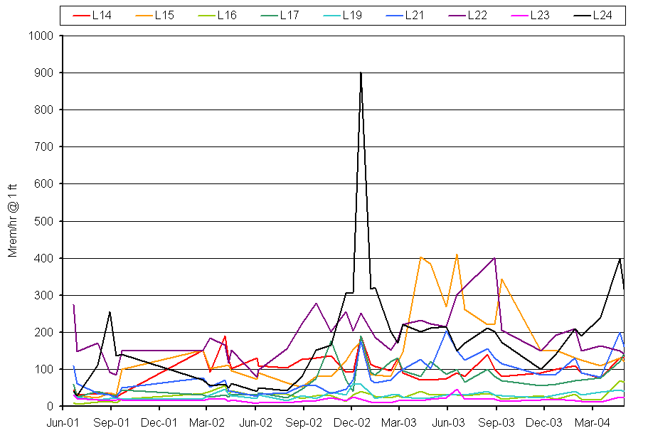
RF System Activation
Activation at RF Cavities
10x more protons
MBooNETurn on
Always been hot cavities
Some hot
Some cool
Date
It’s hoped that a combination of alignment and collimators can keep activation under control (initial data very encouraging).

Slide 16
Increasing intensity with collimators
Our level of activation in the Booster has been more or less constant for more than a year.
It is “OK”:
  Employee exposure within limits
  We believe we have reached equilibrium in terms of radiation damage repairs.
We do not wish to increase it!!
Currently, our most accurate measure of Booster activation is the power loss, which is calculated from lost protons.
This will cease to be a good measure once the collimators are implemented.
Our plan is to measure activation at a set of chosen locations on a weekly basis
  Impact ~2 hrs/wk
As activation is observed to decrease, we will increase intensity to keep it roughly constant.

Slide 17
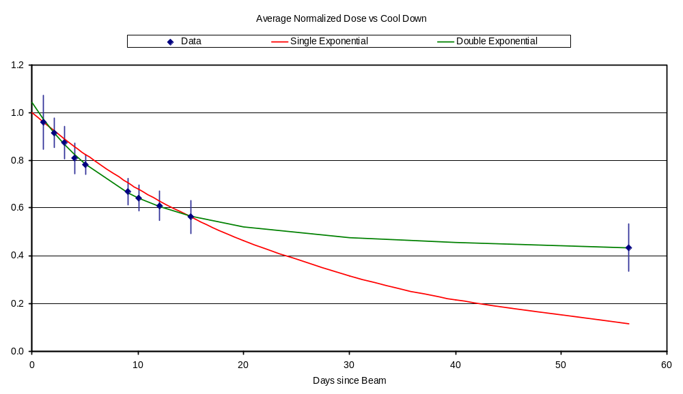
Predicting Rate Based on Cooldown
Best fit with two roughly equal components:
  Half-life 5.6 days
  Half-life 282 days (⁵⁷Co)
Predict effect of increase method based on this model.

Slide 18
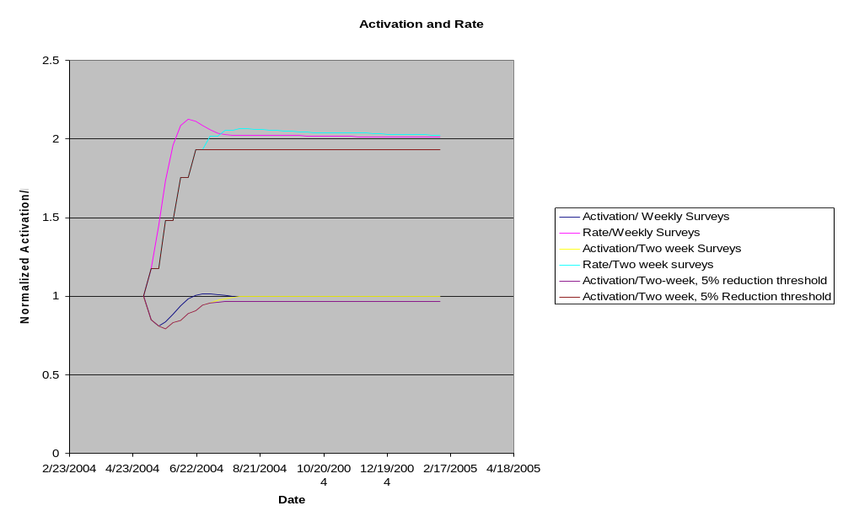
Rate Increase
Assuming 50% loss reduction

Slide 19
Risks of Going from 5Hz -> 7.5 Hz
ORBUMP Power supply
  Capacitor failure
    Risk: Certainty
    Action: Replace all capacitors with new ones (two full changeouts in hand)
    Impact: ~1 day
  SCR Network (minor failure)
    Risk: Moderate
    Action: Replace SCR (two full changeouts)
    Impact: ~1 shift
  SCR Network (major failure)
    Risk: Small
    Action: Intall new switch network, cables, and cable header
    Impact: ~1 week
  Recover Choke
    Risk: Small (much cooler now that water flow is increased)
    Action: Repair coil (or replace entirely)
    Impact: ~1 day (to several days)

Slide 20
Risks (cont’d)
ORBUMP Magnets
  Vacuum failure
    Risk: Moderate
    Action: Attempt to repair in place
    Impact: 1 shift
  Magnet failure (possibly due to vacuum failure)
    Risk: Moderate
    Action: Replace (two spares for four magnets)
    Impact: ~1 day; reduce MB rate
  > two magnets fail irreparably
    Risk: small
    Action: accelerate new magnet production
    Impact: ~several months

Slide 21
Risks (cont’d)
RF System
  Modulator/PA problems
    Risk: Moderate
    Action: Repair
    Impact: hours -> 1 day
  Blocking capacitor
    Risk: Moderate
    Action: Replace (full replacement set), resurrect cooling
    Impact: few hours; plus time to recommission cooling.
MP02 Septum:
  Magnet Failure
    Risk: Small (rated for 15Hz)
    Action: Replace (Currently two spares)
    Impact: 1-2 days

Slide 22
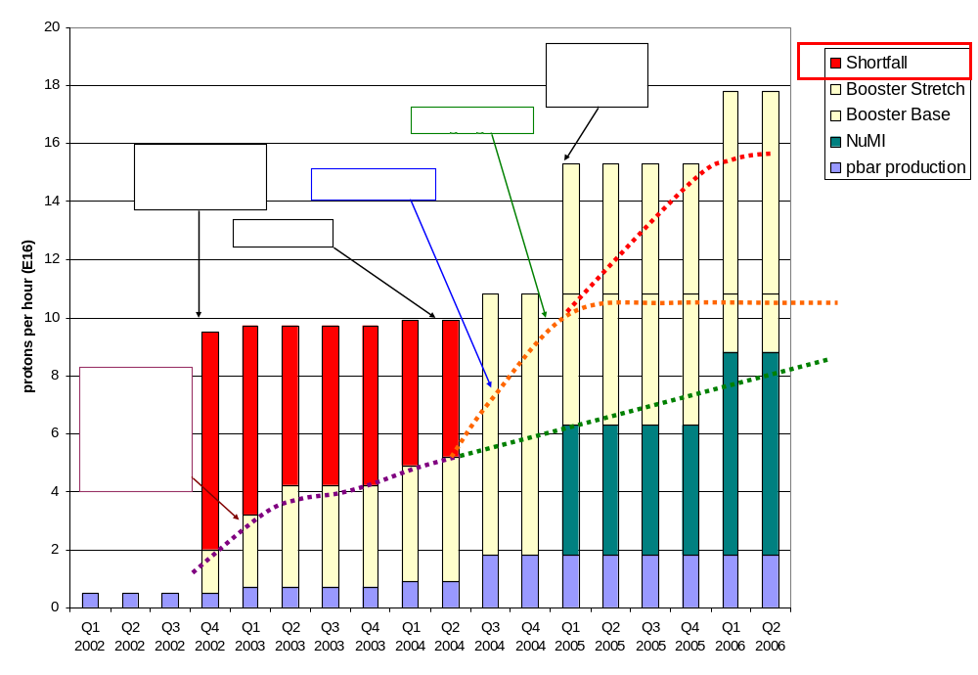
Making Projections
Stretch
Optimistic
Conservative
This week!!!

Slide 23
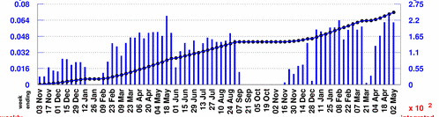
Projecting to MiniBooNE
Rather than use the instantaneous rate, will scale from typical weekly MiniBooNE totals:
Baseline Scenario:
  Improvements compensate for increased protons to pBar -> Continue to average 5.5E18/wk
  MBooNE shuts OFF 1/05
Optimistic Scenario:
  MBooNE rate increases more or less linearly to 10E18/wk at 1/05
  5.5E18/wk after NuMI turns on.
Stretch Scenario:
  MBooNE rate increases linearly to 10E18/wk at 1/05
  5.5E18/wk after NuMI turns on.
  Linearly to 10E18/wk on 1/06
Typically 5.5E18/wk

Slide 24
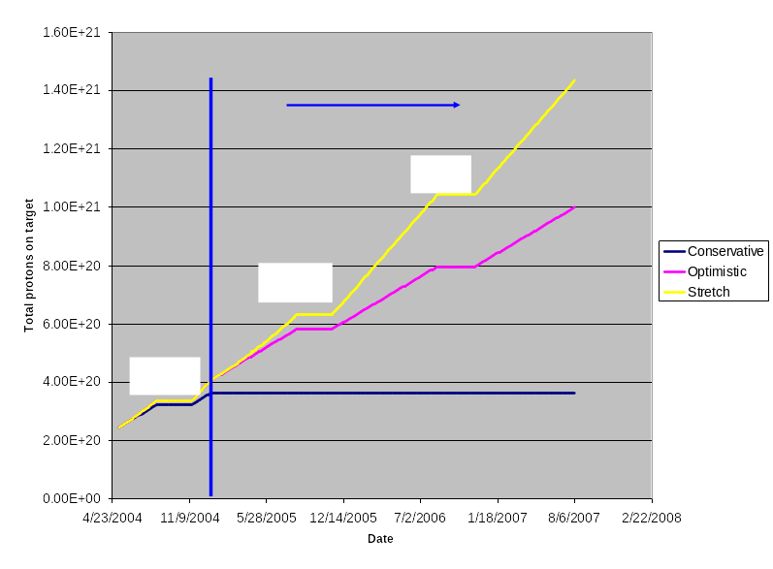
Protons to MiniBooNE

Slide 25
Projecting in Your Head
5E12@5Hz = 9E16 protons/hr = 5E20 protons/yr
MiniBooNE has ~2.5E20 protons now
If we hit 9E16 tomorrow, we would just make 5E20 by 1/05.
After NuMI turn:
  If 1E17 pph remains limit: Another 2 yrs to get to 1E21.
  If limit goes to 1.6E16 pph: Can do it in another year.

