Slide 1
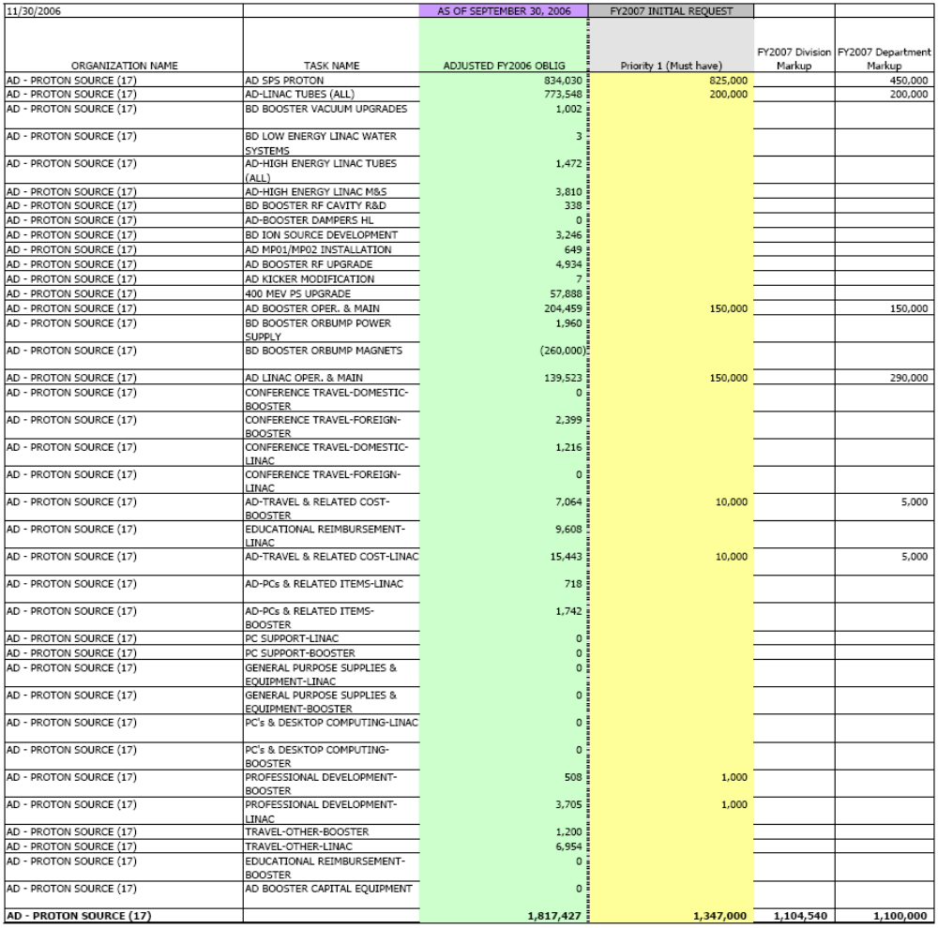

Slide 2
Changes to budget
Reduce overall tube budget
  Old budget aimed at increasing stock. ($1,025M)
  Now have 12 (strategic) + 8 spares
  Aim at keeping that ($650K)
    Enough for ~8 rebuilds + all other tubes
Keep Linac and Booster operating at more or less last year’s level
  Additional money under linac operating for ion source vacuum upgrades

