Slide 1
Eric Prebys
Particle & Accelerator Physicist
Fermilab

Slide 2
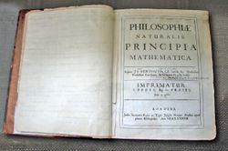
What does a physicist do?
Physicists try to figure out and use the mathematical “rules” that describe the universe:
  People have been trying to do this since the dawn of history, but modern physics started in the 1680’s, when Isaac Newton figured out that the complex motion of the planets could all be figured out from a few simple equations.
Some things physicists think about:
  Fundamental:
    Why do particles have the mass they do?
    Why is the universe mostly matter and not antimatter?
  Practical:
    How can we get useful energy from nuclear fusion?
    How can we put more information on a disk (or “Why DVD blue?”)?
RMS Career Day, April 5th, 2007 - Eric Prebys

Slide 3
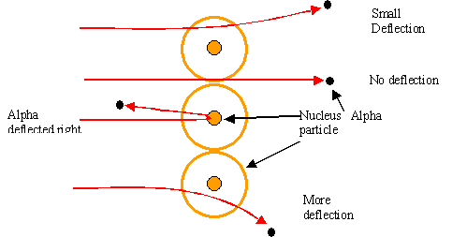
What do particle physicists do?
Particle physicists use high energy particles to study things far to small to be seen any other way
  Find the smallest particles
  Find the rules for how these particles behave
  Recreate conditions as they were right after the Big Bang
The first “particle physics experiment” told Ernest Rutherford the structure of the atom (1911)
Study the way radioactive particles “scatter” off of atoms
RMS Career Day, April 5th, 2007 - Eric Prebys

Slide 4
What do accelerator physicists do?
Accelerator physicists design, build, and operate the machines that accelerate particles to high energies for use in:
  Particle physics
  Medicine:
    Cancer treatment
    Medical isotope production
  Materials science and biophysics
    Study detailed structure of materials, cells, proteins, etc, using
      Electrons
      Protons
      Neutrons
      Photons
  Industrial applications
    Electron welding
    Food sterilization
    Etc, etc, etc
RMS Career Day, April 5th, 2007 - Eric Prebys

Slide 5
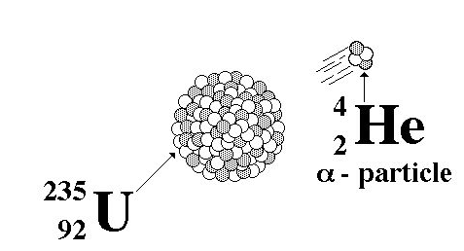
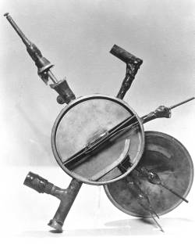
Evolution of accelerators
The first “accelerators” were natural radioactive elements
The first man-made accelerators would fit on a table
Berkley “cyclotron” (1930)
RMS Career Day, April 5th, 2007 - Eric Prebys

Slide 6
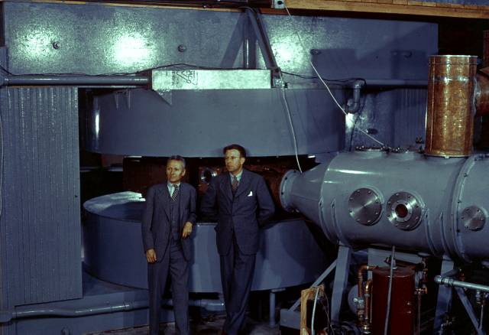
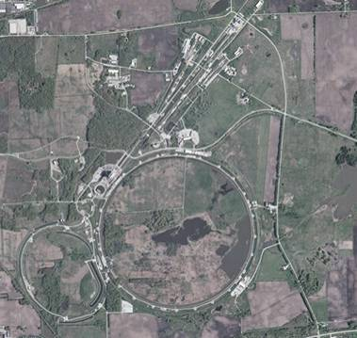
Things keep getting bigger
60” cyclotron (1935)
  Berkeley and elsewhere
Fermilab
  Built ~1970
  Upgraded ~1985, ~1997
  Most powerful accelerator in the world (for a bit longer)
RMS Career Day, April 5th, 2007 - Eric Prebys

Slide 7
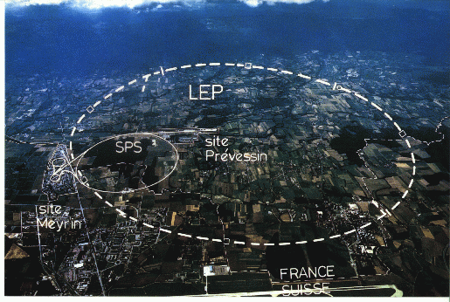
Even Bigger
CERN
  On Swiss-French border
LEP
  27 km in circumference!!
  Built in 1980’s as an electron positron collider
Large Hadron Collider (LHC)
  Being built in LEP tunnel
  Will start up later this year
  About 7 times more energy that Fermilab
My House (1990-1992)
/LHC
RMS Career Day, April 5th, 2007 - Eric Prebys

Slide 8
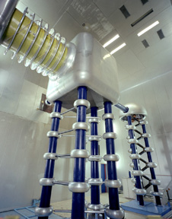
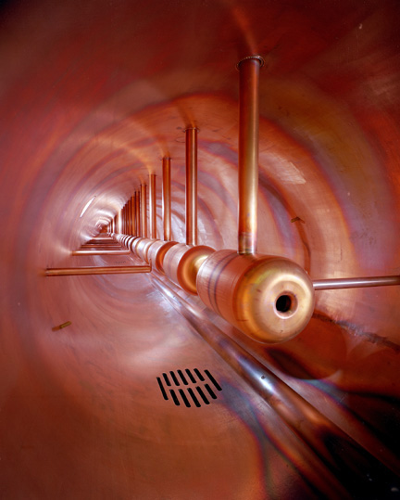
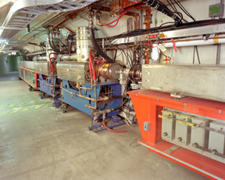
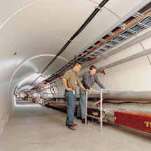
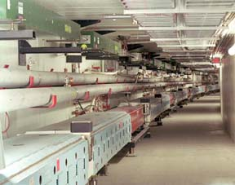
The Fermilab Accelerators
Cockcroft Walton
Linac Drift Tube
Booster
Main Injector
Tevatron
RMS Career Day, April 5th, 2007 - Eric Prebys

Slide 9
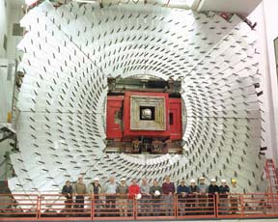
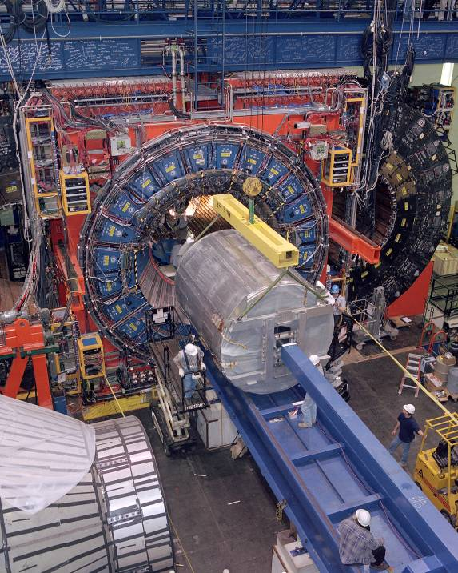
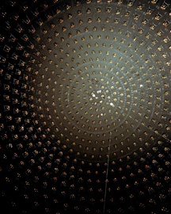
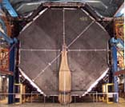
Fermilab Detectors: Seeing what comes out
CDF
DZero
MiniBooNE
MINOS
RMS Career Day, April 5th, 2007 - Eric Prebys

Slide 10
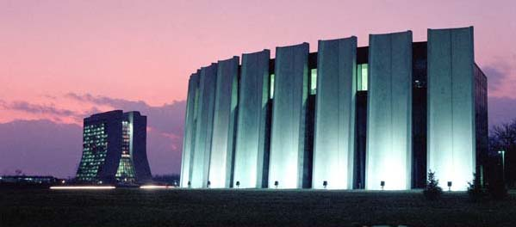
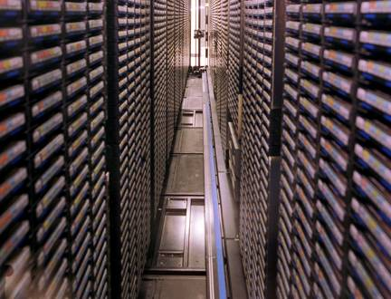
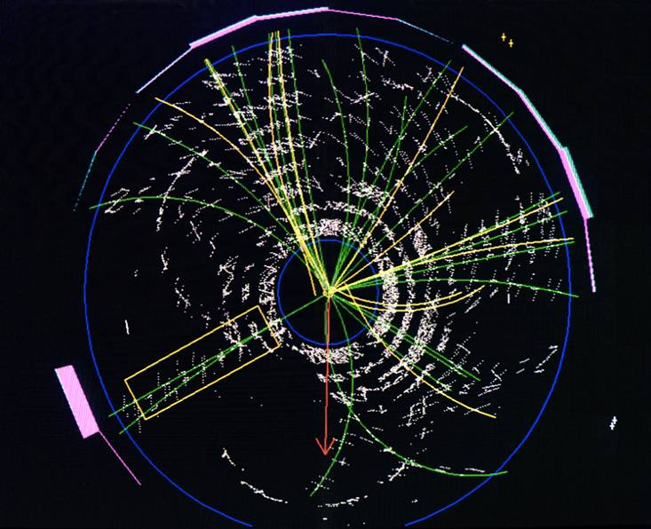
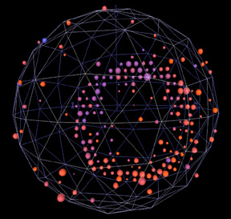
Analysis: What does it all mean?
Feynmann Computing Center
Tape Robot
CDF Top Event
MiniBooNE Neutrino Event
RMS Career Day, April 5th, 2007 - Eric Prebys

Slide 11
OK, but what do I do?
Physicists usually do many different things over the course of their careers. A few of the things I’ve spent a lot of time in the past are:
  (Fermilab, in grad school) Measuring photons to study the structure of protons
    Involved building electronics and measuring liquid Argon purity.
  (CERN, Geneva, Switzerland) Measuring how quarks are produced when electrons and positrons (anti-electrons) hit each other.
    Also worked on a software “fix” for some problems with the detector.
  (Princeton University, USA) Taught physics
  (SLAC, Palo Alto, CA, USA) Studying what happens when a really powerful laser hits an electron beam:
    In 1995, we measured something first predicted in 1935
    I worked on the “readout” for an electron detector and designed a precision particle tracker.
  (KEK, Japan) Measured the difference between matter and antimatter:
    Helped design, test and build one part of a large detector
    Also worked on a system to count bubbles to measure gas flow
RMS Career Day, April 5th, 2007 - Eric Prebys

Slide 12
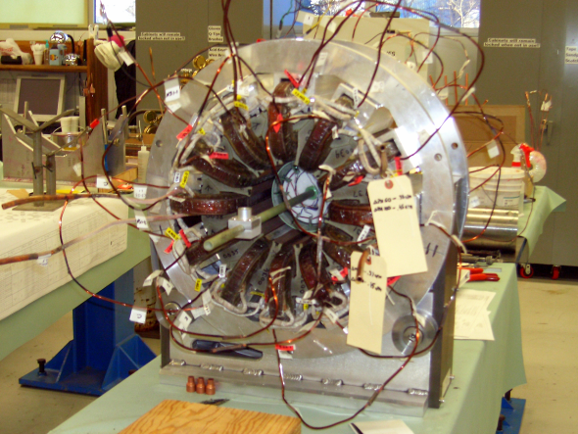
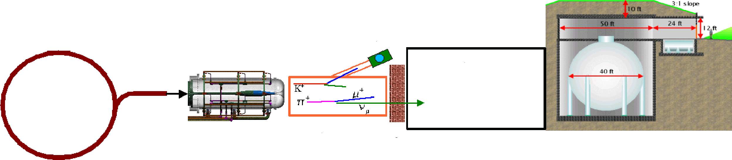
Things I’m working on now
New system for controlling beam into a very old accelerator:
Working on experiment to see if one type of neutrino turns into another:
RMS Career Day, April 5th, 2007 - Eric Prebys

Slide 13
What it takes to be a physicist
Physicists must:
  Be curious about how things work
  Like math (and be good at it!)
Education
  Bachelor’s degree (usually in Physics)
  PhD in Physics
    Takes about six years
      Two years of classes
      About four years doing research and writing thesis
    Physics students are usually supported by the University during graduate school
      Tuition is paid for
      Small monthly living expenses
Career
  After PhD, the physicist will get an entry level “postdoc” position with a lab or university for 2-4 years
  After that their “real” career begins
    Lab
    Industry
    University
RMS Career Day, April 5th, 2007 - Eric Prebys

Slide 14
Pros and Cons
Pros
  I get paid to do things I would probably do as a hobby otherwise.
  I’m always doing new stuff and learning new things.
  I get to use a lot of what I learned in school.
  I get to work around very interesting people from all over the world.
Cons
  I spent a long time in school:
    I got my PhD when I turned 27, which is actually a little on the young side.
  Since then, I’ve had to move every time I got a new job
    Can’t decide to move to a city and then look for a physics job.
RMS Career Day, April 5th, 2007 - Eric Prebys

Slide 15
Other careers in physics
Astrophysics
  The physics of stars and the universe
Biophysics
  How living things do what they do
Solid state and materials physics
  Example: semiconductors
Geophysics
  Example: how can I find where the oil is?
RMS Career Day, April 5th, 2007 - Eric Prebys

Slide 16
Other careers at Fermilab
About 2000 people work at Fermilab
  500 physicists of one sort or another
  The rest are
    Engineers (mechanical, electrical, etc)
    Computer professionals
    Technicians
    Skilled trades (electricians, machinists, ironworkers, etc)
    Business and financial support
    Administrative support
    …
  Also employ summer students
    High school
    College
RMS Career Day, April 5th, 2007 - Eric Prebys

Slide 17
For more information
Fermilab website
  http://www.fnal.gov
Lederman Science Center
  At Pine St. entrance
Email me:
  prebys@fnal.gov
RMS Career Day, April 5th, 2007 - Eric Prebys

