Slide 1
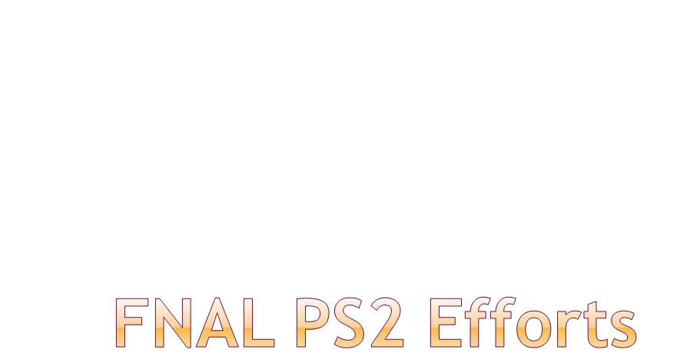
Eric Prebys
10/28/2008

Slide 2
There is a great deal of synergy between PS2 and the Fermilab Main Injector during the Project X era.
  High energy ion transport, injection, and stripping.
  High intensity stability issues
  RF
Will try to build on this synergy and exploit ongoing efforts and available manpower at the lab
  Accelerator Physics Center:
    People currently in various subgroups that will probably reorganize into Project X group
  SciDAC computing effort
    In line with core competencies
  Relationship with Muons, Inc.
    SBIR company with interest in RF
E. Prebys, LARP PS2 Session DRAFT
10/28/2008

Slide 3
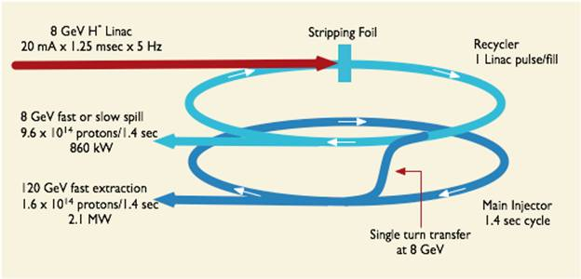
E. Prebys, LARP PS2 Session DRAFT
10/28/2008

Slide 4
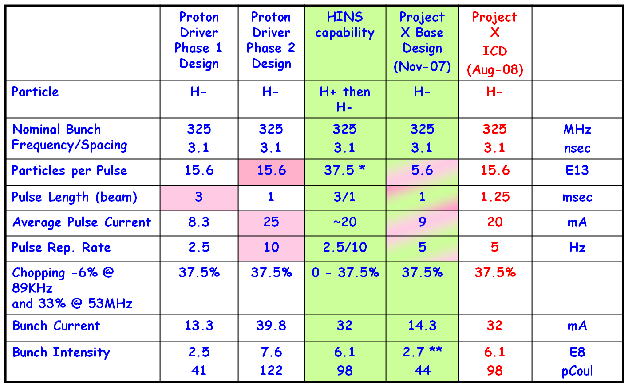
New Parameters
* full un-chopped 3 msec pulse at klystron-limited 20 mA
** ILC bunch intensity is 2E10 (electrons)
E. Prebys, LARP PS2 Session DRAFT
10/28/2008

Slide 5
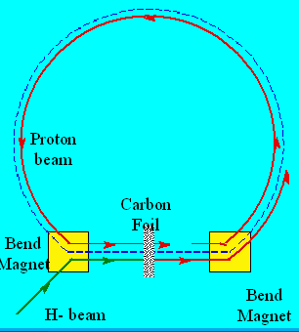
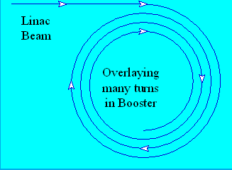
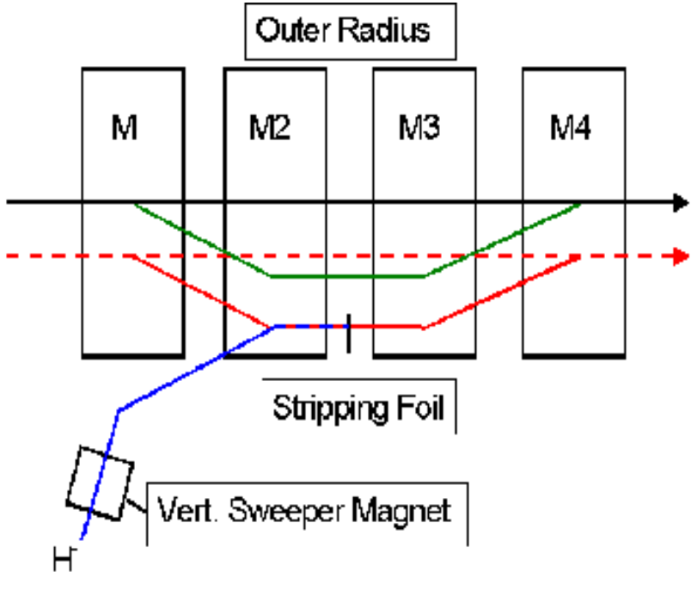
Start injection
Stripping foil
End 1st injection
End 2nd injection
Closed orbit movement
End 3rd injection
Move off foil
Closed orbit
Foil
(injected beam)
E. Prebys, LARP PS2 Session DRAFT
10/28/2008

Slide 6
Working to complete an Initial Configuration Document (ICD) prior to Collaboration meeting on Nov. 21-22
  Currently in draft 4
Use ICD to update Project X R&D plan by end of November.
Use ICD and R&D plan as basis for initial cost estimate to obtain CD0 by early summer 2009
Work on conceptual design report following CD-0
E. Prebys, LARP PS2 Session DRAFT
10/28/2008

Slide 7
H- injection/space charge/ beam collimation
  Tight synergy with Project X
  Exploit Fermilab beam deposition group (Nikolai Mokhov et al)
Instabilities, collective effects, eCloud studies
  Again, very important for Project X
  Good opportunity for multilab collaboration
  Possibly fit under existing eCloud effort even if LARP PS2 descoped?
Laser stripping?
  Lots of interest at LBL
  Not much local expertise
  Muons, Inc interested.
RF cavity development
  Similar RF frequencies at PS2 and Project X (40 MHz vs 53 MHz)
  Interest in compact cavities at Muons, Inc.
  Might be too big/risky for LARP.
*based on Uli Wienands’ notes
E. Prebys, LARP PS2 Session DRAFT
10/28/2008

Slide 8
Spun off of Accelerator Division a few years ago to separate accelerator physics R&D from operations.
Several people have expressed interest or been approached by Project X/PS2
  Francois Ostiguy
    Currently in ILC modeling group
    Interest in applying and comparing various codes to space charge and halo calculations (ORBIT, ACCSIM, etc)
  Bob Zwaska
    In High Energy Neutrino Source (HINS) group
    Interested in electron cloud calculation and modeling.
  Nikolai Mokhov
    Energy deposition group
    Extensive experience designing and simulating collimation
E. Prebys, LARP PS2 Session DRAFT
10/28/2008

Slide 9
Simulation of space charge and halo formation
Comparison and coordination of different codes (ESME, ORBIT, ACCIM, PATRIC (GSI), etc)
E. Prebys, LARP PS2 Session DRAFT
10/28/2008

Slide 10
Community Petascale Project for Accelerator Science and Simulation (COMPASS)
  Run through FNAL CD under DOE Scientific Discovery through Advanced Computer (SciDAC) program
    The SciDAC-1 accelerator project generated a suite of parallel accelerator simulation tools which were applied to important DOE accelerator projects. Under SciDAC-2, these tools will be enhanced to contain new capabilities as needed by HEP projects
  Developing a set of advanced parallel accelerator simulation tools to do space charge calculations
    Panagiotis Spentzouris primary contact
    Close contact with LBL
    Primary tool Synergia
E. Prebys, LARP PS2 Session DRAFT
10/28/2008

Slide 11
Synergia2
Nonlinear
Optics
Space
Charge
Impedance/
Wakefields
Electron
Cloud
Beam-beam
CHEF
IMPACT
Sphyraena
S2Imp
S2Electronika
BeamBeam3D
Sphyraena
TxPhysics
Scientific Computing Infrastructure
CCA
PETSc
Numpy
Matplotlib
PyTables
Numerical Computing Infrastructure
Generic Computing Infrastructure
LAPACK
FFTW
HDF5
Python
Boost
ATLAS
GSL
Flex
Bison
Synergia2 framework development includes multiple advanced accelerator physics
topics. Development is aided by relying on both internally- (orange) and externally-
(magenta) developed state-of-the-art packages. New physics modules (yellow) are
currently under development.
E. Prebys, LARP PS2 Session DRAFT
10/28/2008

Slide 12
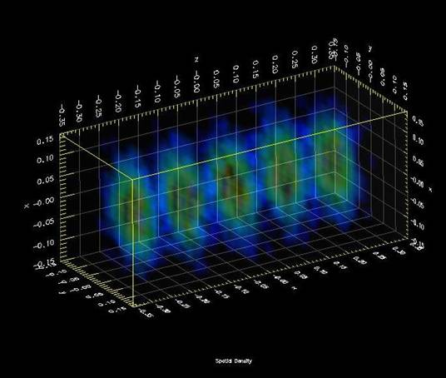
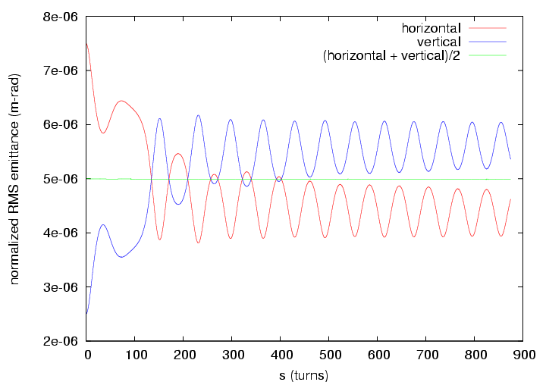
Linac injection into Fermilab Booster
Montague resonance in CERN PS
E. Prebys, LARP PS2 Session DRAFT
10/28/2008

Slide 13
Formed in 2002 to participate in the Small Business Inovating Research (SBIR) and Small Business Technology Transfer (STTR) programs.
Activities primarily focused on muon collider/neutrino factory technology, but general expertise in accelerator technology, particularly RF.
Some interest in compact tunable RF cavities, as well as laser stripping.
E. Prebys, LARP PS2 Session DRAFT
10/28/2008

Slide 14
Project X collaboration meeting
  FNAL, November 21-22
  http://projectx.fnal.gov/nov_08_collab_mtg.html
E. Prebys, LARP PS2 Session DRAFT
10/28/2008

