Slide 1
LHC Status and Plans
Eric Prebys
Fermi National Accelerator Laboratory
Director, US LHC Accelerator Research Program (LARP)

Slide 2
Outline
Background and overview
Current status
Near term plans
Long term plans
US role
Note: as usual, this workshop takes place just before the annual LHC Performance Workshop (Chamonix, Feb 6-10, 2012), so some things will be a lot more concrete in a few weeks.

Slide 3

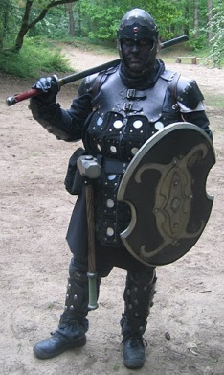
A Word about LARP
The US LHC Accelerator Research Program (LARP) coordinates US R&D related to the LHC accelerator and injector chain at Fermilab, Brookhaven, SLAC, and Berkeley (with a little at J-Lab and UT Austin)
LARP has contributed to the initial operation of the LHC, but much of the program is focused on future upgrades.
The program is currently funded at a level of about $12-13M/year, divided among:
Accelerator research
Magnet research
Programmatic activities, including support for personnel at CERN
Ask me about the Toohig Fellowship!
(I’m not going to say much specifically about LARP in this talk)
NOT to be confused with this “LARP” (Live-Action Role Play), which has led to some interesting emails
“Dark Raven”

Slide 4
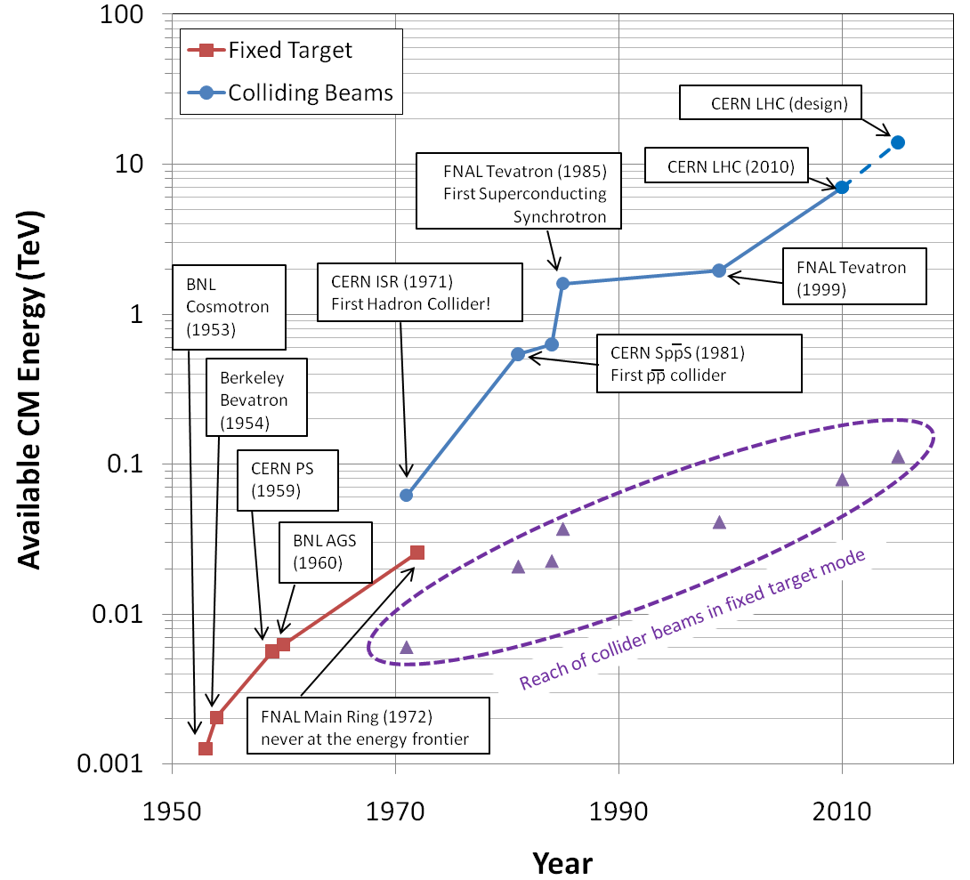
Evolution of the Energy Frontier
~a factor of 10 every 15 years

Slide 5
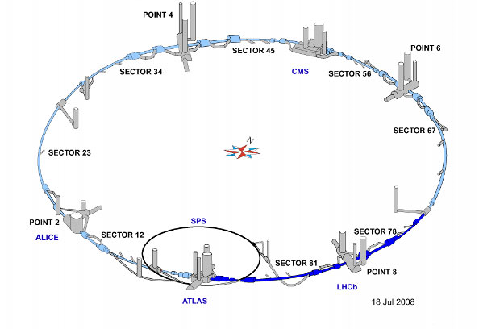
LHC Layout
8 crossing interaction points (IP’s)
Accelerator sectors labeled by which points they go between
ie, sector 3-4 goes from point 3 to point 4

Slide 6
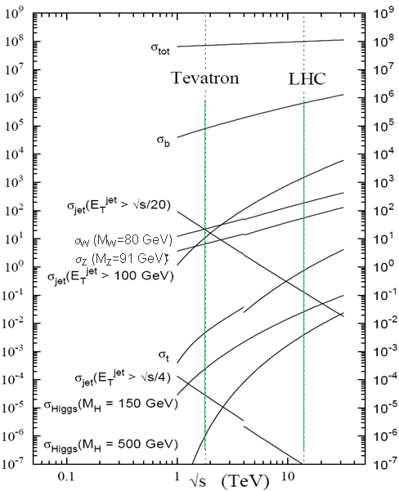
Nominal LHC Parameters Compared to Tevatron
Parameter | Tevatron | “nominal” LHC
Circumference | 6.28 km (2*PI) | 27 km
Beam Energy | 980 GeV | 7 TeV
Number of bunches | 36 | 2808
Protons/bunch | 275x10⁹ | 115x10⁹
pBar/bunch | 80x10⁹ | -
Stored beam energy | 1.6 + .5 MJ | 366+366 MJ*
Magnet stored energy | 400 MJ | 10 GJ
Peak luminosity | 3.3x10³² cm⁻²s⁻¹ | 1.0x10³⁴ cm⁻²s⁻¹
Main Dipoles | 780 | 1232
Bend Field | 4.2 T | 8.3 T
Main Quadrupoles | ~200 | ~600
Operating temperature | 4.2 K (liquid He) | 1.9K (superfluid He)
Increase in cross section of up to 5 orders of magnitude for some physics processes
*Each beam = TVG@150 km/hr ⇒ very scary numbers
1.0x10³⁴ cm⁻²s⁻¹ ~ 50 fb⁻¹/yr= ~5 x total TeV data

Slide 7
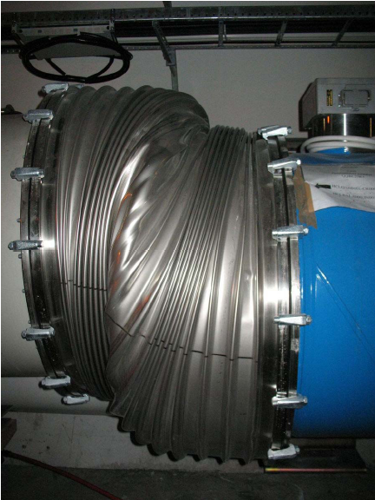
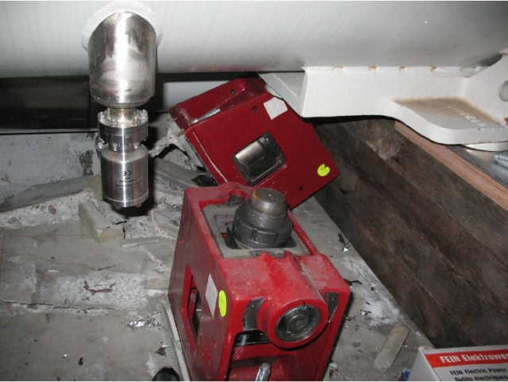
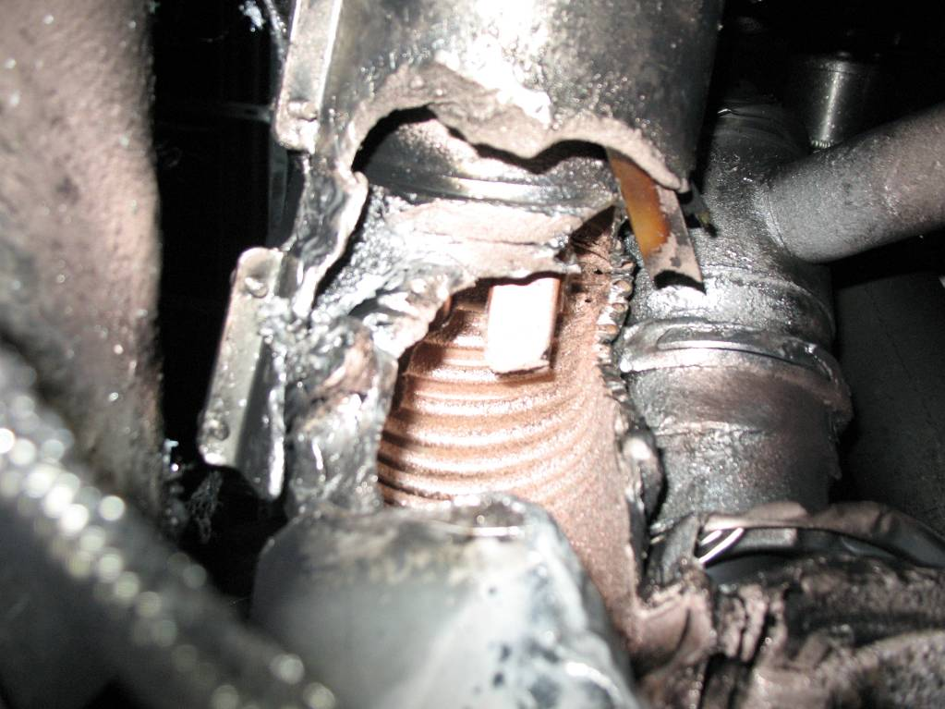
Reminder: “The Incident”
Nine days after the 2008 startup, a quench developed into an arc, causing a great deal of Helium to boil
The resulting pressure did a great deal of damage, and kept the machine off for more than a year.
Debris in beam vacuum pipe
Secondary arcs
Clean
Insulation
Soot

Slide 8
Issues related to “The Incident”
Bad joints
Test for high resistance and look for signatures of heat loss in joints
Warm up to repair any with signs of problems (additional three sectors)
Quench protection
Old system sensitive to 1V
New system sensitive to .3 mV (factor >3000)
Pressure relief
Warm sectors (4 out of 8)
Install 200mm relief flanges
Enough capacity to handle even the maximum credible incident (MCI)
Cold sectors
Reconfigure service flanges as relief flanges
Reinforce floor mounts
Enough to handle what happened, but not worst case
Beam re-started on November 20, 2009
Still limited to 3.5 TeV/beam until joints fully repaired/rebuilt

Slide 9
Digression: Making Luminosity
For identical, Gaussian colliding beams, luminosity is given by
Revolution frequency
Number of bunches
Bunch size
Transverse beam size
Geometric factor, related to crossing angle.
Betatron function at collision point
Normalized beam emittance
Recall:

Slide 10
Limits to LHC Luminosity*
Rearranging terms a bit…
Total beam current. Limited by:
Uncontrolled beam loss!
E-cloud and other instabilities
Brightness, limited by
Injector chain
Max. beam-beam
If n_{b}>156, must turn on crossing angle…
β at IP, limited by
magnet technology
chromatic effects
…which reduces this
*see, eg, F. Zimmermann, “CERN Upgrade Plans”, EPS-HEP 09, Krakow

Slide 11
Important features of the focal region
β
β distortion of off-momentum particles ∝ 1/β* (affects collimation)
s
⇒ small β* means large β (aperture) at focusing triplet

Slide 12
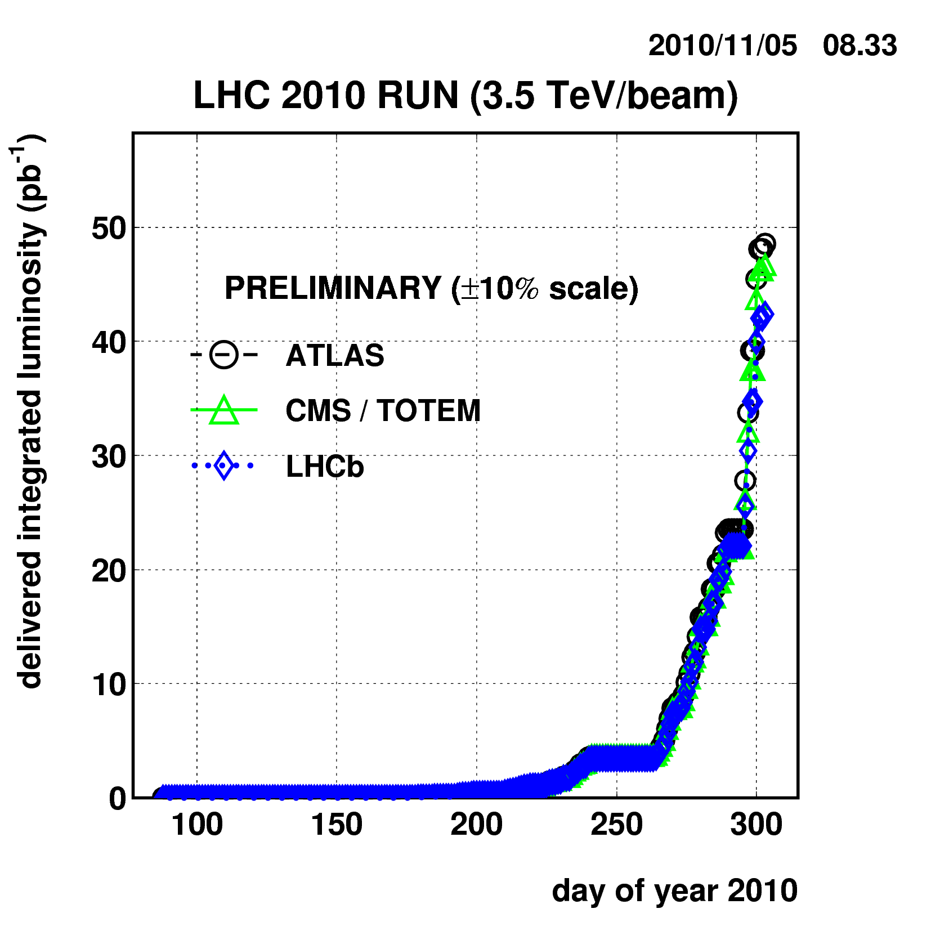
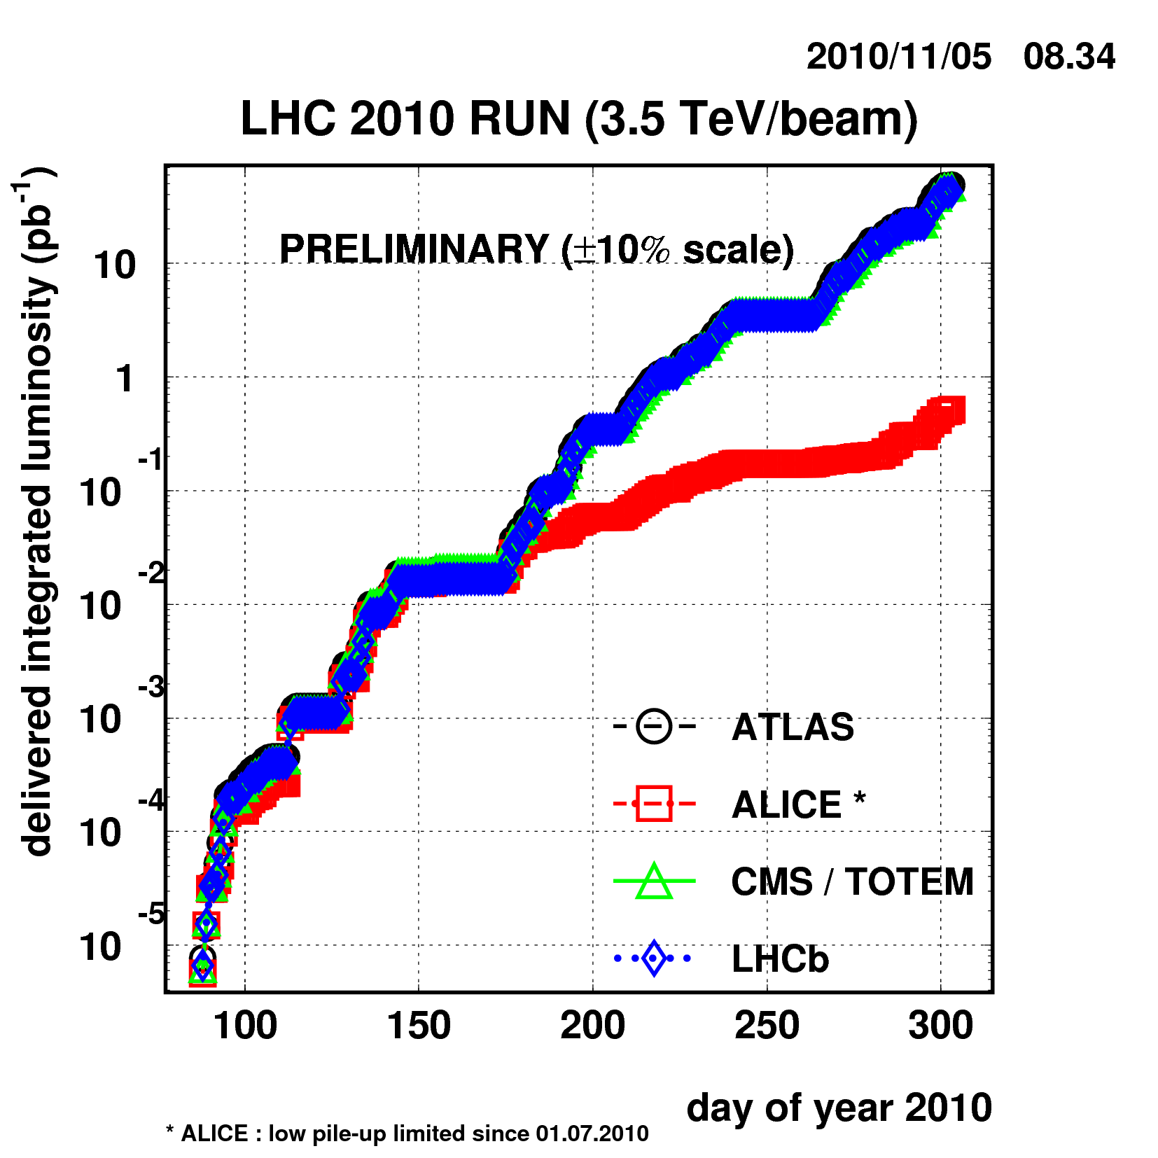
Reminder: 2010 Performance
Reached full bunch intensity
1.1x10¹¹/bunch
Can’t overstate how important this milestone is.
Peak luminosity: ~2x10³² cm⁻²s⁻¹
Enough to reach the 1 fb⁻¹ goal in 2011

Slide 13
Happy Surprises in 2010
Crossing angle not an issue
Able to commission bunch trains earlier than planned
Discovered LHC can live with much higher beam-beam tuneshift than was thought
-> Can go to larger than nominal bunches!
Emittances smaller than expected
Good quality control on field quality
Leads to larger effective aperture -> smaller β*

Slide 14
Major Questions at the 2011 Chamonix
Run through 2012?
Luminosity will likely still be increasing
Answer: Yes (no brainer)
Increase Energy to 4 or 4.5?
Can get same Higgs reach with ~20% less luminosity
5σ discovery over entire allowed mass region with 10 fb⁻¹
Answer: Raising the energy was considered too risky in 2011, so stay at 3.5 and revisit at 2012 Chamonix
Is it worth pursuing the HL-LHC upgrade?
Given the demonstrated performance of the LHC so far, it’s not unlikely that it could reach 2-3x10³⁴ cm⁻²-s⁻¹ in more or less it’s current configuration (once final collimation system is in place).
It’s unlikely the experiments can live with much more that 5x10³⁴.
Answer: Still need to pursue upgrades to reach desired integrated luminosity by 2030. Goal is 5x10³⁴ leveled luminosity

Slide 15
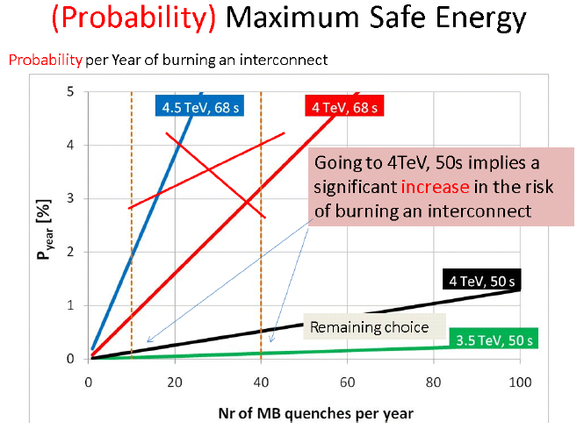
The Energy Decision*
*S. Myers, Chamonix 2011

Slide 16
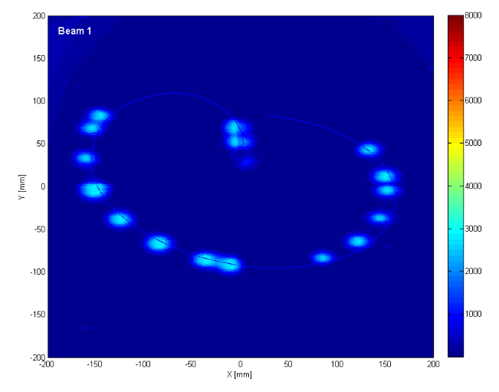
General Plan for 2011
Push bunch intensity
Achieved nominal bunch intensity of >1.1x10¹¹ much faster than anticipated.
Remember: L∝N_{b}²
Rules out many potential accelerator problems
Increase number of bunches
Gone to nominal number (at 50 ns)
Lower β* as far as possible
At all points, must carefully verify
Beam collimation
Beam protection
Beam abort
Remember:
TeV=1 week for cold repair
LHC=3 months for cold repair
Example: beam sweeping over abort

Slide 17
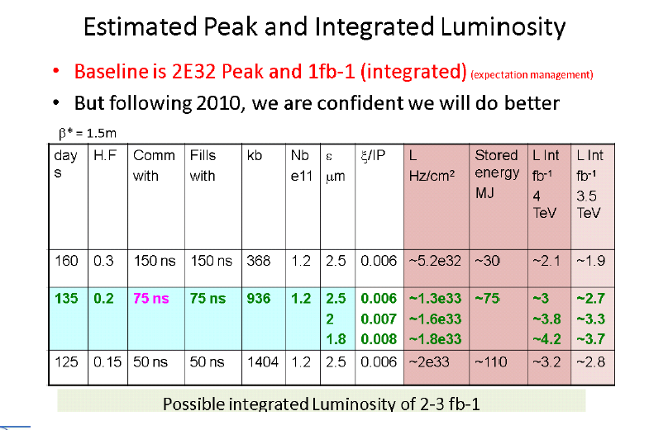
Reminder: The Plan for 2011*
*S. Myers, Chamonix 2011

Slide 18
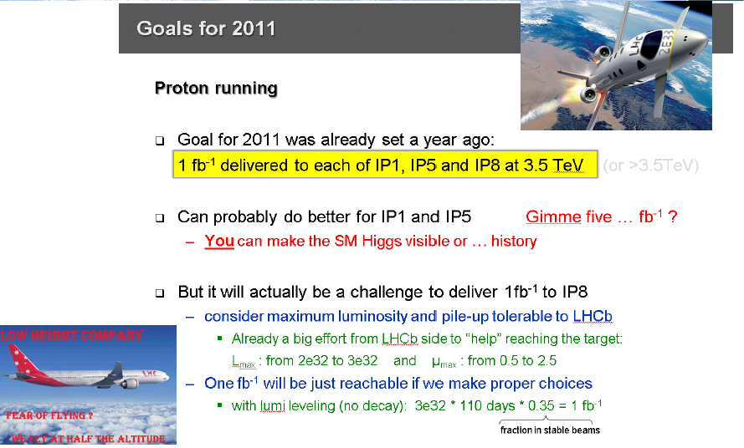
Reminder: The Goal for 2011
*S. Myers, Chamonix 2011

Slide 19
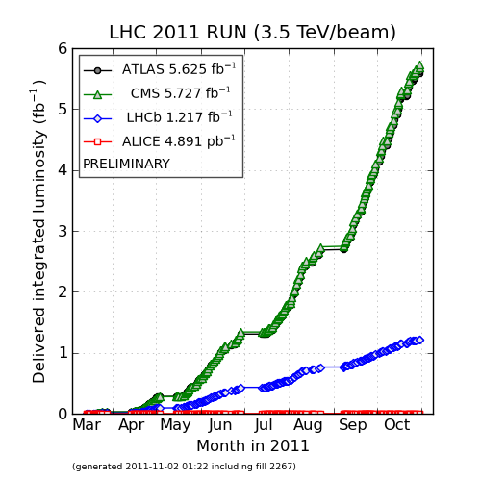
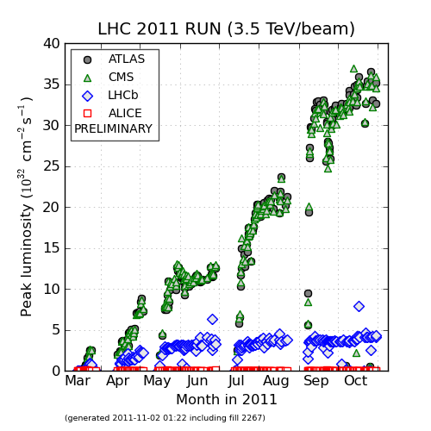
Actual 2011 Performance
2011 Goal
Tevatron Record
Peak Luminosity:
~3.6x10³³ cm⁻²s⁻¹ (36% of nominal)
Integrated Luminosity:
~6.7 fb⁻¹/experiment

Slide 20
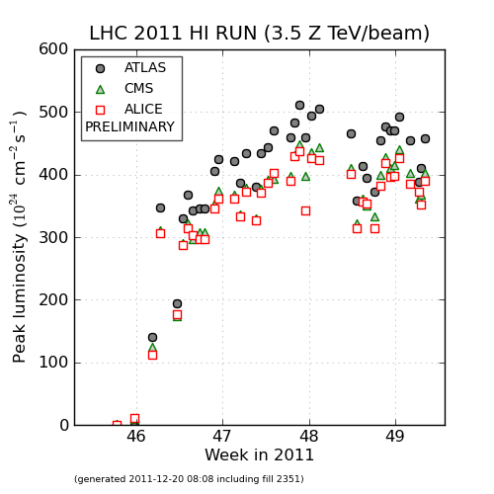
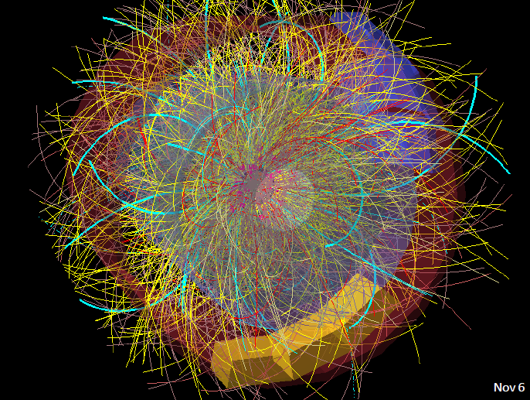
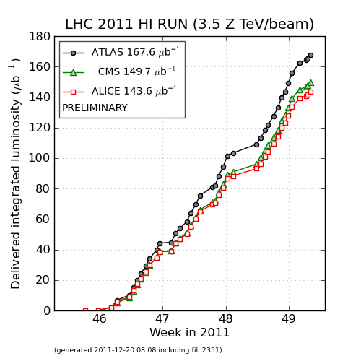
p-Pb Running
Challenge: Common RF frequency
Velocities of two beams are the same
-> momenta are slightly different
Sit at slightly different equilibrium orbits in the two rings
Nevertheless, it worked perfectly

Slide 21
Significant Achievments in 2011
Achieved ->nominal bunch intensity
Achieved standard 1380 bunch operation (limit at 50 ns)
Achieved operational β*=1m
Probably the limit at this energy

Slide 22
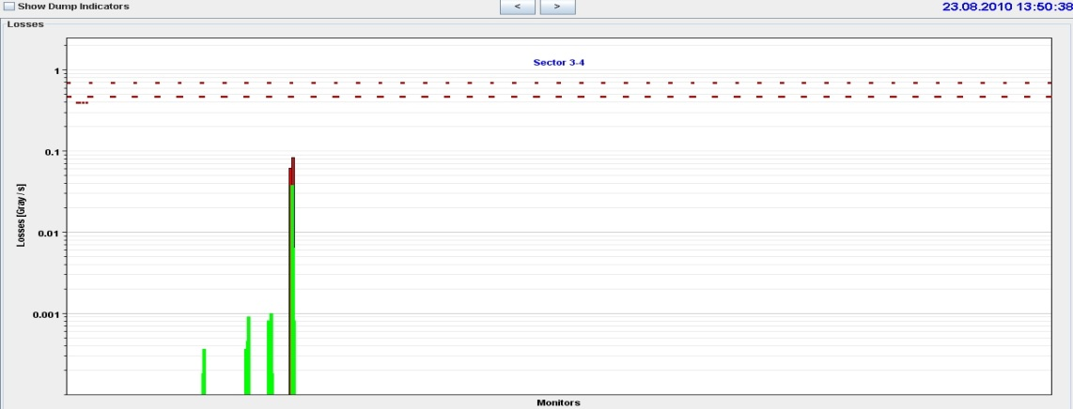
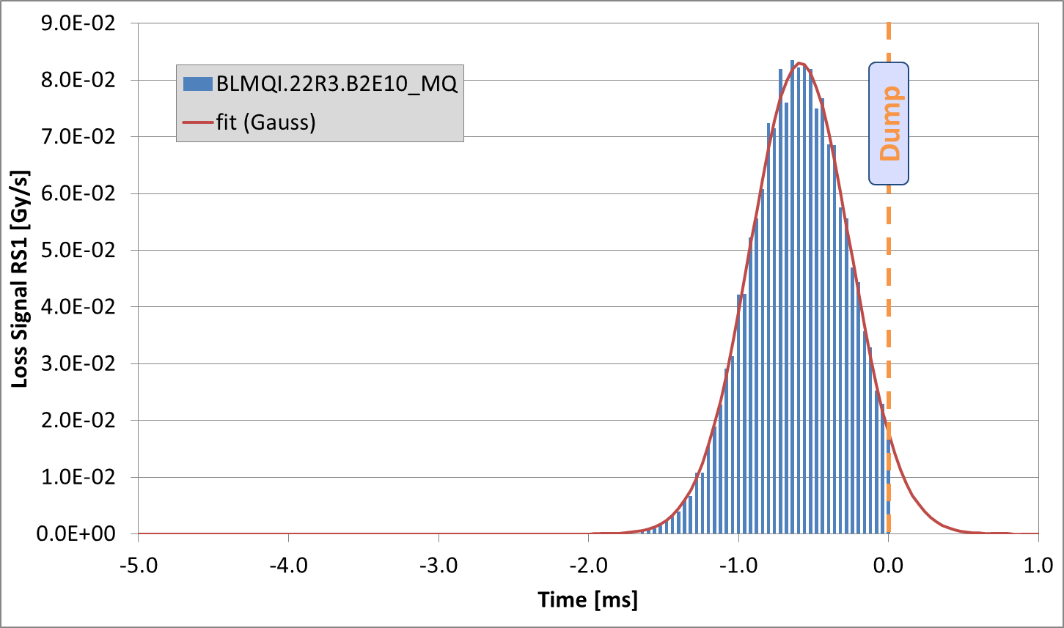
Lingering Issue: UFO’s*
Since July 2010, 35 fast loss events led to a beam dump. 18 in 2010, 17 in 2011. Over the two years: 13 around MKIs. 6 dumps by experiments. 1 at 450 GeV.
Typical characteristics:
Loss duration: about 10 turns
Often unconventional loss locations (e.g. in the arc)
The events are believed to be due to (Unidentified) Falling Objects (UFOs)
Spatial and temporal loss profile of UFO on 23.08.2010
*T. Baer, Evian Operations Workshop

Slide 23
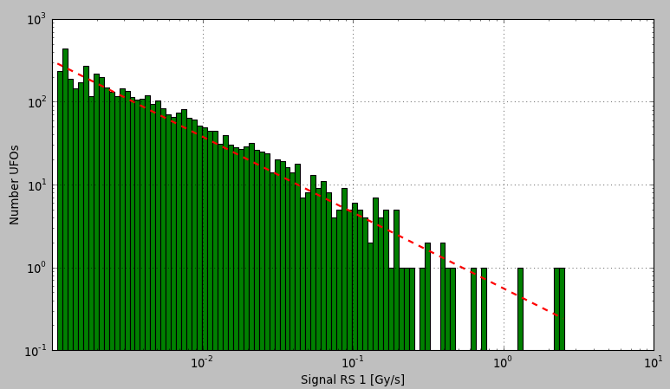
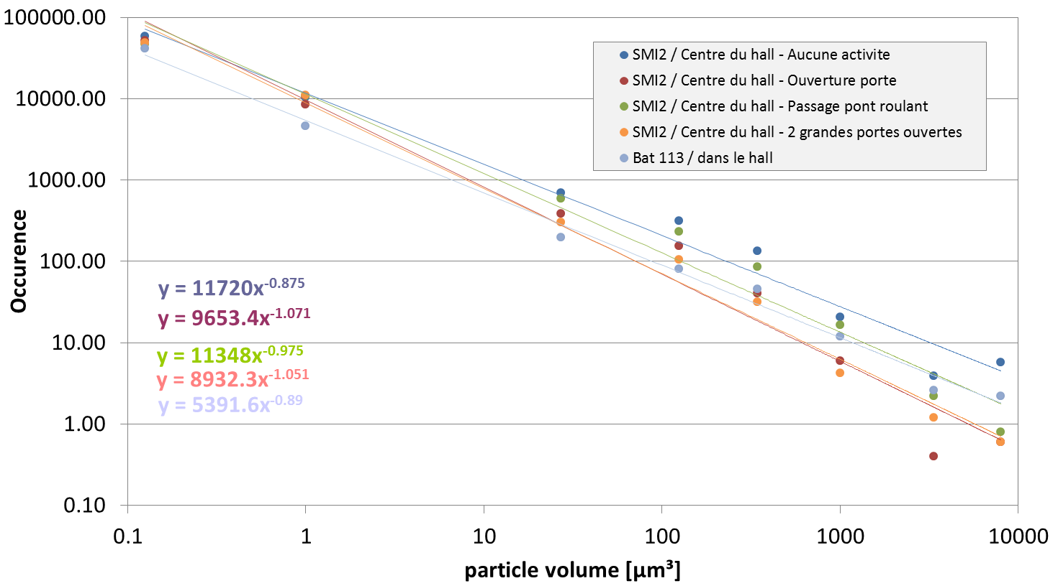
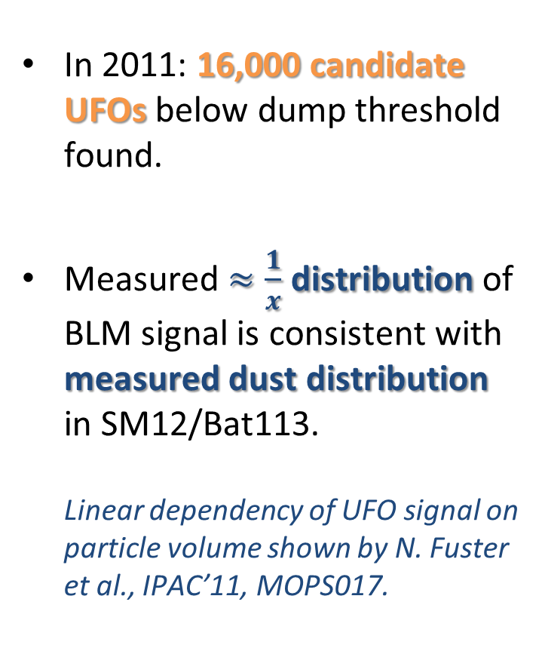


Below Threshold UFOs
In 2011: 16,000 candidate UFOs below dump threshold found.
Measured $≈\frac{1}{x}$ distribution of BLM signal is consistent with measured dust distribution in SM12/Bat113. Linear dependency of UFO signal on particle volume shown by N. Fuster et al., IPAC’11, MOPS017.
4513 arc UFOs (≥cell 12) at 3.5 TeV with signal RS01 > 1∙10⁻³ Gy/s.
$$∝x^{−0.92}$$
$$∝x^{−0.97}$$
courtesy of J. M. Jimenez

Slide 24
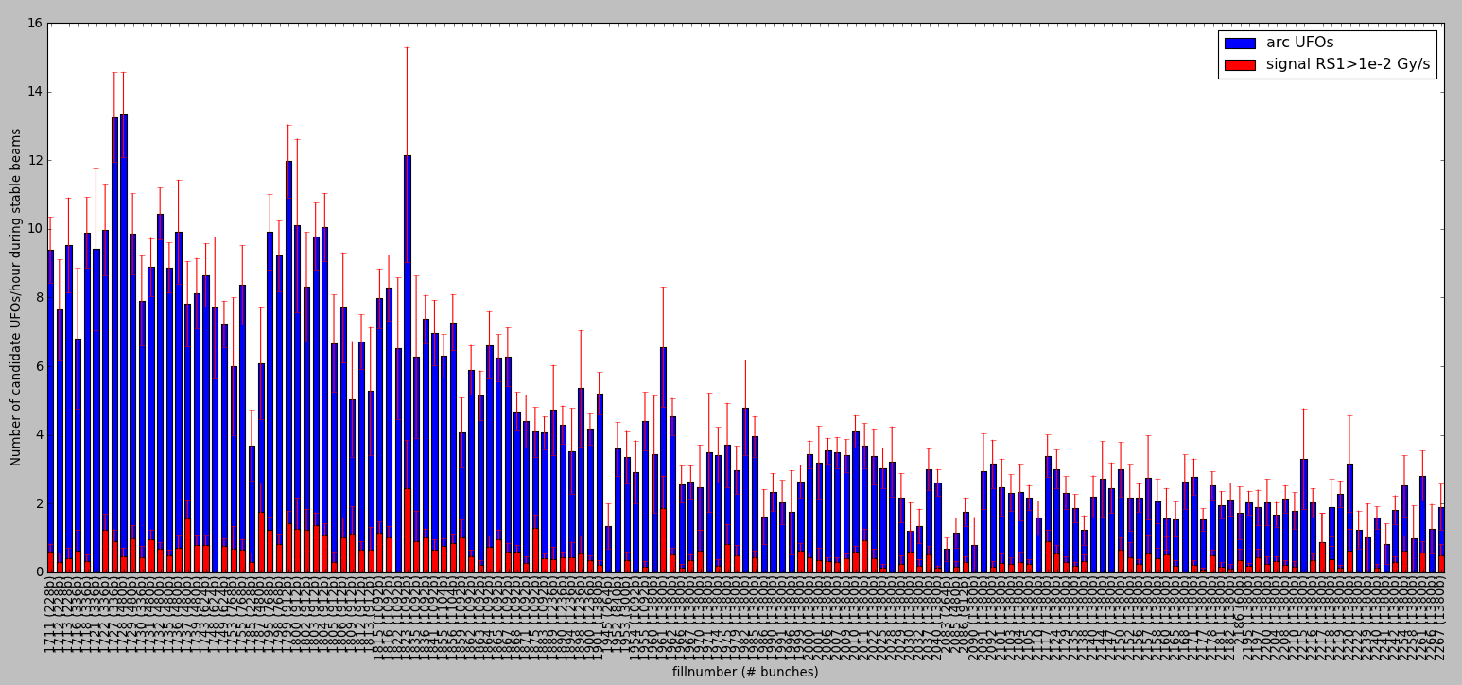
UFO rate 2011
TS #2
(09. – 13.05.2011)
TS #3
(04. – 08.07.2011)
5242 candidate arc UFOs (≥ cell 12) during stable beams between 14.04. and 31.10.2011. Fills with at least 1 hour stable beams are considered. Signal RS04 > 2∙10⁻⁴ Gy/s.
1380 bunches
TS #4
(29.08 – 02.09.2011)
25ns, 60b
Decrease of UFO rate from ≈10 UFOs/hour to ≈2 UFOs/hour.
Looks OK for 2012 and Beyond

Slide 25
Questions for Chamonix
Energy
Are we confident enough to go to 4 TeV?
Bunch spacing
25 or 50 ns?
Luminosity goals for 2012?
There’s a limit to how much higher they can go.

Slide 26
General plan for next few years
Now:
Run at 3.5 or 4.0 TeV
Push luminosity as high as possible
First Long Shutdown (LS1): ~2013
Fix all all joints
Add dispersion collimation around IR3?
Second Long Shutdown (LS2): ~2017
Complete collimation system
Involves 11 T dipoles to make room for dispersion collimators at several IR’s
Reach (at least) nominal luminosity after that
Collimation limit >5x10³⁴ cm⁻²s⁻¹
Hi Luminosity Shutdown: ~2021
Install large aperture, high field Nb₃Sn quads
Crab cavities?
Enable leveled 5x10³⁴ cm⁻²s⁻¹ operation

Slide 27
LARP and HiLumi
The upgrades of the LHC have been organized under the HL-LHC project.
A subset of those activities has been captured in the HiLumi-LHC effort, partially funded by the European Union.
It has been agreed that LARP should be coordinated with this project
HiLumi Work Packages:
WP1: Management
WP2: Beam Physics and Layout
WP3: Magnet Design
WP4: Crab Cavity Design
WP5: Collimation and Beam Losses
WP6: Machine Protection
WP7: Machine/Experiment Interface
WP8: Environment & Safety
To facilitate this, we have begun to hold joint collaboration meetings
Fall: Europe, Spring: US
Significant LARP and other US Involvement
LARP will be involved if crystal or e-beam included

Slide 28
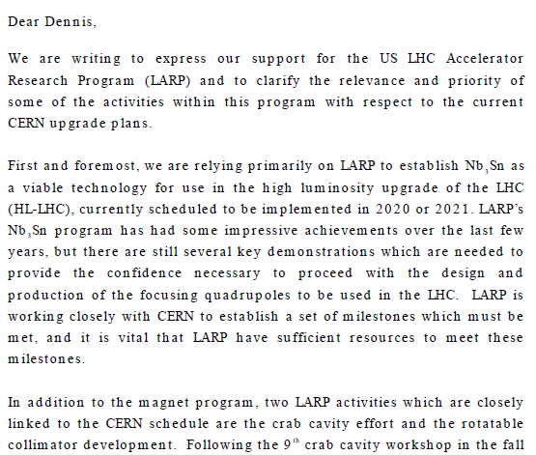
Relevance of LARP to CERN Upgrade*
Letter to Dennis Kovar, Head, DOE Office of High Energy Physics, 17-August-2010
(…)
*letter suggested at review

Slide 29
Overall US Plan for LHC Upgrades
LARP
non-LARP

Slide 30
Scope and Limits of LARP
The “R” in LARP is for “Research”
LARP is an R&D organization
~Fixed budget ⇒ scope and schedule contingency
Not really set up for major hard deliverables
Lumi monitor, although ultimately very successful, was a cautionary tale
Model: Promising LARP R&D will be used to motivate separately funded and monitored projects
Primary candidates:
Final focus triplets
Crab Cavities
Other possibilities
SPS feedback?
Hollow electron beam collimation?

Slide 31
Summary
The startup of the LHC has been a phenomenal success (for the most part)
Nevertheless, achieving the physics goals mean that serious planning for the future has already begun.
Further reading
The LHC Coordination Page is a good place to start
http://lpc.web.cern.ch/lpc/
In addition to accelerator information, it has links to other things.
Evian Operations Workshop (December 12-14, 2011)
https://indico.cern.ch/conferenceDisplay.py?confId=155520
LHC Performance Workshop (will take place Feb 6-10, 2012)
https://indico.cern.ch/conferenceDisplay.py?confId=164089
Special thanks to all the people I stole slides from!

