Slide 1
Status
Had a very successful week of studies the last week of shutdown
(http://www-bd.fnal.gov/pdriver/booster/experiments.html)
New MP02 looks good, although we are still studying some effects in the MI-8 line.
Can now, in principle, run 5Hz beam to MiniBooNE.
We’ve run up to 4 Hz, limited by a timeline issue (misunderstanding).

Slide 2
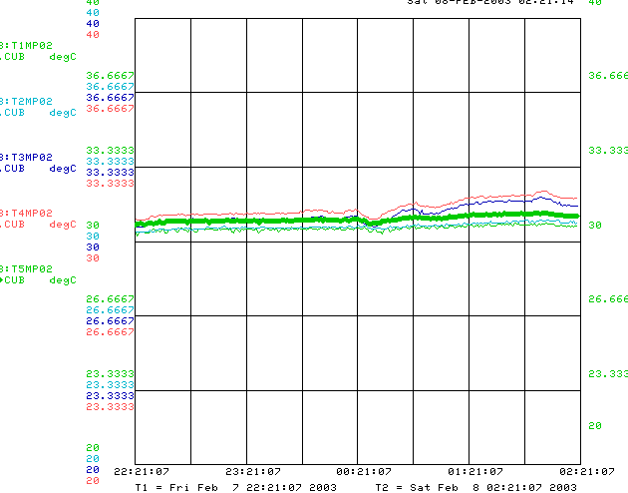
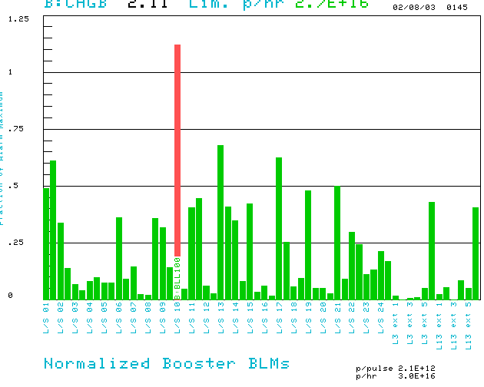
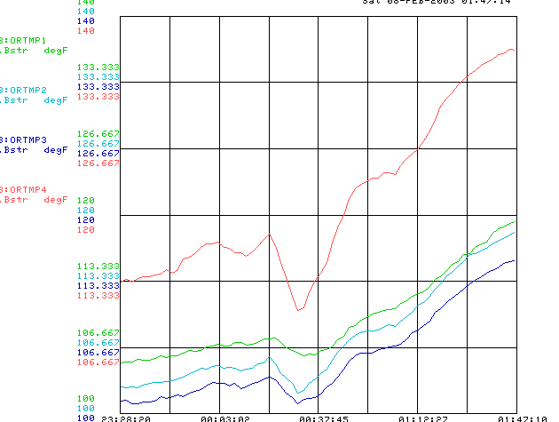
High Rate Running (owl, 2/8/03)
MP02 Temps
2.9E16 pph. Bypassed L10 notch loss
ORBUMP Temp

Slide 3
Plan
This week:
  Establish stable high intensity for stacking (done).
  Try to fix or at least understand MI-8 problems
  Try to understand intermittent beam loss problems.
Next week:
  Shorten notch from 5 to 3 bunches (L10 should go down ~40%).
  Run high rep, low intensity?
  Maybe try gamma-t jump in this mode (tested over shutdown)

Slide 4
Projects Update
Collimators
  Collimator body design more or less complete.
  Settled on main features of mover design (big steppers)
  Ordering parts as we settle on them (bellows, stepper controller, etc.)
RF System:
  Organization in place.
  Design for all university components complete and with Bill Sands.
  Hope to have parts fabricated by mid-April to meet Rene Padilla’s schedule.
  Haggling over definition of “free”.

