Slide 1
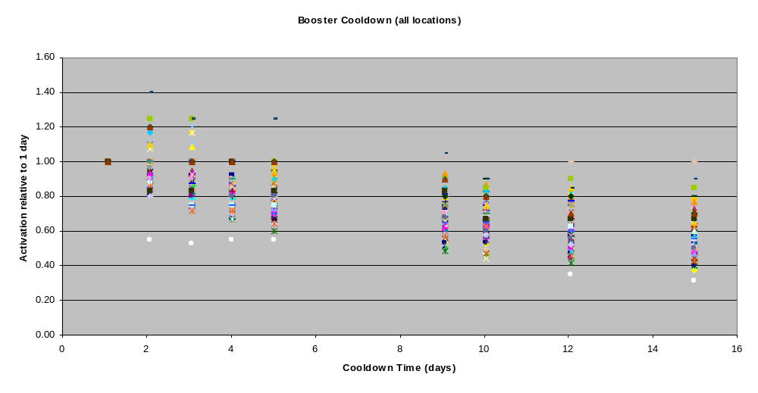
Figure 1: Booster Cooldown (All Points)
Data based on January 2003 shutdown
Readings normalized to ~1 day (26 hours)

Slide 2
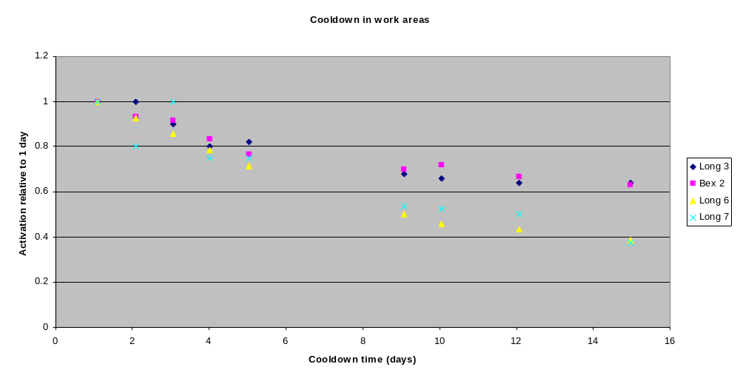
Figure2: Booster Cooldown in Work Areas (L3, L6 and L7)
Cu collimators removed
Long 3 and Bex2 are near where the dogleg work will be done.
Long 6 and Long 7 are where the collimators will go. Note! Cu collimators were in place when data were taken. May have affected curve

Slide 3
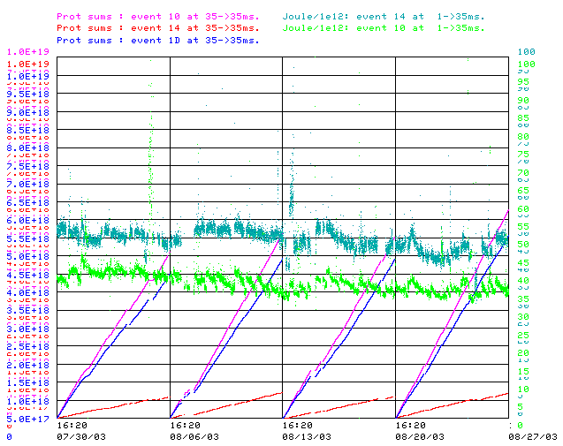
Figure 3: Booster Loss Load
Typical Week’s Protons:
- MiniBooNE: 4.5E18 p (87%)
- Stacking: .7E18 p (13%)
Energy Loss:
- MiniBooNE: 37 J/E12
- Stacking: 50 J/E12
-> Power Load:
- MiniBooNE: 166 MJ (83%)
- Stacking: 35 MJ (17%)

Slide 4
Shutting MiniBooNE off a week early?
Long 3 work:
  Difference between 4 and 5 weeks -> negligible
MI-8 work, based on “typical” (Figure 1)
  Difference between 2 weeks and 3 weeks -> ~negligible
Collimator work based on January (Cu collimators in place) (Figure 2):
  4 days (.80) -> 11 days (.42): 47% reduction
  Pro-rate by BooNE loss load (Figure 3):
    Continue to stack at full intensity: (.83*47=) 39% reduction
    Reduce stacking intensity: (.87*47=) 41% reduction
Collimator work based on “typical” (Figure 2):
  4 days (.80) -> 11 days (.60): 25% reduction:
  Pro-rate:
    Continue stacking at full intensity: (.83*25=) 21% reduction
    Reduce stacking intensity: (.87*25 = ) 22% reduction

