Slide 1
Proton Source Shutdown Work Summary
Major:
  ORBUMP/400 MeV
    Install new ORBUMP magnets and power supply
    Rearrange injection girder and 400 MeV line
  Dump relocation
    Move Booster dump, which is currently at Long 13, to the MI-8 line
    Rework interlocks to allow to run there with MI in access
    Use for test pulses and short batching
Significant:
  Install new water manifolding in Booster
    Preparation for new corrector system in 2007 and 2008
  400 MeV line power supplies
    Replace unreliable “Power 10” supplies with superior Lambda supplies
    Replace a number of badly spec’ed supplies with more appropriate ones.

Slide 2
Shutdown Work Summary (cont’d)
Minor:
  Prep chopper area for MTA beam line
    Move quad
    Install some new vacuum hardware
  Install beam stop in 750 keV line
    Will allow ion source to run with Linac in access
  New collimator in tank 1
    Replace existing manual collimator with motorized one with more granularity in the aperture size.

Slide 3
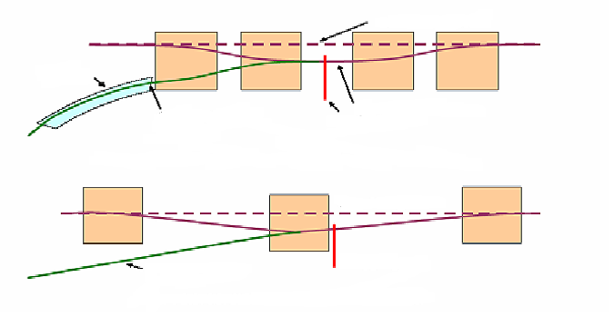
ORBMP/Injection Modification
New Booster Injection - ORBMP Girder & PS
  A simplified 3 Bump injection scheme
      Septa Magnet not required
      Better Lattice Match
      Alignment of Circulating beam with Injected beam
  New ORBMP ps and magnets that can run at 15 Hz
      Present system limited to 7.5 Hz due to heating
Circulating Beam
Septa
Injected Beam
Present Injection Girder
Foil
Circulating Beam
Injected Beam
Foil
New Injection Girder
Provided by Jim Lackey and Fernanda Garcia

Slide 4
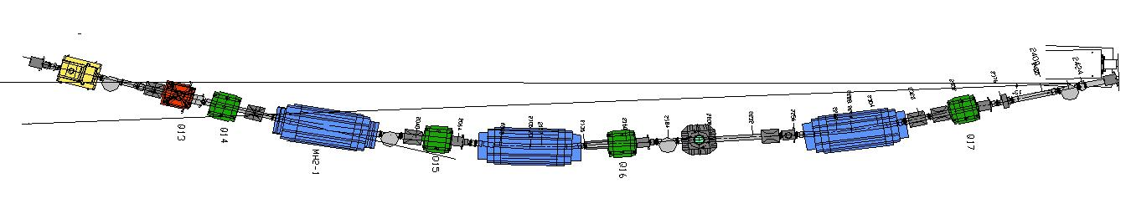
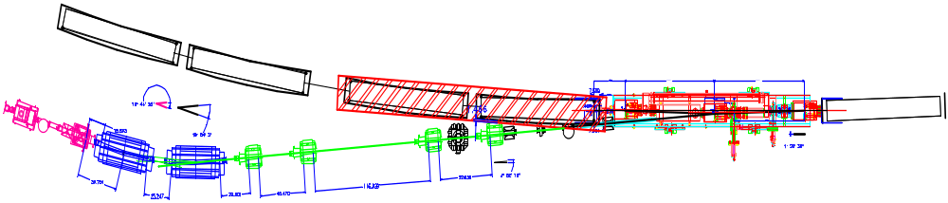
400 MeV Line Modifications
Current Scheme
New Scheme
ORBMP Girder
Booster
ORBMP MAGNETS
New 400 MeV Injection Layout
Provided by Jim Lackey and Fernanda Garcia

Slide 5
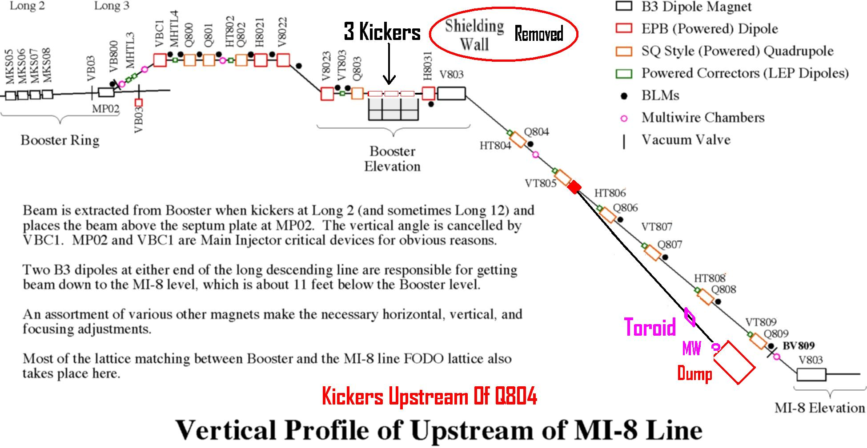
Booster Dump Relocation
New Layout Using 3 Kickers

Slide 6
Additional Booster Work
Install water manifold connections at 48 sub-periods in preparation for corrector upgrades in 2007 and 2008 shutdowns.
  Est. ~300 hours over 37 days
Upgrade DC power supplies for 400 MeV line
  Total of 31 DC supplies replaced in 400 MeV line
  For the most part, this uses different people than all the other work.

Slide 7
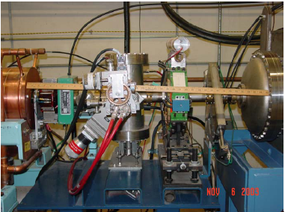
Q74 Move
BLD – will be removed to make space for quad
Quad to be moved 10” upstream
Move Q74 10” upstream to make room for bending C magnet to be used for MuCool/diagnostic beam extraction
Install Y pipe at downstream end of chopper
Est. 2 days

Slide 8
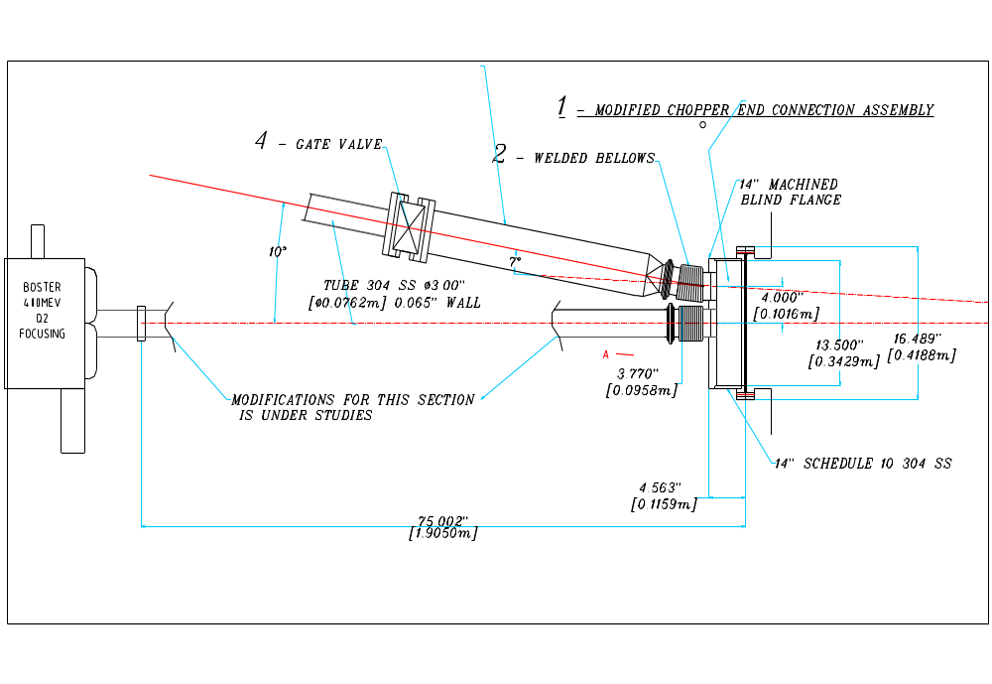

Slide 9
Other Linac Projects
750 keV line beam stop
  To allow ion source to run with Linac in access
  Est. 1 day
Tank 1 collimator upgrade
  Motorize collimator
  Replace collimator wand with one that has finer gradation of hole sizes.
  Est. 2 days

Slide 10
Organization
Rich Andrews
  Shutdown Coordinator
  Booster alignment liaison
Fernanda Garcia
  Coordinate 400 MeV Line/ ORBUMP work
Bill Pellico
  Coordinate Dump Relocation project
Craig Drennan
  Oversee water manifold work
Reggie Martin
  400 MeV line power supply upgrade
All mechanical work coordinated with Dave Augustine and mechanical support

Slide 11
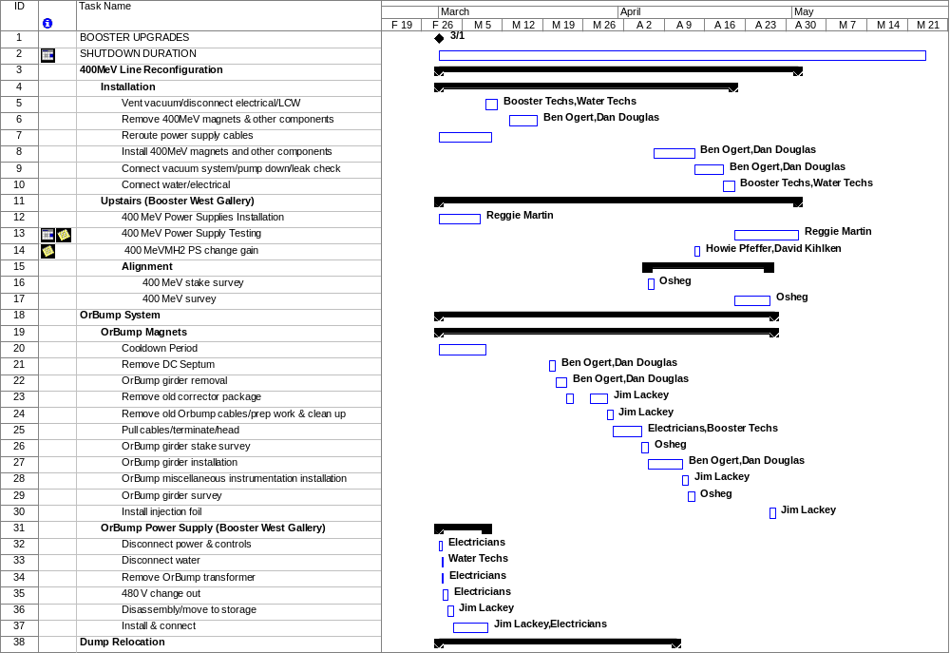
Planning Detail (example)
Continued (3 more pages…)

Slide 12
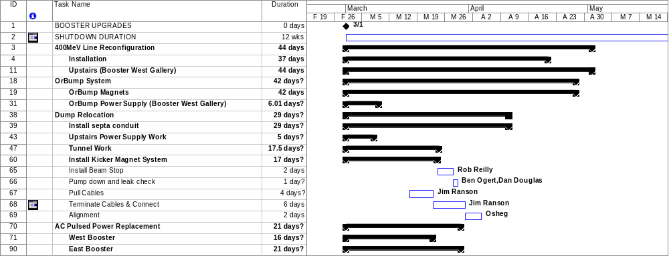
Overall Timetable
~9 weeks total, driven by 400 MeV line work

