Slide 1
Experimental Techniques in Particle Physics
Eric Prebys

Slide 2
Some Definitions…
Particle – the propagation of momentum, energy, and other “information” through space-time.
Force - something which changes a particle in some way (sometimes to a different particle).

Slide 3
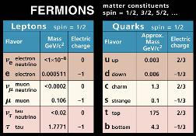
The Standard Model – The Fundamental Particles

Slide 4
Relativistic Quantum Mechanical Perturbation Theory
Non-relativistic perturbation theory:
Free particle
Potential
Discrete interaction
Relativistic perturbation theory “Feynman Diagram”:
Free particle
Discrete absorption of intermediate “virtual” particle.

Slide 5
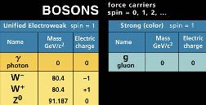
The Intermediate Vector Bosons (Mediators of Force)

Slide 6





Some Basic QED Interactions
e⁺e⁻ scattering
e⁺e⁻ annihilation

Slide 7






Some Basic Weak Interactions
eν scattering
β decay

Slide 8
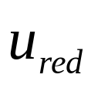
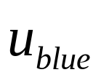
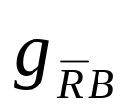
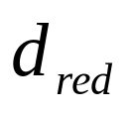
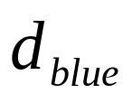
Some Basic Strong Interaction (QCD)

Slide 9
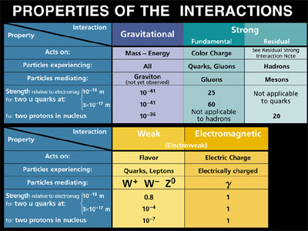
The Fundamental Forces

Slide 10
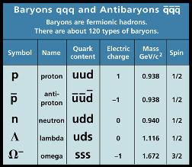
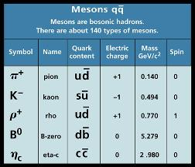
How Quarks Combine
Quarks come in three “colors”: red, green, blue
Combine to form “colorless” (white) particles:
  Three quarks (or antiquarks), one of each color⇒ “Baryons”
  A quark of one color and an anti-quark of the associated anti-color ⇒”Mesons”

Slide 11
The Big Questions in Particle Physics
What is the origin of mass?
  The standard model diverges if we just “plug-in” a mass for all the particles.
  An effective mass comes in through the interaction with a pervasive field with a non-zero vacuum expectation value.
  Perturbations about this vacuum give us a “Higgs Particle”, which probably has a mass 100 GeV< m < 1TeV
What is the nature of CP violation?
  The physics of matter in a right-handed universe is almost the same as that for anti-matter in a left-handed universe.
  This small difference is accomodated in the standard model by complex terms in the quark mixing matrix.
  This must be firmly established, and if true, the associated parameters must be measured.

Slide 12
Big Questions (cont’d…)
Do neutrinos have mass/do they mix?
  In the Standard Model, all neutrino masses are zero by definition.
  There is growing evidence that neutrinos do have mass.
    Solar neutrino deficit.
    Atmospheric neutrino “problem”.
    LSND result.
  If true this could explain the “dark matter” in the universe, at least partially.
  Must be verified, and if true, the details must be studied.

Slide 13
Big Questions (cont’d…)
What lies beyond?
  The standard model eventually diverse
  There is a philosophical (aesthetic? religious?) impulse to unify the quark and the lepton sectors, as well as include gravity.
    Supersymmetry (SUSY):
      Every fermion is associated with a boson.
      Predicts a veritable zoo of new particles, the lightest of which should have m<2TeV.
    String theory
      All particles are states of fundamental objects (strings)
      Supersymmetry is a consequence.
  As yet, absolutely no experimental evidence for either of these theories. Must keep looking.

Slide 14
What we Actually Study
interaction
incident particle
incident particle
big mess!!!

Slide 15
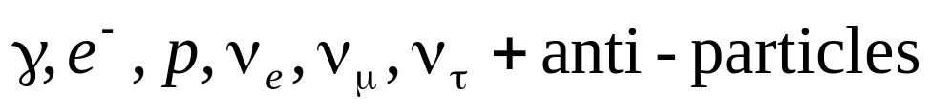
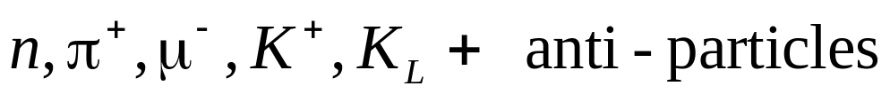
What We Actually Detect
Almost all of the particles of most interest to us are very unstable; we must detect them indirectly through their decay products.
Everything in the universe ultimately decays to
In addition, the following particles live long enough (cτ>1m) to be detected directly:
CANNOT be individually detected

Slide 16
Classes of Particle Detection
Charged Particle Tracking
  Precision: decay position determination.
  Spectroscopy: measure momentum in conjunction with magnetic field.
  Projection: match information from different detectors.
Calorimetry
  Electromagnetic: measure energy of photons, identify electrons.
  Hadronic: measure energy of neutral hadrons, identify types of charged particles.
Particle Identification
  Indirect: based on interaction characteristics
  Direct: determine mass by measuring velocity
    dE/dX
    Time-of-flight
    Cerenkov Radiation

Slide 17
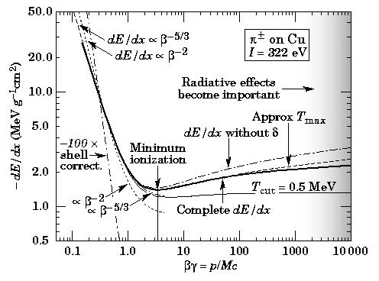

Charged Particle Tracking
As charged particles traverse matter, they deposit energy according to the Bethe-Bloch equation:

Slide 18


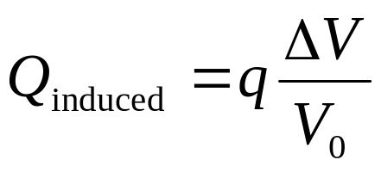

The Detection of Charge
Ultimately almost all types of detectors work through the detection of ionized charges, which induce electrical signals as they move.
Equipotential surfaces

Slide 19

Proportional Wire Chambers
- - - - - - - -- - - --
Track
As the ionized charge gets close to the wire, the rapidly increasing field results in an avalanche of multiple ionization.
The motion of the resulting ions away from the wire induces a signal.
The total signal is proportional to the total ionized charge.
The time of the signal can accurately measure the position of the track.
A charged particle ionizes gas molecules as it passes.
This ionized charge drifts toward a wire which is held a relatively positive potential.

Slide 20

Silicon Detectors
Readout strips
n-type
o
-
o
-
o
-
o
-
Fully depleted
o
-
o
-
o
-
o
-
p-type
-70V
Electron-hole pairs

Slide 21
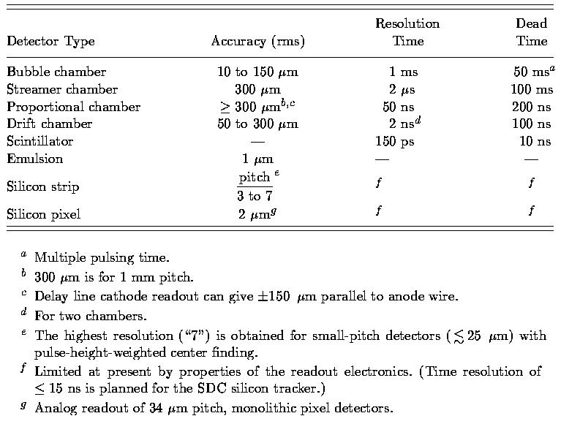
Typical Charged Tracking Resolution

Slide 22
Electromagnetic Calorimetry
Energetic photons in material can convert to e+e- pairs through Bethe-Heitler pair production
Energetic electrons in material loose energy through bremsstrahlung.
These processes continue, ultimately depositing all the energy of the incident particle (e+, e-, or γ) in a well characterized shower.

Slide 23
Electromagnetic Calorimetry (cont’d)
There are basically two types of EM calorimeters...
Total Absorption
shower
Scintillation light
shower
Sampling
Absorption layer (shower develops)
Detection layer (scintillator, PWC, liq. Ar, etc)

Slide 24
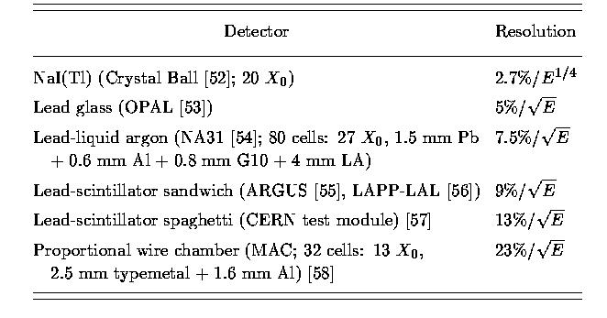
Electromagnetic Calorimeter Resolution
Energy in GeV

Slide 25

Hadronic Calorimetry
EM Component
Hadronic Shower
Nuclear collision
Escaping neutron
Based on nuclear interactions.
Longer and messier than EM showers.
Always use sampling calorimeters (e.g. steel+scintillator)
Very good resolution would be

Slide 26
Particle Identification
We can broadly distinguish particles by how they interact (we’ll discuss this in a minute).
But particles of the same time class (eg charged hadrons) must be distinguished by their different masses.
We determine the mass by independently measuring the momentum and velocity.
One way to do this is to directly measure the time of flight
  Can usually measure time to better than 100 ps
  In a central detector, this can separate π and K up to about 1 GeV
In addition, there are common indirect ways to measure velocity.

Slide 27
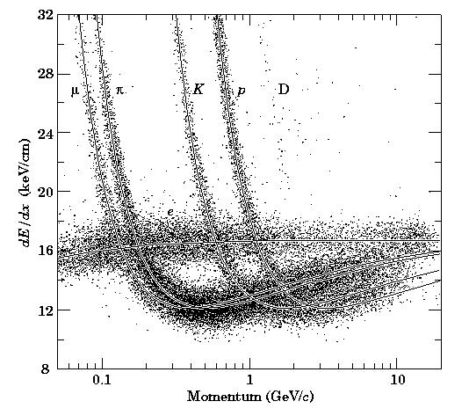
dE/dx
Recall that as particles traverse matter, the energy they deposit is dependent only on the velocity.
⇒particles of the same momentum will deposit different amounts of energy if their masses are different.
This can be easily measured with proportional wire chambers.

Slide 28
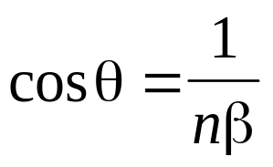
Cerenkov Radiation
A charged particle which is traveling faster than the speed of light in a particular medium will radiate its energy in the form of photons in a cone whose angle is
The existence of such light can be used to discriminate two particles of different masses for a range of momenta (threshold Cerenkov detector).
OR the angle can be directly measured (more accurate but more difficult).

Slide 29
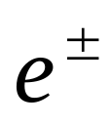

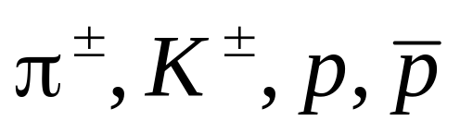
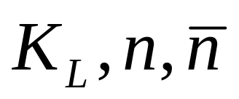
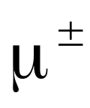
General Detector Layout and Classes of Particles
Charged Tracking
Hadronic Calorimetry
Precision Tracking
Particle ID (sometimes)
Electromagnetic Calorimetry

Slide 30
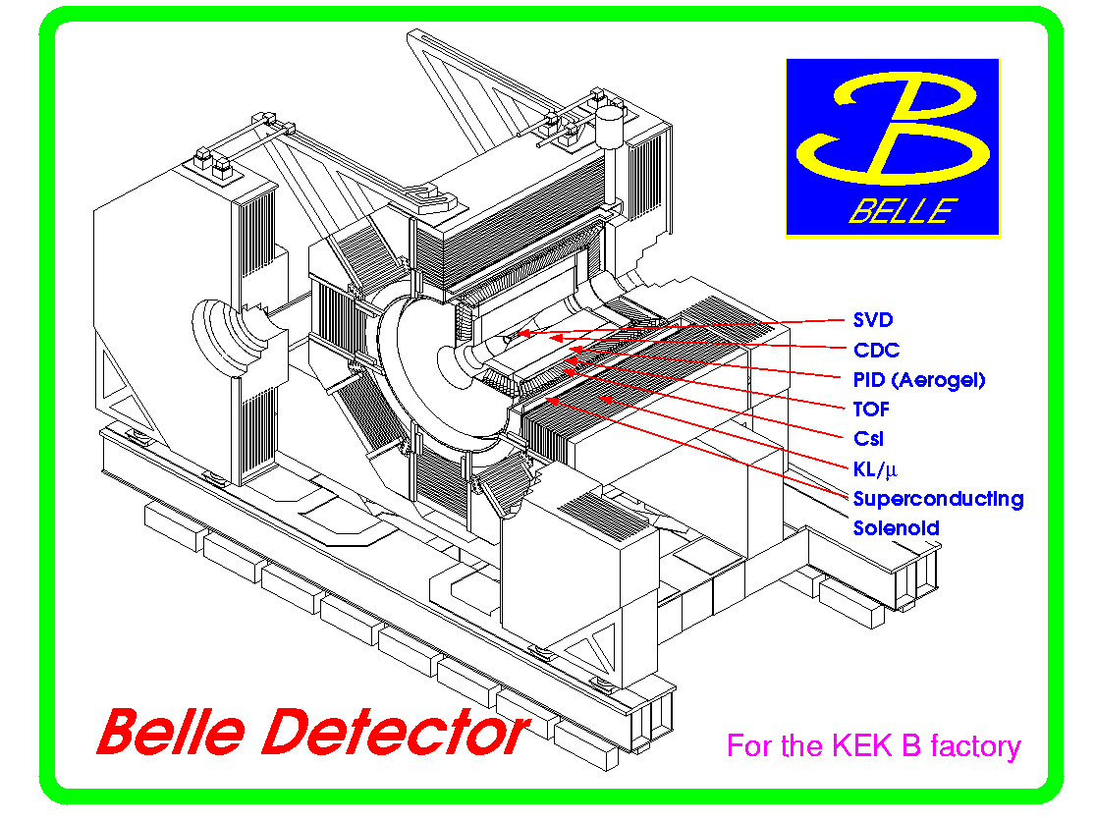
Example – the BELLE Detector

Slide 31
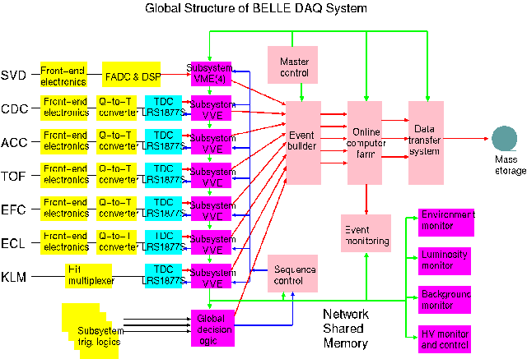
DAQ Overview

Slide 32
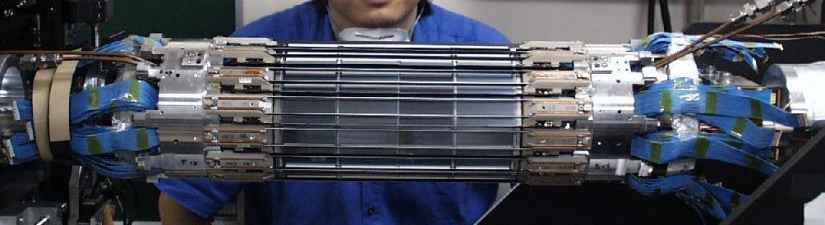
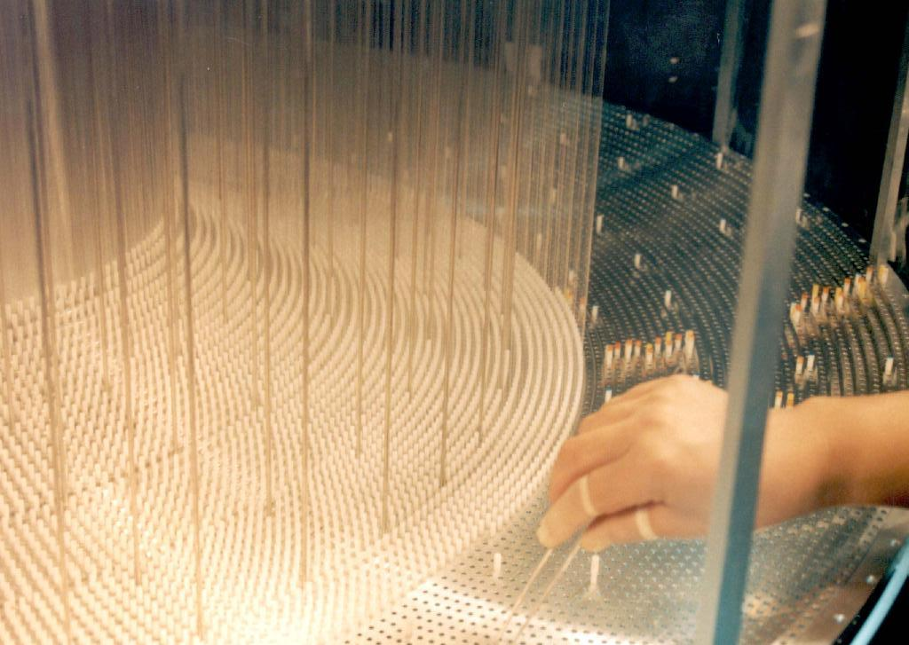
Pictures (Tracking)
SVD
Central Drift Chamber

Slide 33
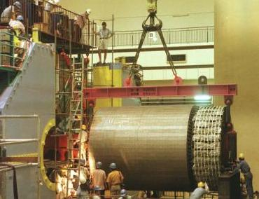
Pictures (Electromagnetic Calorimeter)

Slide 34
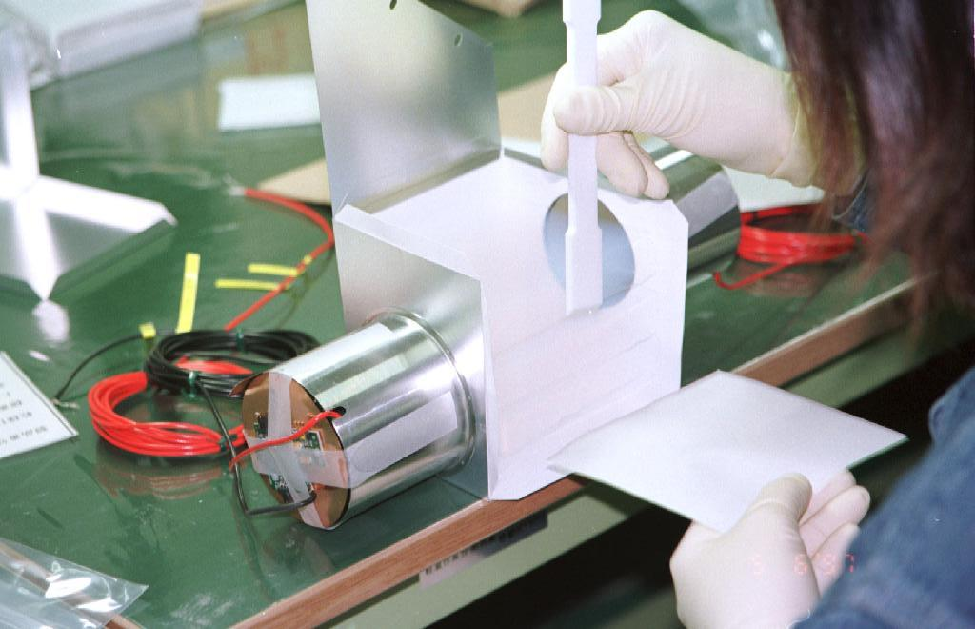
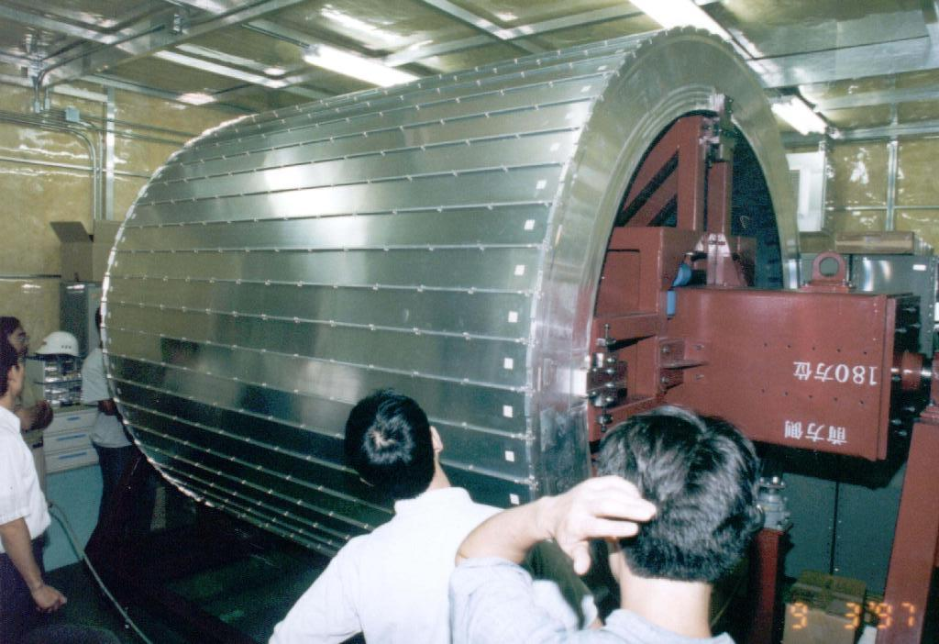
Pictures (Particle ID)
Module Assembly
Barrel Detector

Slide 35
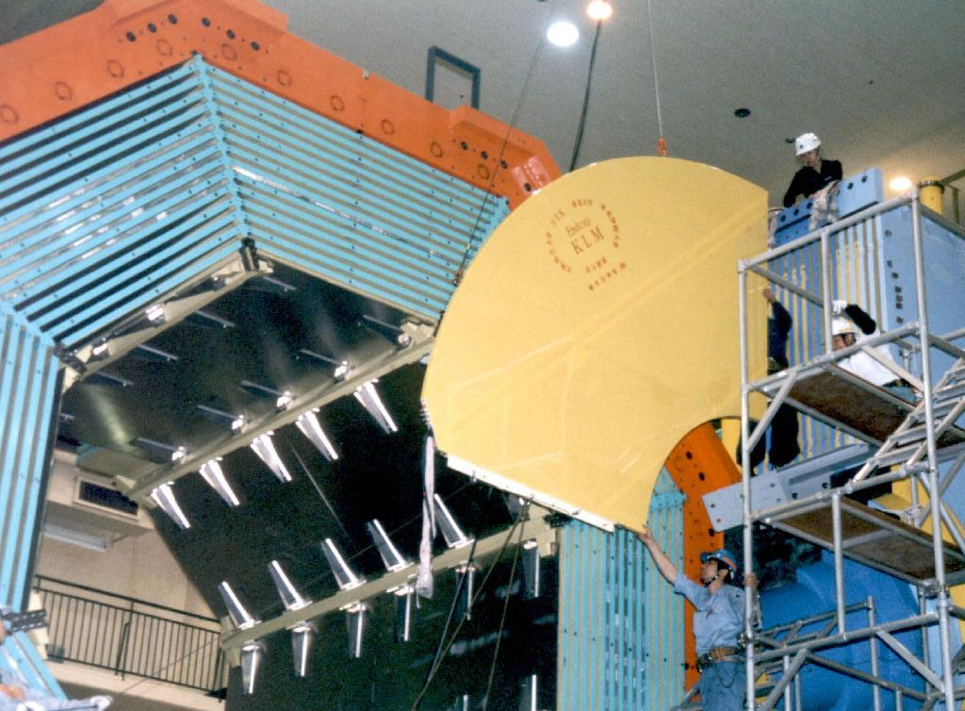
Pictures (K-long Catcher/Muon Tracker)
Barrel Module
Endcap Module

Slide 36
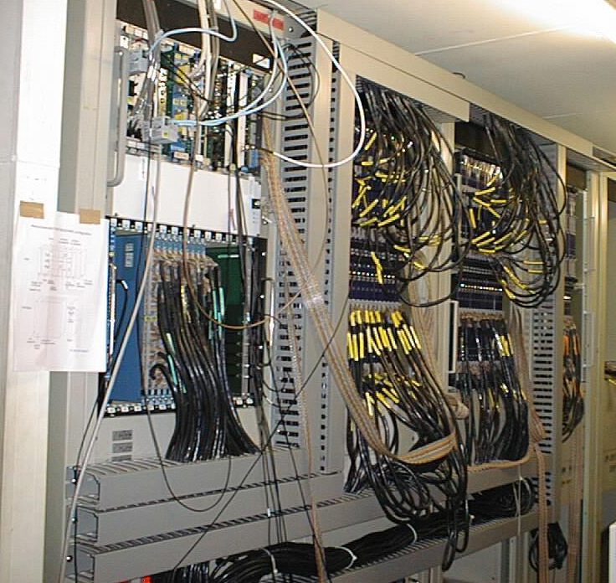
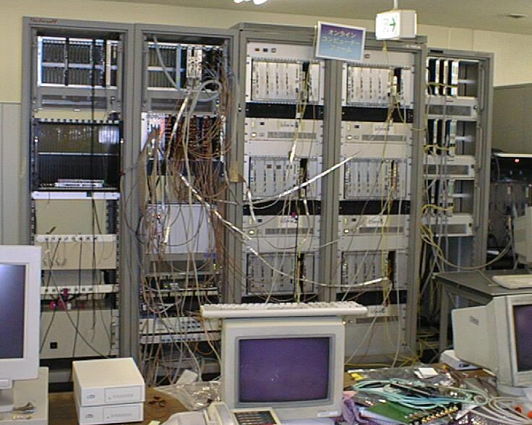
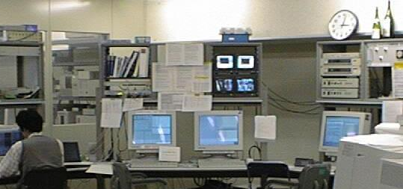
Pictures (DAQ/Control)
Readout Electronics
Event Builder
Custom
LeCroy 1877
Champaign Bottles
Control Room

Slide 37
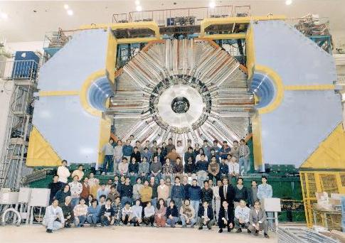
All Finished!!
Me

Slide 38
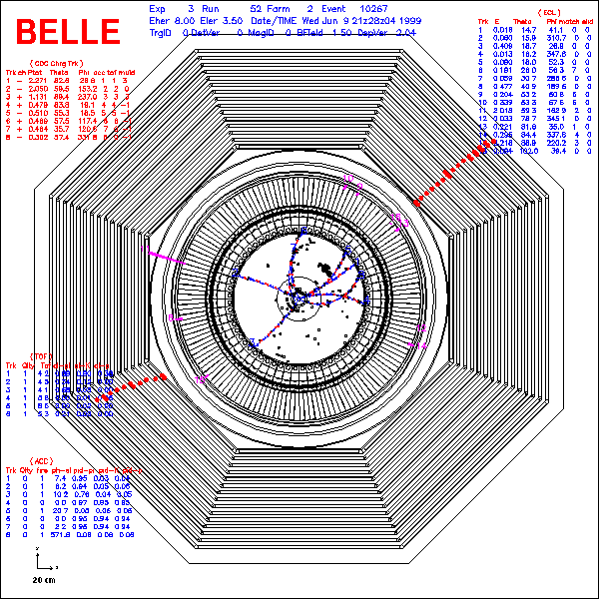
What an Event Looks Like
J/ψ→μμ
  M(μμ) = 3.1 GeV
Precision Tracking
Charged Tracking
Particle ID (Cerenkov)
Electromagnetic Calorimetry
Solenoidal Magnet
Muon ID/Hadronic Calorimetry

