Slide 1
CP Violation in the B Meson System: The Belle Measurement of sin2φ₁
Eric Prebys, Princeton University
for the
BELLE Collaboration

Slide 2
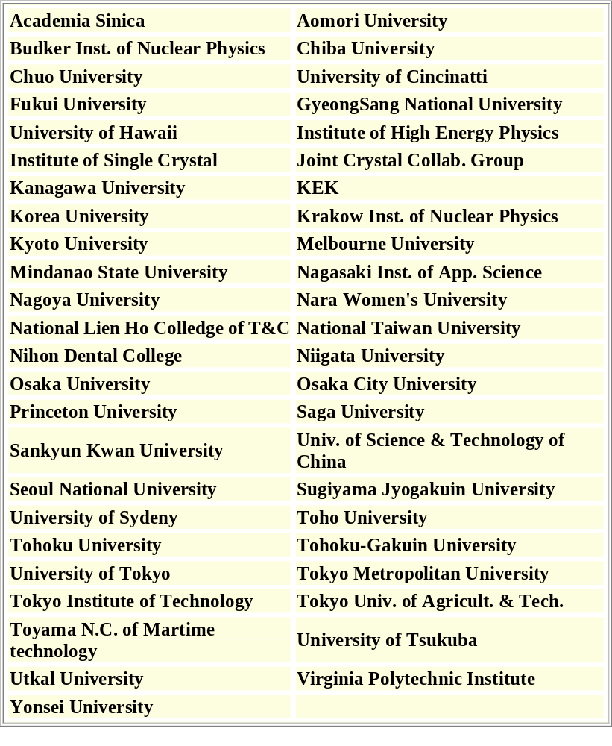
The BELLE Collaboration
≈300 people from 49 Institutions in 11 Countries:
Australia, China, India, Korea, Japan, Philippines, Poland, Russia, Taiwan, Ukraine, and USA

Slide 3




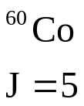
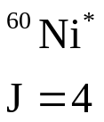

Parity Violation
The “parity” operation transforms the universe into its mirror image (goes from right-handed to left-handed).
Maxwell’s equations are totally parity invariant.
BUT, in the 50’s huge parity violation was observed in weak decays…
β decay of polarized Co:
electron preferentially emitted opposite spin direction

Slide 4
CP (almost) Conservation
It was found that by applying the C[harge Conjugation] operation to all particles, the overall symmetry seemed to be restored (neutrinos are left-handed, anti-neutrinos are right-handed).
This symmetry fit nicely into the current algebras, and later the gauge theories being used to describe weak interactions.
Unfortunately, it wasn’t quite exact…

Slide 5
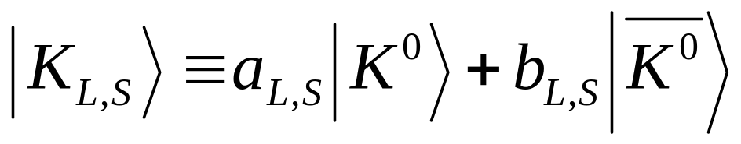
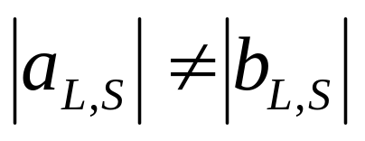
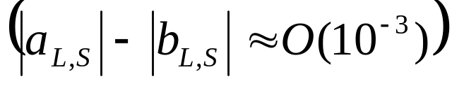
CP Violation
In 1964, Fitch, Cronin, etal, showed that physics is not quite invariant under the CP operation, essentially by proving that neutral kaons formed mass eigenstates
where
This generated great interest (not to mention a Nobel Prize), and has been studied in great detail ever since, but to date has only been conclusively observed in the kaon system.

Slide 6
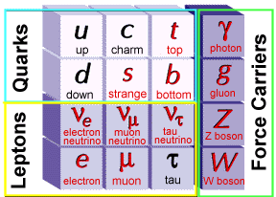







Weak Interactions in the Standard Model
In the Standard Model, the fundamental particles are leptons and quarks
quarks combine as
to form hadrons
leptons exist
independently
In this model, weak interactions are analogous to QED.
OR

Slide 7
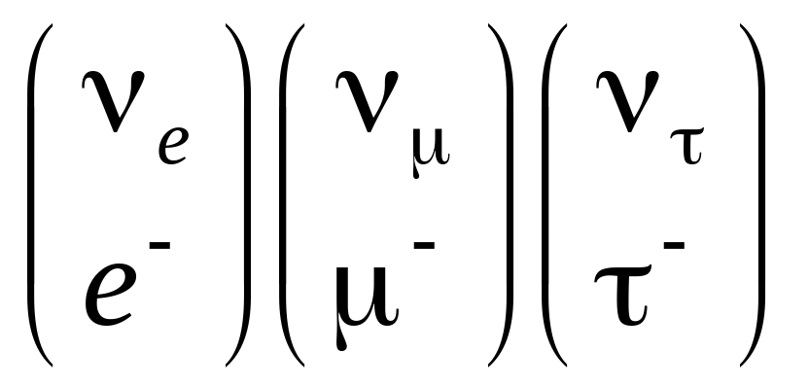
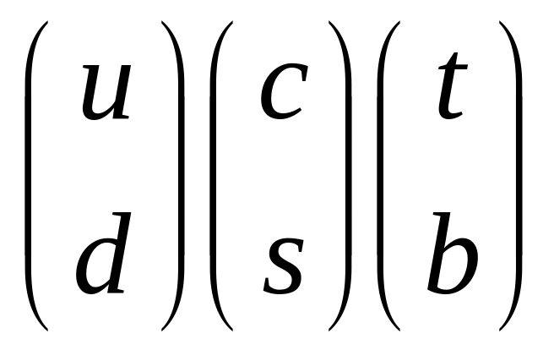
Quark Mixing
In the Standard Model, leptons can only transition within a generation (NOTE: probably not true!)
Although the rate is suppressed, quarks can transition between generations.

Slide 8
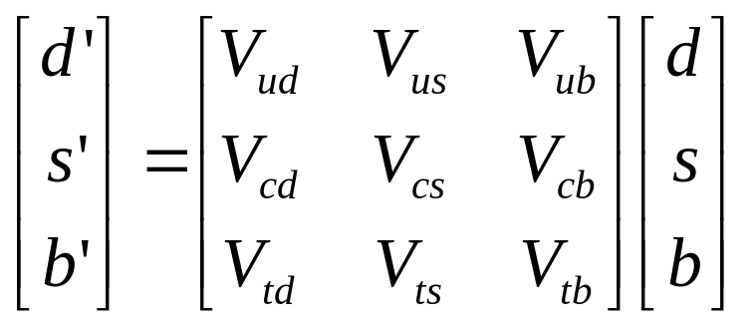
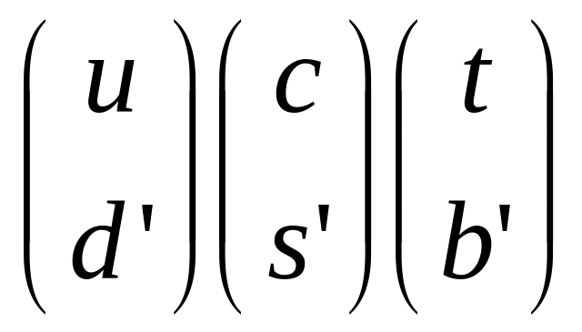
The CKM Matrix
The weak quark eigenstates are related to the strong (or mass) eigenstates through a unitary transformation.
Cabibbo-Kobayashi-Maskawa (CKM) Matrix
The only straightforward way to accommodate CP violation in the SM is by means of an irreducible phase in this matrix (requires at least three generations, led to prediction of t and b quarks)

Slide 9
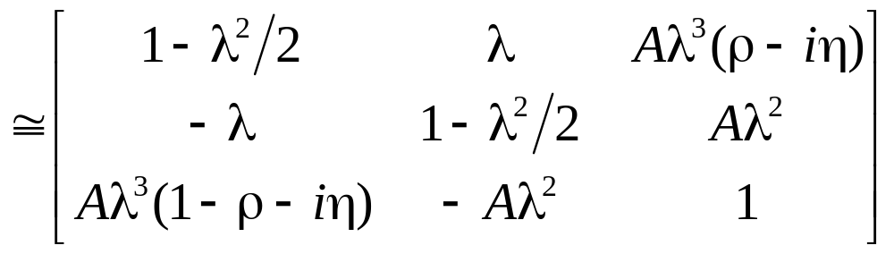
Wolfenstein Parameterization
The CKM matrix is an SU(3) transformation, which has four free parameters. Because of the scale of the elements, this is often represented with the “Wolfenstein Parameterization”
CP Violating phase
First two generations almost unitary.

Slide 10
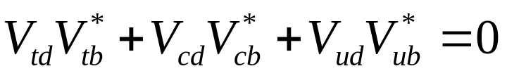
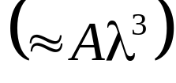
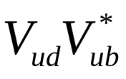

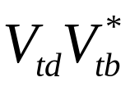


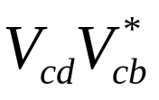
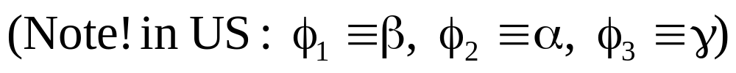
“The” Unitarity Triangle
Unitarity imposes several constraints on the matrix, but one...
Results in a triangle in the complex plane with sides of similar length , which appears the most interesting for study

Slide 11

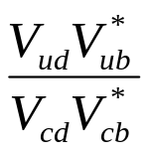
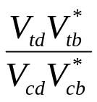


The ρ−η Plane
Remembering the Wolfenstein Parameterization
we can divide through by the magnitude of the base….
CP violation is generally discussed in terms of this plane

Slide 12
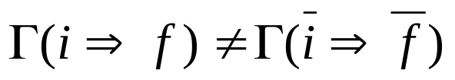
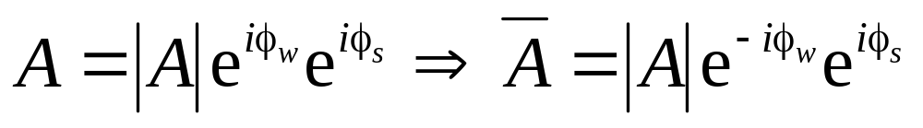
Direct CP Violation
CP Violation is manifests itself as a difference between the physics of matter and anti-matter
Direct CP Violation is the observation of a difference between two such decay rates; however, the amplitude for one process can in general be written
Weak phase changes sign
Strong phase does not
Since the observed rate is only proportional to the amplitude, a difference would only be observed if there were an interference between two diagrams with different weak and strong phase.
⇒ Rare and hard to interpret

Slide 13
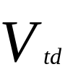




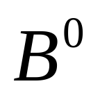
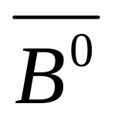




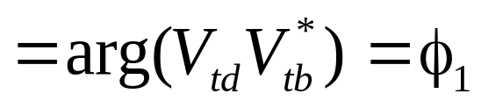
Indirect CP Violation
Consider the case of B-mixing
Mixing phase

Slide 14



Indirect CP Violation (cont’d)
If both can decay to the same CP eigenstate f, there will be an interference
And the time-dependent decay probability will be
Difference between B mass eigenstates
Decay phase
CP state of f
Mixing phase

Slide 15







The Basic Idea
We can create pairs at the resonance.
Even though both B’s are mixing, if we tag the decay of one of them, the other must be the CP conjugate at that time. We therefore measure the time dependent decay of one B relative to the time that the first one was tagged (EPR “paradox”).
PROBLEM: At the resonance, B’s only go about 30 μm in the center of mass, making it difficult to measure time-dependent mixing.

Slide 16

The Clever Trick
If the collider is asymmetric, then the entire system is Lorentz boosted.
In the Belle Experiment, 8 GeV e⁻’s are collided with 3.5 GeV e⁺’s so
⇒
So now the time measurement becomes a z position measurement.

Slide 17
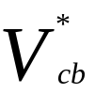


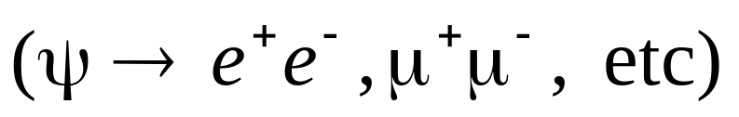




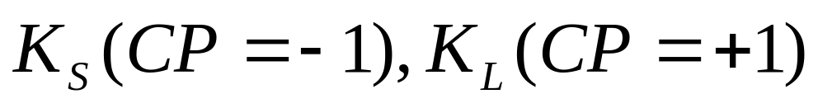
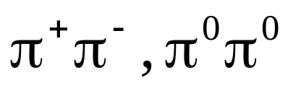
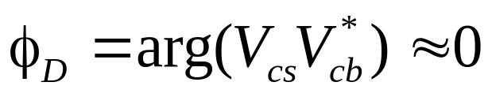
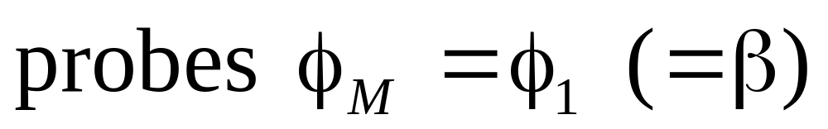
“Gold-Plated” Decay
Total state CP

Slide 18
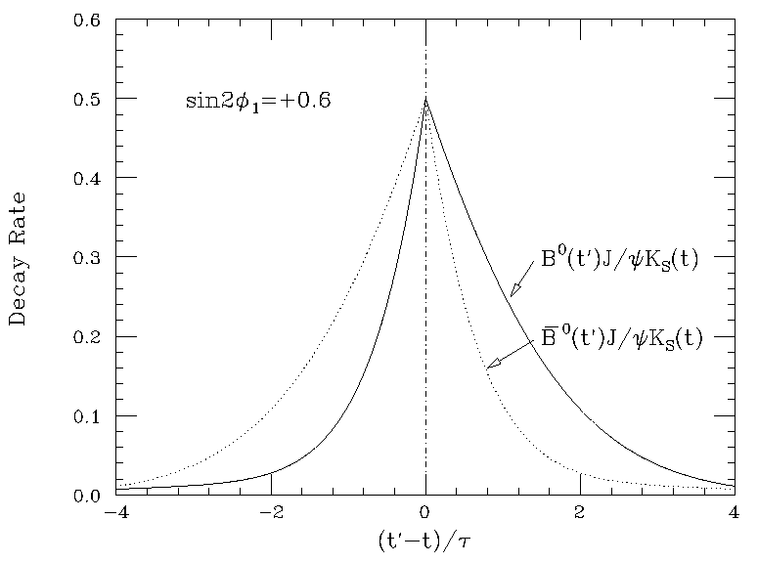
Predicted Signature
t = Time of tagged decays

Slide 19
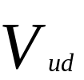
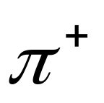



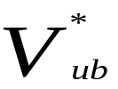
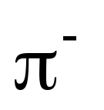
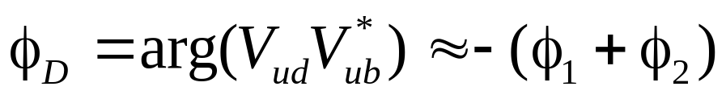
“Tin-Plated” Decay
Complicated by “penguin pollution”, but still promising

Slide 20


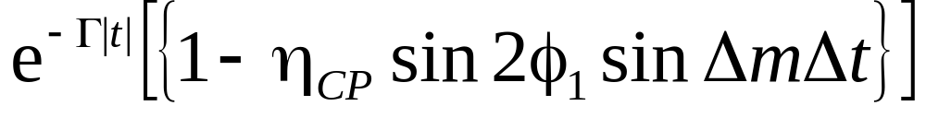
Review - What B-Factories Do...
Make LOTS of pairs at the ϒ(4S) resonance in an asymmetric collider.
Detect the decay of one B to a CP eigenstate.
Tag the flavor of the other B.
Reconstruct the position of the two vertices.
Measure the z separation between them and calculate proper time separation as
Fit to the functional form
Write papers.

Slide 21
Motivations for Accelerator Parameters
Must be asymmetric to take advantage of Lorentz boost.
The decays of interest all have branching ratios on the order of 10⁻⁵ or lower.
  Need lots and lots of data!
    Physics projections assume 100 fb⁻¹ = 1yr @ 10³⁴ cm⁻²s⁻¹
    Would have been pointless if less than 10³³ cm⁻²s⁻¹

Slide 22
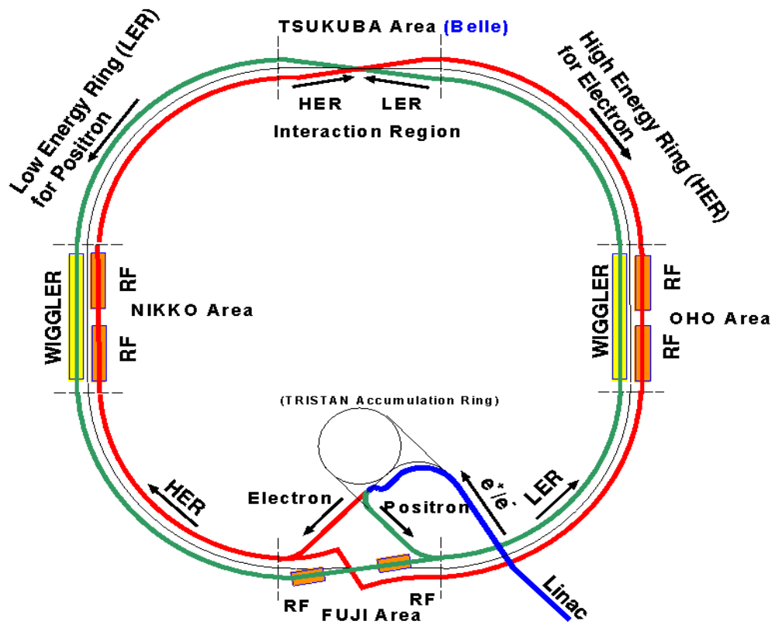
The KEKB Accelerator
Asymmetric Rings
  8.0GeV(HER)
  3.5GeV(LER)
E_{cm}=10.58GeV= M(ϒ(4S))
Target Luminosity: 10³⁴s⁻¹cm⁻²
Circumference: 3016m
Crossing angle: ±11mr
RF Buckets: 5120
⇒ 2ns crossing time

Slide 23
Motivation for Detector Parameters
Vertex Measurement
  Need to measure decay vertices to <100μm to get proper time distribution.
Tracking…
  Would like Δp/p≈.5% to help distinguish B→ππ decays from B→Kπ and B→KK decays.
  Provide dE/dx for particle ID.
EM calorimetry
  Detect γ’s from slow, asymmetric π⁰’s → need efficiency down to 20 MeV.
Hadronic Calorimetry
  Tag muons.
  Tag direction of K_{L}’s from decay B→ψK_{L .}
Particle ID
  Tag strangeness to distinguish B decays from Bbar decays (low p).
  Tag π’s to distinguish B→ππ decays from B→Kπ and B→KK decays (high p).
Rely on mature, robust technologies whenever possible!!!

Slide 24
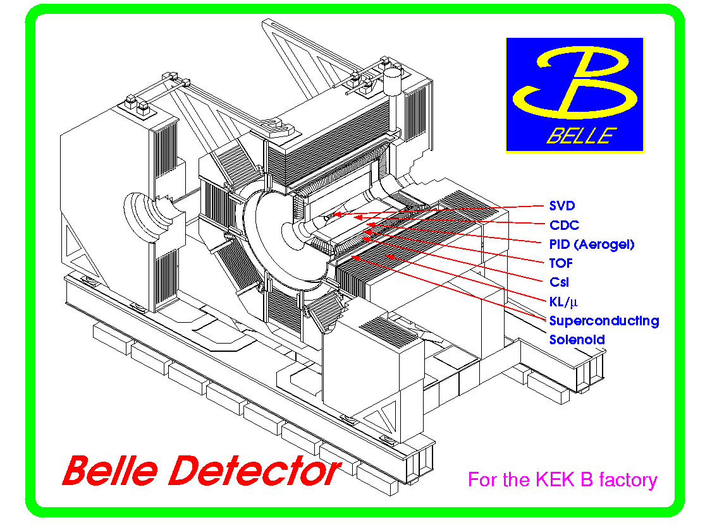
The Detector

Slide 25
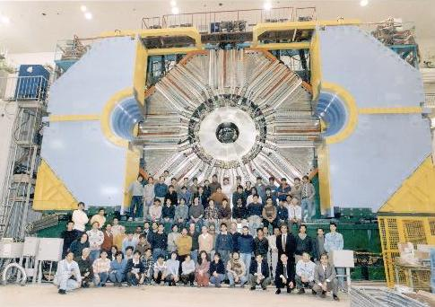
All Finished!!

Slide 26
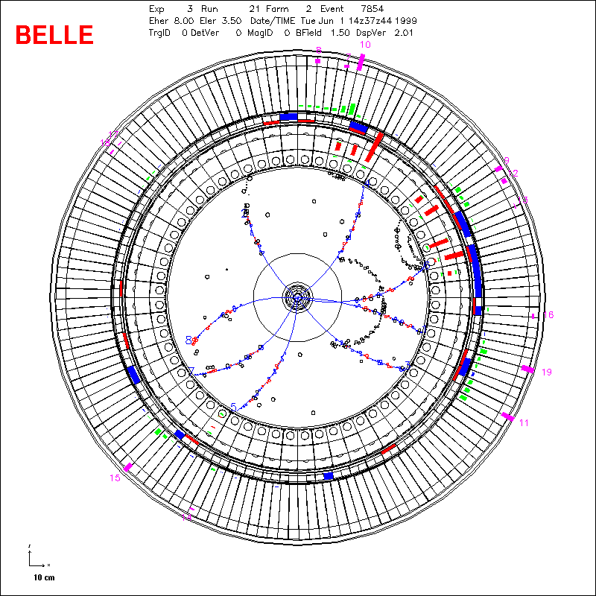
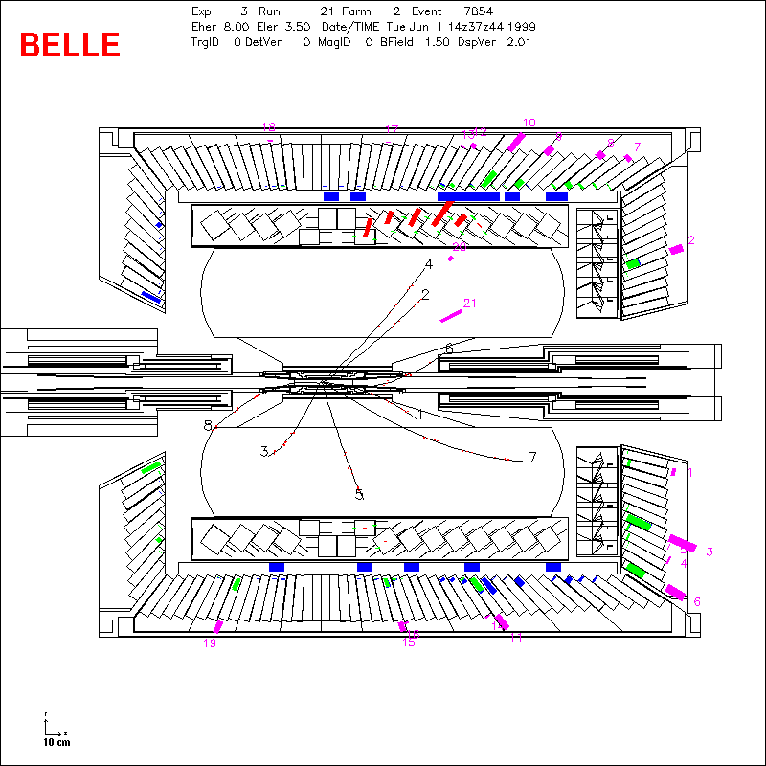
June 1, 1999: Our First Hadronic Event!!

Slide 27
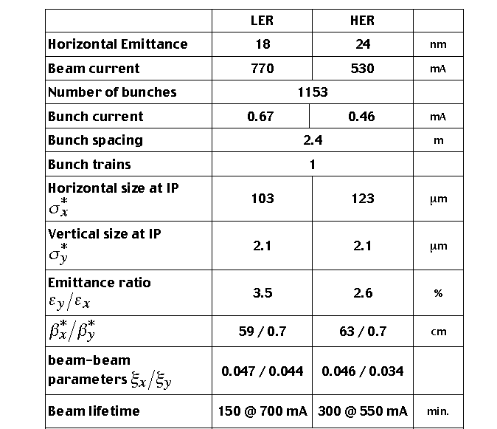

Best Beam Parameters
(17)
(18)
(2600)
(1100)
(4600)
(.56)
(.24)
(0.6)
(8)
(140)
(140)
(1.4)
(1.4)
(1)
(1)
() = design
(.05/.05)
(.05/.05)

Slide 28
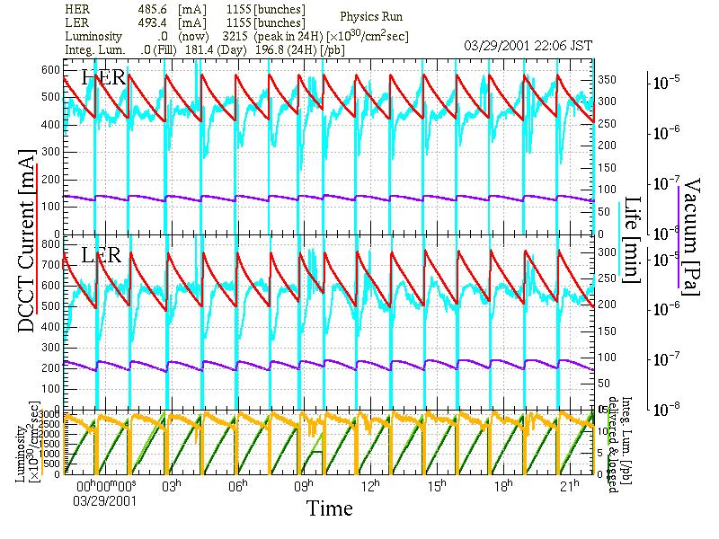
A (not a-)Typical Day
STOP Run
+HV Down
+Fill HER
+Fill LER
+HV Up
+START Run
= 8 Minutes!

Slide 29
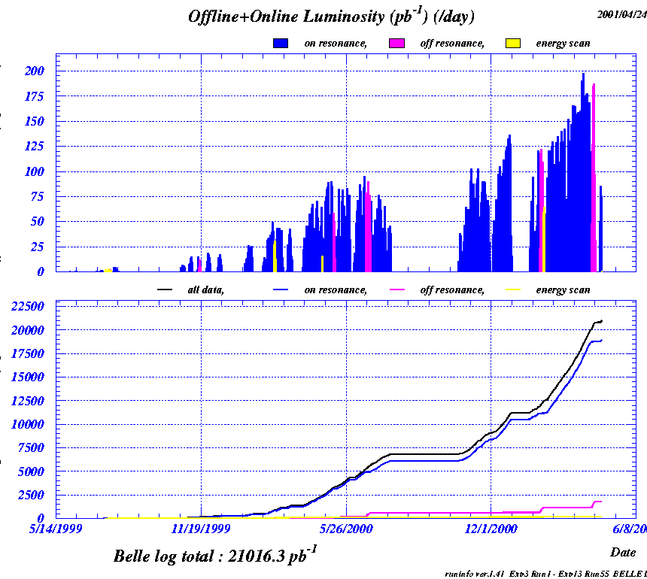







Luminosity
Our Records:
Instantaneous:
Per (0-24h) day:
Per (24 hr) day:
Per week:
To date:
World Records!!
Daily integrated luminosity
Total integrated luminosity
(on peak)
Note: integrated numbers are accumulated!
Total for these Results:
Total for first CP Results (Osaka):

Slide 30
The Pieces of the Analysis
Event reconstruction and selection
Flavor Tagging
Vertex reconstruction
CP fitting

Slide 31
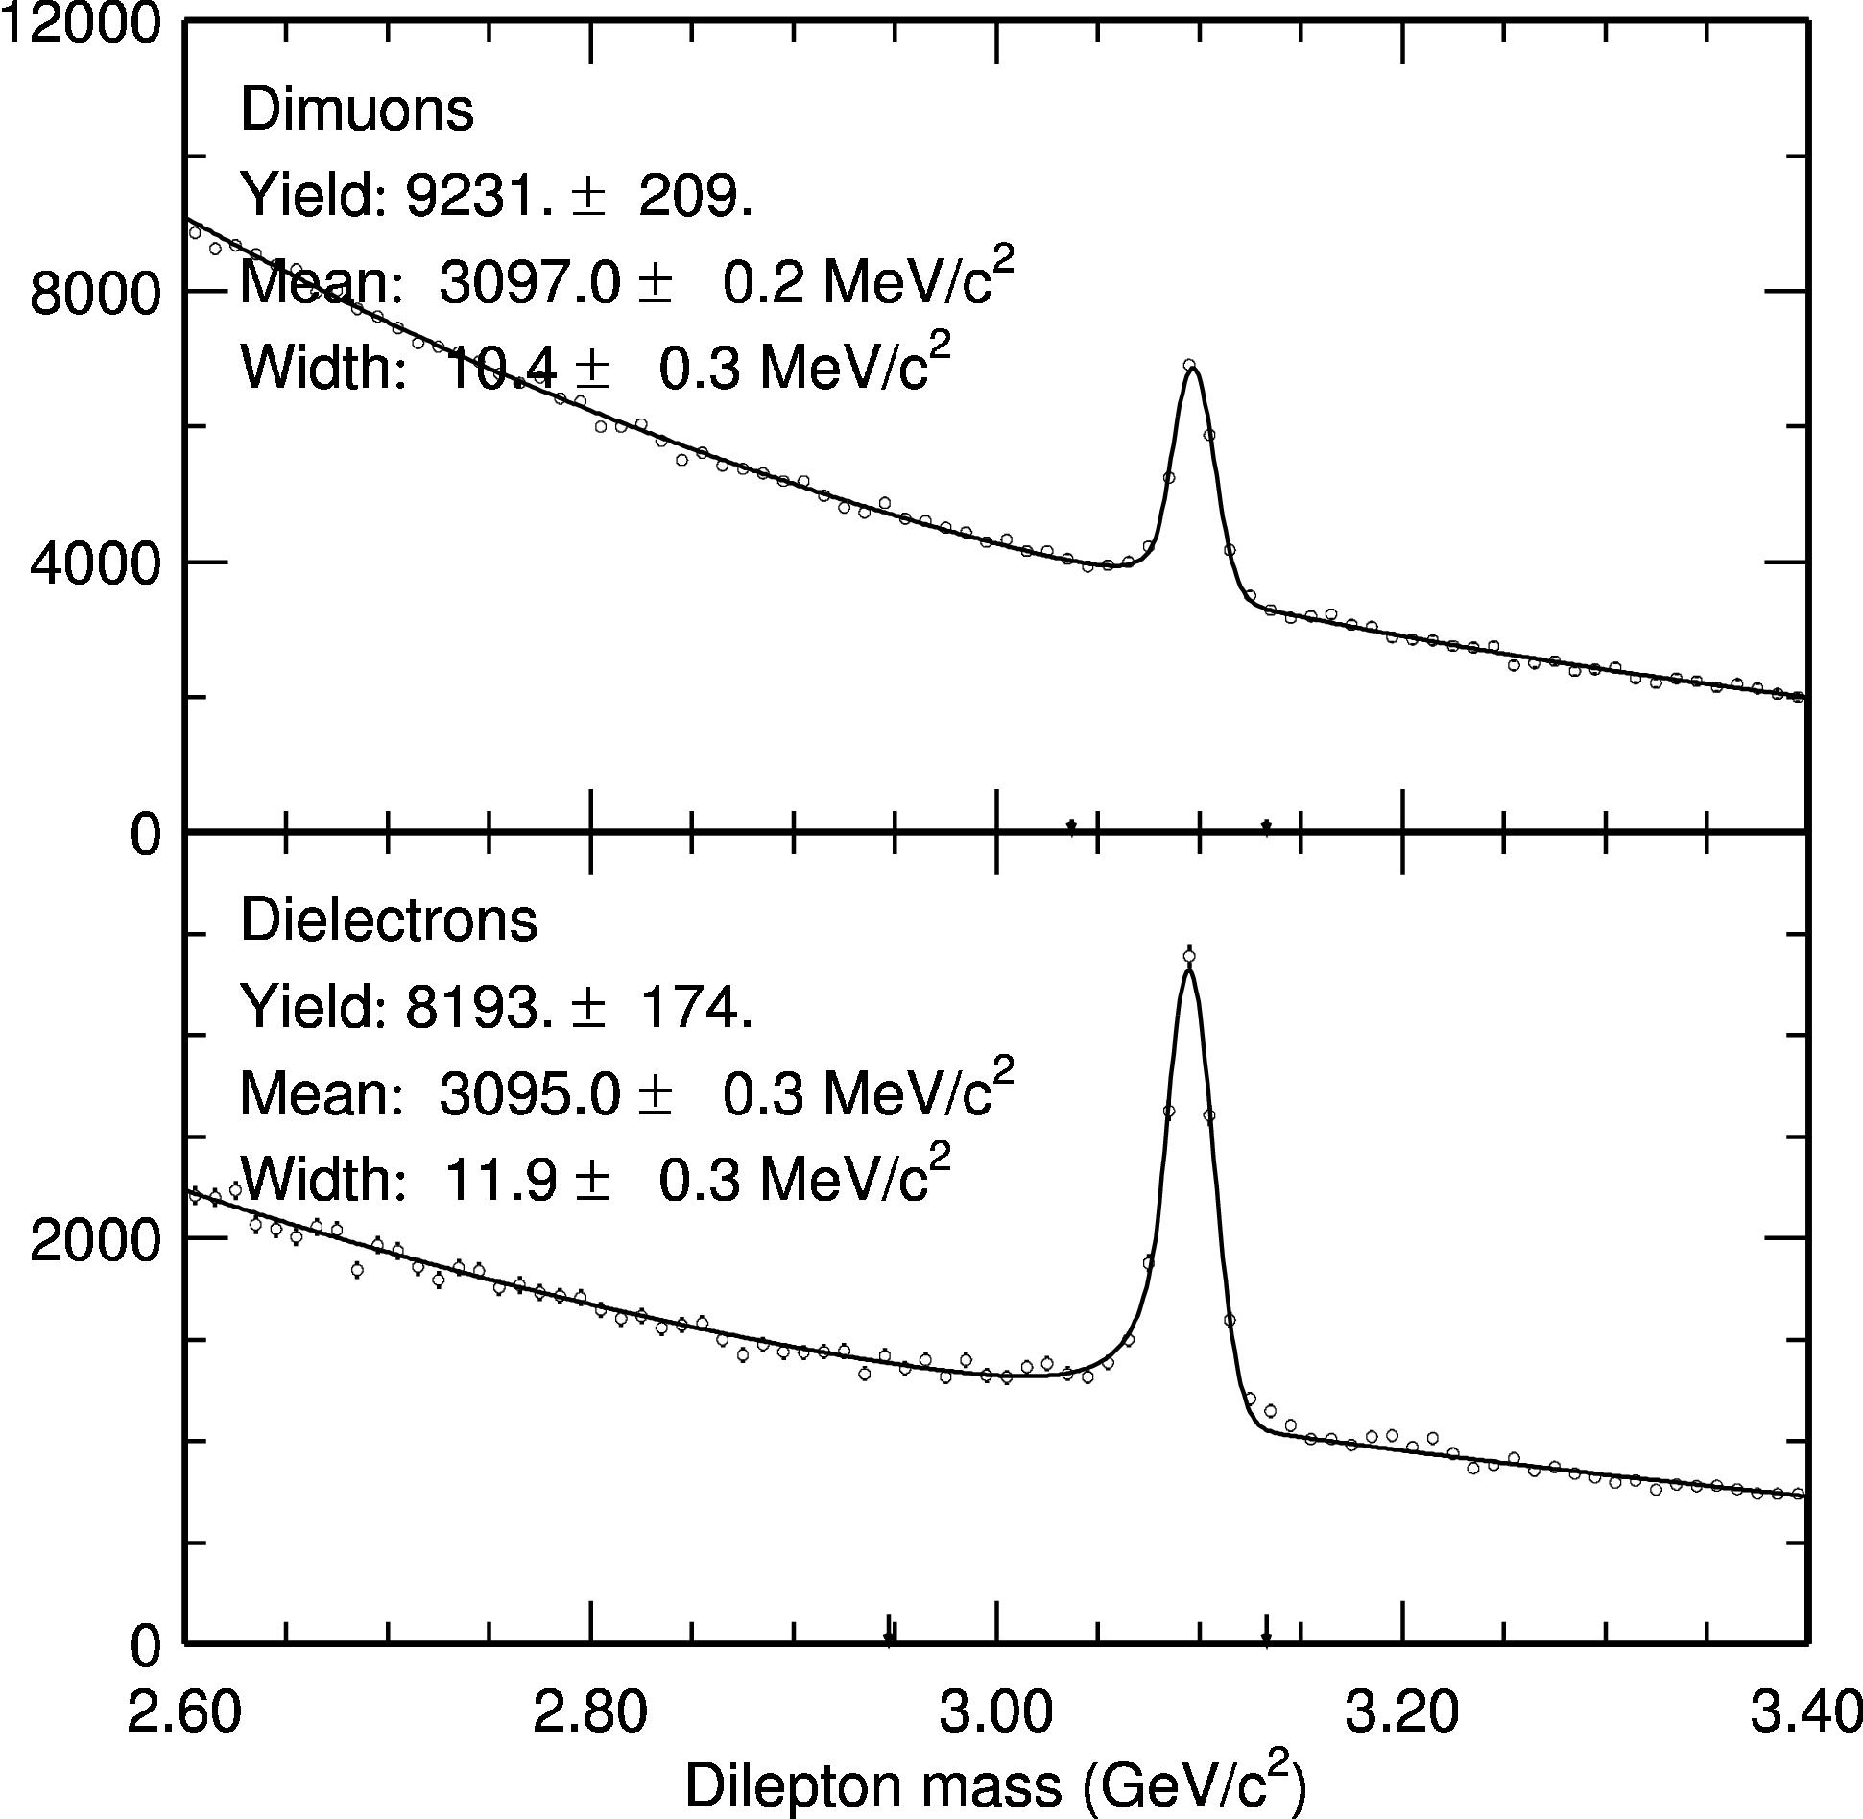
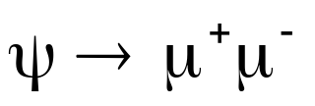
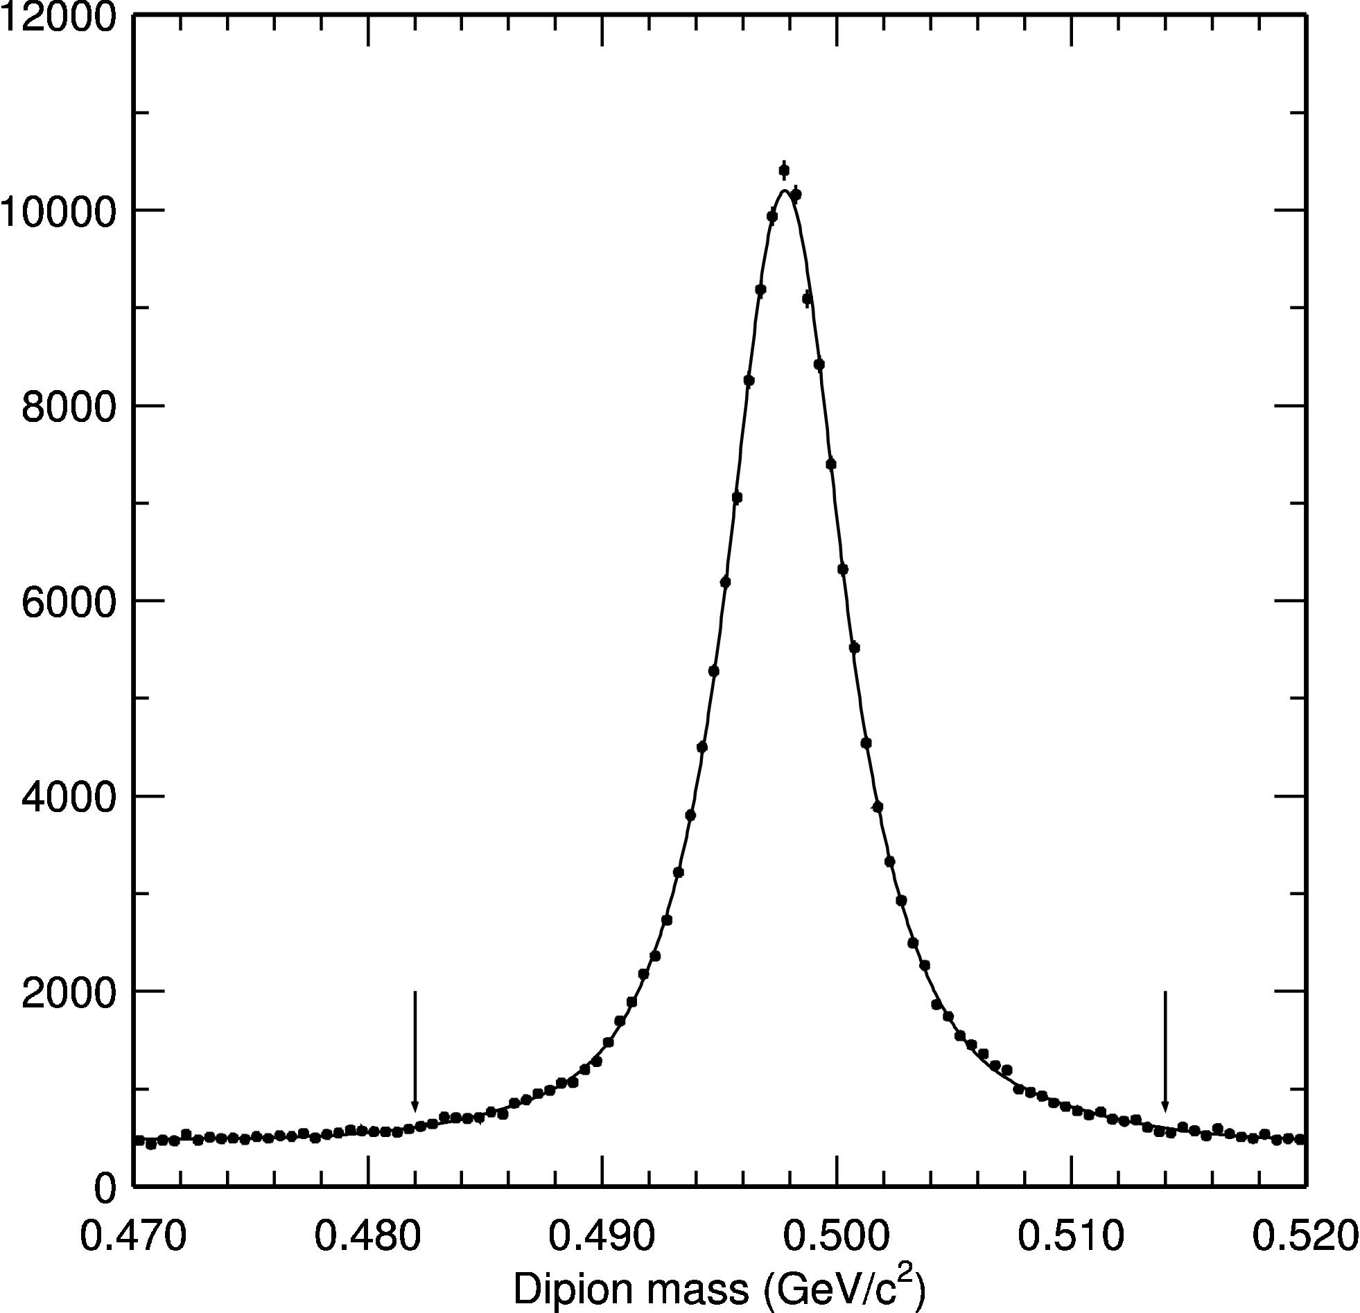


J/ψ and K_{S} Reconstruction
σ=4 Mev
Require mass
within 4σ of PDG

Slide 32


B→ψK_{S} Reconstruction
In the CM, both energy and momentum of a real B⁰ are constrained.
Use “Beam-constrained Mass”:
Signal
123 Events
3.7 Background

Slide 33

All Fully Reconstructed Modes (i.e. all but ψΚ_{L})
Mode | Events | Background
B→ψΚ_{S} | 123.0 | 3.7
All Others | 71.0 | 7.3
Total | 194.0 | 10.0

Slide 34

B→ψK_{L} Reconstruction
KLM Cluster
K_{L}
J/ψ daughter particles
Measure direction (only) of K_{L} in lab frame
Scale momentum so that M(K_{L}+ψ)=M(B⁰)
Transform to CM frame and look at p(B⁰).

Slide 35

B→ψK_{L} Signal
0<p_{B}*<2 GeV/c
Biases spectrum!
131 Events
54 Background

Slide 36

Complete Charmonium Sample
Total 325 65

Slide 37






Flavor Tagging
X

Slide 38








Flavor Tagging (Slow Pion)
Very slow pion

Slide 39



Comparison Between MC and Data
Diluted B-Mixing
Events
+ Data
--- MC

Slide 40

Tagging Efficiency
Experimentally determined w values in each r region
Tagging efficiency ε_{Τ} = 99.4% (vs. 99.3% in MC)
Effective efficiency ε_{eff} = ε_{Τ}(1-2w)² = 27.0% (vs. 27.4% in MC)

Slide 41

Vertex Reconstruction
Common requirements in vertexing
  # of associated SVD hits > 2 for each track
  IP constraint in vertex reconstruction
CP side vertex reconstruction
  Event is rejected if reduced χ² > 100.
Tag side vertex reconstruction
  Track parameters measured from CP vertex must satisfy:
    |Δz|<1.8mm, |σz|<500μm, |Δr|<500μm
  Iteration until reduced χ² < 20 while discarding worst track.
|z_{CP} - z_{tag}|<2mm (≈10τ_{B})
Overall efficiency = ~87%. In total 282 events for the CP fit.

Slide 42

CP Fit (Probability Density Function)
f_{BG} = background fraction. Determined from a 2D fit of E vs M.
R(Δ t) = resolution function. Determined from D*’s and MC.
PDF_{BG}(Δ t) = probability density function of background. Determined from ψΚ sideband (210 events).

Slide 43


Resolution Function
Fit with a double-Gaussian…

Slide 44
















Test of Vertexing – B Lifetime
Mode
Lifetime (ps)
pdg2000
Combined
[ps]

Slide 45


The Combined Fit (All Charmonium States)

Slide 46









Individual Subsamples
Fit
(stat. err.)
Mode
Non-CP
CP = -1
CP = +1
All CP

Slide 47


Consistency Check
Plot asymmetry in individual time bins…
Fix at PDG value
A_{CP}
Our fit

Slide 48


Sources of Systematic Error
Bottom Line
Published in Phys.Rev.Lett. 86, 2509 (2001)

Slide 49
Other Recent Publications
“Measurement of B⁰_{d} - B⁰_{d}-bar Mixing Rate from the Time Evolution of Dilepton Events at Upsilon(4S)” PRL 86,3228
"Observation of Cabibbo suppressed B -> D(*)K- decays at Belle"
(submitted to PRL )
"A Measurement of the Branching Fraction for the Inclusive B->Xs gamma Decays with Belle“ (submitted to PLB)
"Measurement of Inclusive Production of Neutral Pions from Upsilon(4S) Decays” (submitted to PRL)
+ Several More in the Pipeline!!

Slide 50
Summary and Outlook
Belle is working very well!!
Our current value of sin2φ₁, based on 10.5 fb⁻¹ of data is
This is consistent with the BaBar value of
  and with other previous results (CDF, LEP)
The probability of observing this value if CP is conserved is 4.9%
The next few years should be very exciting!

Slide 51
Key Belle Milestones
Early 1990’s: Japanese groups begin working.
January 1994: Collaboration forms.
April 1995: TDR Submitted.
…lots of work by lots of people in lots of places...
Dec 18, 1998: Belle detector completed (including SVD)
Jan 26, 1999: First cosmic ray with full detector.
May 1, 1999: Belle rolled into place.
June 1, 1999: First hadronic event!!!!!
November 9, 1999: Integrated luminosity exceeds 100 pb⁻¹
February 29, 2000: Integrated luminosity exceeds 1 fb⁻¹
July 28, 2000: First CP results presented at Osaka (used 6.2 fb⁻¹)

Slide 52
What about φ₃?
Corresponding decay would be B_{s}→ρ K_{S,}, but…
  Require move to ϒ(5s) resonance (messier)
  Time dependent B_{s} mixing not possible.
⇒ Have to find another way.

Slide 53
Are Two B-Factories Too Many?
These are not discovery machines!
Any interesting physics would manifest itself as small deviations from SM predictions.
People would be very skeptical about such claims without independent confirmation.
Therefore, the answer is NO (two is not one too many, anyway).

Slide 54
Differences Between PEP-II (BaBar) and KEKB (Belle)
  PEP-II has complex IR optics to force beams to collide head-on.
  Pros: Interaction of head-on beams well understood.
  Cons: Complicates IR design.
  More synchrotron radiation.
  Can’t populate every RF bucket.
  In KEK-B, the beams cross at ±11 mr.
  Pros: Simple IR design.
  Can populate every RF bucket.
  Lower (but not zero!!!) synchrotron radiation.
  Cons: Crossing can potentially couple longitudinal
  and transverse instabilities.
At present, both designs seem to be working.

Slide 55
Differences (cont’d)
Readout:
  BaBar uses an SLD-inspired system, based on a continuous digitization. The entire detector is pipelined into a software-based trigger.
  Pros: Extremely versatile trigger.
  Less worry about hardware-based trigger systematics.
  Can go to very high luminosities.
  Cons: Required development of lots of custom hardware.
  Belle’s readout is based on converting signals to time-pulses. The trigger is an “old-fashioned” hardware-based level one. Events satisfying level one are read out after a 2 µs latency.
  Pros: Simple.
  Readout relies largely on “off-the-shelf” electronics.
  Cons: Potential for hardware-based trigger systematics.
  Possible problems with high luminosity.

Slide 56


Particle ID needs

Slide 57
Nuts and Bolts: Readout
Philosophy: Signal ⇒ Time Pulse ⇒ TDC (LeCroy 1877) ⇒ Generic DAQ
Analog Signal
Variable Length Pulse
⇒
Binary Data
⇓
Pulse Train Encoding (Hit ⇒ Edge)

Slide 58

DAQ Overview

Slide 59
Nuts and Bolts: Analysis Framework
Belle AnalysiS Framework (Pronounced “BASF”):
  Developed entirely with freeware (GNU, Cernlib, CLHEP, etc)
  Script Driven
  Based on individual data generation/processing modules (C++ classes), with common members (hist_def, begin_run, event, etc).
  All data (raw, intermediate, physics, constants) arranged in named banks based on the PANTHER bank system and stored in files.
  Individual banks or groups of banks can be read or written to files at any point in data processing.
  Constants stored in database based on Postgresql.
  Multiprocessing supported for read/write file access and histogram/ntuple generation.

Slide 60
Example BASF full MC Job
path add_module main qq98 gsim acc_mc
path add_module main calcdc calsvd reccdc recsvd trasan trak
path add_module main AnadEdx ext rectof rececl_cf
path add_module rececl_match rececl_gamma
path add_module main rececl_pi0 rec_acc mu2 klid
path add_module v0finder rec2mdst evtcls sakura
path add_module main kid_mc_mon AnadEdx_mc_mon tof_mc_mon
path add_module main table_list
nprocess set 5
module put_parameter qq98 USER_TABLE\b02psikl.dec
histogram define signal_tag.hbk
initialize
table savebr belle_begin_run
table save belle_event
table save mdst_all
table save evtcls_all
table save gsim_rand
table save hepevt_all
output open signal.evt
generate_event 10000
terminate
Specify Processing Modules
Number of Processors
Pass Parameters to Modules
Histogram File
Specify Tables to Save
Output File
Go!

Slide 61
Example BASF Analysis Job
Will look for user_ana.so
path add_module main user_ana
histogram define user.hbk
initialize
process_event signal.evt
terminate
Could be real data or MC

Slide 62
Example User Analysis (user_ana.cc)
Access charged track PANTHER bank
// Charged tracks
Mdst_charged_Manager &ChgMgr = Mdst_charged_Manager::get_manager();
for(vector<Mdst_charged>::iterator it = ChgMgr.begin();
it != ChgMgr.end() ; it++) {
// Form a 4-vector for this particle
Vector3 p_i(it->px(),it->py(),it->pz());
Vector4 p4_i(p_i,sqrt(p_i.mag2()+EMass2));
// Now loop over the second particle
for(vector<Mdst_charged>::iterator jt = it+1;
jt != ChgMgr.end() ; jt++) {
// Require opposite charges
if((jt->charge())==(it->charge())) continue;
// If we're here, we have two tracks of opposite charge.
// Calculate the pair mass
Vector3 p_j(jt->px(),jt->py(),jt->pz());
Vector4 p4_j(p_j,sqrt(p_j.mag2()+EMass2));
Vector4 p4 = p4_i+p4_j;
float pairMass = p4.mag(); // Calculate the pair mass
}
}
Loop over list of individual objects (tracks)
Manipulate using standard tools

Slide 63








Event by Event Tagging Quality
If we tag events wrongly, we’ll measure CP violation as
So the measurement is diluted by a factor
Ideally, we can determine this on an event by event basis to be used in the CP fit
Example, for high-p lepton
wrong
right
p*

Slide 64

Multi-dimensional Flavor Tagging

