Slide 1
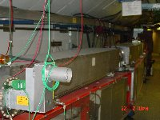
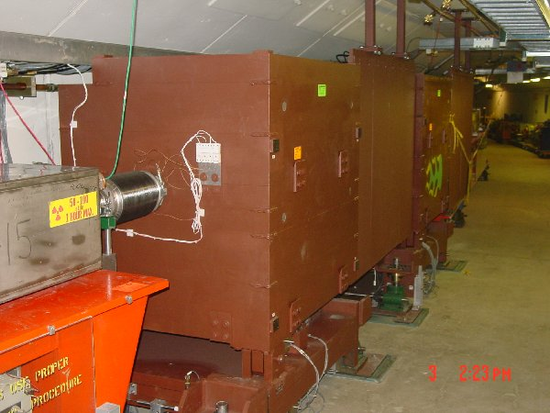
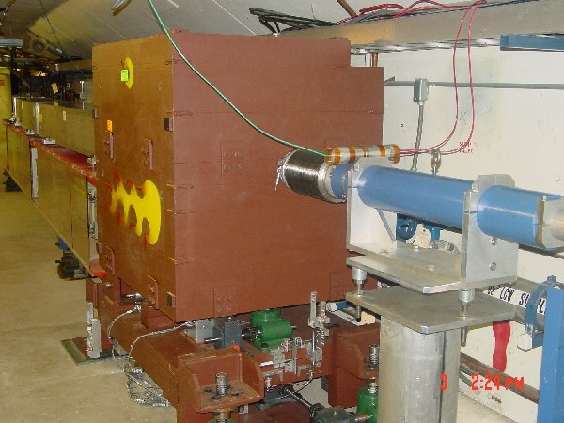
New Collimator System
Basic Idea…
A scraping foil deflects the orbit of halo particles…
…and they are absorbed by thick collimators in the next periods.
Should dramatically reduce uncontrolled losses

Slide 2
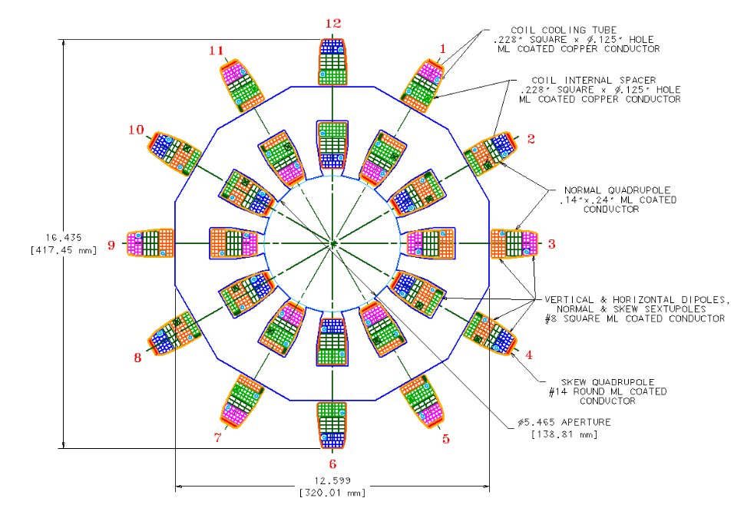
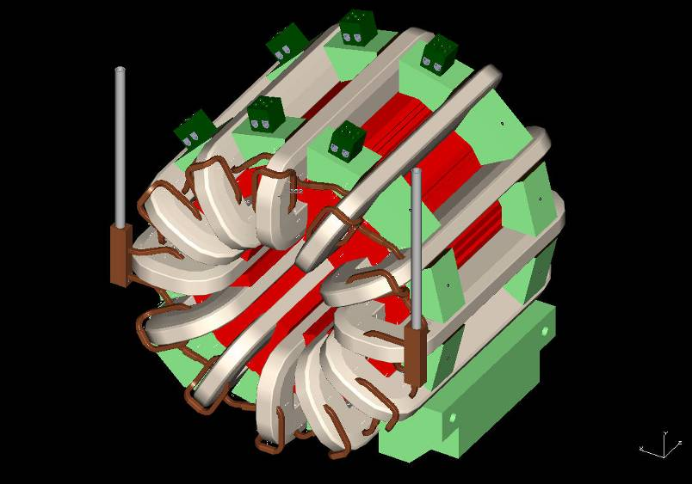
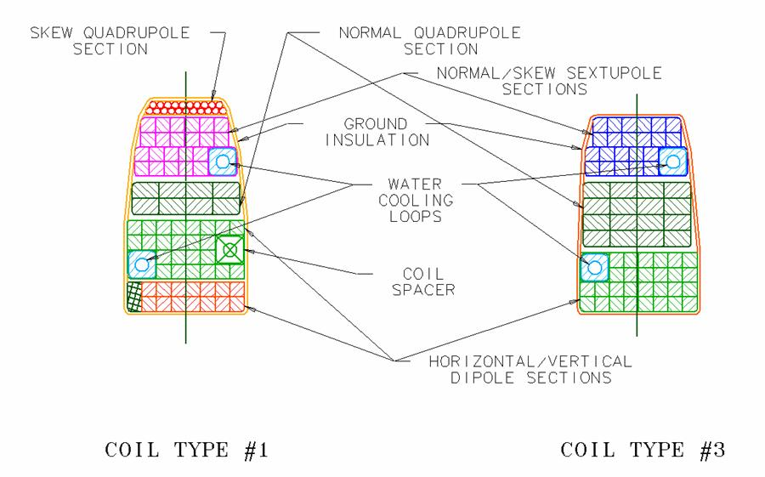
Magnet Design

Slide 3
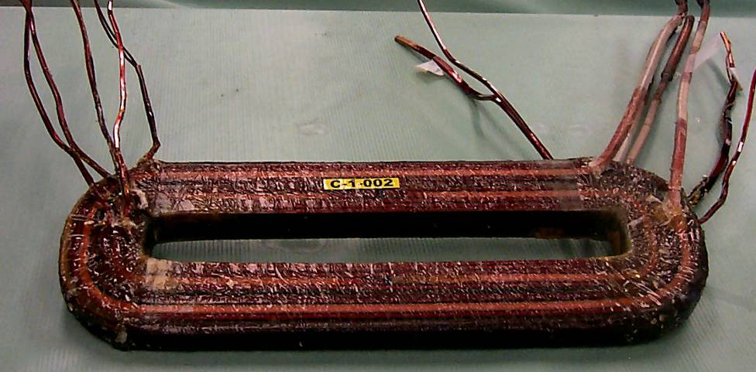
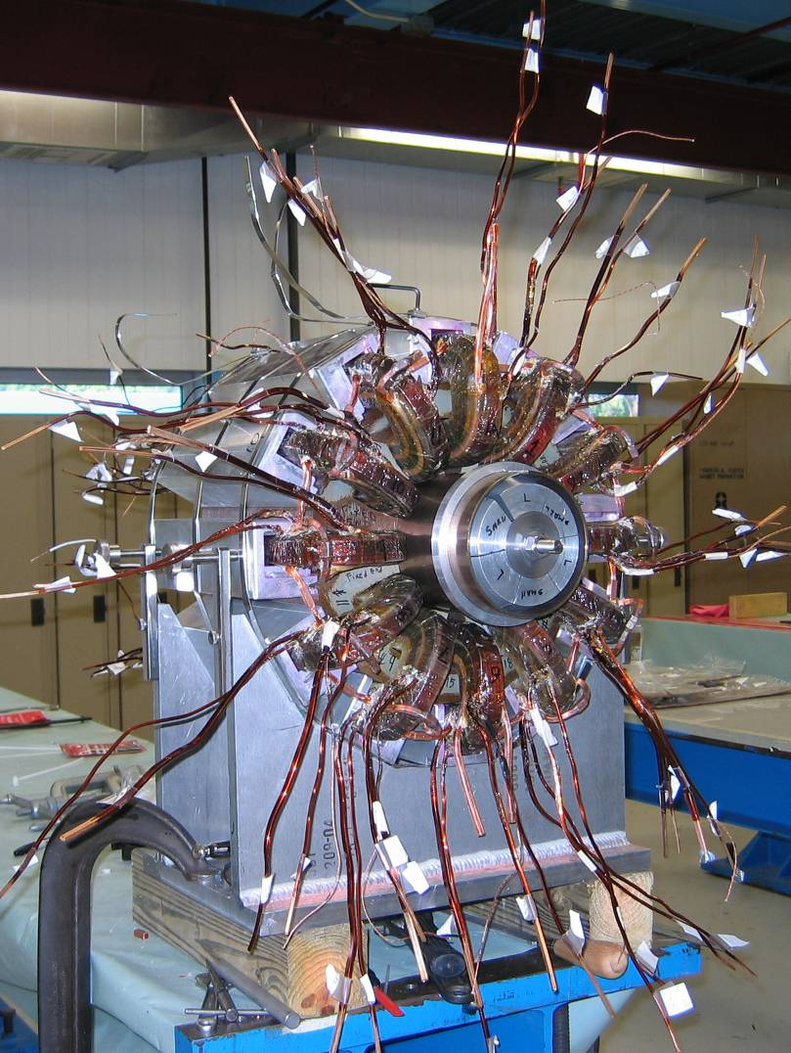
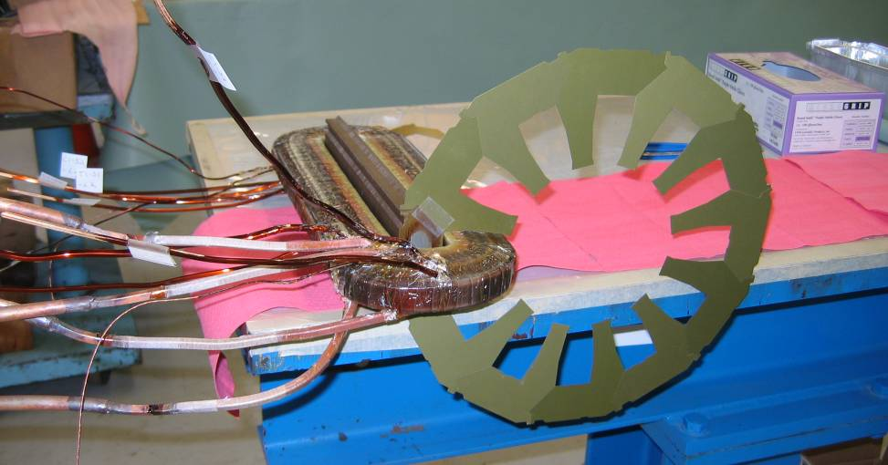
Prototype Magnet Being Assembled

Slide 4
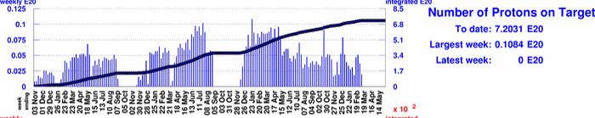
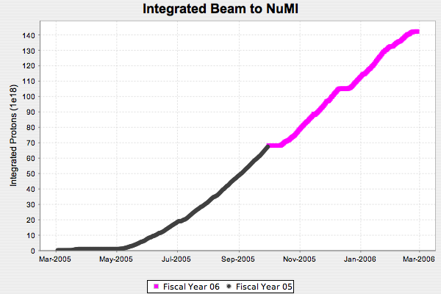
Proton Delivery
MiniBooNE (since 11/02)
NuMI running
1.4E20
NuMI (since 3/05)
Total protons delivered in ~30 years prior to MiniBooNE: 5E20
Total protons to MiniBooNE and NuMI since 11/02: 8.6E20

Slide 5
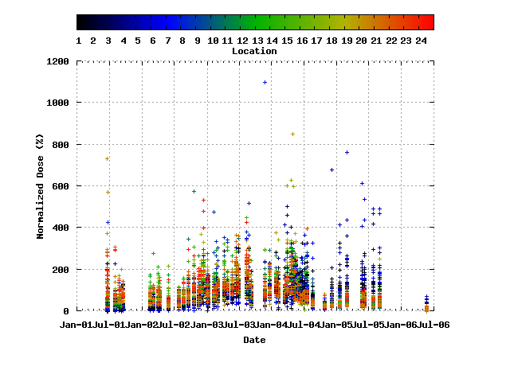
Booster Activation
MiniBooNE
NuMI
Collimator locations
The activation of most of the Booster is within a factor of two of what it was before MiniBooNE, when we were delivering ~15 times less beam

