Slide 1
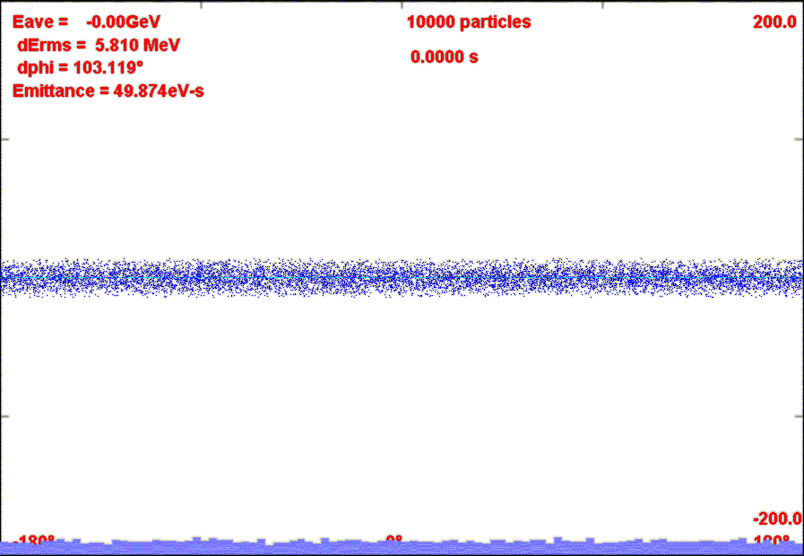
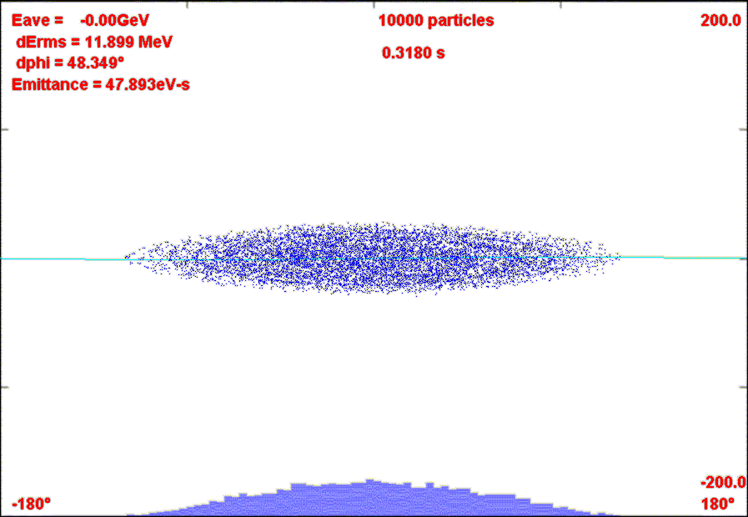
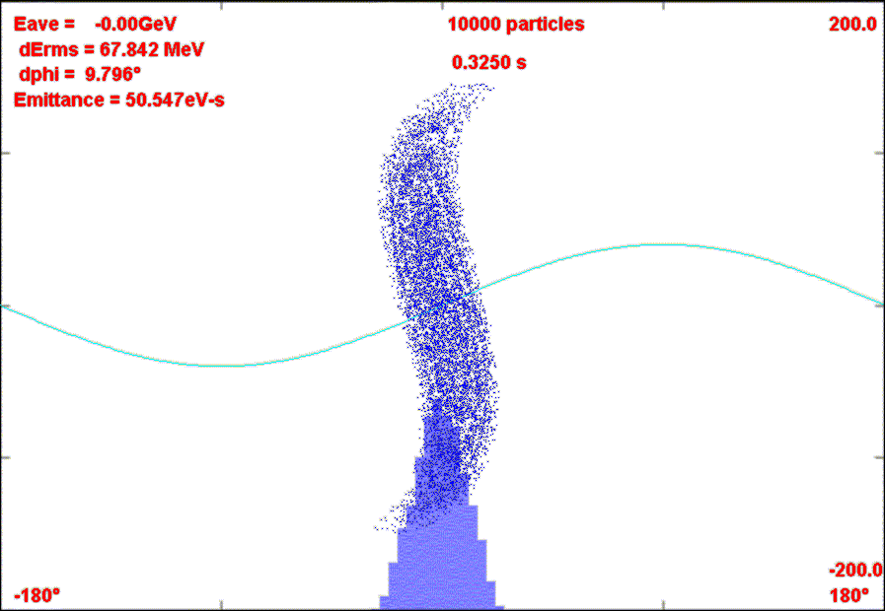
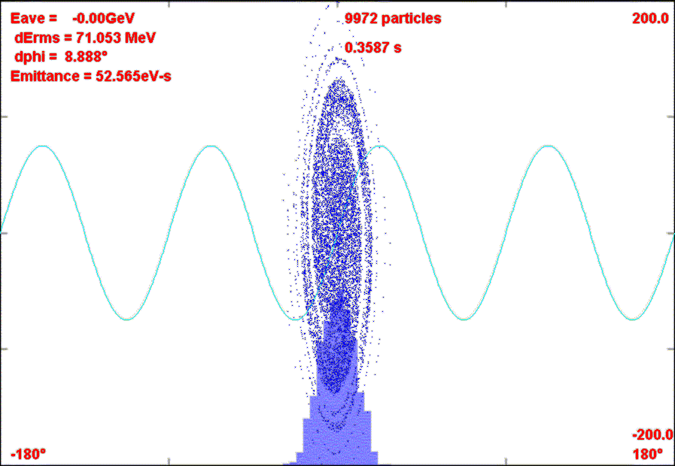
Rebunching in Accumulator/Debuncher
Momentum stack 6 Booster batches directly in Accumulator (i.e. reverse direction)
Capture in 4 kV h=1 RF System.
Transfer to Debuncher
Phase Rotate with 40 kV h=1 RF in Debuncher
Recapture with 200 kV h=4 RF system
σ_{t}~40 ns

