Slide 1

Typical Booster Cycle
Various Injected Intensities
Transition
Intensity (E12)
Energy Lost (KJ)
Time (s)

Slide 2
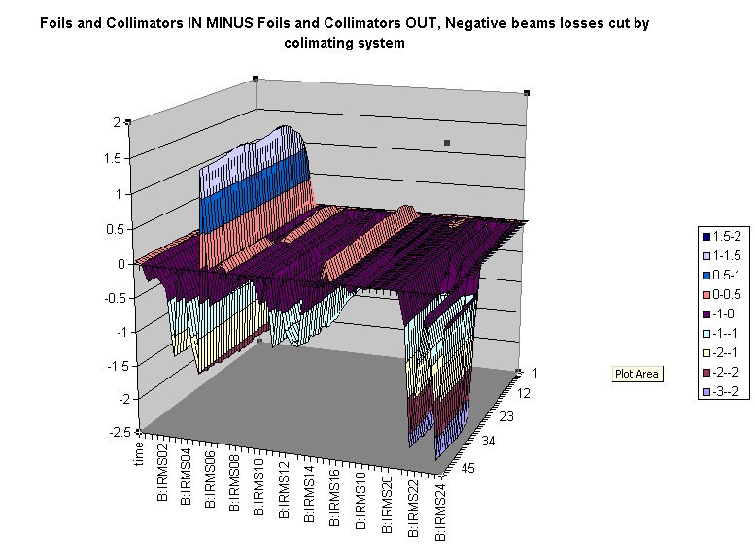
Differential Loss Monitor Example: Collimators in – Collimators Out
Collimator Position
Relative Loss
Time
Position

