Slide 1
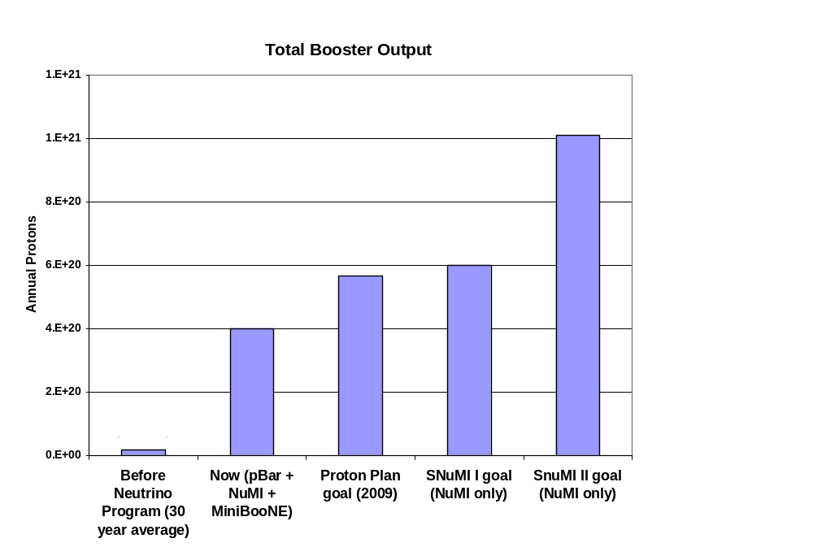
Total Protons
Present

Slide 2
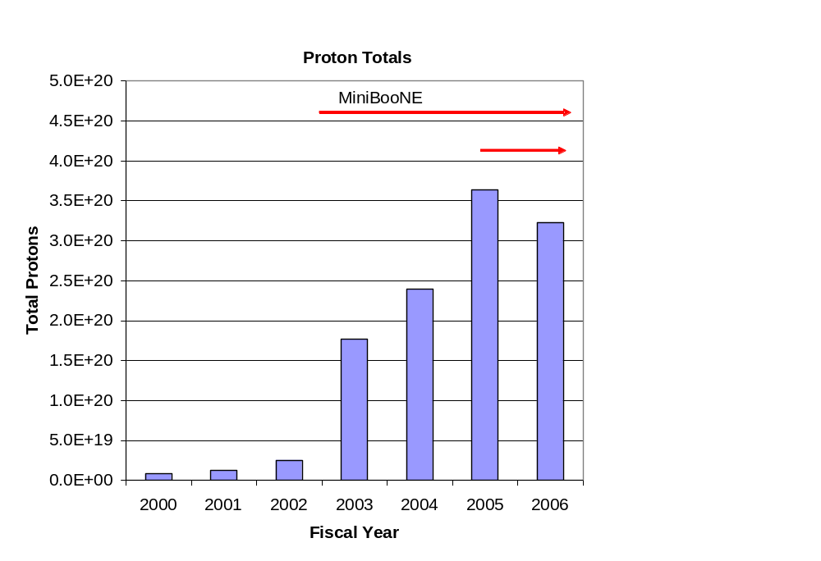
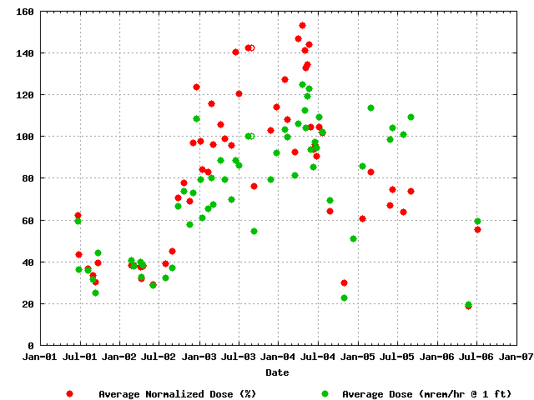
Success of Plan
Total Protons Delivered
Average Booster Activation
MiniBooNE
NuMI
Factor of 15 increase in protons

Slide 3
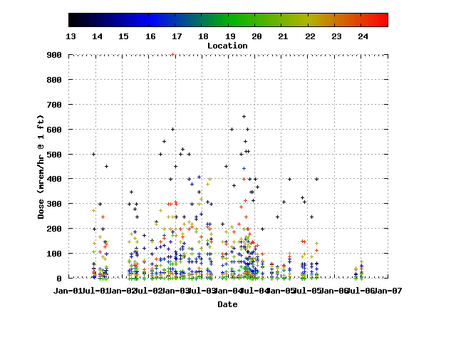
Activation in RF Areas
MiniBooNE

